Slide 1
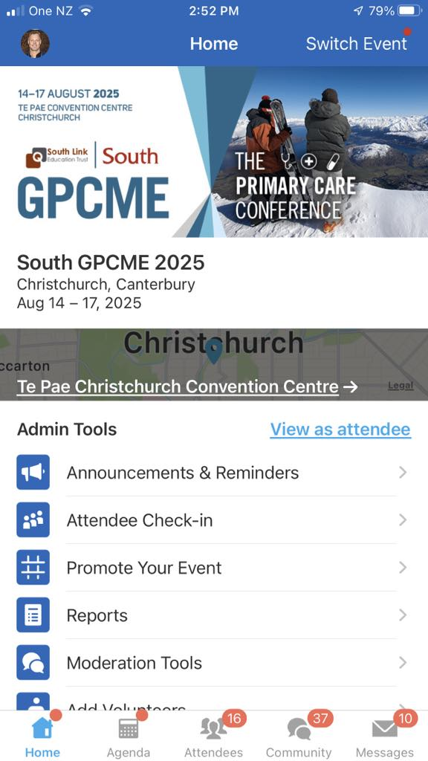
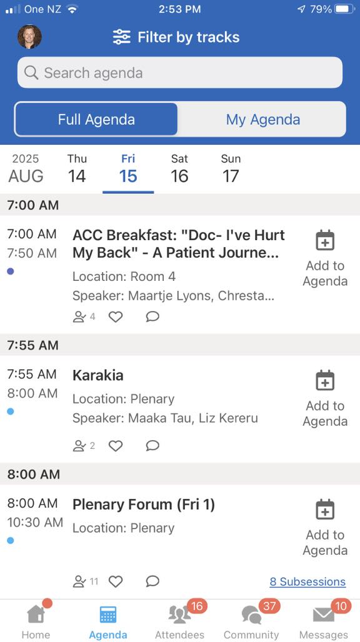
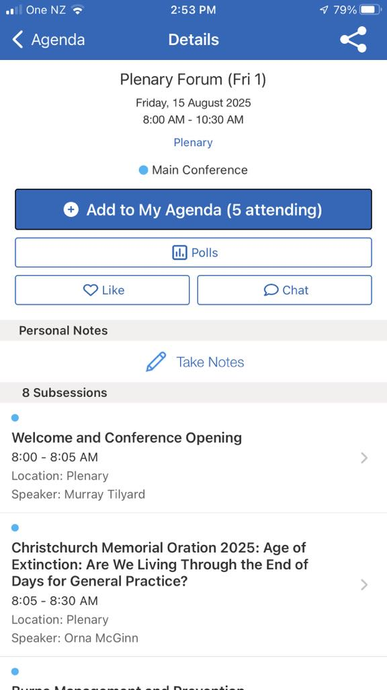
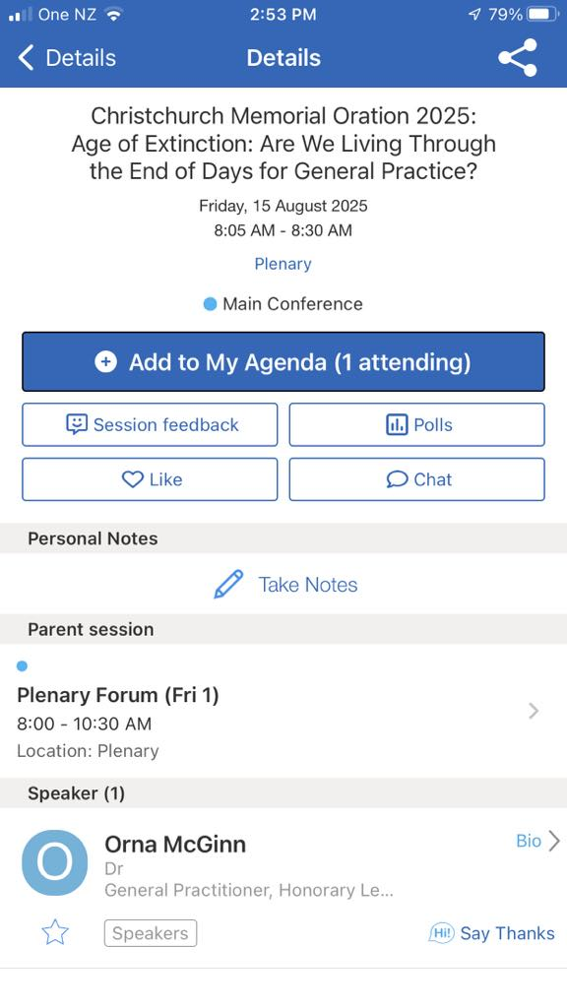



Don’t forget to provide feedback
on this session in the Whova app
All feedback is anonymous and appreciated
Step 1: Open the Whova app and click on Agenda
Step 2: Click on the day and Session Time
Step 3: Click on session you want to provide feedback on
Step 4: Click on session feedback

