Slide 1
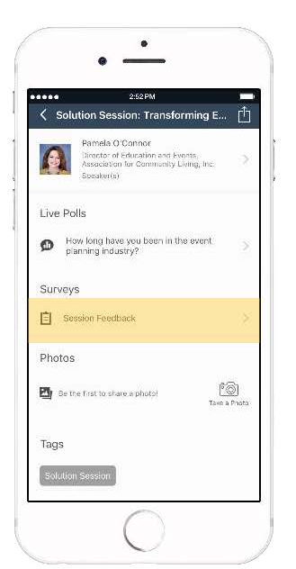
Don’t forget to provide feedback
on this session in the Whova app.
All feedback is anonymous and appreciated.

