Slide 1




Mr Andrew Whittington
Medtech
16:30 - 17:30 WS #129: Prescribing Beating the Blues

Slide 2
South GP Conference and Medical Exhibition
August 2016

Slide 3



Our past informing our future
The Children’s
Action Plan
The Green Paper
The White Paper
Almost 10,000 submissions received.
From children, young people, frontline workers, and NGOs.
White Paper is based on these submissions.
It contains what changes are needed to protect children from harm.
Implements the decisions made in the White Paper.
Notes:
This is part of a long process begun in October 2012 when the Government released its Children’s Action Plan.
Was the biggest change since the Children and Young Persons legislation was introduced in 1989.
The plan was developed from a highly consultative process based on a Green Paper released in July 2012 which attracted nearly 10, 000 submissions.
This large number of submissions is a strong indication of just how passionate we are about protecting vulnerable children in New Zealand.
We have built on this over these past four years as we implement the actions contained in the Children’s Action Plan and as we all know, this is everyone’s responsibility and we all need to be involved.
The Children’s Action Plan provides support and help for communities in taking the lead in identifying vulnerable children and helps us in working together to help them thrive, achieve and belong.

Slide 4

What did the Community ask for?
Better sharing of information and communication.
Concern about statutory responses
Better identification and support for most vulnerable
Higher levels for safety and competency of workforce
Increased recognition that everyone needs to be responsible for keeping children safe.

Slide 5
The Children’s Action Plan taking the lead for vulnerable children
A safe, competent and well-connected children’s workforce, which identifies vulnerable children early, and supports them to be safe, thrive, achieve and belong.
Notes:
The Children’s Action Plan introduces a safer children’s workforce, better child protection and Children’s Teams.
There are now ten Children’s Teams and an on-going, robust programme to support a different way of working to improve results for vulnerable children and their families.
The Children’s Team approach brings together professionals from health, education, welfare and social service agencies and non-government agencies and local expertise.
It’s everyone’s responsibility to protect children and this workshop will outline the way this relates to you.
There will be adequate time for in-depth interactions and questions from the floor.

Slide 6
A Children’s Action Plan – for change
  Key work streams from the Action Plan:
  A safe and competent workforce (vetting and screening, child protection policies, core competencies
  Intensive cross-agency support (Children’s Teams)
  Early identification & triaging (The Hub/ViKI/AISA)

Slide 7

Vulnerable Children Defined ...
“Vulnerable children are children who are at significant risk of harm to their wellbeing now and into the future, as a consequence of the environment in which they are raised, and in some cases, due to their own complex needs. Environmental factors that influence child vulnerability include not having their basic emotional, physical, social, developmental and/or cultural needs met at home or in the wider community.”
Source: Cabinet Social Policy Committee (2012:9) White Paper for Vulnerable Children. Wellington: Office of the Minister for Social Development.

Slide 8

The Vulnerable Children Act (2014)
  Signaled major changes in the way vulnerable children are identified, protected and nurtured.
  Introduced clear accountabilities and strong direction for the children’s workforce.
  Is the biggest change since the Children, Young Persons and their Families Act was introduced in 1989.
Notes:
The legislation is the backbone of the Action Plan and is already influencing transformational change for the children’s workforce.
It is intended to:
Ensure that everyone understands and fulfils their responsibilities towards children
Provide new tools to identify vulnerable children earlier
Reinforce joint accountability and action across government
Develop a new direction for sharing information
Develop a new cross-agency Strategy for Children and Young People in Care
Deliver a responsive children’s workforce
Introduce a range of tough new measures aimed at abusers
Deliver a new way of caring for vulnerable children with the child at the centre
The Vulnerable Children Act became law in July 2014.
Chief Executives from the Ministries of Health, Education, Social Development, Justice and the Police are jointly accountable in law for implementing the plan.

Slide 9
The Children’s Team Approach
Child focused - The child at the centre of everything we do.
Trans-disciplinary - Joined up support, intervening early.
Strongly connected - Working together, sharing information.
Notes:
Children’s Teams put each vulnerable child at the centre of everything they do.
Wrapping early services and joined up support around each child to address their needs.
As a fundamentally different way for practitioners to work together to support vulnerable children who have multiple and complex unmet needs. It focuses on earlier intervention so children get support sooner without waiting until it reaches a level where statutory intervention is required.
A Children’s Team is not a new service but a new approach.
Children’s Teams bring together practitioners and professionals from the iwi/Māori, health, education and social services sector to develop a single plan.
The Children’s Action Plan maps out how government is working to improve results for vulnerable children and their families and whānau.
It includes the establishment of Children’s Teams as well as measures to protect vulnerable children and get better results, including safety checking of people who work with children and a programme to build children’s workforce capability.
Under the Act the five Chief Executives of the Ministries of Social Development, Health, Education and Justice and the Police are required to work together to prepare and report progress on a Vulnerable Children’s Plan.

Slide 10
Information Sharing
The Vulnerable Children’s Hub
Vulnerable Kids Information system (ViKI)
Approved Information Sharing Agreement (AISA)
- S.15 protects referrer from any action (good faith)
- Privacy Principle 11 (f)(ii) allows information to be shared

Slide 11

Children’s Workforce
Safety checking
Child protection policy
Core competencies
Notes:
Children have a fundamental right to have all their needs met and to be safe from abuse and neglect. The Government is committed to growing a safe and competent children’s workforce who can play their part in keeping vulnerable children safe.
The children’s workforce is a big concept – it includes everyone who plans, manages and delivers services to children. It is a new way at looking at everyone who works with children, and includes their managers and leaders.
The Vulnerable Children Act 2014 introduces standard safety check requirements for staff in organisations funded by state services. The Act also restricts employment of people with convictions for certain offences in some children’s workforce roles. – the workforce restriction. Finally, the Act includes new child protection policy requirements.
In addition, the Children’s Action Plan contains work to develop the capability and commitment of the children’s workforce to better work together when responding to child vulnerability. For example, we are working on core competencies that will help the whole children’s workforce to understand what is needed to keep kids safe.
These system changes are being phased in over four years.
Our priority is for everyone to understand the changes, the reasons for them and what the new obligations are. We want to support and embed good practice right across our sector without creating too much of an administrative burden for you so we’re taking an educative approach.
In the first years agencies will be offering information, advice and support for you to meet the regulations.
Our aim is to build the children’s workforce’s knowledge base, skills and experience to recognise and respond to child vulnerability.

Slide 12
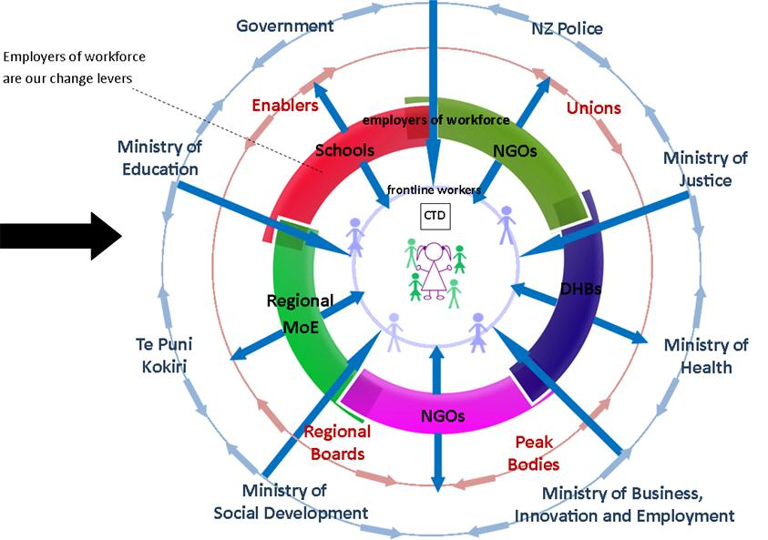

Slide 13
Working in Silos
One children’s workforce
One agency responsible
Shared responsibility
Individual competence
Collective competence
Service driven
Child centred

Slide 14
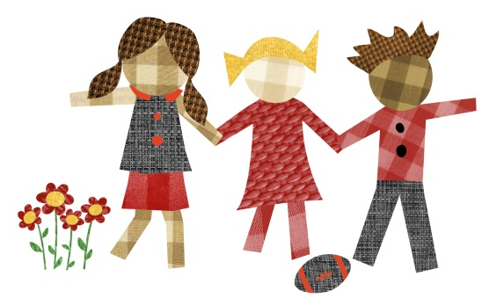
Children’s Teams making the difference
Working better together leads to better results for the child:
Earlier support and services
The more in-depth, trans-disciplinary assessment provides more information about the child and what they need
The mix of services wrapped around each child and their family/whānau changes and adapts, as their needs evolve

Slide 15

Investing in Children - Expert Panel Report
Government’s response for the future of care and protection and the system-wide transformation
Focus on five core services:
  prevention,
  intensive intervention,
  care support services,
  transition support
  youth justice service aimed at preventing reoffending.
Supports what Children’s Action Plan is already doing and strengthens and expands our approach.
Notes:
Recent announcement of major state care reforms and a complete overhaul of CYF
New system makes radical changes to the way we work with young people and their families
Focus on five core services – prevention, intensive intervention, care support services, transition support and a youth justice service aimed at preventing reoffending
Will take time but will be in place by end of March 2017 and implemented over five years.
Supports what CAP is already doing and strengthens and expends our approach

Slide 16
www.childrensactionplan.govt.nz

