Slide 1
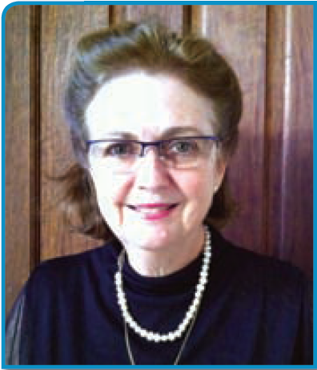
Dr Catherine Black
Head of WOOMB NZ

Slide 2
What can we do if not qualifying for IVF?
Dr Catherine Black, FRCNZGP
GP Oxford Clinic Womens Health
Head of WOOMB NZ

Slide 3
Summary
Infertility – size of the problem.
Report on study using The Billings Ovulation Method™ to assist conception.
What is The Billings Ovulation Method™?
The physiology of cervical mucus.
The rules of The Billings Ovulation Method™ to achieve pregnancy.
Charting the cervical mucus symptom as a marker of ovulation, and reproductive and endocrine health.

Slide 4
Infertility :
- the inability of a couple to achieve conception after a year of unprotected intercourse, or the inability to carry pregnancies to a live birth.

Slide 5

Infertility statistics
One in six couples suffer infertility
  40 percent of cases the problem rests with the male
  40 percent with the female
  10 percent with both partners
  10 percent of cases the cause is unknown
Fertility problems strike one in three women over 35
1 in 25 males has a low sperm count and 1 in 35 is sterile

Slide 6
Infertility statistics
For healthy couples in their twenties having regular unprotected sex, the chance of conception per cycle is 25 percent
More than one per cent of births in Australasia involve the use of assisted reproductive technologies.

Slide 7
A Study to investigate whether knowledge of the Billings Ovulation Method™ is efficacious in assisting couples to achieve pregnancy:

Slide 8
Total Participants - 449
Outcome known – 358
Total Pregnancies Achieved
278/358 (78%)
Evaluable Data – 384/449 (65 insufficient data)
240 achieved pregnancy
For the 240 achievers
Average age – 33yrs (22-46 yrs)
Outcome Unknown - 91
80 did not conceive
64 unknown outcome
60% childless couples
Average mths trying – 15
For the 240 achievers
Average time from instruction to
conception – 4.7 mths
30% in the1st mth
54% by the 3rd mth
89% by the10th mth
For the 240 achievers
169/240 (70%) known live birth rate
excluding 14 women still pregnant & 24 unknown
31 miscarriages & 2 ectopic pregnancies (8 > 38 yrs old)

Slide 9
For the 240 achievers :
    Only 18% of study participants reported that they had adequate prior knowledge of their signs of fertility.

Slide 10
Hormonal control of ovulation

Slide 11
Emotional
Stress
Eating disorder
Environmental
Nutrition
Exercise
Drugs
Hypothalamus
Pituitary
Thyroid
Adrenal
Pancreas
Ovary
Ovary
endometrium
cervix
cervical mucus observed at the vulva

Slide 12
What is the Billings Method™?

Slide 13

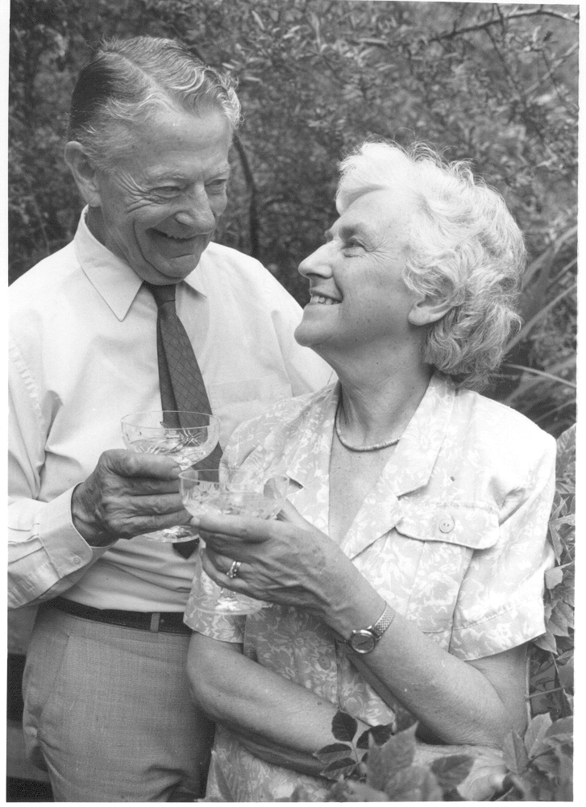
    Drs John and Evelyn Billings
    Order of Australia for their work
    On Natural Fertility Awareness

Slide 14
Male Fertility
Sperm production begins at puberty.
Production of sperm continues throughout life.
Female Fertility
Begins from puberty.
Cyclic – potentially fertile for approx 5-7 days.
Finishes at menopause.
+
=
Couple Fertility

Slide 15
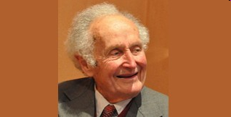
Professor Jim Brown.
A New Zealand chemical pathologist
The Billings Method™ - a Kiwi method after all?

Slide 16
    The cervical mucus symptom is a daily bioassay of the ovarian hormones.

Slide 17
    Summary of Professor Brown’s research
    Types of ovarian activity in women and their significance: the continuum (a reinterpretation of early findings)
    Oxford Journal, Human Reproduction Update 15 February 2011.

Slide 18
Scientific validation of the Billings Ovulation Method™ & Correlation of Symptoms with Science of Ovarian Activity

Slide 19
Pituitary and Ovarian Hormones
of a woman’s reproductive cycle

Slide 20
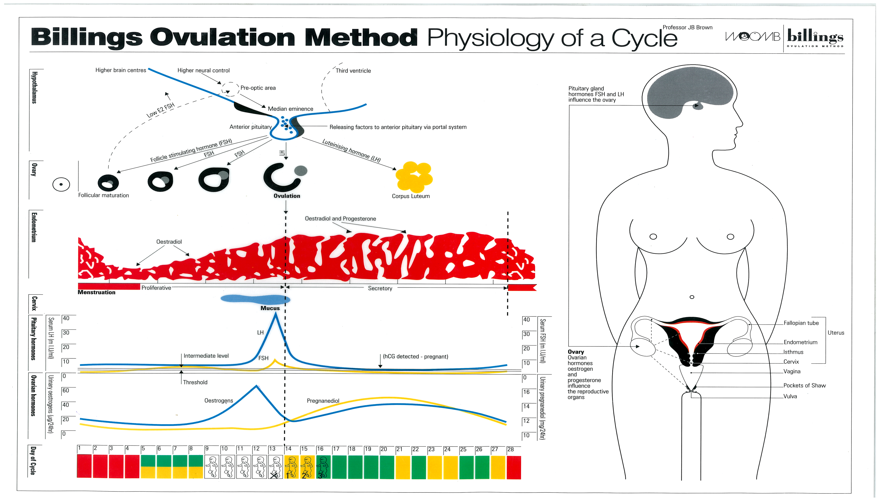
OESTRADIOL and PROGESTERONE levels fall
suppression of FSH and LH lifted – new CYCLE commences

Slide 21
THE 28 DAY CYCLE
The time taken for the total fertile process is always approximately 21 days
        Rapid growth phase of follicle and its development
        Ovulation
        Formation of corpus luteum and its demise
In a 28 day cycle it takes about 7 days for the FSH values to rise to threshold
During these 7 days very little oestradiol is produced,
the woman experiences several days of Basic Infertile Pattern (BIP) after the cessation of bleeding
Notes:
21
Note:
This slide specifically discusses the 28 day cycle. For the normal cycle, regardless of length the first point re the 21 days is true.
In cycles longer than 28 days FSH takes longer to reach threshold.

Slide 22
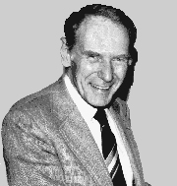
Professor Eric Odeblad
University of Umea, Sweden

Slide 23
Anatomy and Physiology of the Cervix

Slide 24
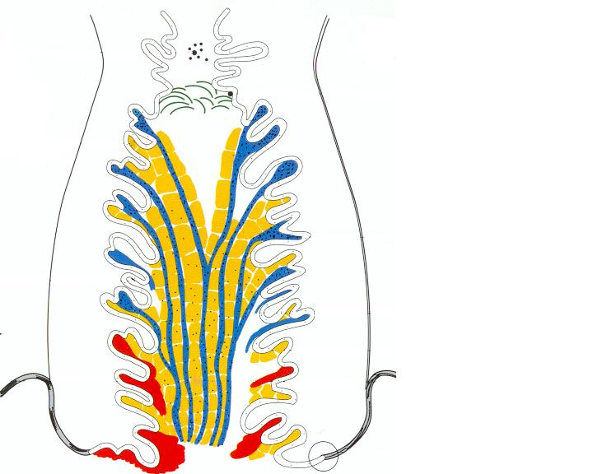


G Mucus

Slide 25
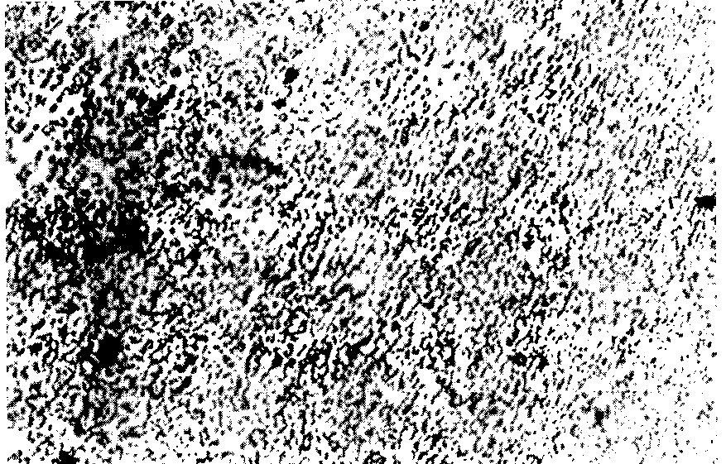
G- MUCUS – no crystalline formation
Notes:
25
Microscopic photo of sample of G mucus taken from the cervical canal and spread thinly on a glass slide.

Slide 26

G MUCUS
Has no crystalline formation.
Very cellular and forms part of the immune system which protects the woman’s reproductive system from infection
Closes the cervix for most of the cycle ensuring infertility at these times.
G- mucus occurs before the fertile phase begins – has a larger mesh
G+ mucus develops after ovulation

Slide 27
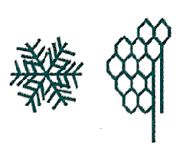


P Mucus
L Mucus
G Mucus

Slide 28
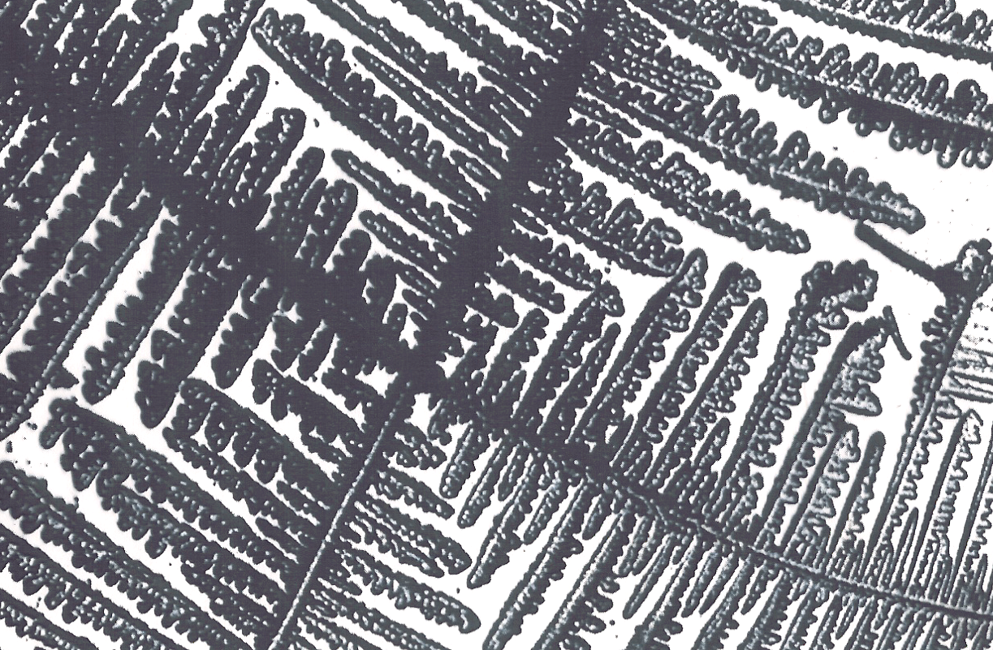
L MUCUS - fern pattern 90⁰ angles
Notes:
28
Microscopic photo of sample of L mucus taken from the cervical canal and spread thinly on a glass slide.

Slide 29
L MUCUS
Secreted by crypts throughout the length of the cervical canal.
Forms crystals at right angles to main stem.
Supports the P mucus and the string-like S mucus.
Attracts low-quality sperm which are then eliminated.
Locks sperm into S crypts.

Slide 30
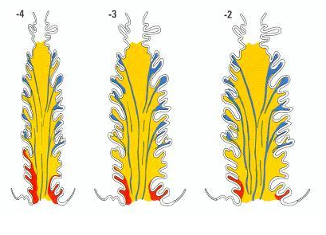
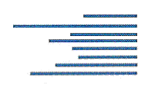
P Mucus
L Mucus
S Mucus
G Mucus

Slide 31
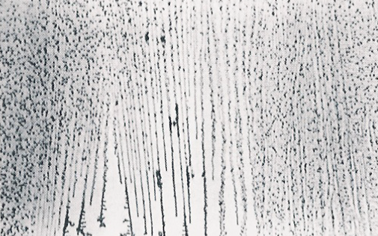
S MUCUS - channels
Notes:
31
Microscopic photo of sample of S mucus taken from the cervical canal and spread thinly on a glass slide.

Slide 32
S MUCUS
S Mucus crypts occupy upper half of the cervix
Crystalline pattern shows parallel needles
Present for a variable number of days before and up to 3 days past Peak
Provides nourishment for the high-quality sperm and channels for their transport to the S crypts

Slide 33
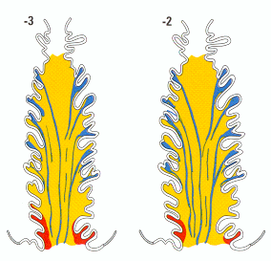
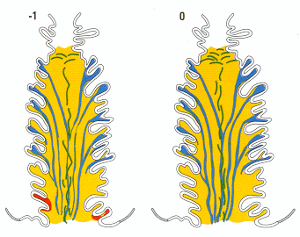
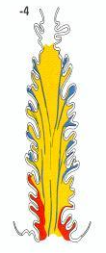
Z Granules
P Mucus
P Mucus
L Mucus
S Mucus
G Mucus

Slide 34
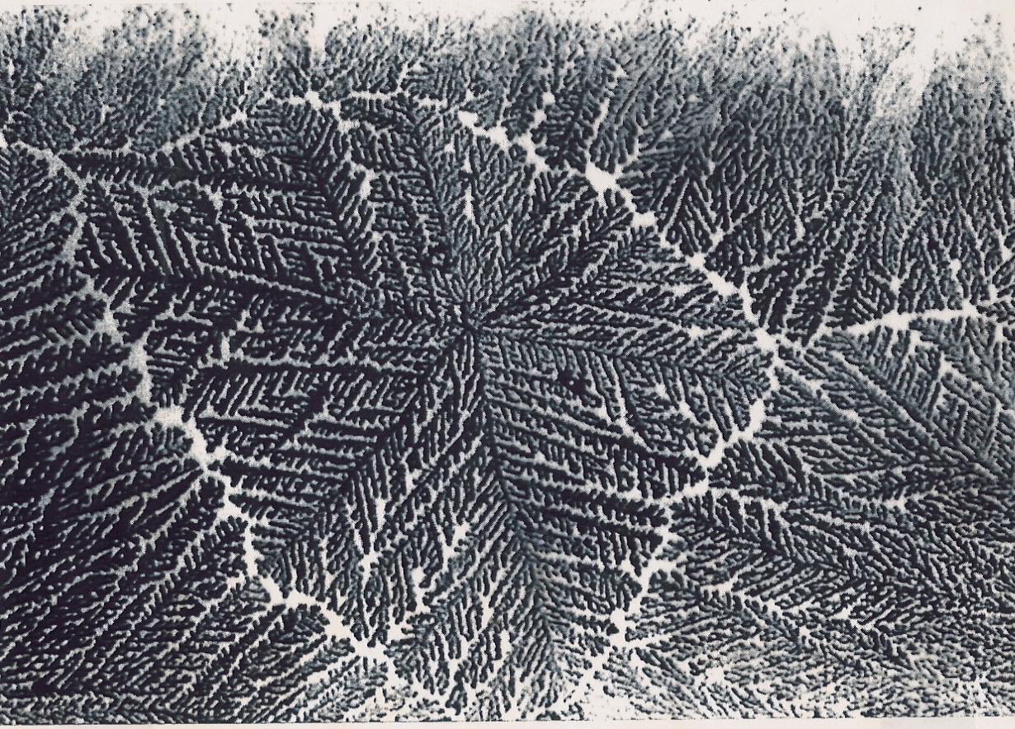
P MUCUS – fern pattern 60° angle

Slide 35
P MUCUS
Produced in uppermost crypts of cervix.
Crystals in hexagonal structures at 60 degrees to the main stem
Combines with enzyme from Z granules
• liquefies the thick G- mucus plug
• liquefies L mucus, unlocks S crypts
Liquefies L & S leaving a slippery sensation often without visible mucus
Conveys sperm to body of uterus

Slide 36
Peak of Fertility
menstruation
infertility
fertility
infertility
P
L
S
G
G
Baseline
oestrogen levels

Slide 37
    The Peak indicates the optimum fertile time in the cycle and is identified as the last day of slippery sensation at the vulva after developing mucus pattern of variable length.

Slide 38
    Changes in cervical mucus are controlled specifically by changing levels of oestradiol and progesterone during the ovarian cycle. The woman’s observations of her cervical mucus are in effect a self bioassay of these hormones.

Slide 39
    The effects of hormonal contraception on cervical mucus crypts.

Slide 40
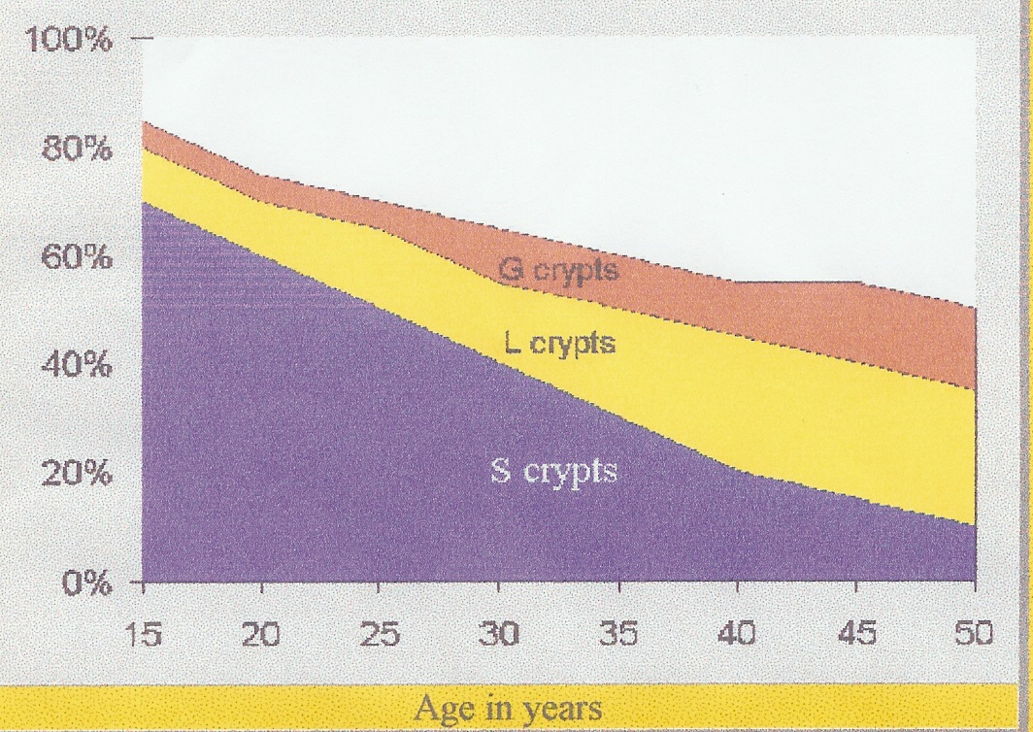
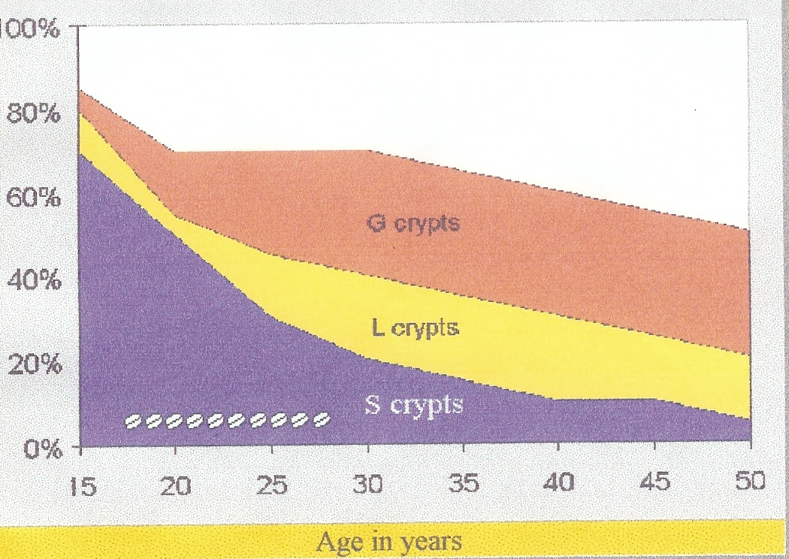
Cervical Crypts
No pregnancy,
no chemical contraception
No pregnancy,
10 years chemical contraception
Per Erik Odeblad

Slide 41
    Billings Ovulation Method™ Rules for achieving pregnancy and rationale.

Slide 42

    Couples encouraged to have intercourse on alternate nights during the Basic Infertile Pattern.
    Rationale:
      The women needs to be upright during the day in order to observe the cervical mucus symptom of that day.
      The use of alternate nights allows seminal fluid to leave the body the next day. Observations throughout the following day enable her to observe her cervical mucus symptom afresh .

Slide 43
    Couples advised to abstain from intercourse at the first sign of change in the cervical mucus symptom and to recommence intercourse at the onset of the development of the slippery sensation and for one or two days afterwards.
    Rationale:
      This allows the couple to identify the Peak day of fertility. Initial abstinence at the beginning of the fertile stage allows for sperm maturation.

Slide 44
    Professor Brown’s research has validated the normal patterns of cervical mucus in women from menarche to menopause. This includes the breastfeeding women and women post hormonal contraception. Teachers of the Billings Ovulation Method™ are trained to initiate medical referral in the presence of a chart not consistent with her age and history.

Slide 45
Benefit of BOM
This timely referral can initiate earlier management of women who are not ovulating
Failure to ovulate regularly may be a marker of a generalised endocrinopathy

Slide 46
Emotional
Stress
Eating disorder
Environmental
Nutrition
Exercise
Drugs
Hypothalamus
Pituitary
Thyroid
Adrenal
Pancreas
Ovary
Ovary
endometrium
cervix
cervical mucus observed at the vulva

Slide 47
Management of abnormal mucus pattern
History examination, Pap smear, BMI
Prolactin
TSH
17-hydroxy-progesterone, DHEAS
BSL/GTT
Vitamin D
Testosterone level

Slide 48
Summary
IVF can be a daunting prospect, physically, emotionally and financially for sub-fertile couples.
The BOM is a scientific, cost effective approach to maximising their natural fertility.
Teaching the knowledge of “Couple Fertility” can empower and restore hope to the sub-fertile.

Slide 49

Patron of WOOMB International
Professor John Edward Murtagh, Emeritus Professor of General Practice at Monash University, and Patron of WOOMB International (2013)

Slide 50
Acknowledgements
Drs Evelyn and John Billings
Professor James Brown and St Michael NFP Services
Professor Erik Odeblad
WOOMB International and all Billings Method Teachers
All women throughout the world who have participated in studies and trials

Slide 51
For more information
www.thebillingsovulationmethod.org
www.woombinternational.org
Freephone: 0800 NZ FERTILITY
0800 69 33 78

