Slide 1
Prof André van Rij
Professor of Surgery
Dunedin School of Medicine

Slide 2



AAA what is new
South GP CME 2013
Andre van Rij
Department of Surgical Sciences
Dunedin School of Medicine

Slide 3
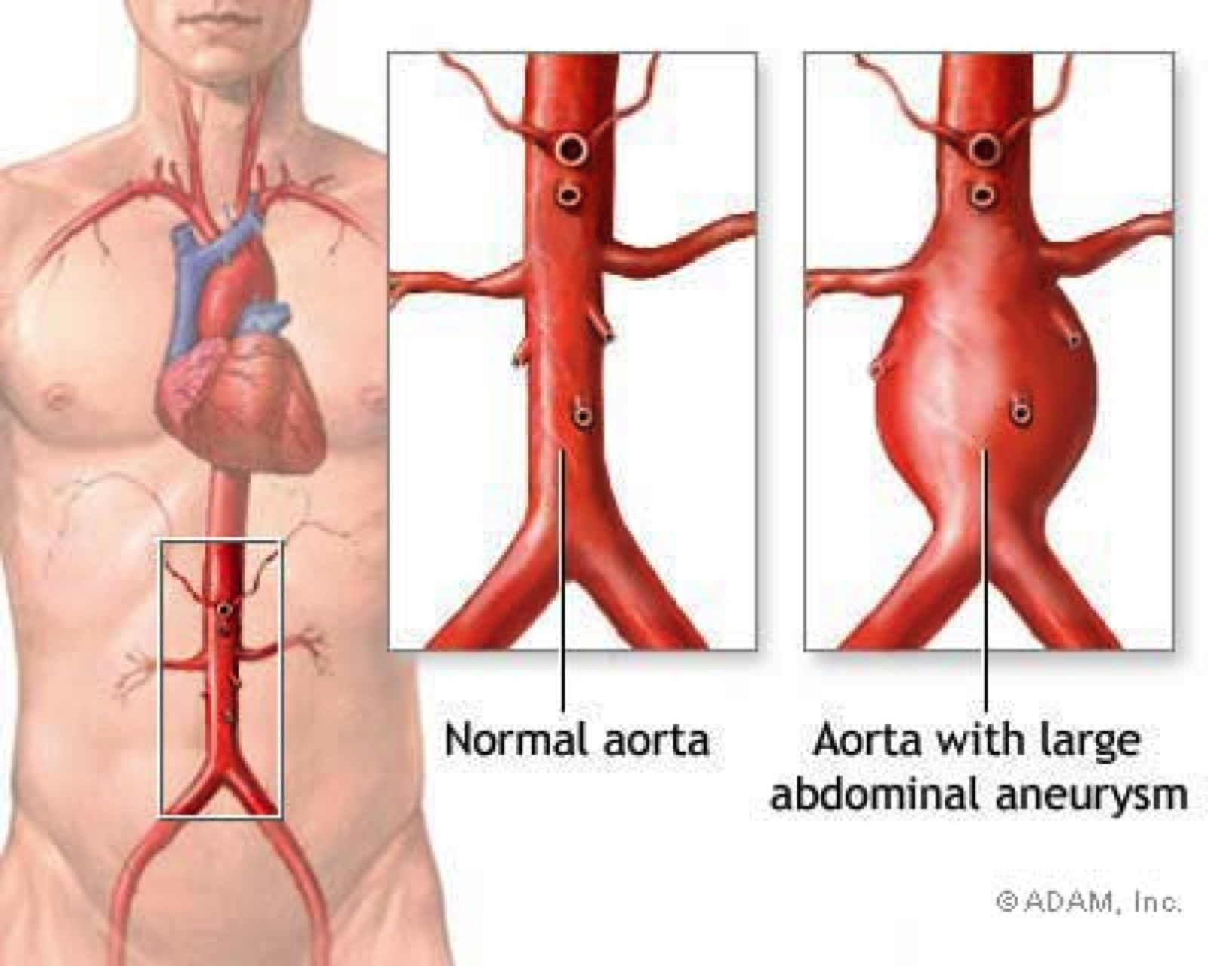

Slide 4
Old reminders
New Treatments
Screening
Surveillance
Genetics / Biomarkers

Slide 5
AAA in New Zealand
267 elective repairs Mortality 6.7
87 emergency Mortality 35.2
236 known AAA related deaths / year
Women
Maori 2x age standardised mortality
Abdominal Aortic Aneurysm Disease in New Zealand:
Epidemiology and Burden between 2002 and 2006
Nisha Nair, Caroline Shaw, Diana Sarfati, James Stanley

Slide 6
Maori
Incidence AAA 2 -2.5 x
Younger at presentation
More are ruptured
Outcomes are worse
Rossaak JI, Sporle A, Birks CL, van Rij AM. Abdominal aortic aneurysms in the New Zealand Maori population. Br J Surg 2003; 90: 1361–1366.
Notes:
Incidence 10.1 vs 3.7 /100,000 Age – 64 vs 72 Rupture 49% vs 30%

Slide 7
Female
Higher rupture rate
Higher Operative Mortality
Selection Bias
Grant, M.W., Thomson, I.A., van Rij, A.M. In-Hospital Mortality of Ruptured Abdominal Aortic Aneurysm. ANZ Journal of Surgery. 78:698-704 (2008)

Slide 8

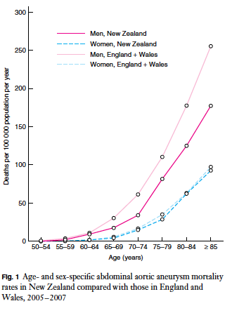

Slide 9
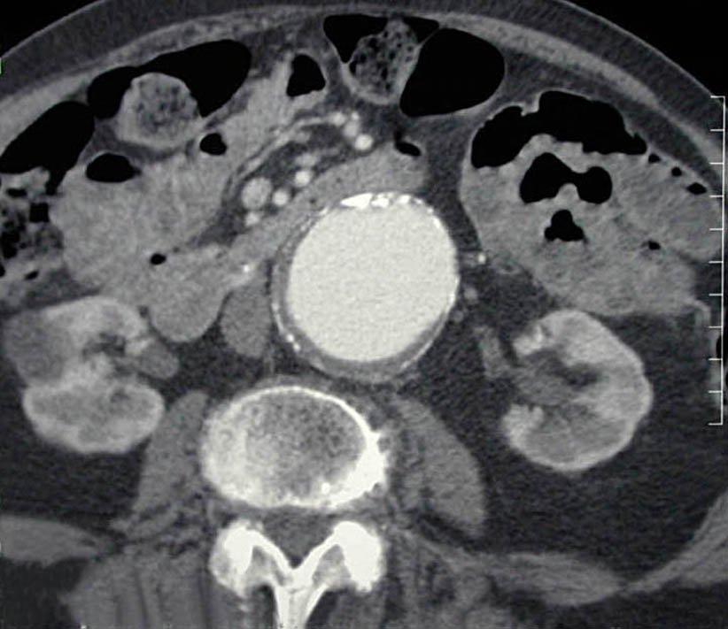
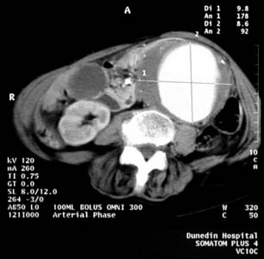
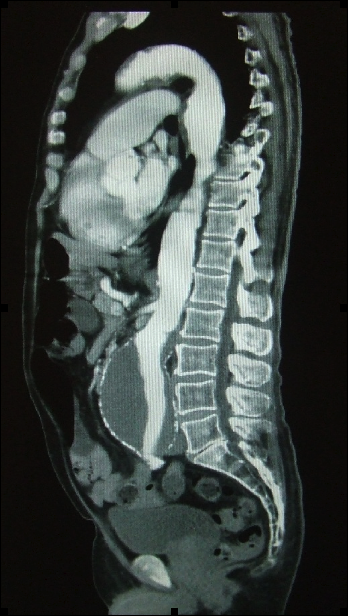
6
3
9.8

Slide 10
Outcomes
Mortality 5.5 cm - 5% per annum
Treatment Mortality
  Elective 2 -3 %
  Rupture 23 – 70 %

Slide 11
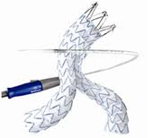
New Treatments
Endovascular explosion
EVAR
Imaging

Slide 12
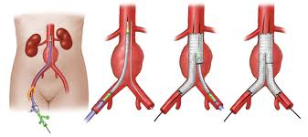
Endovascular Graft

Slide 13

Video

Slide 14
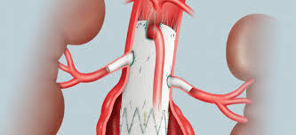
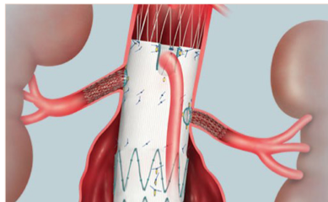
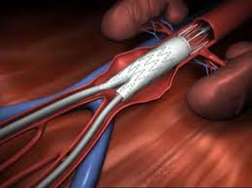

Slide 15
Imaging

Slide 16
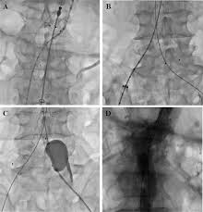
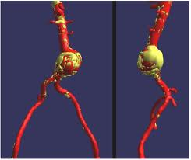

Slide 17
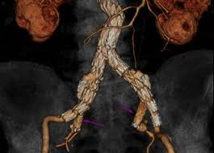

Slide 18
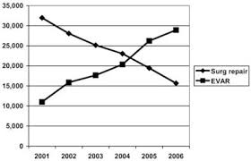
Trends in Treatment

Slide 19
Screening

Slide 20
AAA screening saves lives

Slide 21
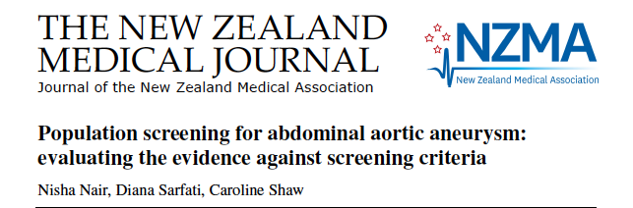
AAA Screening saves lives
Males ≥ 65

Slide 22
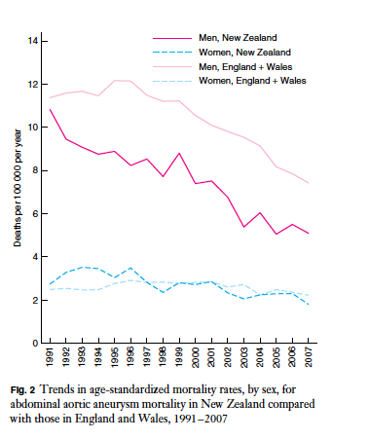

Slide 23
Changing our thinking
Women
Maori
Cardiovascular risk
Under 65

Slide 24
Changing our approach
Opportunistic screening
Selected Population screening
VS
Population screening

Slide 25
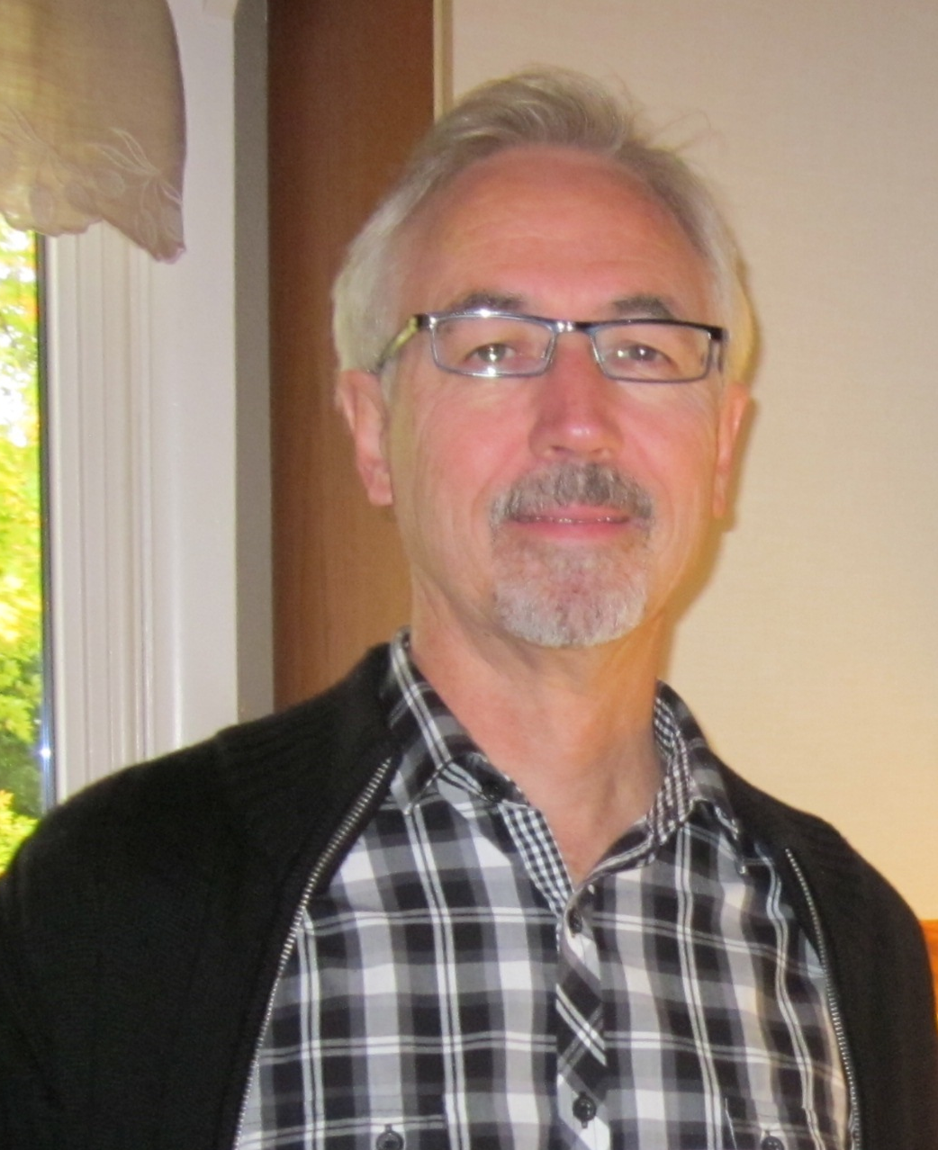
Mr Jones your BP is up
My, that Cholesterol is still up too
The hospital tells me the coronary arteries show some narrowing
Its time you had your AAA screen !

Slide 26
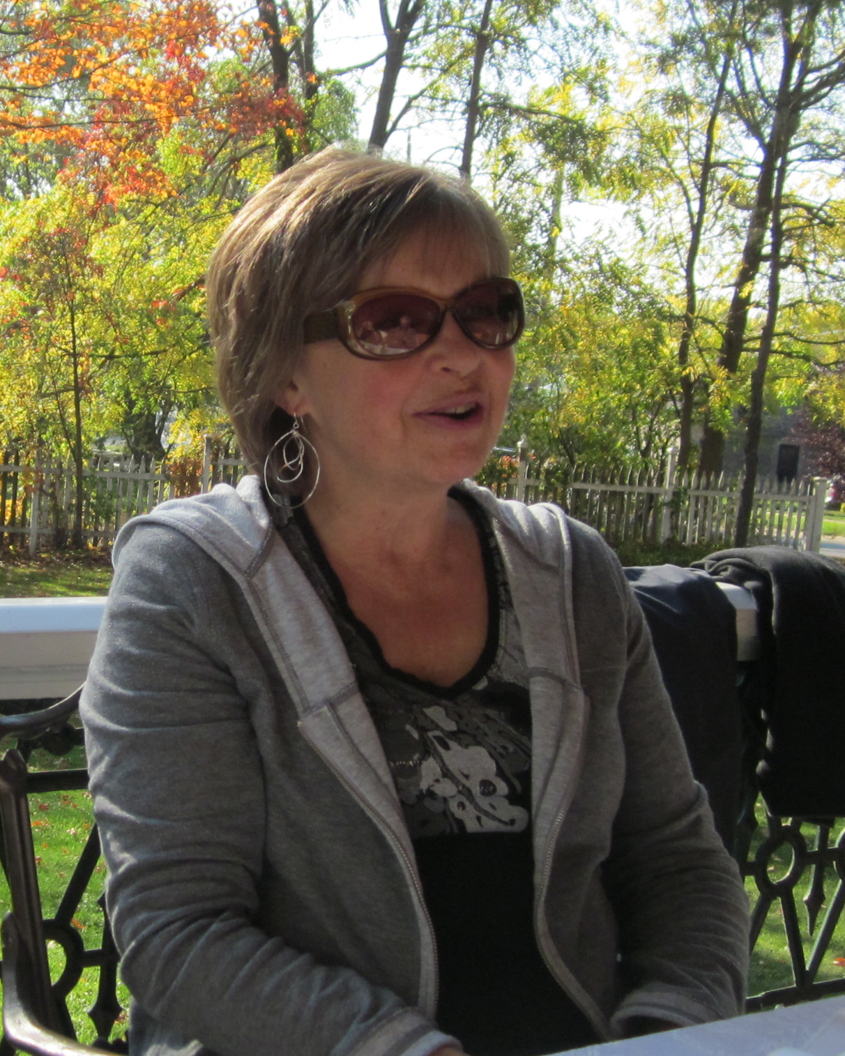
Mrs Jones your BP is up
My, that Cholesterol is still up too
The hospital tells me the coronary arteries show some narrowing
Its time you had your AAA screen

Slide 27
What are the implications?
What are the relevant prevalences ?
What are current cost benefits
Demonstrating we can improve the screening strategy
Notes:
This is not new

Slide 28
Making Screening Ultrasound less expensive
Training and Monitoring Novice Sonographers
Using Cheap Foolproof Ultrasound Equipment

Slide 29
Training and Monitoring Novice Sonographers
TRAINING AND MONITORING NOVICES TO SCREEN FOR ABDOMINAL AORTIC ANEURYSMS
Anh T.V. Nguyen, Geraldine B. Hill, MHSc, Matthew P. T. Versteeg, BSc (DipGrad), Ian A. Thomson, FRACS, and André M. van Rij, MD, FRACS Dunedin, New Zealand

Slide 30
Novice Trainee vs Expert Sonographer
Bland-Altmann plots n=198

Slide 31
Cusum Analysis based on time taken

Slide 32
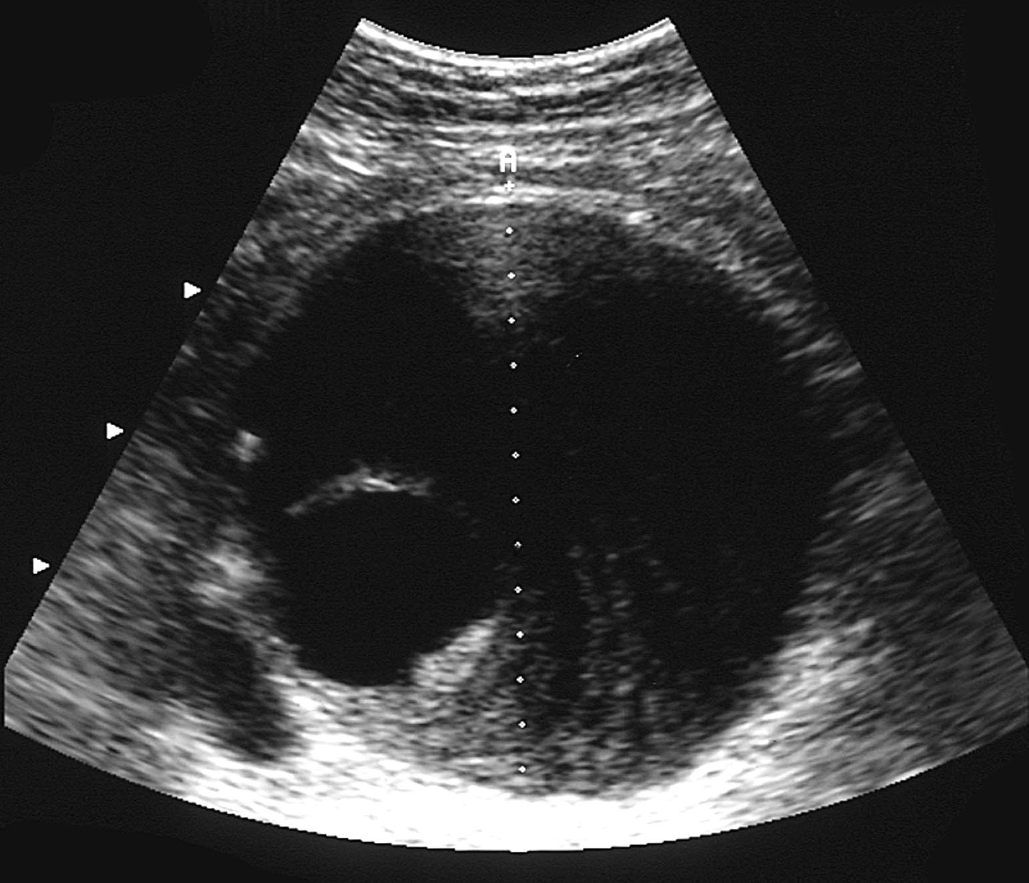
Abdominal Aortic Aneurysm Screening
Outcome :
Large Aneurysms for treatment
Small Aneurysms for prevention
Small Aneurysm for surveillance Ultrasound
Notes:
Might want to add in some additional info on the negative effects of screening

Slide 33
Abdominal Aortic Aneurysm Screening
Outcome :
Large Aneurysms for treatment
Small Aneurysms for prevention
Small Aneurysm for surveillance Ultrasound
Notes:
Might want to add in some additional info on the negative effects of screening

Slide 34
AAA Surveillance
Surveillance is critical to a Screening Programme
Cheap
Still imposes significant time and cost burdens to patients and practices.
Notes:
Might want to add in some additional info on the negative effects of screening

Slide 35
AAA Surveillance
Small Aneurysm takes 10 years
  10-15 scans
Intermediate Aneurysm takes 2 years
  2 scans
Notes:
Might want to add in some additional info on the negative effects of screening

Slide 36
Surveillance AAA Population
Otago Vascular Diagnostics AAA Surveillance
N | 271
Males | 189 (70%)
Age (years) | 75 (51 – 92)
Follow-up (years) | 2.7 (1.7 – 9.4)
Number of Aorta scans | 4 (2 – 14)
Initial AAA diameter, mm | 42 (30 – 63)
Notes:
Patients were included only if they had multiple scans over a period of 6 mo or greater.
The negative growth makes no sense

Slide 37
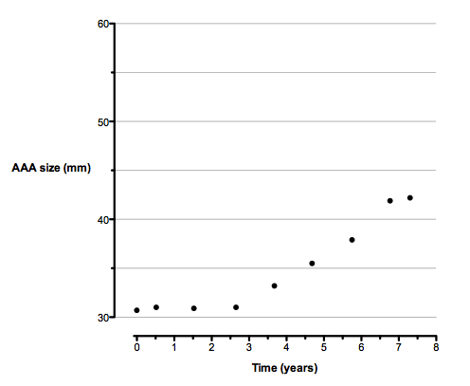
Serial AAA diameter measurements

Slide 38
Average time taken for AAA to reach 55 mm limit
AAA size | Time to grow to 55 mm
30 mm | 11.1 years
40 mm | 4.6 years
50 mm | 1.3 years

Slide 39
Surveillance Population
Otago Vascular Diagnostics AAA Surveillance
N | 271
Males | 189 70%
Age (years) | 75 (51 – 92)
Follow-up (years) | 2.7 (1.7 – 9.4)
Number of Aorta scans | 4 (2 – 14)
Initial AAA diameter, mm | 42 (30 – 63)
Annual growth rate, mm/y | 2.6 (-8.4 – 15.2)
Notes:
Patients were included only if they had multiple scans over a period of 6 mo or greater.
The negative growth makes no sense

Slide 40
Biomarkers and Genes
AAA has a familial component

Slide 41
Would it be one gene or many genes ?
Marfan’s Disease
ApoE knockouse mouse !

Slide 42
Marfan’s Disease
A (single) defect in the fibrillin-1 gene, results in weak connective tissue
Tall, long fingers and limbs
Cardiovascular disease
(Aortic aneurysms)

Slide 43
AAA turns out to be many genes ?
And how could you discover them ?
Needles in the genetic
hay stack !

Slide 44
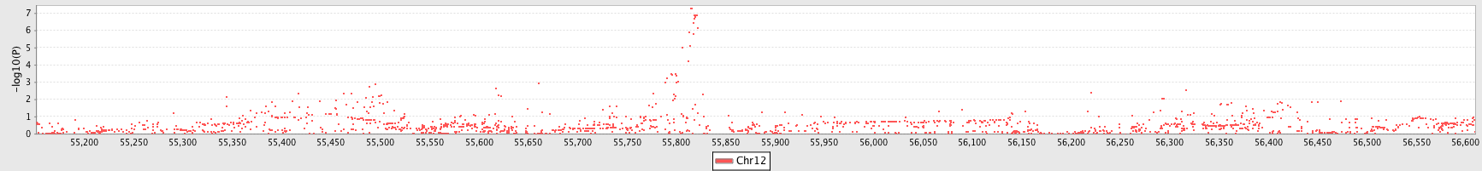
AAA- Genome Wide Association Scan
~3M common genetic variants (MAF>5%)
270k markers
1700 markers

Slide 45
AAA Risk Scores: Gene Score
ANRIL locus - Chr9p21 A allele 1pt/allele
DAB2IP – 9q33 A allele 1pt/allele
LRP1 – 12q13 CC genotype 2pts
SORT1 – 1q13 AA genotype 2 pts
ABCG5 – 2p21 C allele 1pt/allele
Possible maximum score 10
Gene Score >6 equals an 80% increase in AAA risk

Slide 46
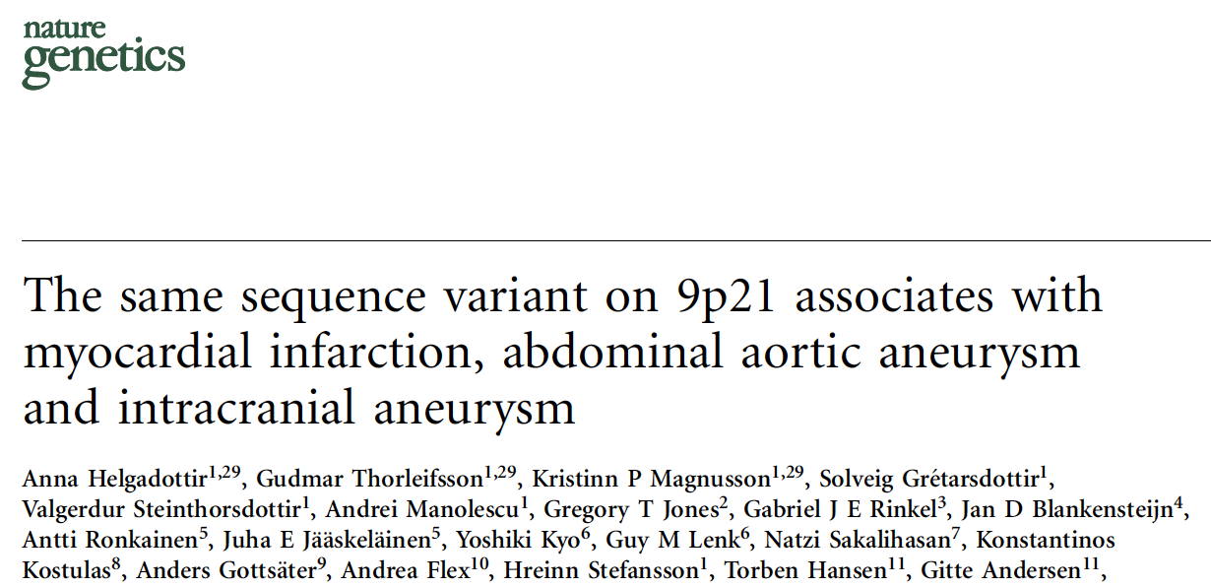
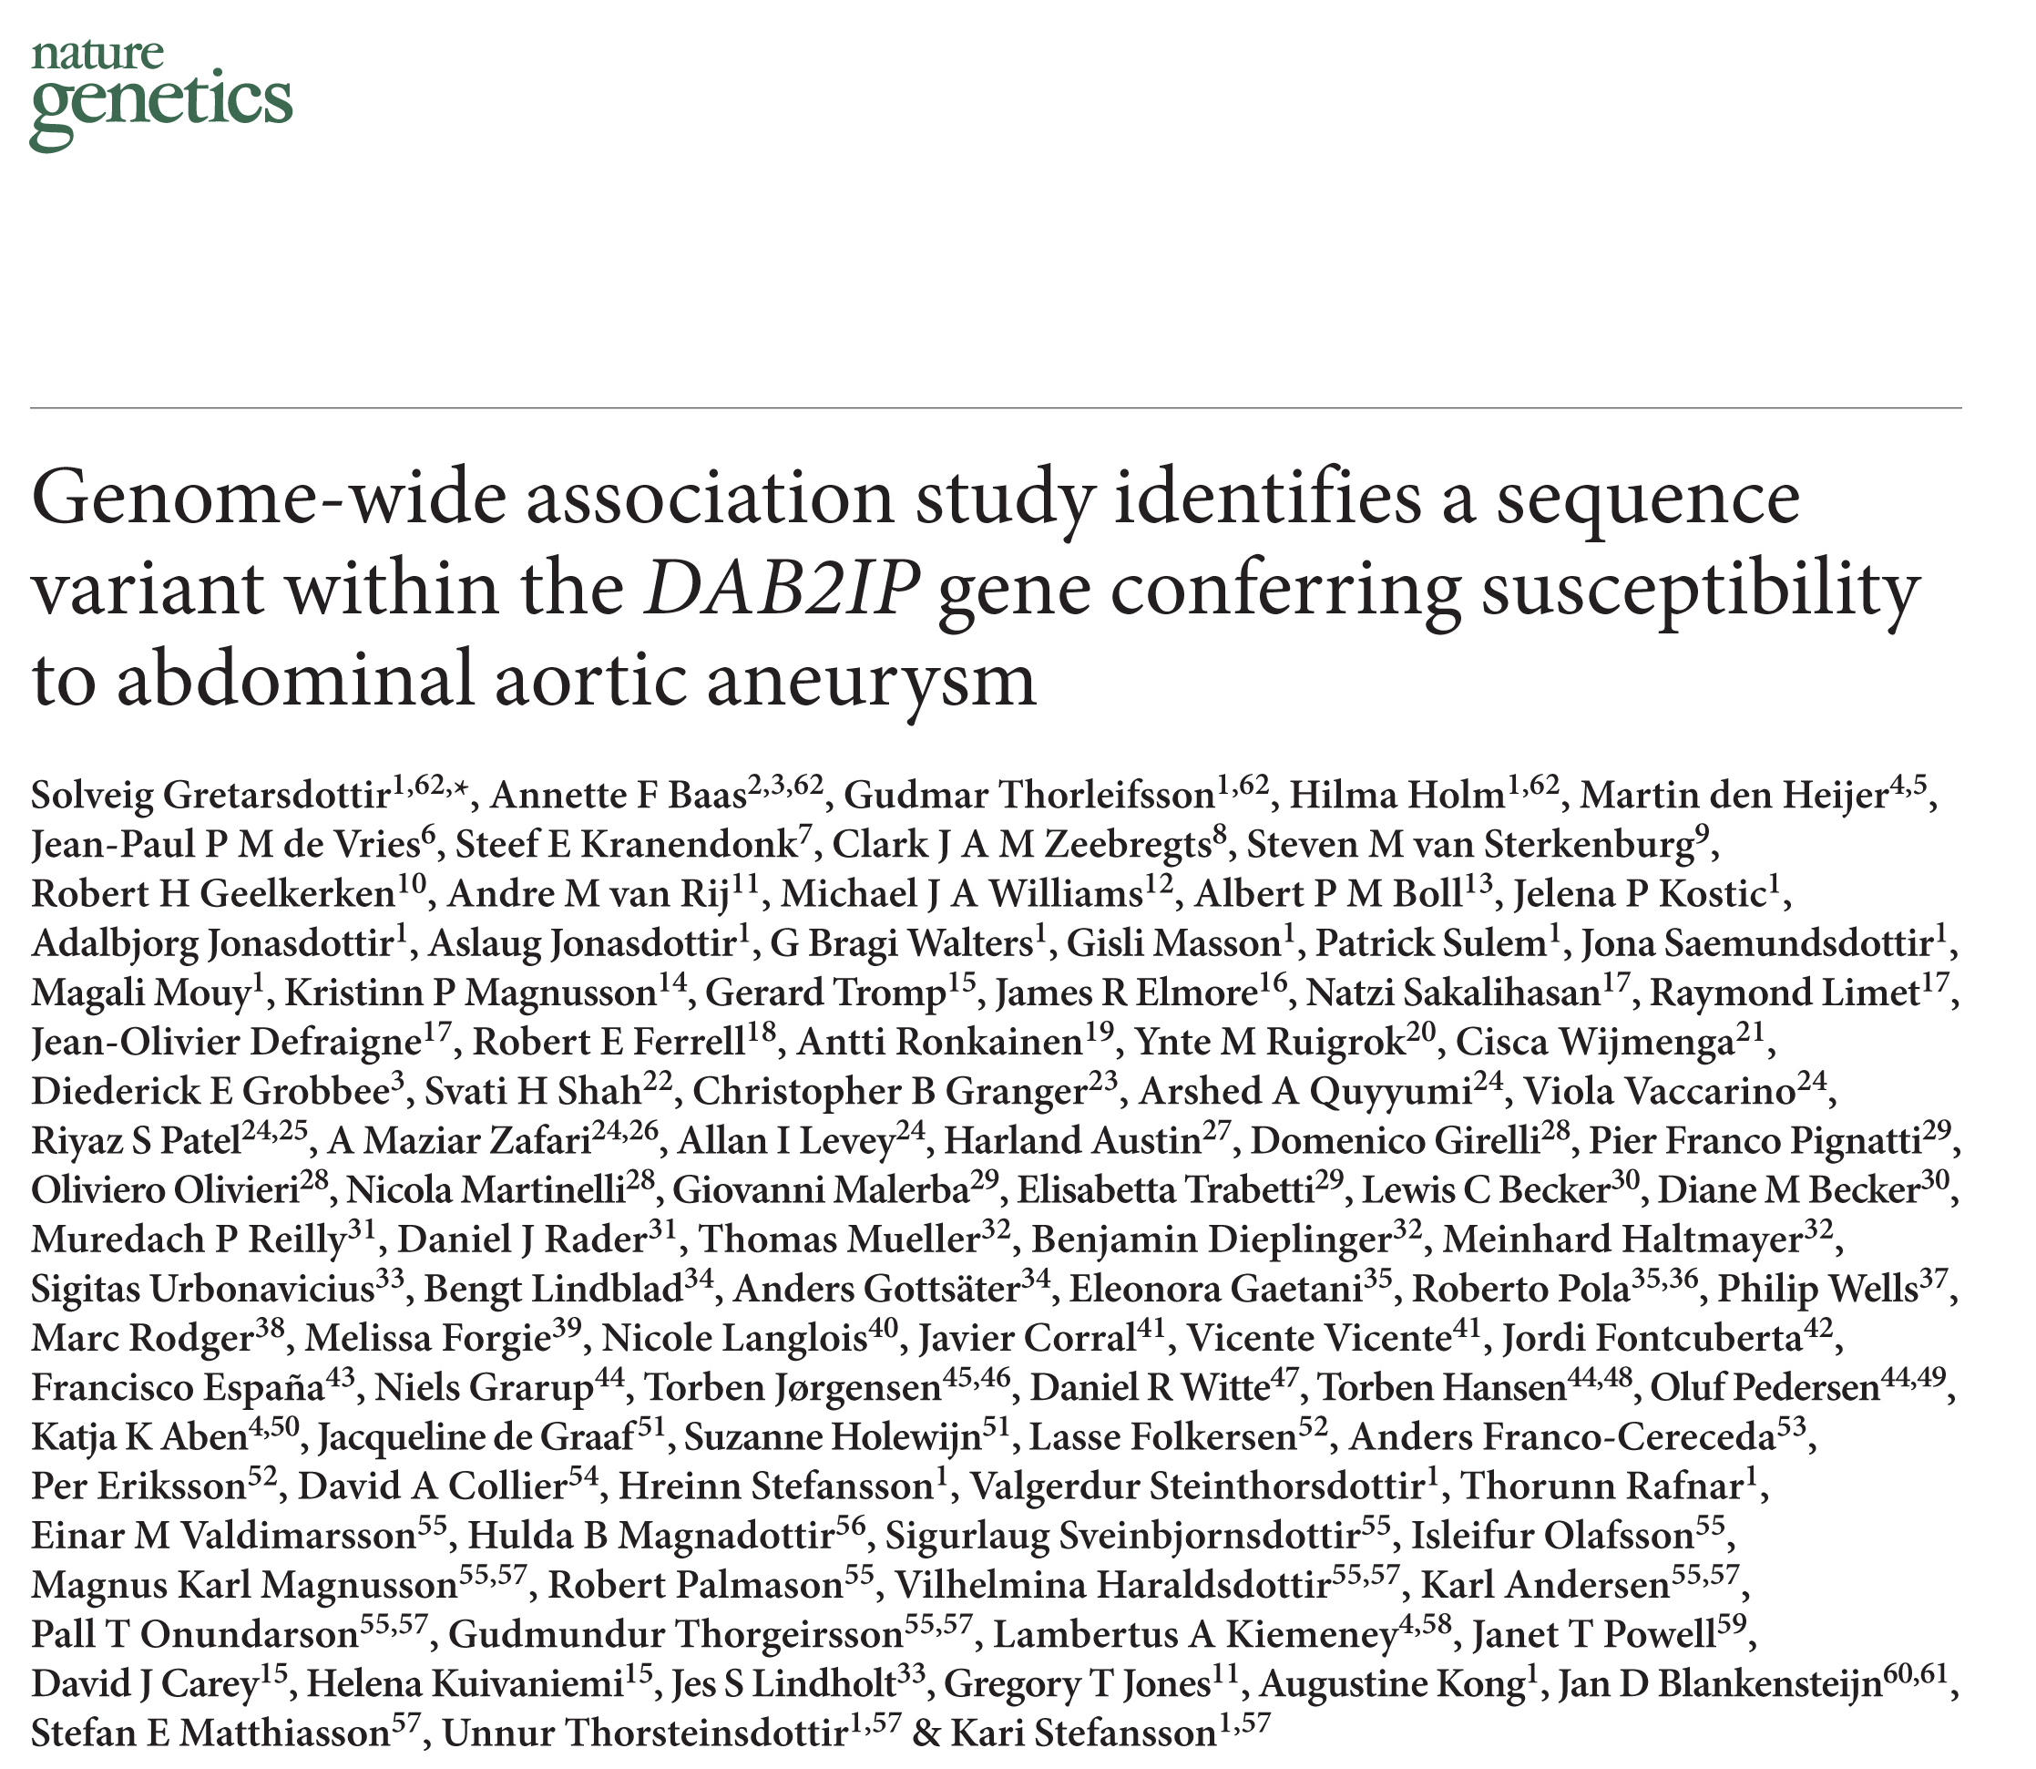
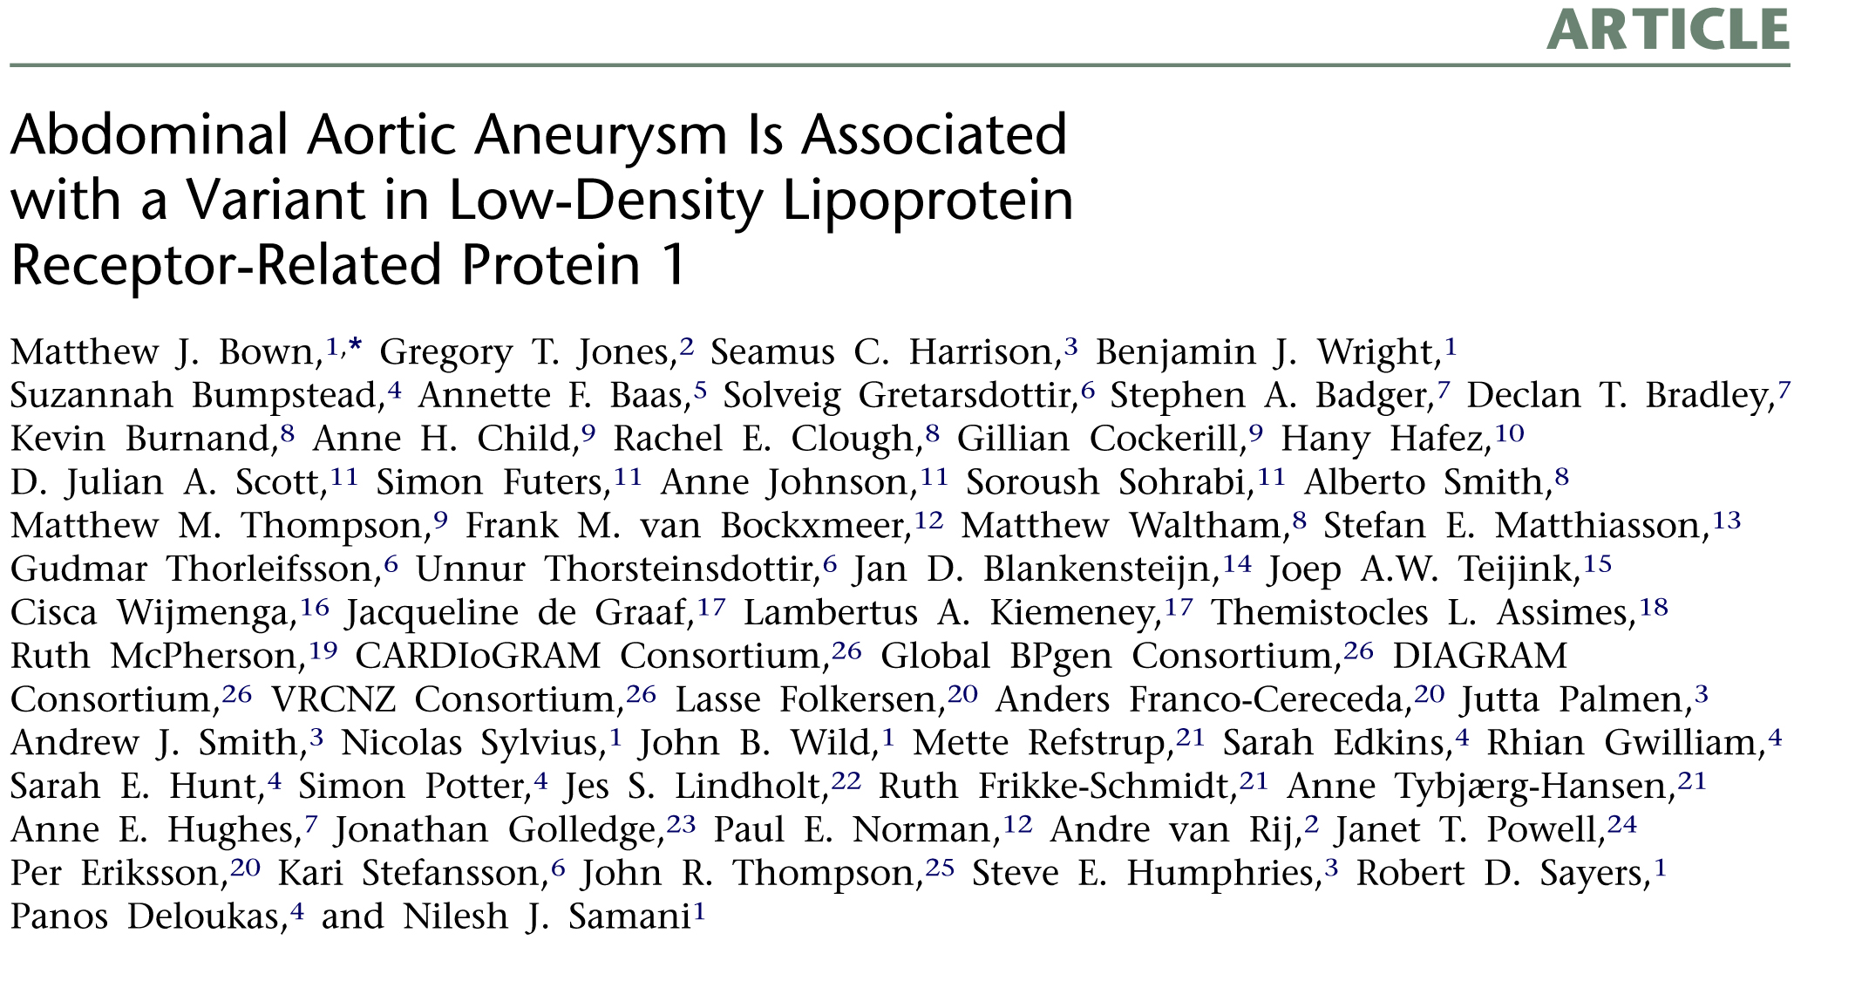
AAA Genetic Risk Factors
Chr9 p21.3
Chr9 q33
Chr12 q13

Slide 47

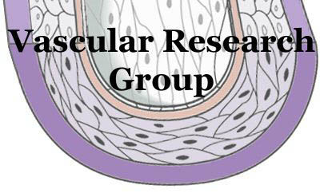

Western Australian HIMS study
Paul Norman (UWA)
BHF Cardiovascular Genetics
Lab (UCL)
Steve Humphries
Andy Thompson
Jackie Cooper
The Aneurysm Consortium
Matt Bown (St Georges)
Hany Hefez (Chichester)
Wellcome Trust Sanger Institute
Decode Genetics
Sólveig Grétarsdóttir
Unna Thórsteinsdóttir
Hilma Hólm
Anna Helgadóttir
Otago Vascular Research Group
Greg Jones
Andre van Rij
Vicky Phillips
Grace Yu
Otago Vascular Diagnostics
Tony Merriman
Les McNoe
Vascular Research
Consortium (NZ)
Andrew Hill (ADHB)
Thodur Vasudevan (WDHB)
Ross Blair (WDHB)
David Lewis (CDHB)
This work was supported by the
Health Research Council of New Zealand

Slide 48
Thank you

