Slide 1
Dr Paul Thibault
Phlebologist & Assistant Editor
Phlebology (International Journal)
Australasian College of Phlebology

Slide 2
Modern Management of Varicose Veins and CVI
Dr Paul Thibault FACP
Newcastle, Australia

Slide 3
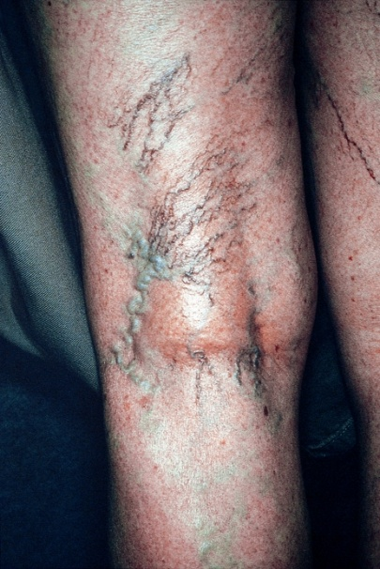
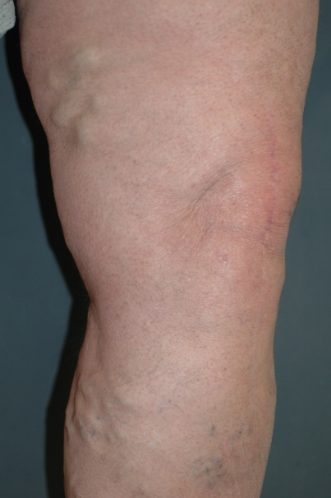
What is Venous Disease?
Widmer’s Classification(1978) Basle Study
Varicose Veins
  “hyphenwebs” (=telangiectasias, spiders):
  Reticular varicose veins: dilated, tortuous subcutaneous veins, not belonging to the main trunk or its major branches
  Trunk varicosities: dilated, tortuous trunks of the great or small saphenous vein and their abnormal tributaries

Slide 4
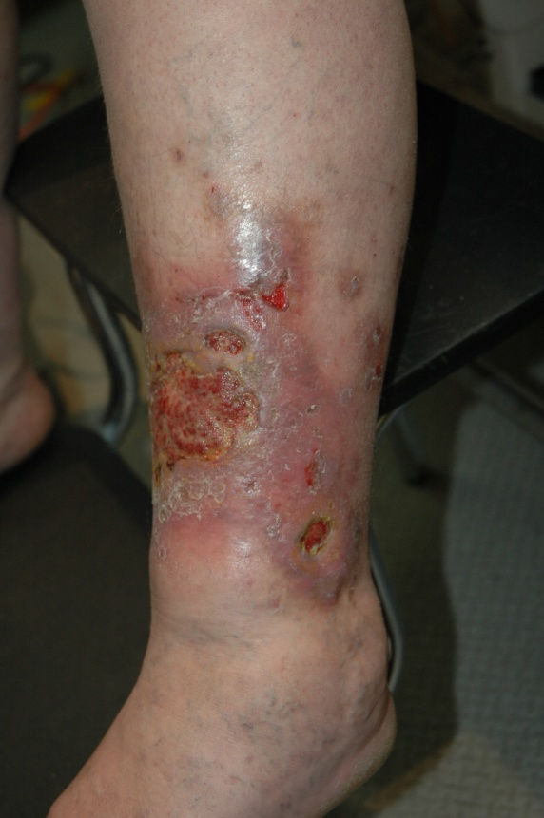
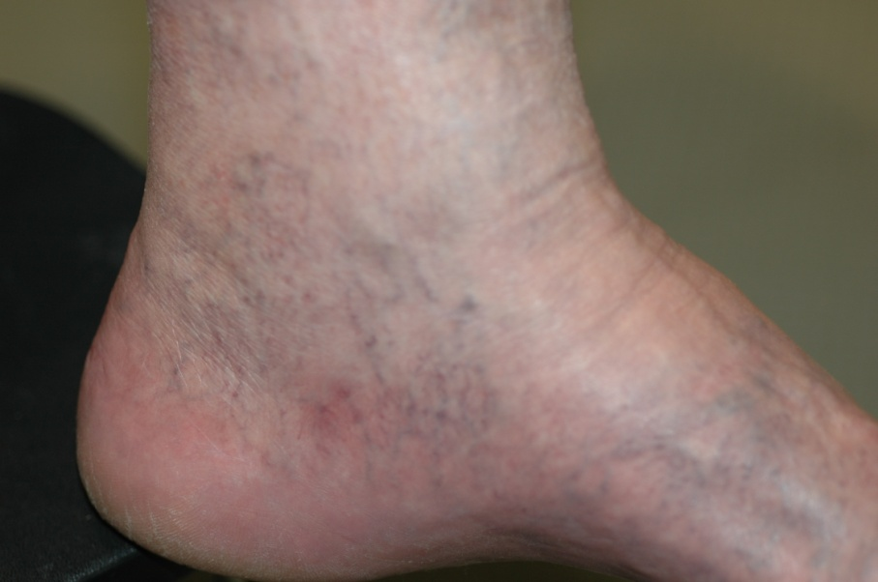
Widmer’s Classification
Chronic Venous Insufficiency
  Grade I: Dilated subcutaneous veins including corona phlebectatica
  Grade II: Hyper- or depigmented areas, with or without corona phlebectatica
  Grade III: Active or healed venous ulcer

Slide 5
CEAP Classification (1995)
C - Clinical signs
E - Etiology
A - Anatomic distribution
P - Pathophysiologic dysfunction

Slide 6
Clinical Classification
Class 0: No visible or palpable signs of venous disease
Class 1: Telangiectasias and reticular veins
Class 2: Varicose veins
Class 3: Oedema
Class 4: Skin changes (pigmentation, eczema, lipodermatosclerosis)
Class 5: Healed ulceration
Class 6: Active ulceration

Slide 7
Compression
Bandages
  High stretch (high resting pressure, medium working pressure)
  Low stretch (low resting pressure, high working pressure)
Compression stockings
  Class 1 (15-25mmHg)
  Class 2 (25-35mmHg)
  Class 3 (35-45mmHg)
  Class 4 (45-60mmHg)
  Knee high, Thigh high, with or without waste attachment, pantyhose

Slide 8
Conditions Managed by Compression
Varicose veins
Prevention of vv
VVs in pregnancy
Post-partum vvs
Functional problems
Venous thrombosis
Chronic DVI
Venous ulcers
Lymphoedema

Slide 9
Compression
Often used in conjunction with
  Surgery
  Sclerotherapy
  Physical ablation techniques
  MOBILIZATION

Slide 10
Surgery
Ligation of junctions and perforators
Surgical stripping
Endoscopic ligation of perforators
Ambulatory phlebectomy
External valvular “cuffing”

Slide 11
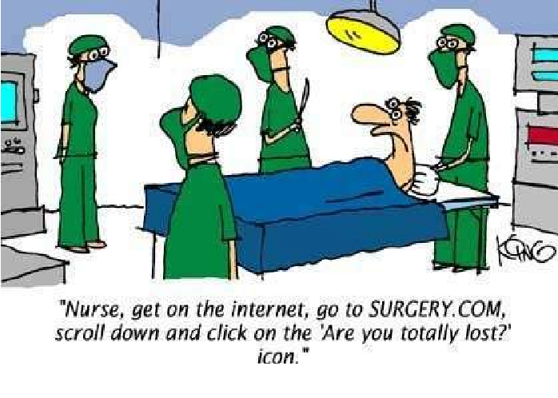
Surgery

Slide 12
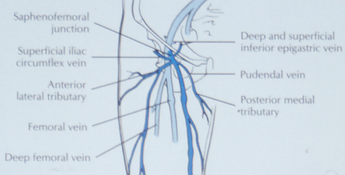
Ligation of Junctions and Perforators

Slide 13
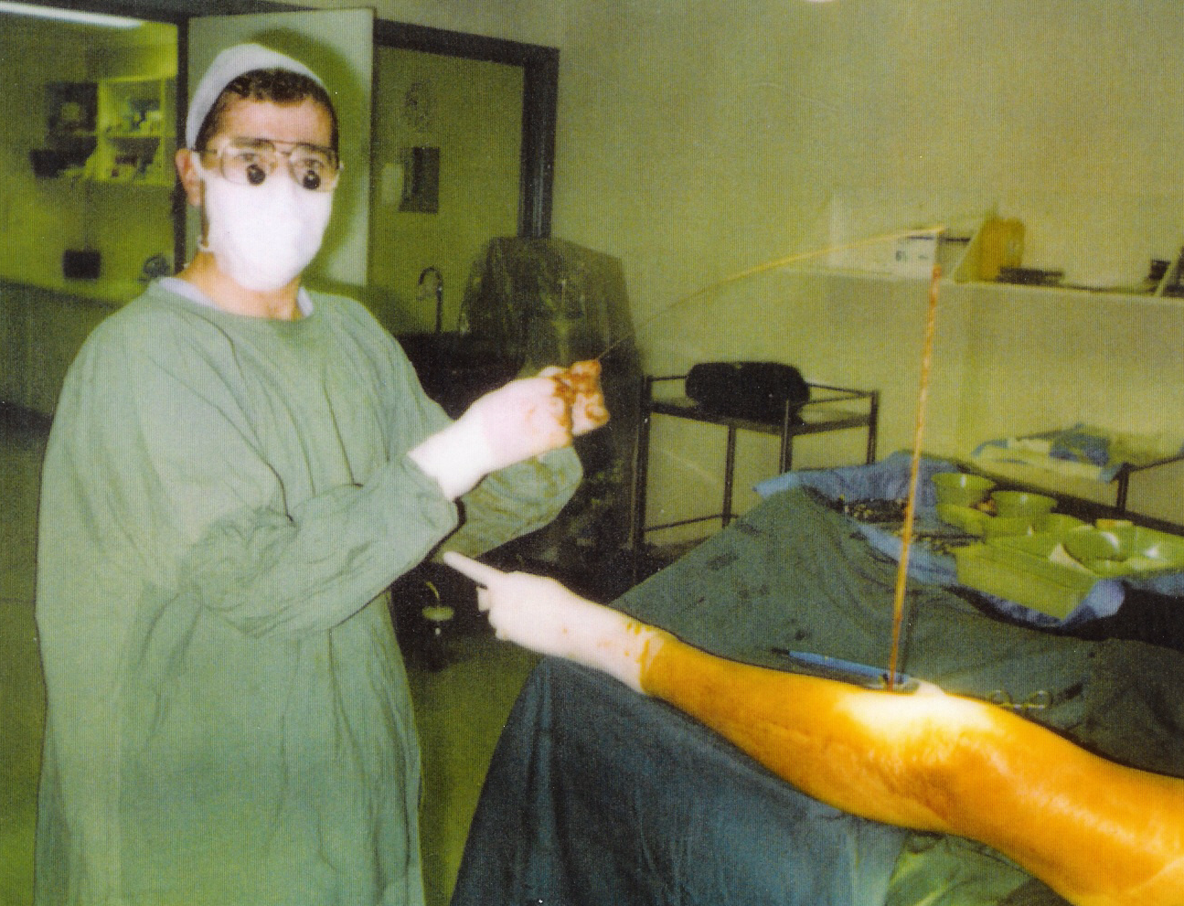
Surgical Ligation and Stripping

Slide 14
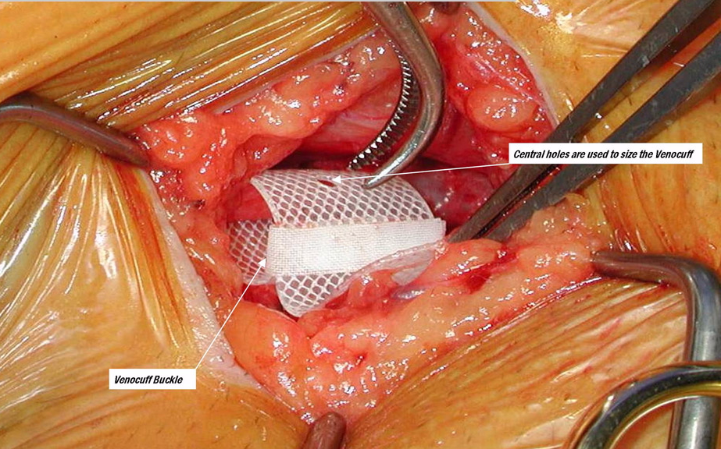
External Valvular “Cuffing”

Slide 15
Mini-Phlebectomy (Muller)
Indicated for tributary disease
Usually performed in association with
  other surgery (stripping, external valvuloplasty)
  Endovenous laser ablation (or radiofrquency)
  UGS
Usually as outpatient procedure (ambulatory phlebectomy)

Slide 16

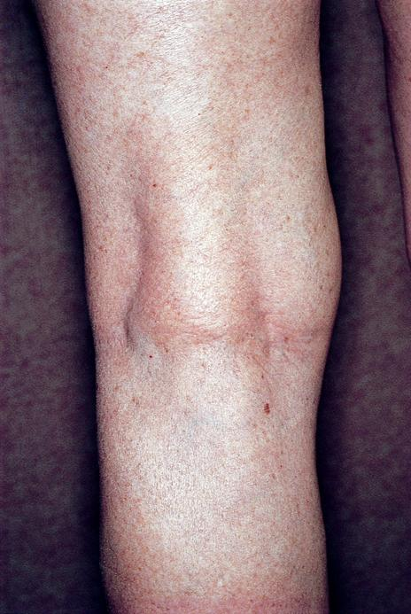
Sclerotherapy
Treatment of choice for reticular veins and telangiectasias

Slide 17
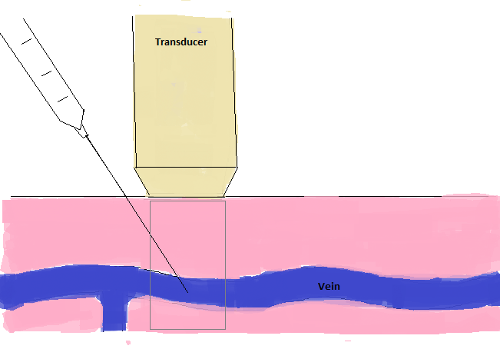
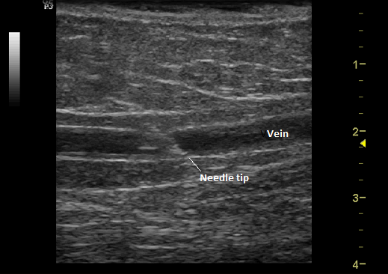
Ultrasound-Guided Sclerotherapy
Ultrasound-guided foam sclerotherapy used for
  Truncal incompetence with vein diameters<6mm
  Incompetent perforators
  Recurrent-post surgical varicose veins
  Atypical refluxes e.g. Giacomini, femoro-popliteal

Slide 18
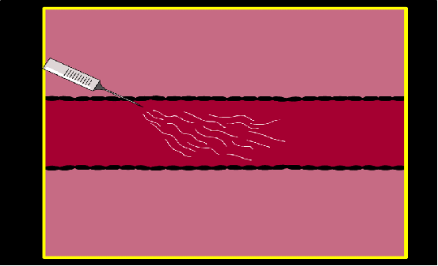
Principles of UGS
Ultrasound monitors intraluminal injection and directional control of sclerosing agent

Slide 19
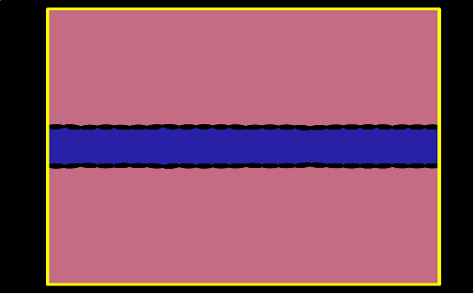
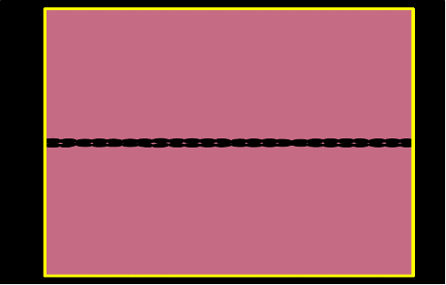
Principles of UGS
Ultrasound determines the End-Point
8 minutes 8 months

Slide 20
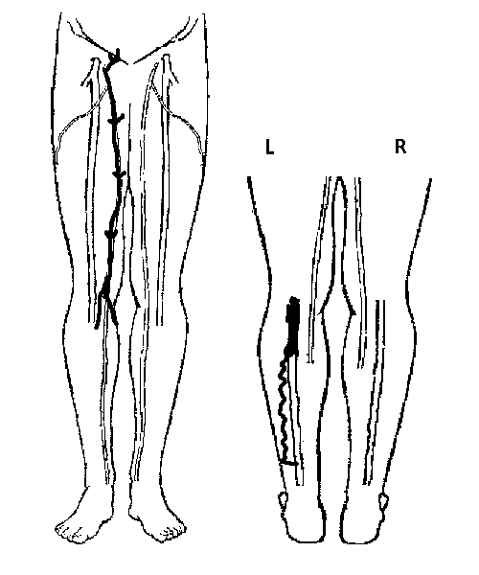
Protocol
Prior detailed anatomical mapping of deep and superficial reflux

Slide 21
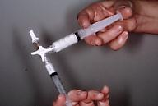
Detergent Foams
STS and Polidocanol
3 way tap, 5ml, 3ml syringe
1 ml sclerosant, 3-4 mls air
Approx 4 times effectiveness compared with standard solutions
Excellent contrast medium on ultrasound.

Slide 22
Longitudinal View

Slide 23
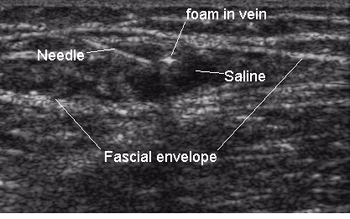
Immediate Perivenous Compression

Slide 24
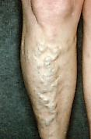
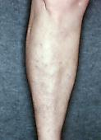
Ultrasound-Guided Sclerotherapy
Ultrasound-guided foam sclerotherapy used for
  Truncal incompetence with vein diameters<6mm
  Incompetent perforators
  Recurrent varicose veins
  Atypical refluxes e.g. Giacomini, femoro-popliteal

Slide 25
Physical Ablation Techniques
Alternative, less invasive approaches to surgical striping
Endovenous laser
  810nM diode
  940nM
  980nM
  1064nM - NdYAG
  1320nM – NdYAG
  1500nM
Radio-frequency
  “VNUS” closure

Slide 26
VNUS Closure ®
Multi-Center International Registry Results
The VNUS international, multi-center registry results demonstrate a highly effective, stable outcome with 5 year follow-up after Closure® procedure. Of patients reflux-free at 1 year follow-up, 92% remain reflux-free at latest follow-up out to 5 years.

Slide 27
3 Randomised Trials
VNUS vs Surgery
The Closure procedure in these trials resulted in:
Less post-operative recuperation time
Faster return to work and normal activity
Less post-operative pain and limitation of physical activity
Higher quality of life scores than vein stripping
In addition, the multi-center comparative trial showed fewer complications and adverse events in the Closure treated patients than patients receiving vein stripping.
In every comparison of the two procedures in which statistically differences were observed, the result was always in favor of the Closure procedure
80.5% of Closure treated patients returned to normal activities within one day

Slide 28
Neovascularization
The rate of neovascularization, reportedly a cause of reflux recurrence in stripping and ligation procedures, was 0.5% at 24 month follow-up in limbs treated with the Closure procedure.
Disadvantage – costly consumables

Slide 29
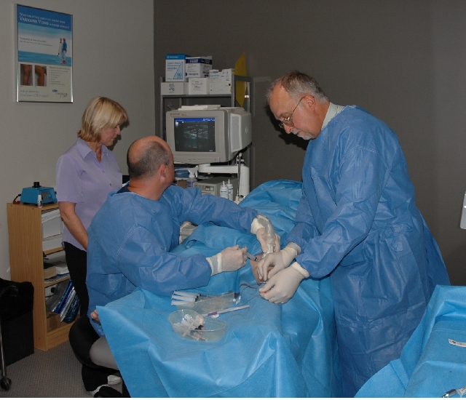
Endovenous Laser Ablation

Slide 30
Light Absorption in Tissue
810- 940-980
1320 Nd:YAG
1 µm
Melanin
10 µm
Hemoglobin
100 µm
1 mm
10 mm
100 mm
Water
1 m
10 m
100 m
0.1
0.2
0.3
0.4
0.5
1
2
3
Wavelength
© 2005 CoolTouch Inc.

Slide 31
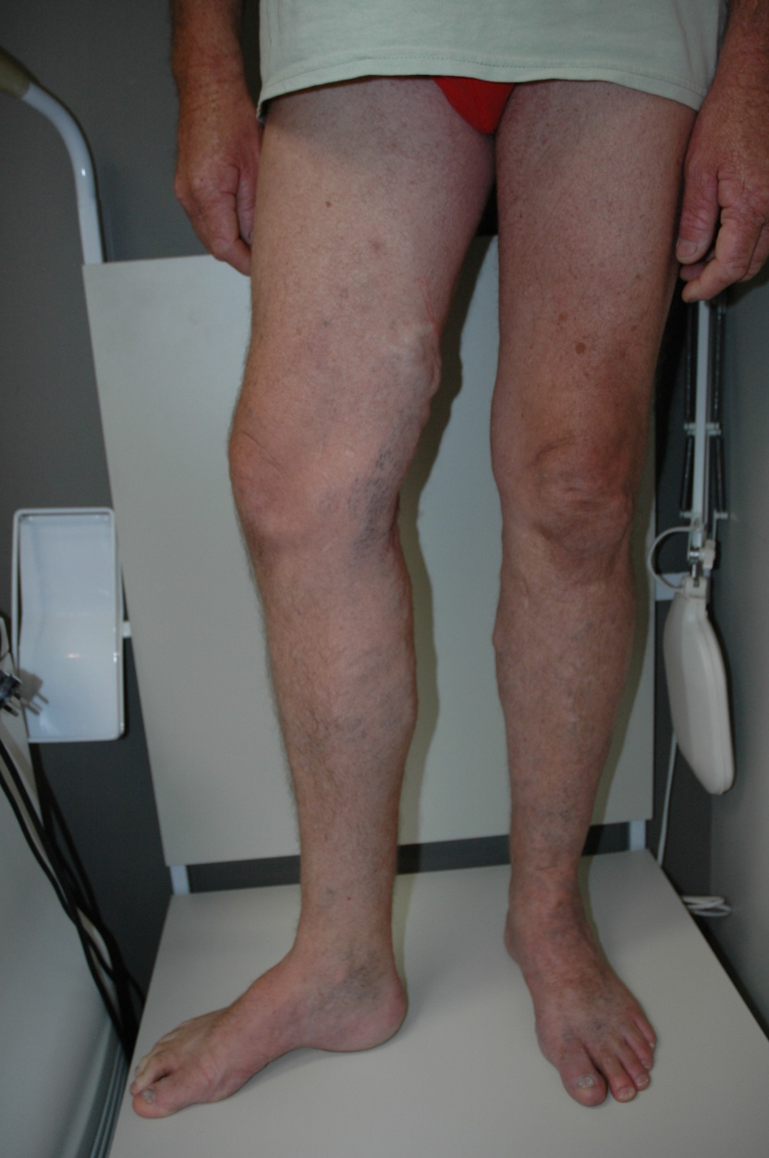
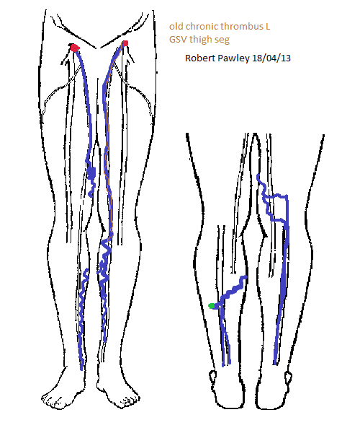
EVLA – truncal varicosities

Slide 32
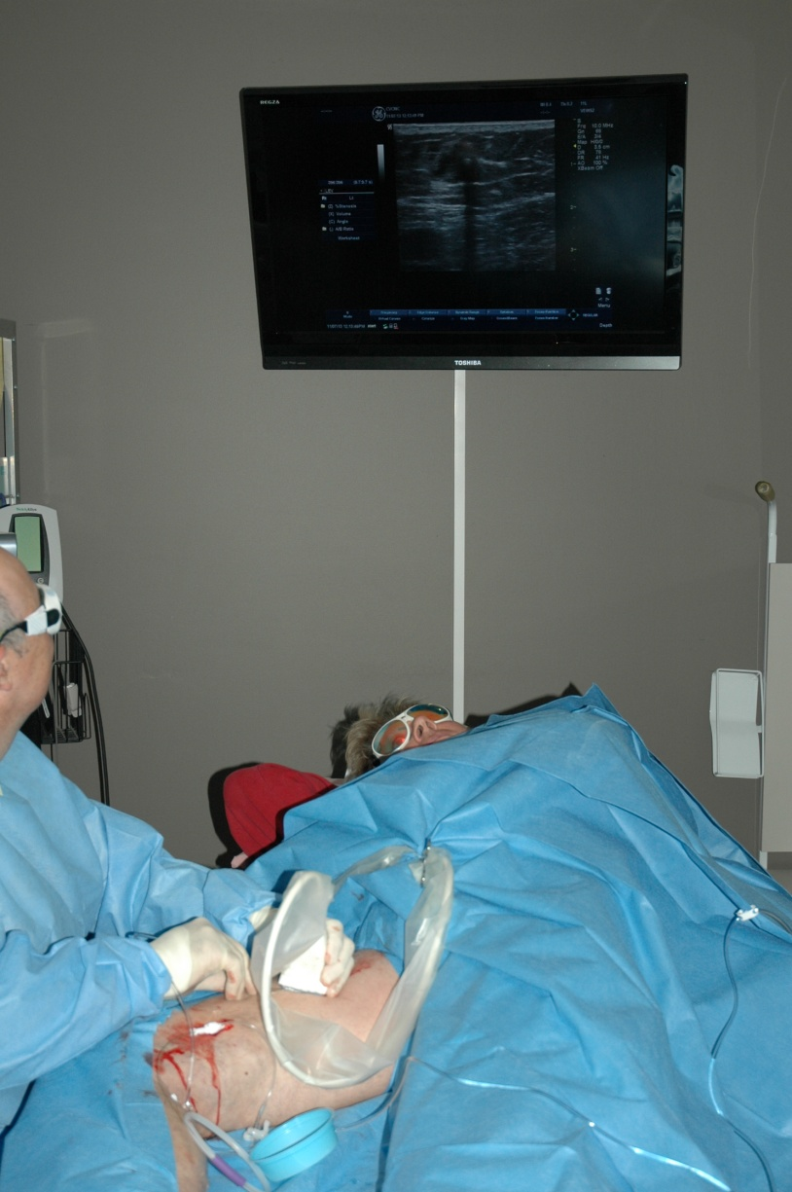
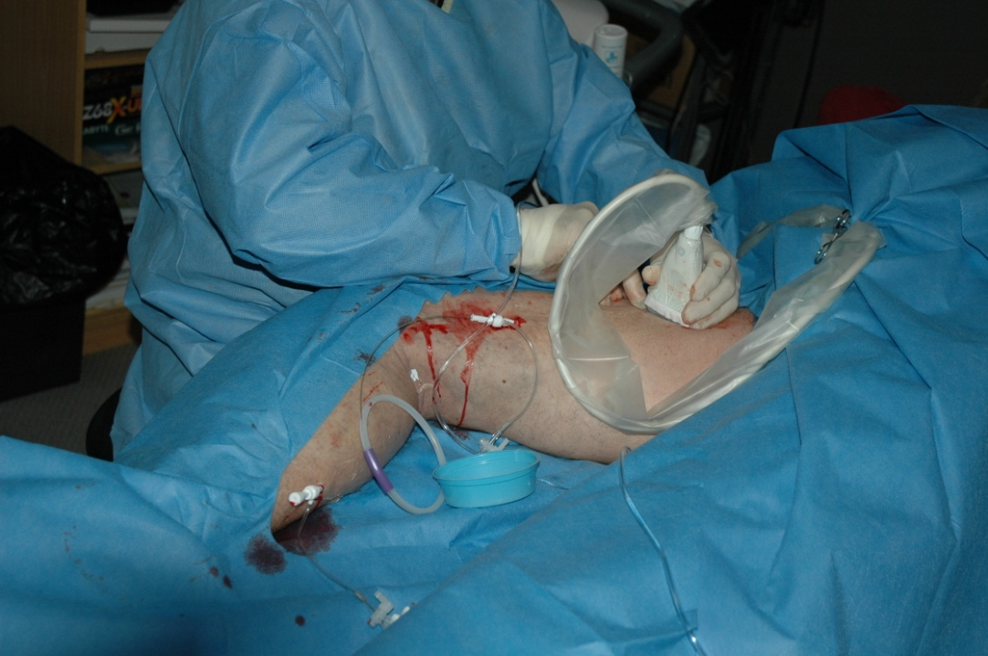
CTEV- truncal venous insufficiency

Slide 33
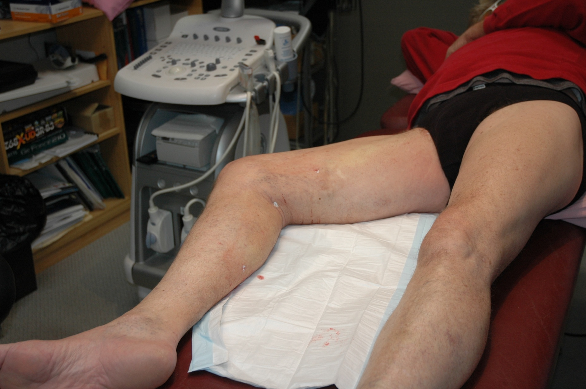
EVLA – truncal incompetence
Immediately after

Slide 34
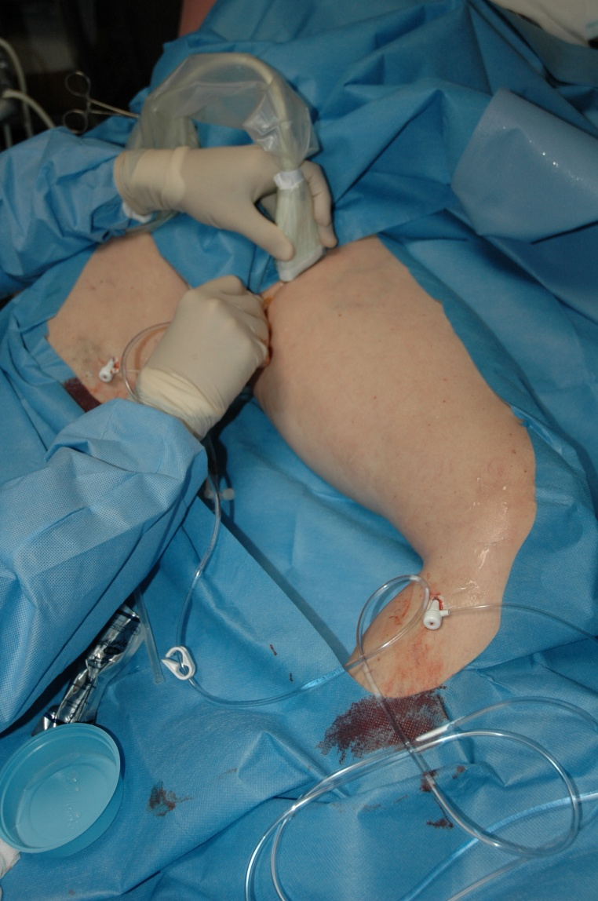
EVLA – both legs

Slide 35
EVLA – Management of the Varicose Tributaries
UGS – usually 1 to 4 weeks following evla
Phlebectomies – usually at time of evla

Slide 36
Ultrasound Success Rates for Surgery
85%
58%
8

Slide 37
Primary Ultrasound Success Rates

Slide 38
Ultrasound Success Rates for EVLT
N

Slide 40
Rasmussen et al, Br J Surg 2011
Randomized clinical trial comparing endovenous laser ablation, radiofrequency ablation, foam sclerotherapy and surgical stripping for great saphenous varicose veins.
Recurrence | EVLT | RFA | FoamUGS | Surgery
Clinical | 11.6% | 7.3% | 13.8% | 14.8%
GSV channel | 5.8% | 4.8% | 16.3%. | 4.8%
1 year follow-up 580 legs
Conclusion. All treatments were efficacious.
Technical failure was highest with Foam UGS.
RFA, Foam UGS associated with faster recovery and less post procedure pain that evla and surgery

Slide 41
Vascular (Cutaneous) Laser
Limited applications in phlebology
  Progressive ascending telangiectasia
  Vascular malformations
  Post-sclerotherapy pigmentation
Wavelengths 532nM – 585nM (green-yellow)

Slide 42
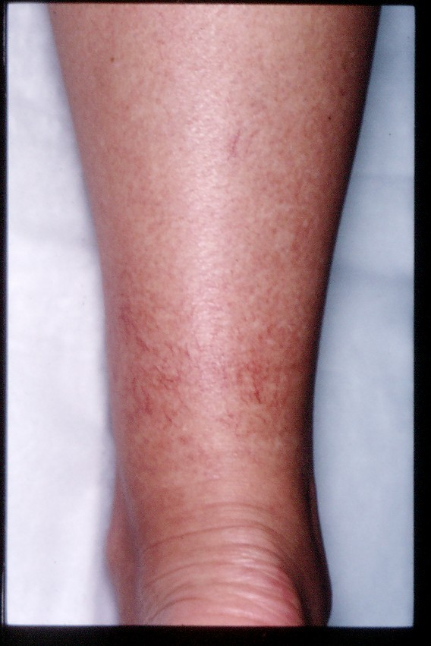
Vascular (Cutaneous) Laser

Slide 43
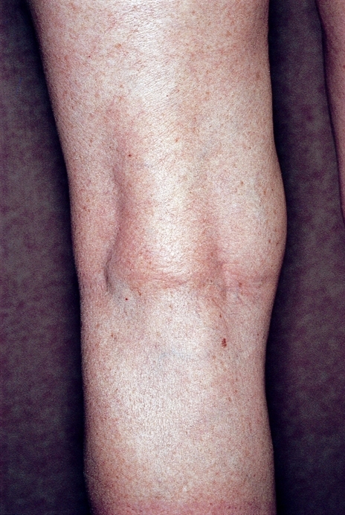

C₁
Telangiectasias and reticular veins
Standard sclerotherapy
Microsclerotherapy

Slide 44
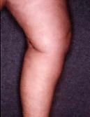
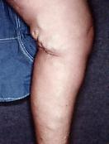
C₂
Varicose veins
UGS
Standard sclerotherapy

Slide 45
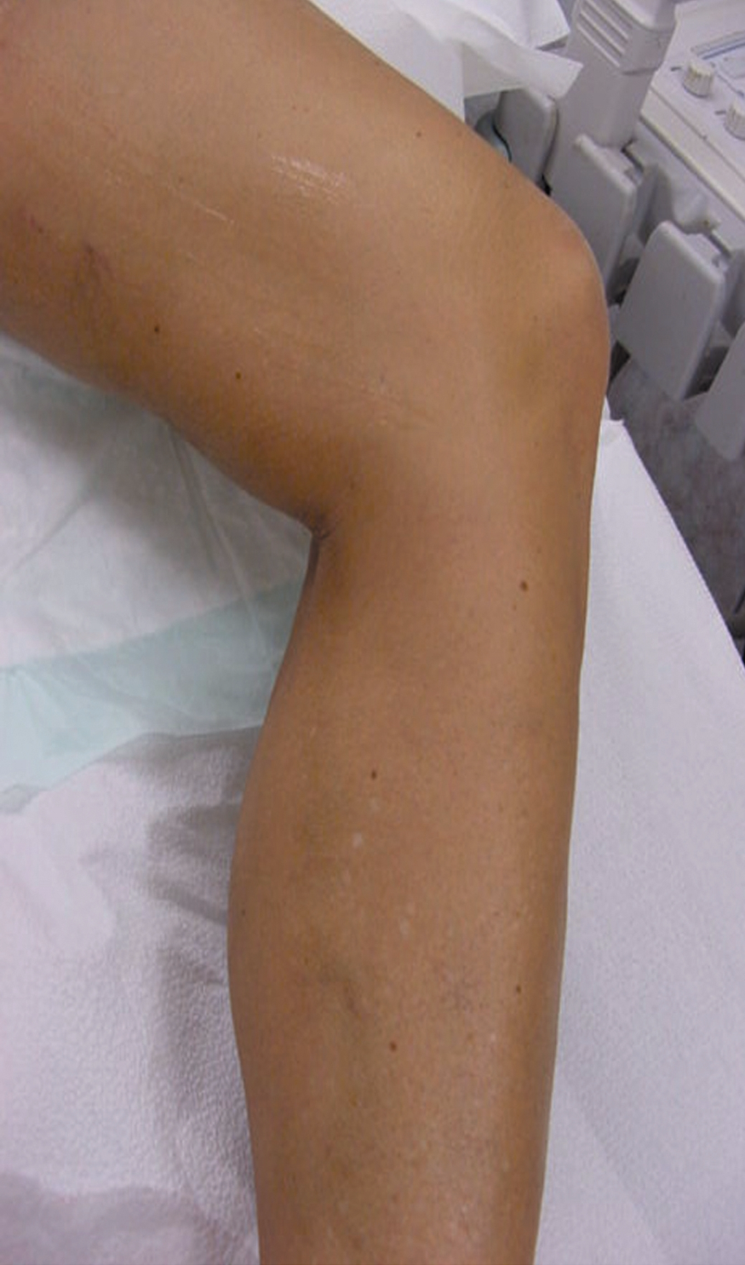
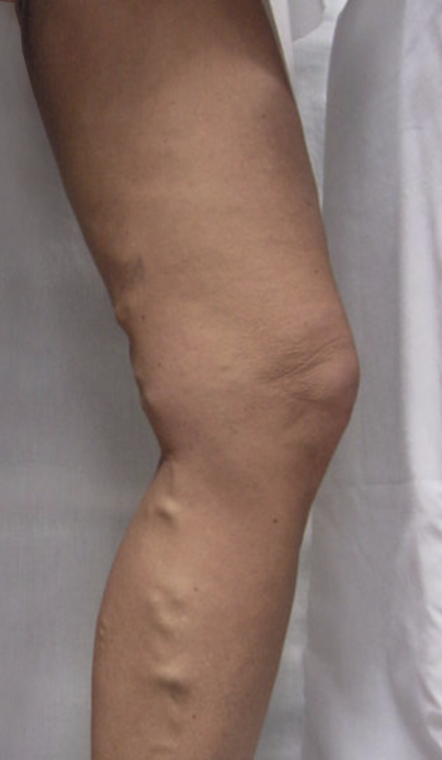
C₂
Varicose veins
Endovenous laser
UGS or phlebectomy

Slide 46
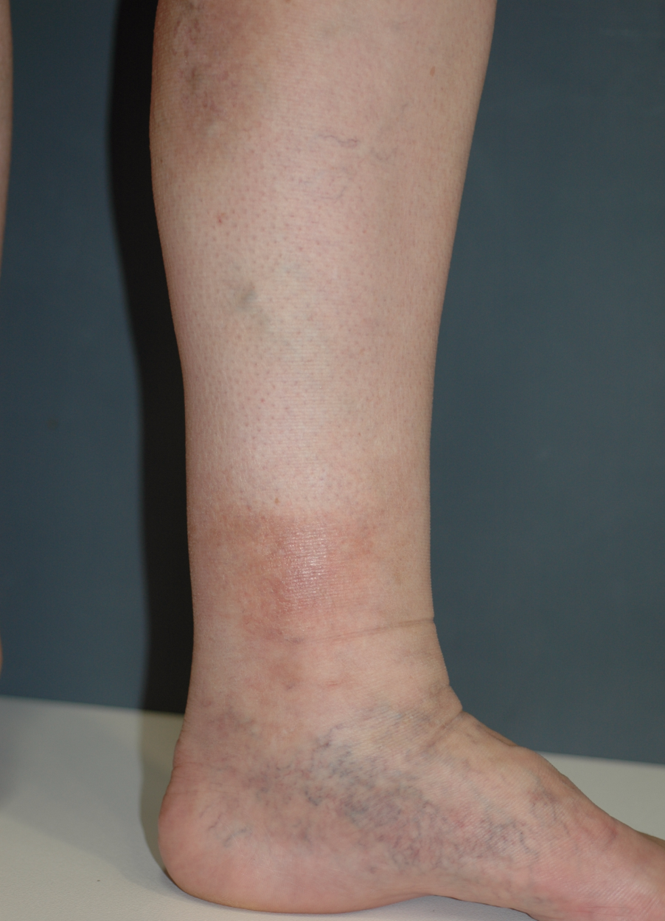
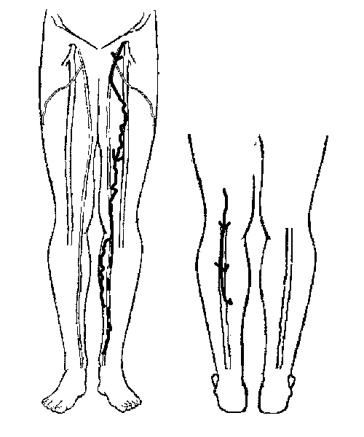
C₄
Lipodermatosclerosis, eczema, vvs, corona phlebectasia

Slide 47

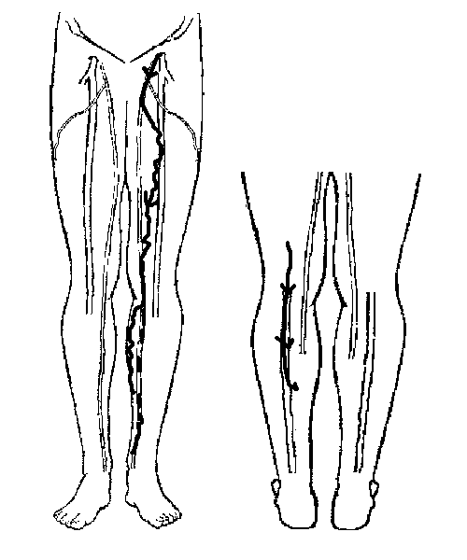
C₄
Lipodermatosclerosis, eczema, vvs, corona phlebectasia
Endovenous laser
UGS
Post-treatment compression

Slide 48
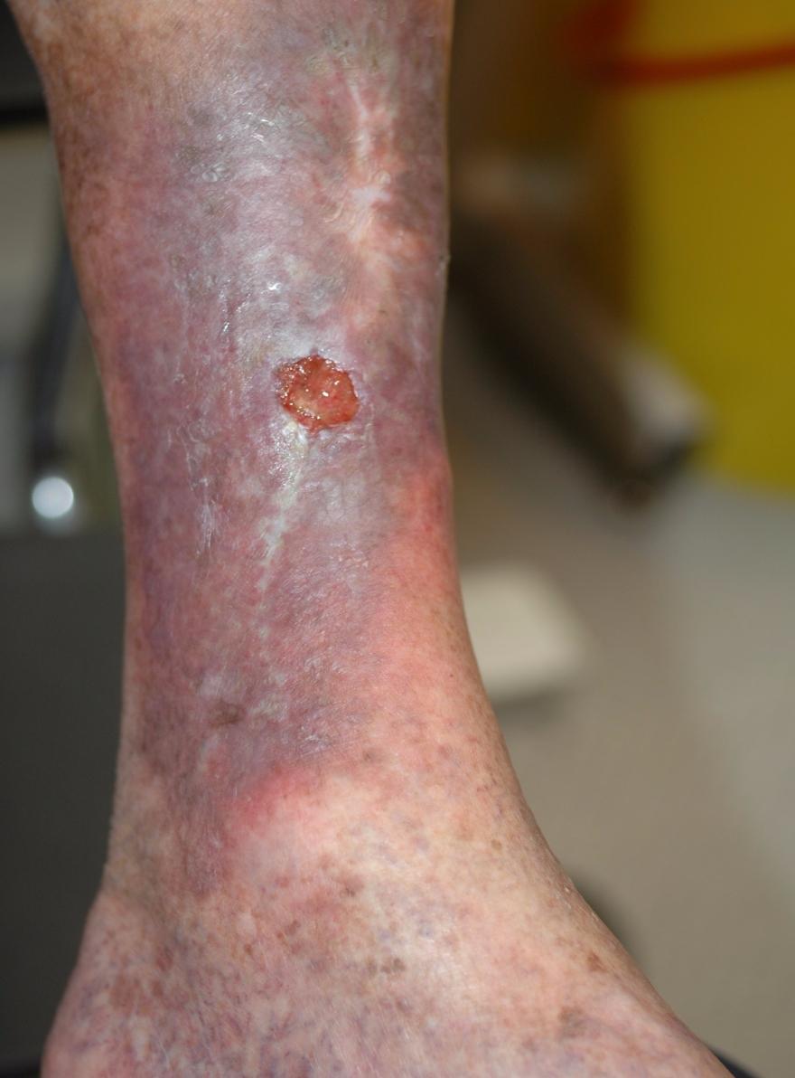
C₆
Active ulceration
Assess venous incompetence with Duplex scan
Gentle wound debridement - Silvazine
Commence compression Rx
Organise definitive Rx of venous incompetence

Slide 49
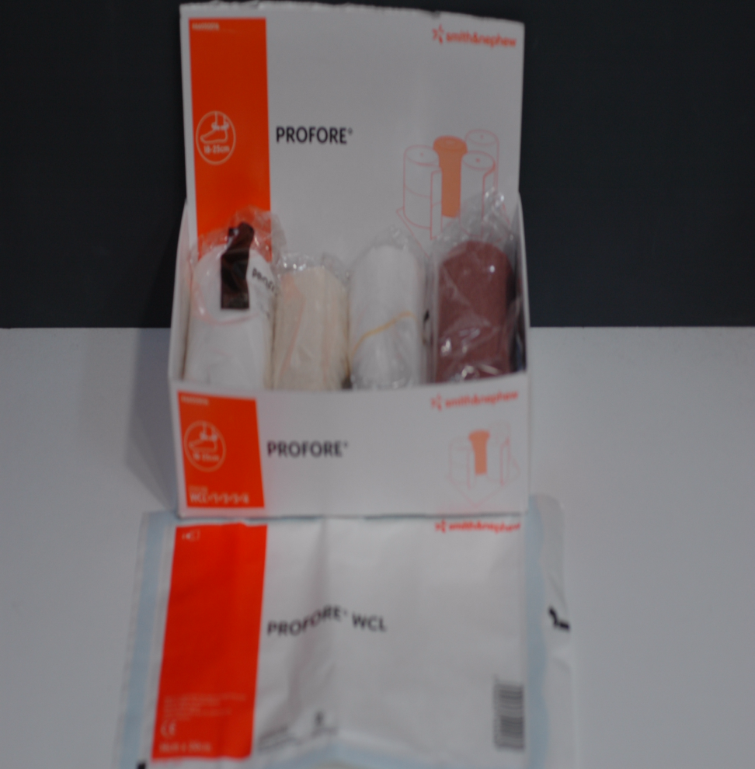
C₆
Active ulceration
Compression –multi-layer technique
Sterile wound contact layer
Natural padding bandage
Light conformable bandage
Light compression bandage
Flexible cohesive bandage
May be worn for up to 7 days at a time.

Slide 50
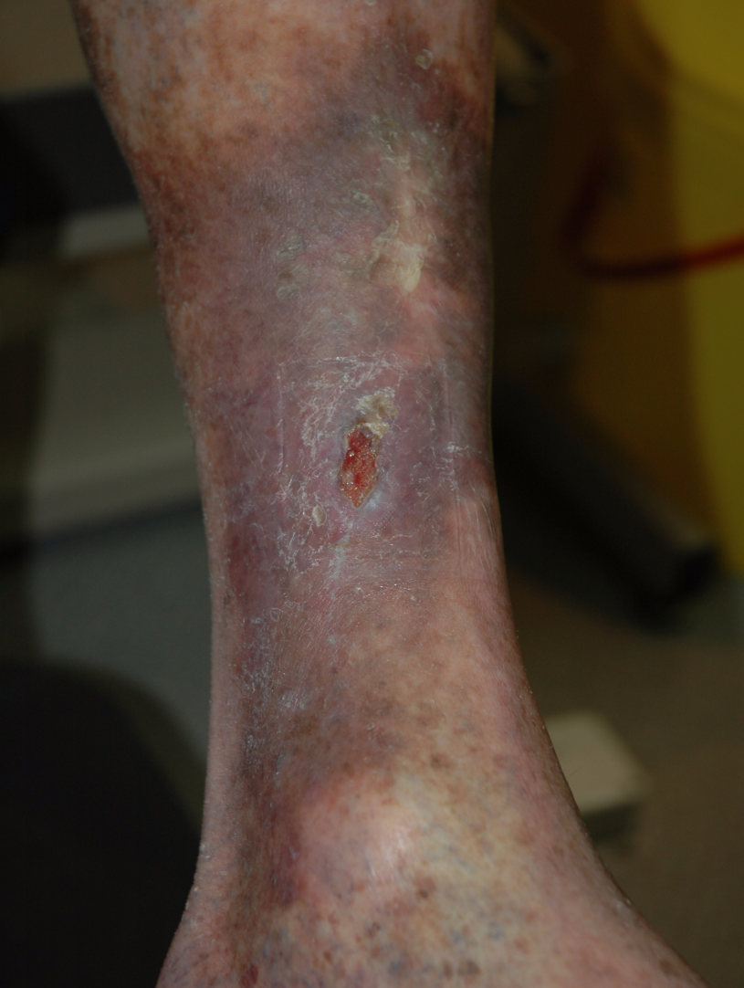
C₆
Active ulceration
Treat underlying incompetence
UGS to incompetent perforators

Slide 51
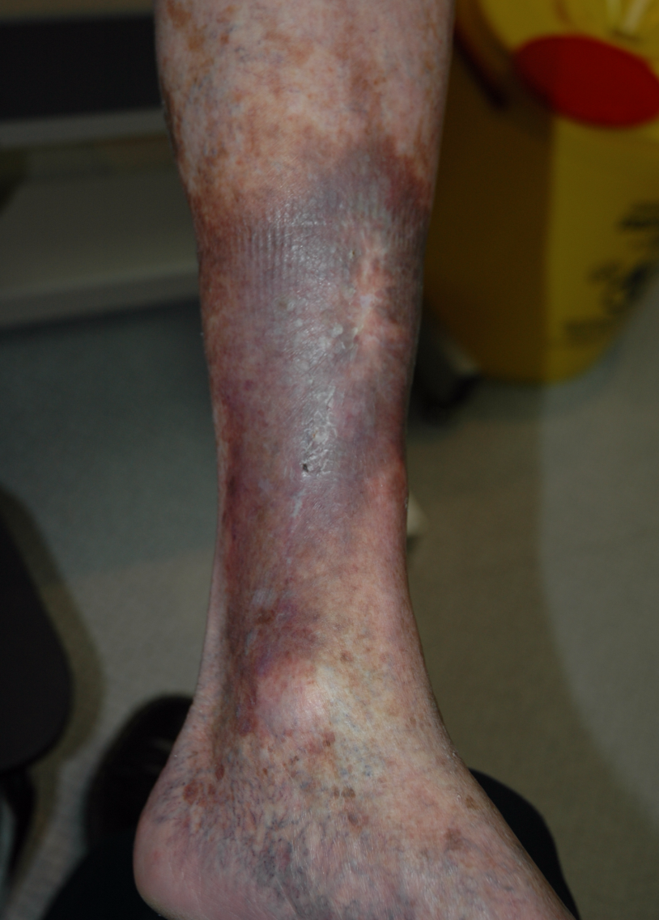
C₆
Active ulceration
Consider long-term compression with Class 2 stockings if venous incompetence not corrected or if chronic lymphatic damage.

Slide 52
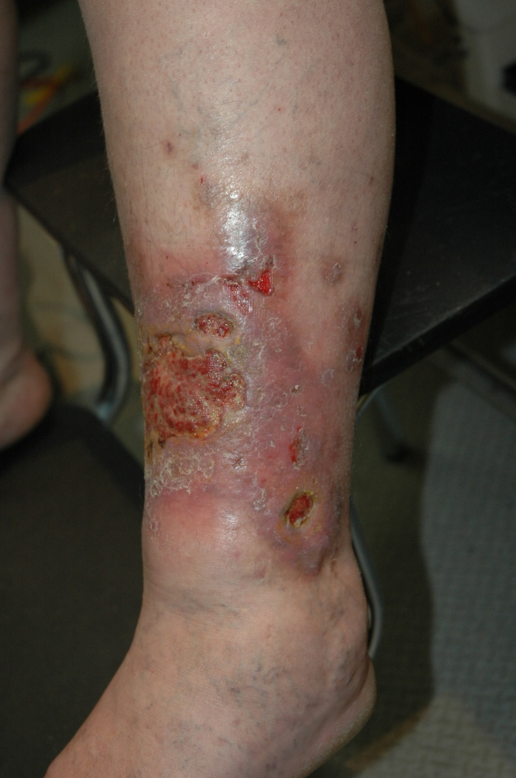
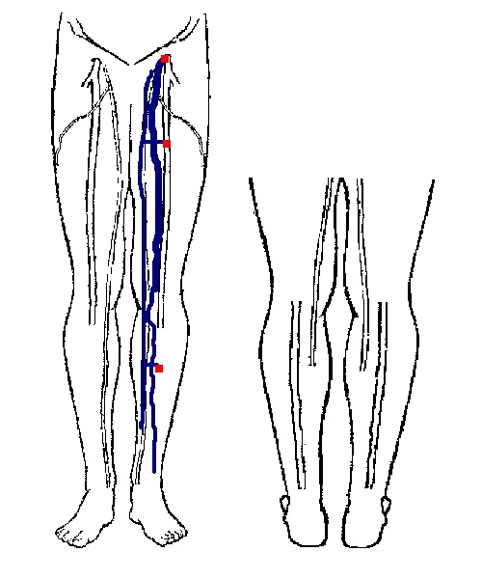
Active Management of Venous Ulcers

Slide 53
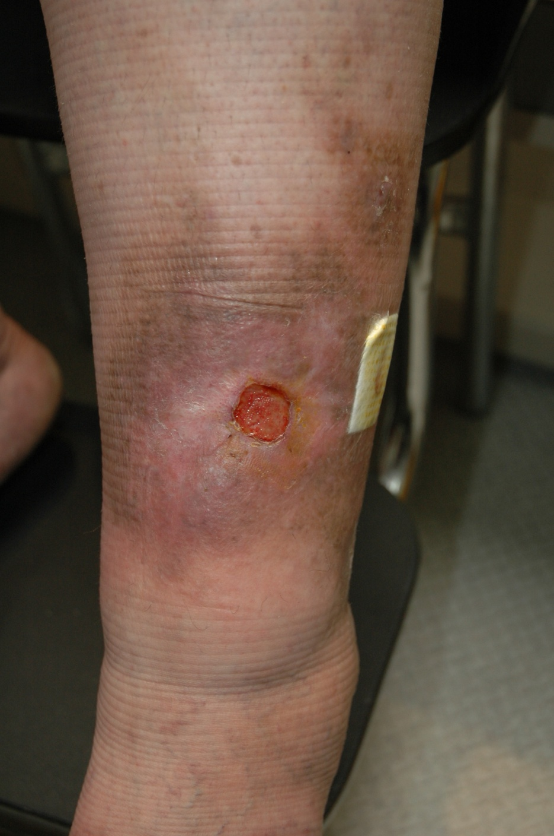
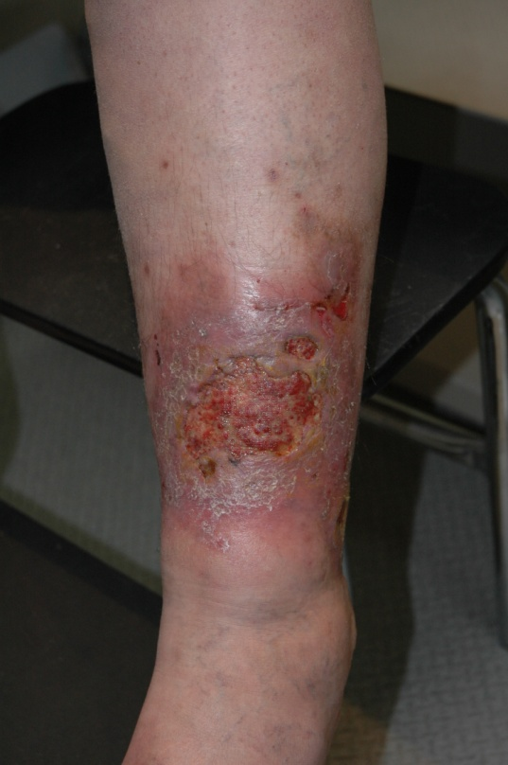
Active Management of Venous Ulcers
After 2 treatments with foam UGS to GSV and ALTV
4 months after initial treatment

Slide 54
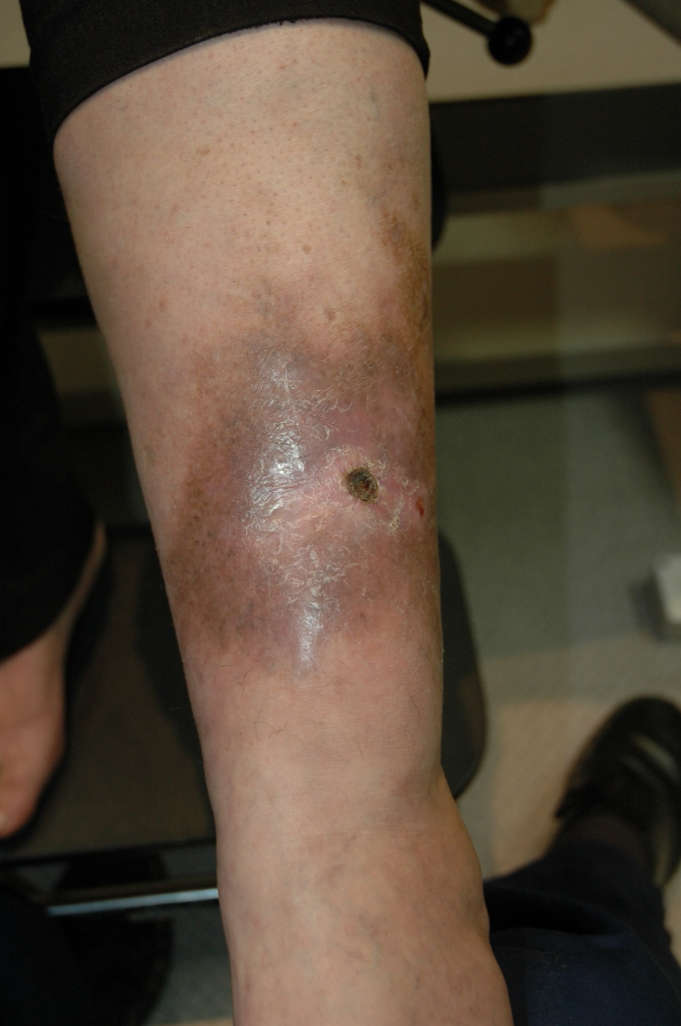

Active Management of Venous Ulcers
2 further minor treatments to residual channel in GSV and lower leg tributaries
5 months after initial treatment

Slide 55
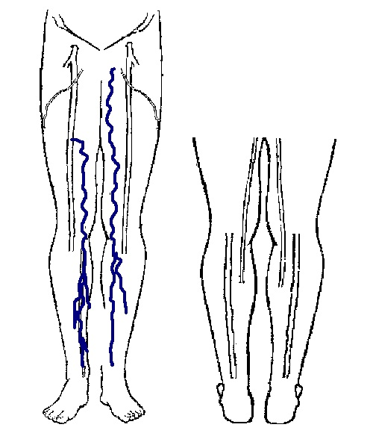
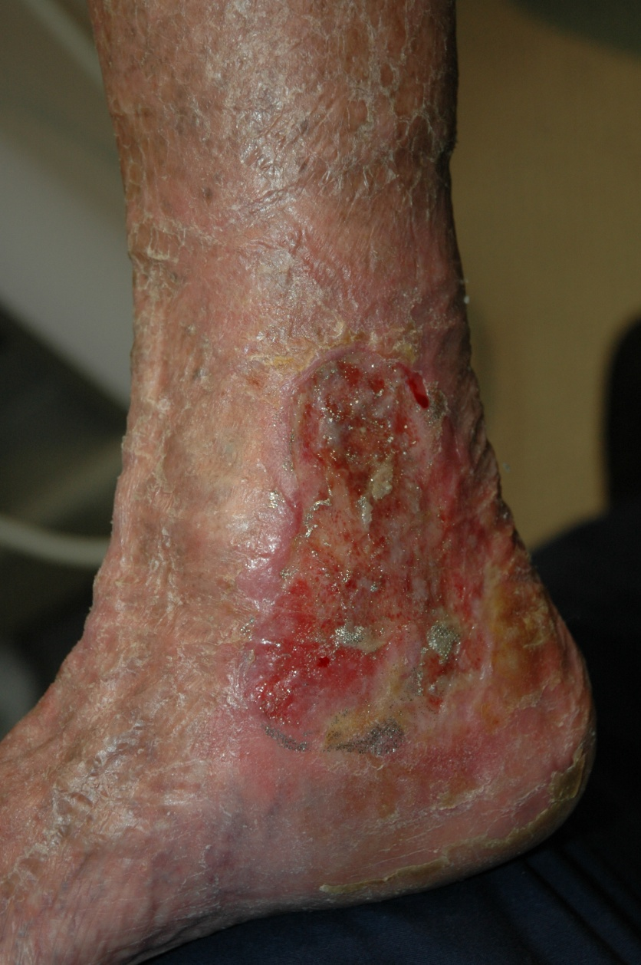
Active Management of Venous Ulcers

Slide 56
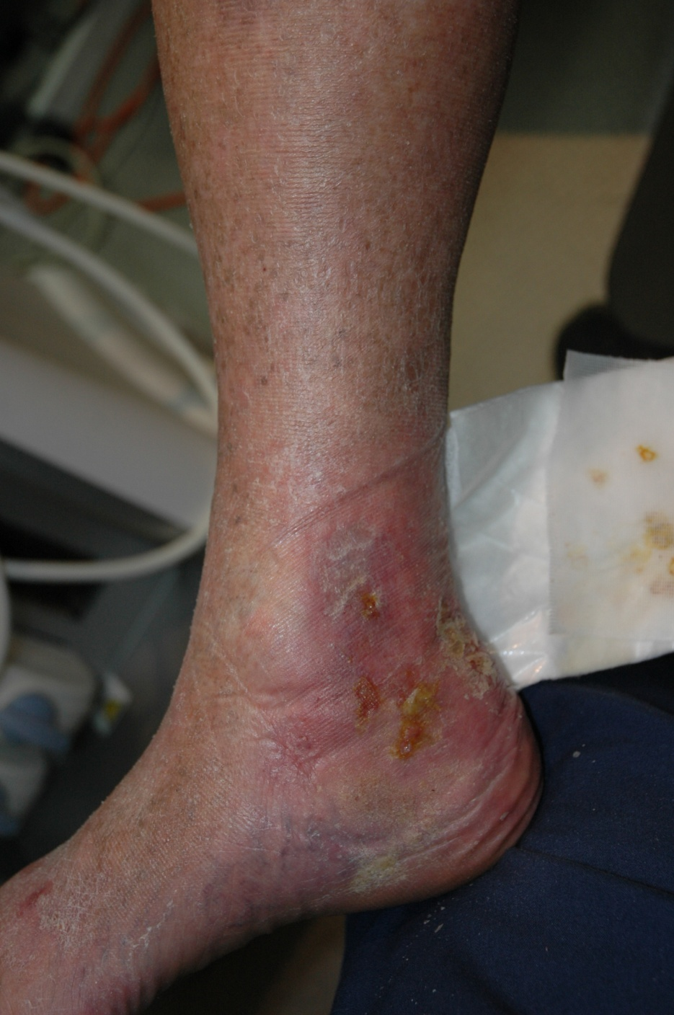

Active Management of Venous Ulcers
3 treatments with foam UGS
2 months after initial treatment

Slide 57
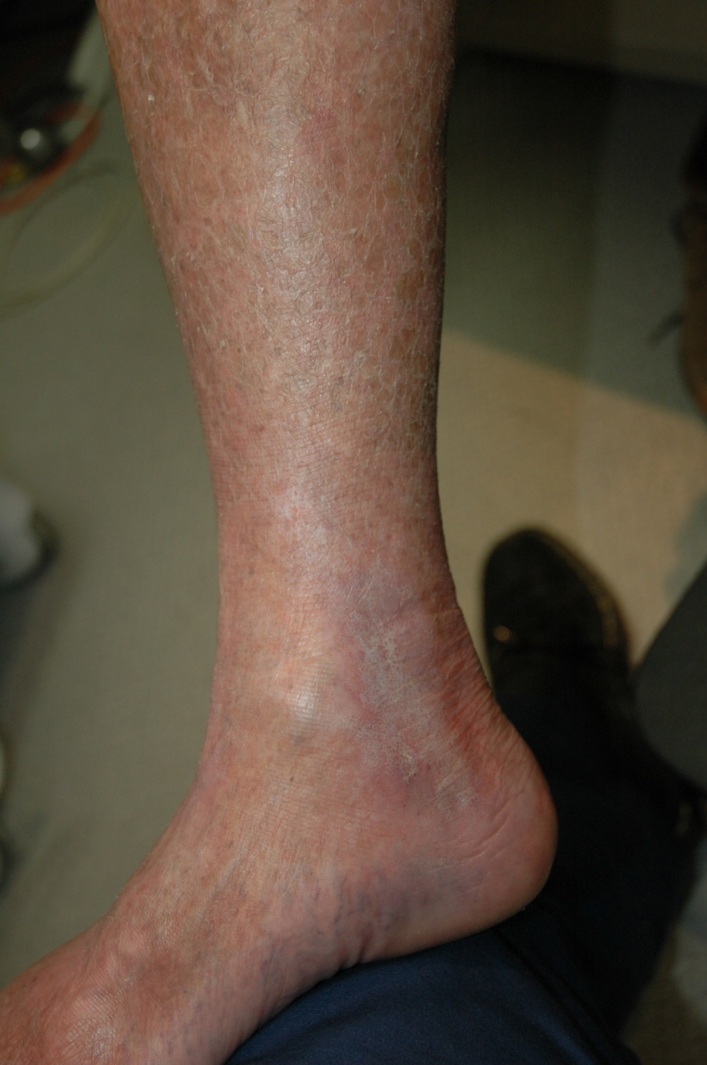
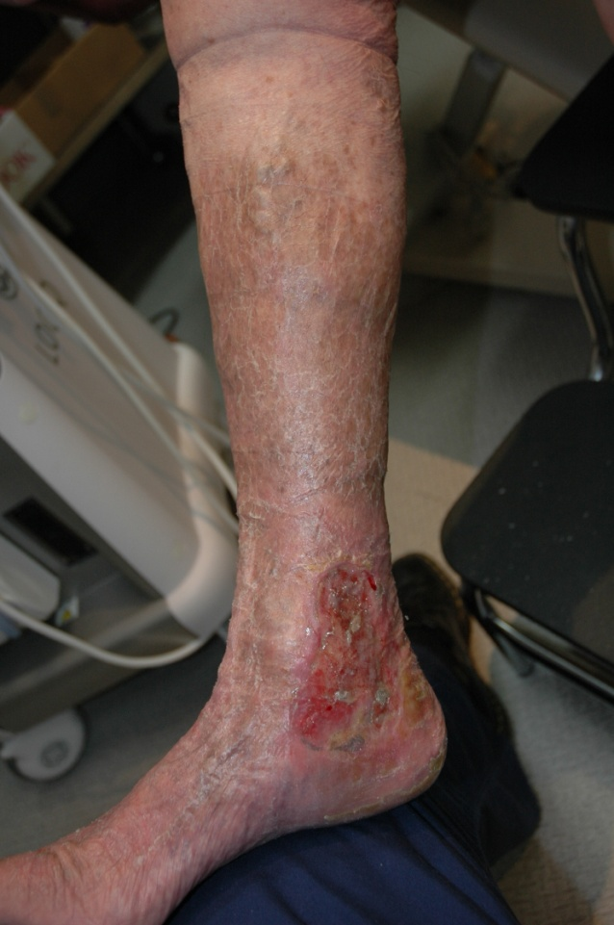
Active Management of Venous Ulcers
12 months after initial treatment

Slide 58
Summary of Management of Venous Diseases
Assess the clinical problem
Investigate the condition appropriately (Duplex Ultrasound)
Pathology - Reflux or Obstruction
Modalities of therapy
  Compression
  Ablation to superficial incompetent (refluxing) veins
  Lifestyle modifications – weight, activity, medications
Appropriate follow-up

