Slide 1
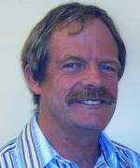
Dr Chris Milne
Sports Physician
Hamilton

Slide 2
The Politically Incorrect guide to Exercise in Middle Age
Dr Chris Milne
Sports Physician
Hamilton

Slide 3
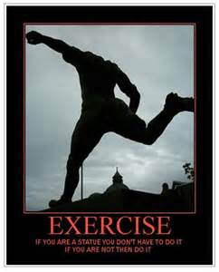
Activity for life, my personal creed

Slide 4
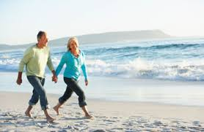
Why spoil a good walk with a golf ball?

Slide 5
My background
Doctor
General and specialist training and experience- 2 yrs as medical registrar, 15 yrs in general practice, 10 yrs in specialist practice
Middle aged- in my fifties
Not particularly politically correct
Athlete in my youth, still trying to be an athlete now

Slide 6
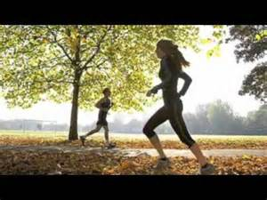
Possibly Twin Oaks Drive, Cornwall Park Auckland, late 1970s

Slide 7
Youth vs Middle Age- attitudes to exercise
Youth
Maximising performance
Goal oriented=winning
Social- Hang out with mates
Middle Age
Preservation of remaining function
Self discovery [can I do a marathon?]
Social- Still hanging out with mates
Early maturity
Late maturity

Slide 8
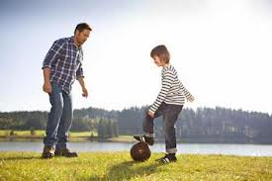
Is this the next Marco Rojas?

Slide 9
Political Correctness
Correct
Dr Finlay or Dr Kildare
Helen Clark
Incorrect
Dr Gregory House
Tim Shadbolt
Policy advisor to Helen Clark
Drinking buddy of Danny Crane

Slide 10
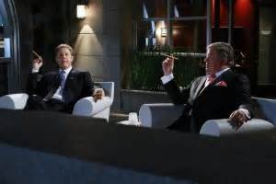
All the philosophy you will ever need

Slide 11
My influences/ inspirations for exercise in middle age
Jerry Morris + Ralph Paffenbarger –the fathers of exercise medicine
Tim Noakes – Doctor and physiologist, possibly the greatest living South African after Nelson Mandela
John Davies – Olympic bronze medallist in the 1500m at Tokyo Olympics in 1964, later renowned athletics coach and President of NZOC- the embodiment of Olympism

Slide 12
Physiological ageing 101
Physiological peak between ages 25 and 30
After that, decline in organ function by about 10% per decade
However, regular exercise can slow this decline, possibly by about half

Slide 13
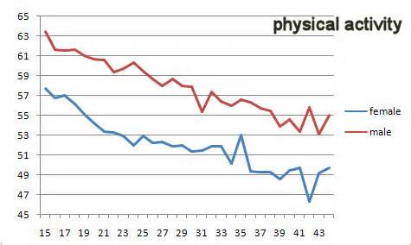
Decline in VO2 max with age

Slide 14
Physiology 101, the specifics of exercise
CV/respiratory systems- still trainable
Muscular strength- reduced muscle mass, less type 2 fibres. Result- limb girdle weakness, but muscles still trainable
Decreased proprioception [ joint position sense] and righting reflexes- more prone to ankle sprains and falls
Tendon tissue is less resilient- result is tendinopathy – the middle aged equivalent of teenage acne

Slide 15
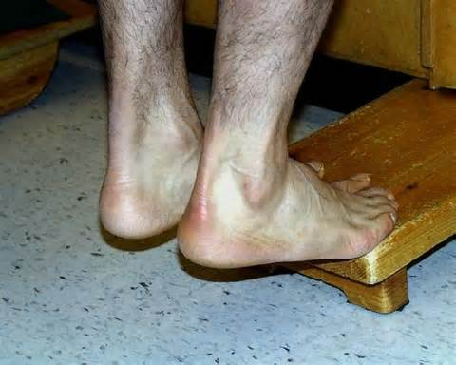
Tendinopathy- it takes very little time to get worse, but ages to get better

Slide 16
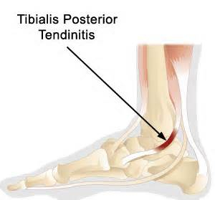
Tibialis posterior- the ‘shin splint’ tendon

Slide 17
Physiology 101 continued
Increased body fat, with distribution around the waist in men, and the hips in women
Deceased bone mass, with increased risk of fractures
The good news is that brain function tends to remain well preserved though middle age, unless you have been a heavy smoker, when micro-infarcts can be an issue [remember the 5 year plans of the former USSR, hatched in smoke filled rooms- hardly quality thinking]- and let’s not mention the vodka!

Slide 18
Paradigm shift in 1990s
Pre 1990s – thought that it was necessary to train hard enough to increase physical fitness to make health gains. This involved sweat, so not an easy sell, particularly to Americans [think Segway]
Mid 1990s – US Surgeon General’s report. No longer need to train as hard to get health benefits.
Result- ADL for health, eg climb stairs, walk/cycle to work, do gardening, have sex. All good healthy activities, and contribute to better health status.

Slide 19
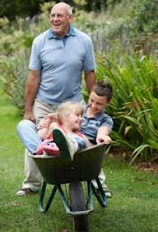
The new fitness training for dads

Slide 20
How does exercise work to improve health?
Burns calories during/after activity [EPOC]
Decreases body weight
Decreases body fat
Increases lean muscle
Increases insulin sensitivity
Increases micro-circulation [higher capillary density]
Increases fibrinolysis- less risk of clotting
Decreases blood pressure
Decreases heart rate at a given workload
Improves mood

Slide 21
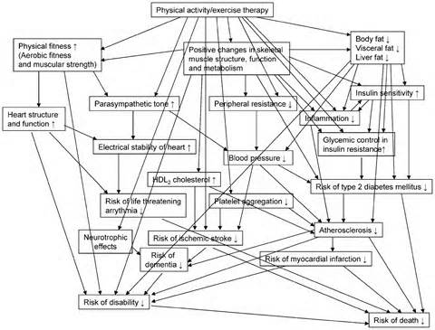
How exercise works- what you don’t need to know today

Slide 22
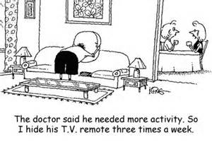
How exercise works, what you do need to know today

Slide 23
Health hazards of activity
Youth
Acute- collision related
Pristine anatomy + physiology- body is a temple
Sudden death is rare
Middle age
Chronic- overuse
Ageing body- still a temple, but with battle scars
Sudden death more common
Youth = bullet proof
Middle age = not so much

Slide 24
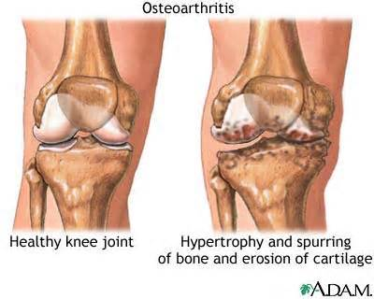
The weekend warriors’ curse

Slide 25
Attitudes of middle agers to exercise
Prevention and management of non communicable disease
Extend life span
Improve mood
Limit weight gain- enjoy more food and wine
Improve your sex life
Push the limits- sometimes too far!
Politically correct
Politically incorrect

Slide 26
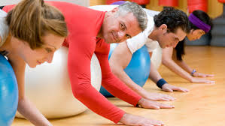
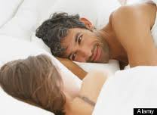
Reasons for middle agers to keep exercising
Is this a hook-up?
Looks like they have just exercised

Slide 27
Advice you may not have heard elsewhere
1-Look after your tendons- do heel drops when you have some spare time
2-If running hard, try it on an empty stomach
3-Salt is not necessarily a bad thing for the middle aged exerciser
4-Taking NSAID prior to provocative activity is not a bad thing in most circumstances
5-Lying prone and propping yourself up on your elbows can help low back pain [with thanks to the late, great Robin McKenzie]

Slide 28
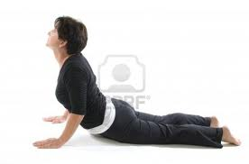
Passive lumbar extension- try it some time

Slide 29
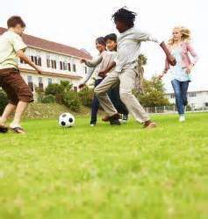
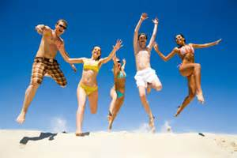
Remember your youth- life should be fun!

Slide 30
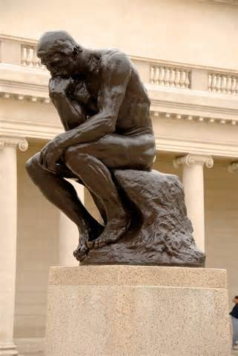
We are all athletes, just in middle age we tend to be more cerebral athletes

Slide 31
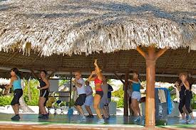
Thank you

