Slide 1
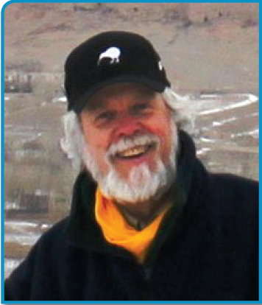
Prof Marc Shaw
Medical Director
Worldwise Travellers Health Centres

Slide 2

Too Much of a Good Thing - Tourism and Masses Who Travel
Marc Shaw DrPH, FRNZCGP, FACTM, FFTM (ACTM), FFTM RCPS (Glas),
Professor, James Cook University, Townsville, Australia
Medical Director - WORLDWISE Travellers Health and Vaccination Centres NZ
WORLDWISE OnLINE ( www.worldwise.co.nz )
‘Travel Health Information for Professionals’

Slide 3
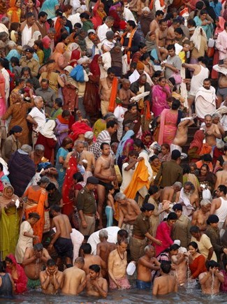
This Presentation…
Focuses on ‘types of masses of travellers’ and ‘what do they do’ that impacts on travelling
Probes the question - ‘how much do we know about, what the travellers we advise for their health needs, will do on their travels’?
Develops ‘Impact Consultation Points’ for Travel Health Professionals
Acknowledges that travelling masses can seriously impact upon a destination, and therefore what can we (as health professionals) do to minimise this

Slide 4

Who are ‘the Masses of Travellers’?
‘All the world’s a stage’
MOBIL POPULATIONS (after Leggat P)
  Immigrants and Refugees
  Migrant and guest workers
  Missionaries
  Humanitarian Aid Workers
  Military personnel, Diplomatic corps
  Scientists
  Students
  Business personnel and expatriates
  Aircrew, sailors, astronauts
  Tourists
    Cruise ships
    Eco-tourists
    Adventure tourism
    VFR ( Visiting Friends and Relatives )
    Sex tourists
    … et cetera

Slide 5

Mass Gatherings
The WHO defines a mass gathering MG as “an event [where] the number of people attending is sufficient to strain the planning and response resources of the community, state, or nation hosting the event.”
Mass gatherings can be spontaneous events, e.g. funeral for a head of state or a rally or march, but most are planned events
Every year, millions of people travel internationally to engage in MG:
  sports events, religious occasions, festivals, concerts, political rallies.
Mass gatherings may occur regularly at different locations ( e.g. Olympic Games), and others recur in the same location (e.g. the Hajj or Kumbh Mela)

Slide 6
This Presentation
The reason for the mass gathering will often set a predictable tone for the event
  The purpose often influences the characteristics of the participants (age, origin, culture, homogeneity)
  Rock concerts are expected to be loud and boisterous
  Religious events have other predictable characteristics
    Religious and family oriented events have participants at the extremes of age, with ? incr. suscept. to certain diseases
LOCATION:
  Will determine the climate and weather
    E.g. Altitude can predispose problems such as AMS, dehydration
  Gives some indication of social and political stability in that area
  Diseases endemic to that area

Slide 7
Physical / Social Features
MGs pose special risks for travellers,
  large no.s people in small areas
  thus - spread of infectious diseases or increase the risk of injury
Venue can be: fixed (stadium, open space)
mobile (procession, pilgrimage)
Crowd characteristics, e.g age, mood, availability of drugs/alc
The health infrastructure at the event + area determines ability to respond to anticipated and unanticipated incidents
Facilities for food, water, and sanitation
  affect the health of attendees
  maybe temporary, recently erected
  may not meet the needs of the population

Slide 8
Physical / Social Features
The density of the crowd influences the potential risks e.g.
  problems with crowd control, which can overwhelm
  disease transmission
  Injury
Events with large nos. of internat. participants tend to have increased risk of infectious disease outbreaks.
  Endemic diseases in host and visitors’ home countries
  Different levels of vaccinations in those locations
The longer an event lasts, the more likely that stresses to facilities, organizers, and participants will be observed.

Slide 9
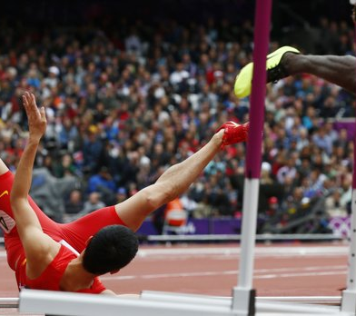
Health Diseases
Commonest health problems reported at mass gatherings:
  injuries
  respiratory and cardiac issues
  heat-related illness
  alcohol or drug effects
  gastrointestinal illnesses
2012 Olympic Games, European Champions League 2012 Medical Rx needed by 0.1% visitors
  Non-communic. health problems - 70 to 99% consultations… accidents > illnesses
Communicable diseases are a concern for organizers but historically Non-signif
  e.g. infectious diseases contributed to <1% of health care visits during the 1996 Atlanta Olympic Games and the 2000 Sydney Games

Slide 10
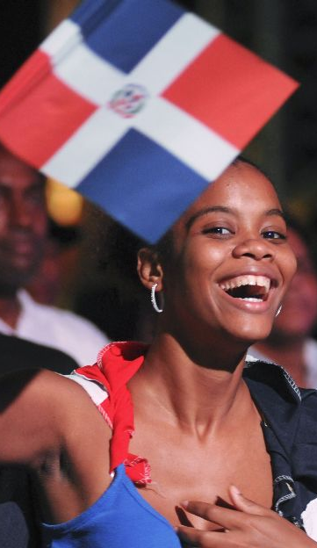
Year 2013 … Now
Today’s travel health issues: complex:
  1. The Traveller
    Appropriateness of advice for type of travel:
    Affect of traveller on host nations + vice versa
    Effect of Migrants on new regions
  2. Environmental Travel
    Eco-economy
    Expeditions and adventure
    Religious travellers and its impact
  3. Safety and Security: Terrorism!
    Personal Security
    Social security
    Biosecurity

Slide 11

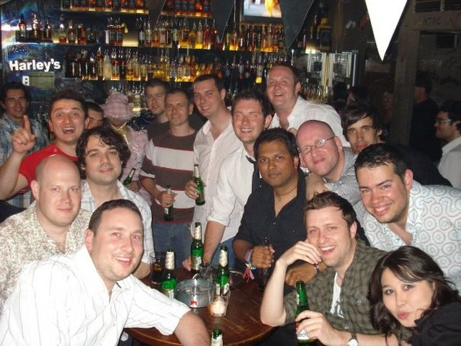
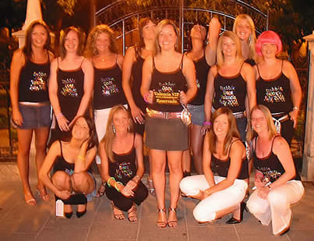
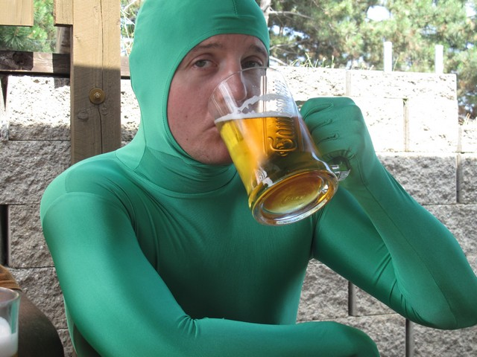
Sometimes it is hard to plan!
UK Travellers ‘en masse’
No homework done by health resources!!
The "massive influx" of UK stag and hen parties to Prague has made the Czech Republic a hotspot for British travellers in trouble, figures suggest
A Foreign and Commonwealth Office (FCO) report says Britons visiting the Czech Republic need a "disproportionate" amount of consular assistance
More Britons lose their passports, get arrested or taken to hospital in the country than some more popular places
UK travellers to India, Thailand and Australia also need a large amount of assistance
Foreign Office research last year suggested 24% of people on stag and hen parties faced problems abroad.
No questions what this lot will get up to!!!
Words like ‘sex’, ‘drugs’ and ‘rock n roll’ bring up all thought of matters medical!!

Slide 12
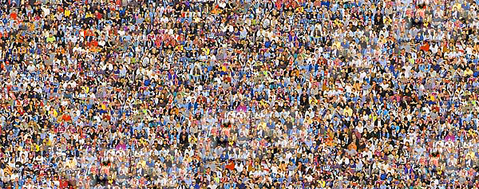
Numbers at Mass Gatherings
Mass gatherings (MG) are events attended by at least 1,000, usually over 25,000 people in a specific location
Among the largest:
  the Kumbh Mela 2013 in Allahabad for 55 days with 120 million devotees – every 12 years, in between years only 10 million

Slide 13
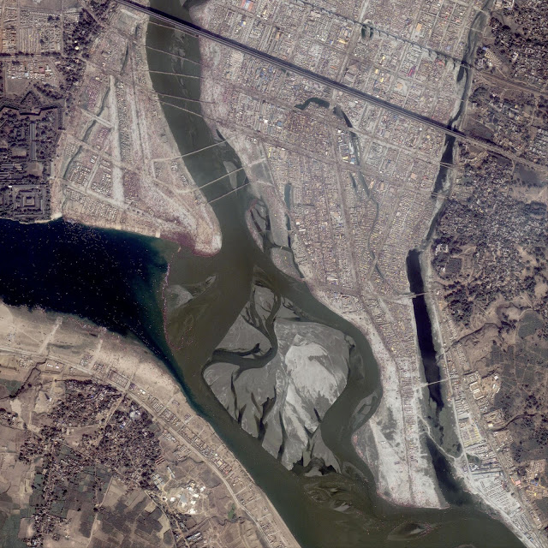
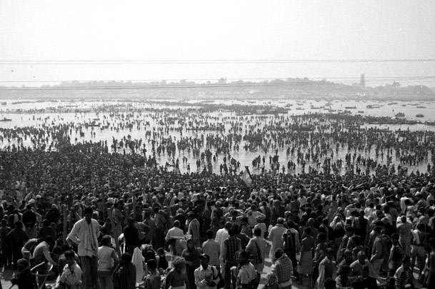
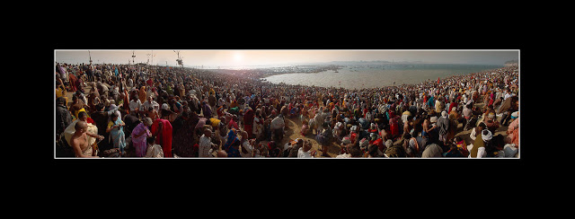
Kumbh Mela

Slide 14
Numbers at Mass Gatherings
Mass gatherings (MG) are events attended by at least 1,000, usually over 25,000 people in a specific location
Among the largest:
  the Kumbh Mela 2013 in Allahabad for 55 days with 120 million devotees – every 12 years, in between years only 10 million
  the New Year’s Eve Copacabana, 2008 Brazil, 4 million revellers

Slide 15
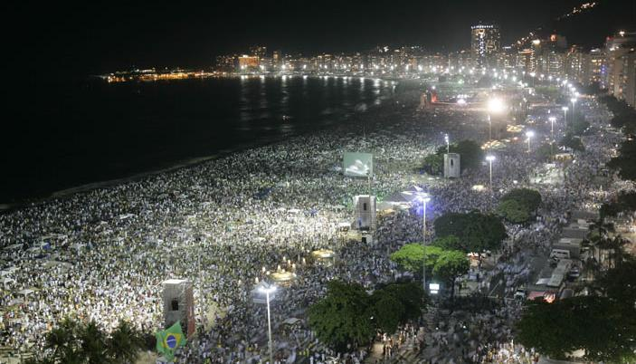
Copacabana 2008

Slide 16
Numbers at Mass Gatherings
Mass gatherings (MG) are events attended by at least 1,000, usually over 25,000 people in a specific location
Among the largest:
  the Kumbh Mela 2013 in Allahabad for 55 days with 120 million devotees – every 12 years, in between years only 10 million
  the New Year’s Eve Copacabana, 2008 Brazil, 4 million revellers
  Association Football (soccer) 8-12 million per season, [game ave 20-40,000]

Slide 17
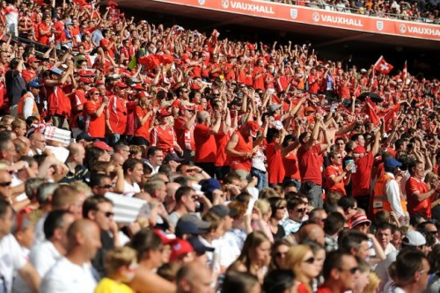
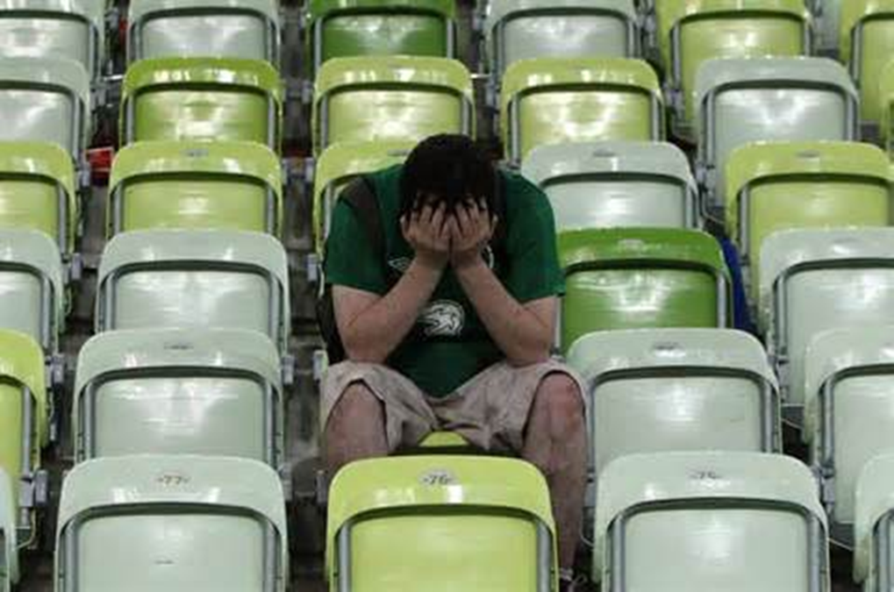
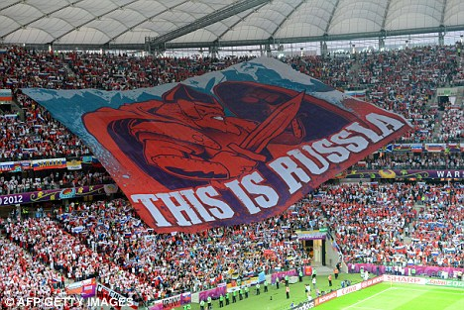
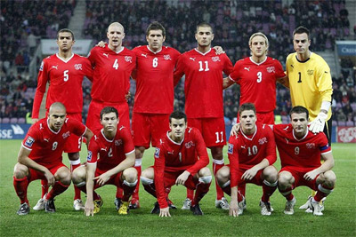
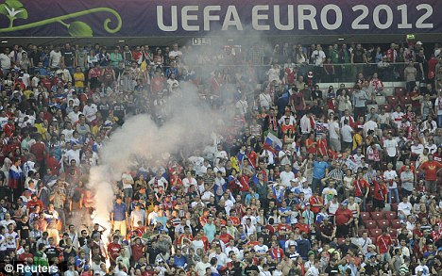
Uefa Cup 2012

Slide 18
Numbers at Mass Gatherings
Mass gatherings (MG) are events attended by at least 1,000, usually over 25,000 people in a specific location
Among the largest:
  the Kumbh Mela 2013 in Allahabad for 55 days with 120 million devotees – every 12 years, in between years only 10 million
  the New Year’s Eve Copacabana, 2008 Brazil, 4 million revellers
  Association Football (soccer) 8-12 million per season, [game ave 20-40,000]
  up to 3 million pilgrims join the annual Hajj to Mecca

Slide 19
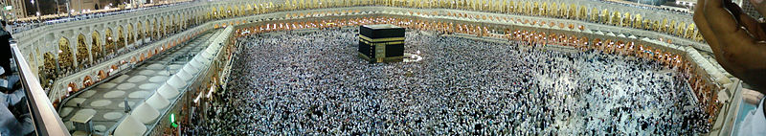
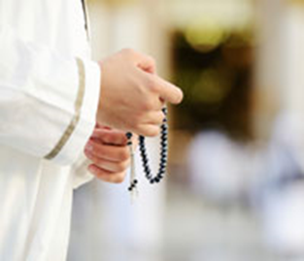
The Hajj
Pilgrimage to Mecca
To be performed once in a life-time by each Muslim
2006 NZ census 36,072 people identified themselves as Muslim

Slide 20
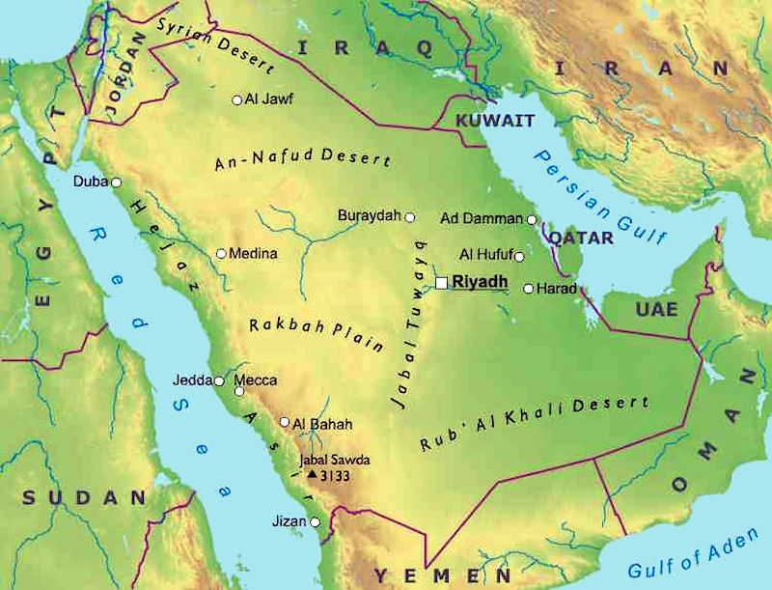
Facts about the Hajj
Considered as one of the five pillars of Islam → each Muslim is duty to bound to perform one hajj in his/her lifetime
10-15th day of the 12th month of the Islamic calendar (lunar)
  2008: 6-9th Dec
  2009: 25 – 28th Nov
  2010: 14 – 17th Nov
  2011: 4-7th Nov
  2012: 24-29th Oct
  2013: 13-18th Oct
Climate: 25°C (winter) to
>45°C (summer), humid
Average stay: 2 wks – 1 month

Slide 21
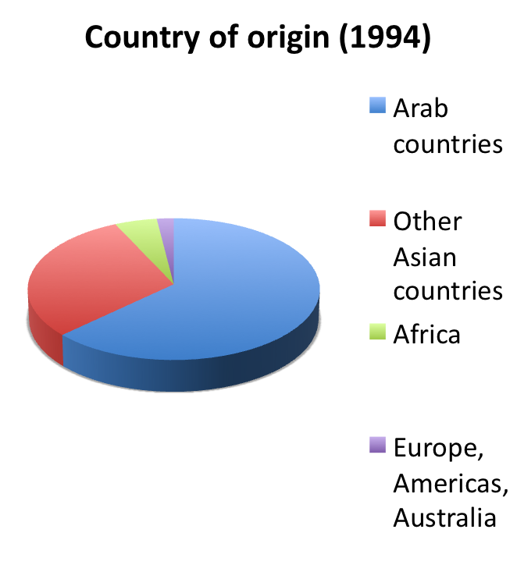
Profile of the Pilgrim

Slide 22
Numbers attending the Hajj
Year | Hijri Yr | Saudi | Foreign | Total Pilgrims
2003 | 1423 | 610,117 | 1,431,012 | 2,041,129
2004 | 1424 | 592,368 | 1,419,706 | 2,012,074
2005 | 1425 | 629,710 | 1,534,769 | 2,164,469
2006 | 1426 | 573,147 | 1,557,447 | 2,130,594
2007 | 1427 | 746,511 | 1,707,814 | 2,454,325
2008 | 1428 |  | 1,729,841
2009 | 1429 | 154,000 | 1,613,000 | 2,521,000
2010 | 1430 | 989,798 | 1,799,601 | 2.8 million
2011 | 1431 | 1,099,522 | 1,828,195 | 2,927,717
2012 | 1432 | 1,408,641 | 1,752,932 | 3,161,573

Slide 23
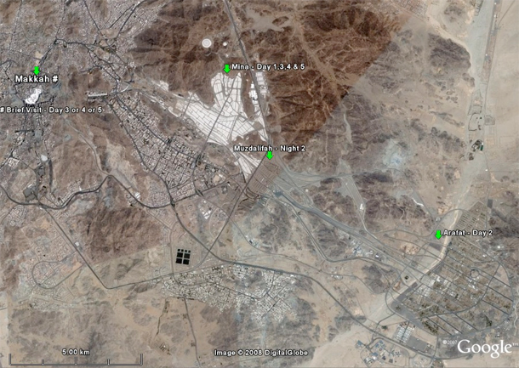
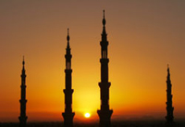
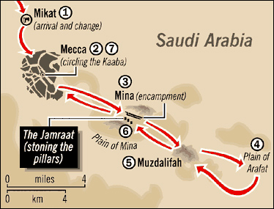
The Hajj Procedure
Day One
The Muslim begins her / his spiritual journey by reciting intention to perform Hajj
He/She then enters a spiritual state called Ihraam where they refrain from e.g. cutting nails and hair, marriage proposals, hunting or killing animals, sex, wearing perfume
The Muslim then makes their initial tawaf (circle) around the Kab' ah [Kaaba]
Afterwards, Muslims run between the hills of Safa and Marwa, symbolic of Hajar, wife of Ibrahim, searching for water for their son, Ismail
The pilgrims then travel to the nearby town of Mina.

Slide 24
The Hajj Procedure
Day One
The Muslim begins her / his spiritual journey by reciting intention to perform Hajj.
He/She then enters a spiritual state called Ihraam where the Muslim will refrain from things such as cutting their nails and hair, making marriage proposals, hunting or killing animals, sex, and wearing perfume.
The Muslim then makes their initial tawaf (circle) around the Kab' ah [Kaaba]
Afterwards, Muslims run between the hills of Safa and Marwa, symbolic of Hajar, wife of Ibrahim, searching for water for their son, Ismail.
It is here that water appeared from a well (the well of Zamzam) below Ismail's feet.
The pilgrims then travel to the nearby town of Mina.

Slide 25
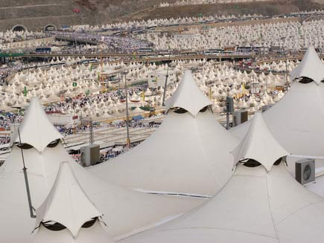
The Hajj Procedure

Slide 26
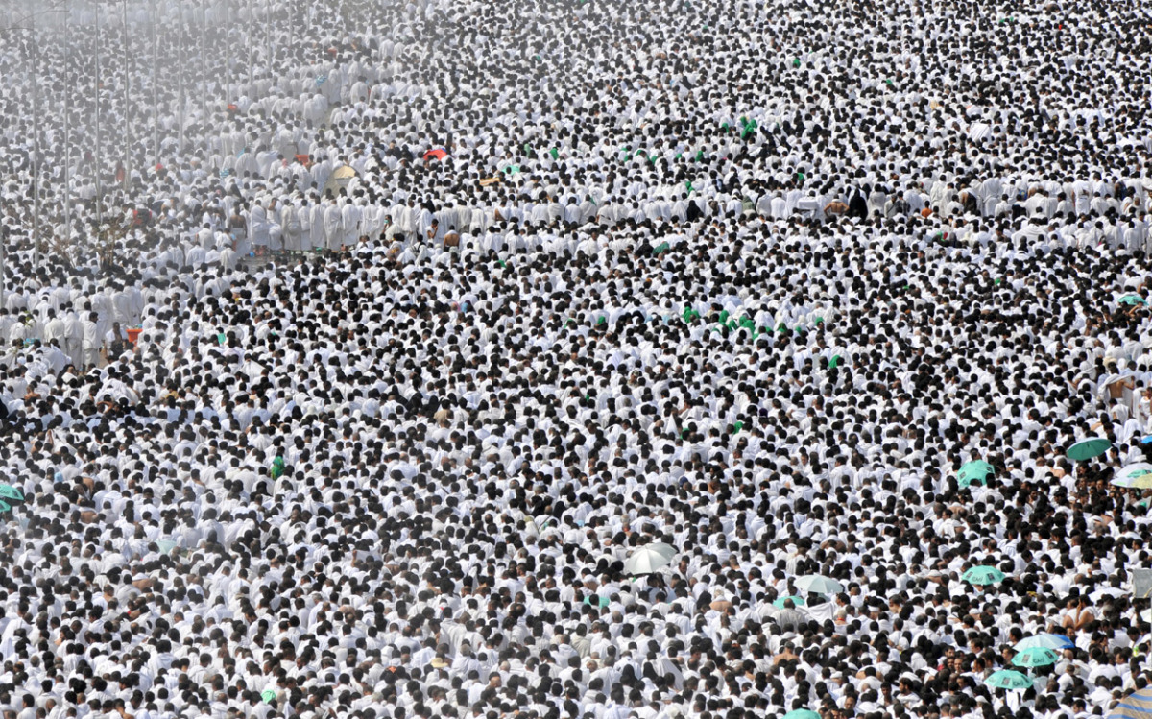
The Hajj Procedure
Day Two
Pilgrims travel to Arafat after morning prayer. Once there, the pilgrims pray and repent for their sins on Mount Rahma (Mountain of Mercy)
After this, the pilgrim travels to Muzdalifah and collects seventy pea-sized pebbles, which will be used the following day for throwing.

Slide 27
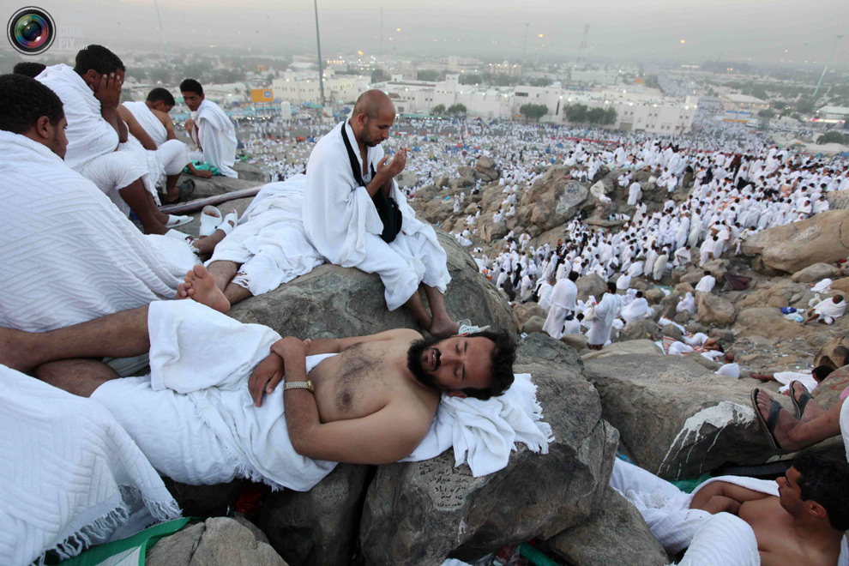

Slide 28
The Hajj Procedure
Day Three
Pilgrims travel to Mina and throw stones at the Jamarat, which is the symbol of all the evil in the world
While throwing the pebbles, pilgrims recite "God is great"
Pilgrims may then sacrifice an animal, 1/3 to themselves, 1/3 to friends and family, and 1/3 to celebrate joy of Eid-ul-Adha
Pilgrims then return to Mecca and circle (tawaf) around the Kabaa'

Slide 29
The Hajj Procedure
Day Three
Pilgrims travel to Mina and throw stones at the Jamarat, which is the symbol of all the evil in the world
These ceremonial actions represent our continuous battle against evil
While throwing the pebbles, pilgrims recite "God is great“, and the like
Pilgrims may then sacrifice an animal, consuming 1/3 of meat, giving 1/3 to friends and family, and giving 1/3 to celebrate Eid-ul-Adha. [celebrated world-wide]
It is a joyous day for all Muslims. Pilgrims then return to Mecca and circle (tawaf) around the Kabaa'

Slide 30
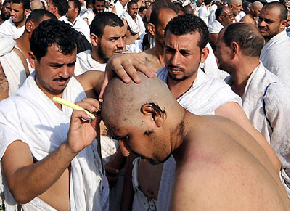
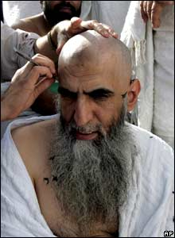
The Hajj Procedure

Slide 31
The Hajj Procedure
Day Four
Pilgrims then leave Mecca and return to Mina where they once again stone the Jamarat Pillars, this time stoning three instead of just one
Once again, the pilgrims recite "God is great" and "in the name of God."

Slide 32
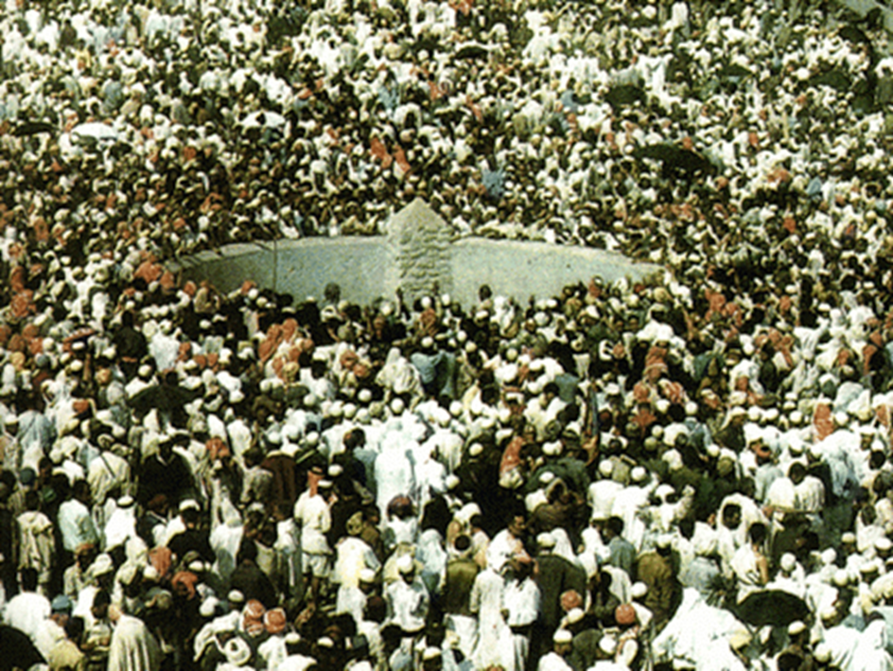
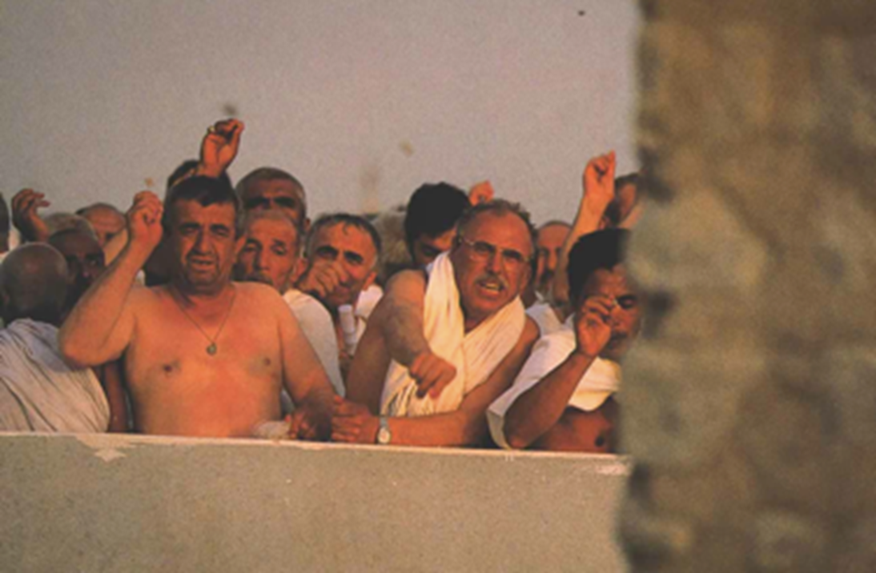

Slide 33
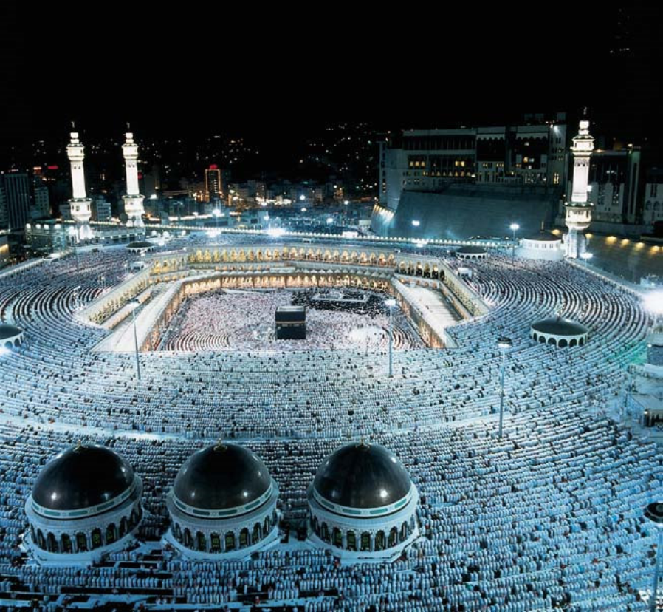
Day Five
Pilgrims stone the Jamarat once again and return to Mecca
Once in Mecca, they once again tawaf around the Kab’ah
This is the "farewell" tawaf
This is an emotional time for the pilgrims because this is the last time they will see the Kab'ah
This completes the Holy Pilgrimage.
The Hajj Procedure

Slide 34
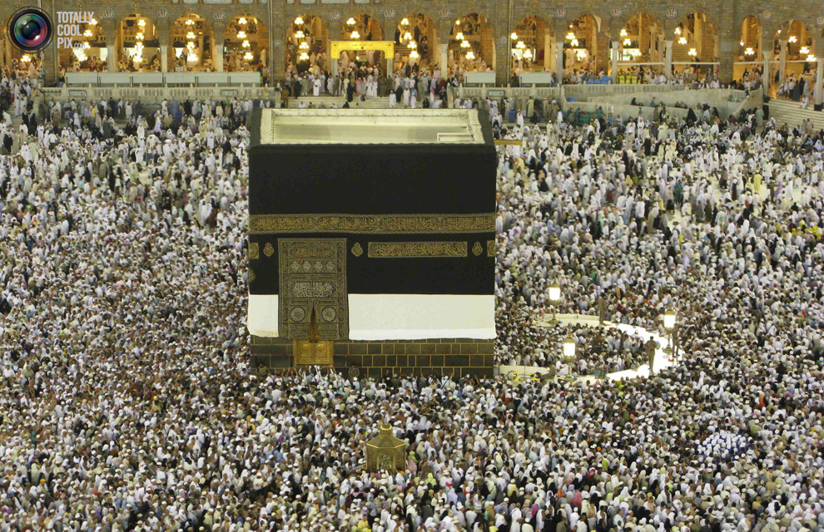
Circling the Kab’ah

Slide 35
Health Risk Profile
Infectious risks
  Meningococcal disease, tuberculosis, other respiratory tract infections, diarrhoea
Non-infectious risks
  Cardiovascular disease, stampedes, MVA
Current Health regulations issued by the Saudi Government for pilgrims travelling to the Hajj …

Slide 36
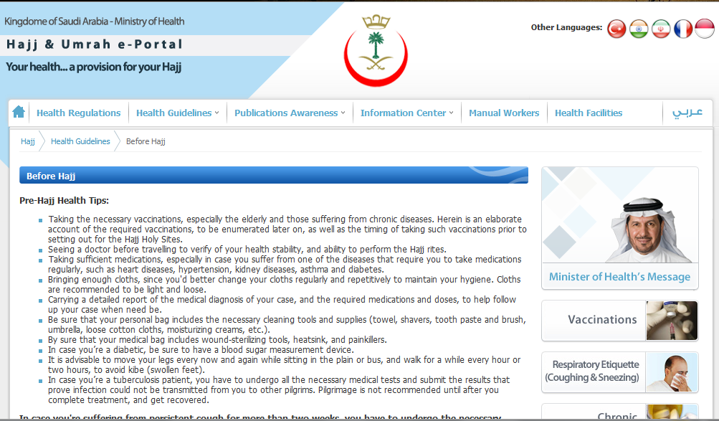
http://www.moh.gov.sa/en/Hajj/HealthGuidelines/Pages/BeforeHajj.aspx
Saudi Government Requirements

Slide 37
Infection | Causes
Meningococcal disease | All pilgrims and children over two, as well as pregnant women
Yellow Fever | Pilgrims hailing from places affected by the disease, such as African semi-desert regions, and some South-American countries.
Seasonal Influenza | ​All pilgrims, especially the elders, those suffering from chronic diseases, patients with immunodeficiency (natural and acquired alike), as well as patients with metabolic diseases, obese persons, and pregnant women (beginning with the fourth month)
Vaccination against pneumonia | Patients with such diseases as sickle cell anemia, renal failure, immunodeficiency, and splenectomy. It could be given, also, to the elders and those suffering from chronic diseases in the liver, heart and lungs.
Polio | Pilgrims of all age groups hailing from regions stricken by polio.
Saudi Government Vax Requirements

Slide 38
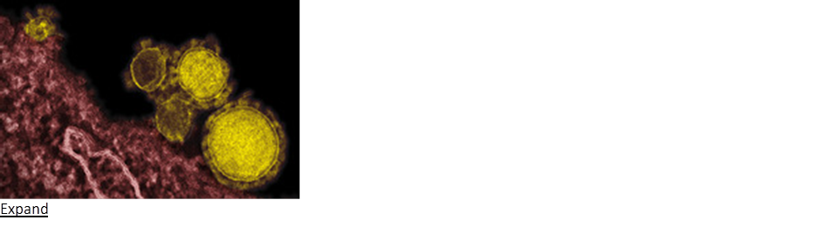
Middle East Respiratory Syndrome Coronavirus (MERS-CoV)
MERS-CoV (formerly called "novel coronavirus") has caused respiratory illness in a number of people in the Middle East, including Saudi Arabia.
  Most people with MERS-CoV had severe illness and pneumonia, approx 50% have died.
  The virus spreads from person to person by close contact,
  pilgrims living and traveling in close quarters may be at risk.
Pilgrims can help protect themselves from respiratory illnesses by washing their hands often; not touching their mouth, nose, or eyes; and avoiding contact with sick people.
Seek medical care if they develop a fever and cough or shortness of breath within 14 days after returning from their trip.
Saudi authorities have recommended this year 2103 that people over 65 years of age, those with chronic diseases or immune deficiency, pregnant women and children under the age of 12 years of age should not participate in the Hajj or Umrah this year for their own safety.
Saudi Government Requirements

Slide 39
Preparation
Preventive measures during the Hajj:
  Saudi Arabia provides free health care to all pilgrims during the Hajj.
  For the 2012 Hajj: 25 hospitals,
  4427 beds including 500 critical care and 550 emergency care beds
  141 health care centres in the vicinity of the Hajj area with 20 000 specialised health care workers.
18 hubs at King Abdulaziz International Airport Hajj terminal in Jeddah, each with 2 clinical examination rooms: assess arriving pilgrims, check immunisation status, admin. prophylactic medicines
The public health teams and teams at the ports of entry report back to the command centre on 9 communicable diseases: influenza, influenza-like illness, meningococcal disease, food poisoning, viral haemorrhagic fevers, yellow fever, cholera, poliomyelitis, and plague

Slide 40
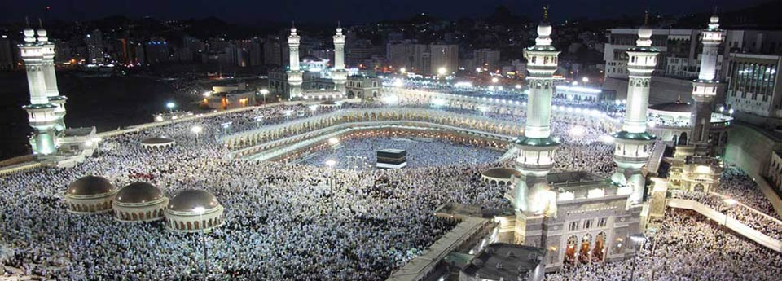
Travel Health Practitioner Consult

Slide 41
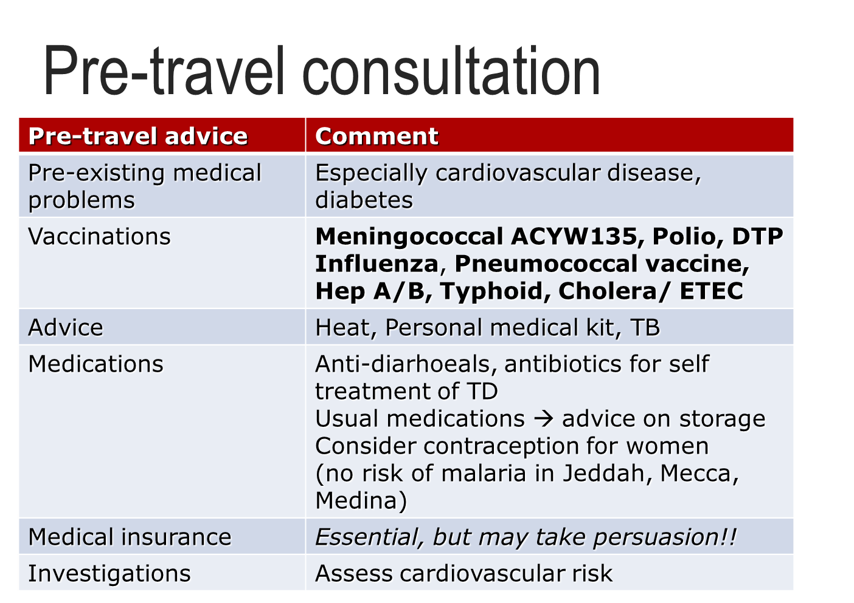

Slide 42
Risks | Advice
Traveller’s diarrhoea | Food and water safety
 | Management of dehydration, travellers’ diarrhoea Self-treatment, when to seek medical advice
Sunburn, heat exhaustion, heat stroke | Sunscreen, good umbrella (allowed) Perform rituals at night, in shaded areas Recognition of symptoms of heat exhaustion and Mx
Stampede | Safety in numbers (stay with family members) Avoid extremely large crowds
Cardiovascular ischaemia | Rituals by proxy Consider using wheel-chair
Hand injuries | Arrange for slaughtering by professional butcher
Skin infections, esp feet | Good footwear Keep skin dry, protect exposed areas
Diabetes | May need to adjust insulin with stress, physical activity, food intake Check feet carefully, protective footwear

Slide 43
Infection | Causes
Hepatitis B, C and HIV | Shaving of head by ill-trained barbers
Skin infections, especially of feet | Humid, hot climate, long periods of standing/ walking
Travellers’ diarrhoea and Cholera | Poor hand hygiene Eating from street vendors Drinking contaminated water Inadequate storage of food
Respiratory Tract Infection [RSV, Parainfluenza, Adenovirus] | Crowed conditions and close contact Shared sleeping conditions
Meningococcal Disease | Overcrowding Hugh Humidity Dense air polution
Tuberculosis | Overcrowding Pilgrims from TB endemic Areas
Hepatitis A | Food and water
Malaria | Not in Mecca, Medina, Jeddah
Infectious Disease Risks

Slide 44
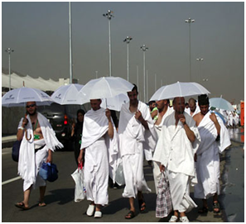
Sunburn / Heat exhaustion / heat stroke
Cardiovascular disease
Trauma
MVA,
stampedes
Hand injuries
Stoning
Burns
Non-infectious disease risks

Slide 45
Sunburn / Heat exhaustion / Heat stroke
Leading cause of morbidity at the Hajj
Summer: day temp > 45°C
Winter: 25-30°C
Causes:
  Lack of acclimatisation / fluids
  Arduous physical rituals
  Exposed areas limited / no shade
  Men: not permitted to cover heads
Rituals in the desert at Arafat high risk
Desert sand reaches high temperatures; need good quality footwear
Footwear must be removed during times of prayer

Slide 46
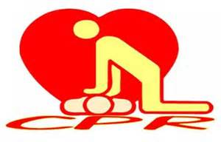
Cardiovascular disease
Most common cause of death in Hajj (43%)
Hajj physically demanding → precipitate ischaemia
Most pilgrims have out of hospital cardiac arrest → rarely resuscitated!!
Difficulty and danger in retrieving peri-arrest patients in large crowds

Slide 47
Trauma
MVAs
  Causes: dense traffic,
  disordered traffic flow,
  poor compliance with seat belts
  Mecca: highest incidence of accidents
Stampedes:
  Large crowds in limited spaces
  → 1-2 individuals trip and fall
  → precipitate stampede
  Mass panic
  Death via head injury or asphyxiation
  High risk areas: Jamarat (ritualistic stoning), Circumambulation at Ka’abah

Slide 48
Trauma
Year | Chronicle of Hajj disasters
1990 | 1426 pilgrims killed by stampede / asphyxiation in tunnel leading to holy sites
1994 | 270 killed in stampede
1997 | 343 pilgrims died and 1500 injuried in a fire
1998 | 119 pilgrims died in a stampede
2001 | 35 pilgrims died in stampede
2003 | 14 pilgrims died in a stampede
2004 | 251 pilgrims died in a stampede
2006 | 76 pilgrims died after a hotel housing pilgrims collapsed; a stampede wounded 289, killing 380
2013 | ??

Slide 49
Trauma
Hand injuries from ceremonial slaughtering of animals
  80% from knives (Rahmann et al 1999)
Stoning
  Over enthusiastic pilgrims may hurl larger stones with great ferocity
Burns to feet from standing barefoot on marble floors (in holy areas)
  Sand temperature gets very high

Slide 50
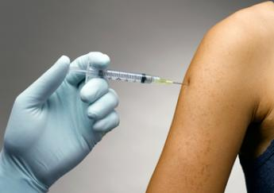
What Consultation is needed for MG

Slide 51
What consultation is needed - A
All travellers to international mass gatherings should be evaluated by a travel health provider ideally 4–6 weeks before travel:
  to assess the level of risk faced by the traveller and
  to take steps to manage the risk.
Travellers advised take precautions to mitigate risks associated with mass gatherings:
  Be aware of the most likely health risks associated with the event they are attending and what they can do to stay healthy and safe.
  Avoid gatherings:
    where drug and alcohol use could contribute to dangerous behaviour,
    where political or religious fervour may contribute to violence,
    where inadequate facilities may contribute to an unhealthy environment.
  Avoid densely congested areas with limited egress.
  Be aware of emergency precautions and the location of exit routes and medical facilities.

Slide 52
What Consultation is needed - B
It is essential and the THPractitioner advise upon:
Knowledge of the country or region being visited
  This can be obtained from destination pages on the CDC Health website (http://wwwnc.cdc.gov/travel/destinations/list.htm),
  World Health Organization www.who.int
  Worldwise NZ specific information - www.worldwise.co.nz [INTEREST DECLARED]
For all international travel, travellers should practice healthy and safe behaviors, including:
  Safe food and water habits
  Prevention of insect bites
  Avoidance of animals, especially dogs
  Avoidance of barbers, tattooists…
  Hygiene and regular hand washing
  Safe driving
  Advice on basic first aid and ‘what to do’ with personal health care

Slide 53
What Consultation is Needed - C
Things for THP to Consider in Consultation:
Traveller advised to consider the characteristics of the event and how they might contribute to health risks:
  Local diseases: THP to advise the traveller on local diseases
    Advise the traveller on preventative management for them
    Advise the traveller on when to seek advice for any illness
Climate: the Traveller needs to be wary of the climate .
  Hot or cold, thus think about ways to reduce the risk of heat- or cold-related illnesses.
Crowd Demographics – is the traveller aware of the other participants??
  Crowd density: injuries are more likely where people are packed closely together.
  Age of the crowd,
  Purpose of the gathering
  ? Drugs or alcohol … are used can influence the risk of violence.

Slide 54
IMPACT THP Consultation Points
Things for the THP to Consider in ‘Focusing the Event’ - 1
Research of the event in advised
Vaccinations
  Compulsory
  Recommended
  Routine
Personal Hygiene – including food and water, insect repellent
Environment and Clothing
Finances

Slide 55
IMPACT THP Consultation Points
Things for the THP to Consider in ‘Focusing the Event’ - 2
Safety and security
Personal Behaviour – alcohol and drug, sexual
Risk of disease and dis-ease
What medical resources are available to the traveller
Consular contact if in a foreign country
FAMILY CONTACT

Slide 56
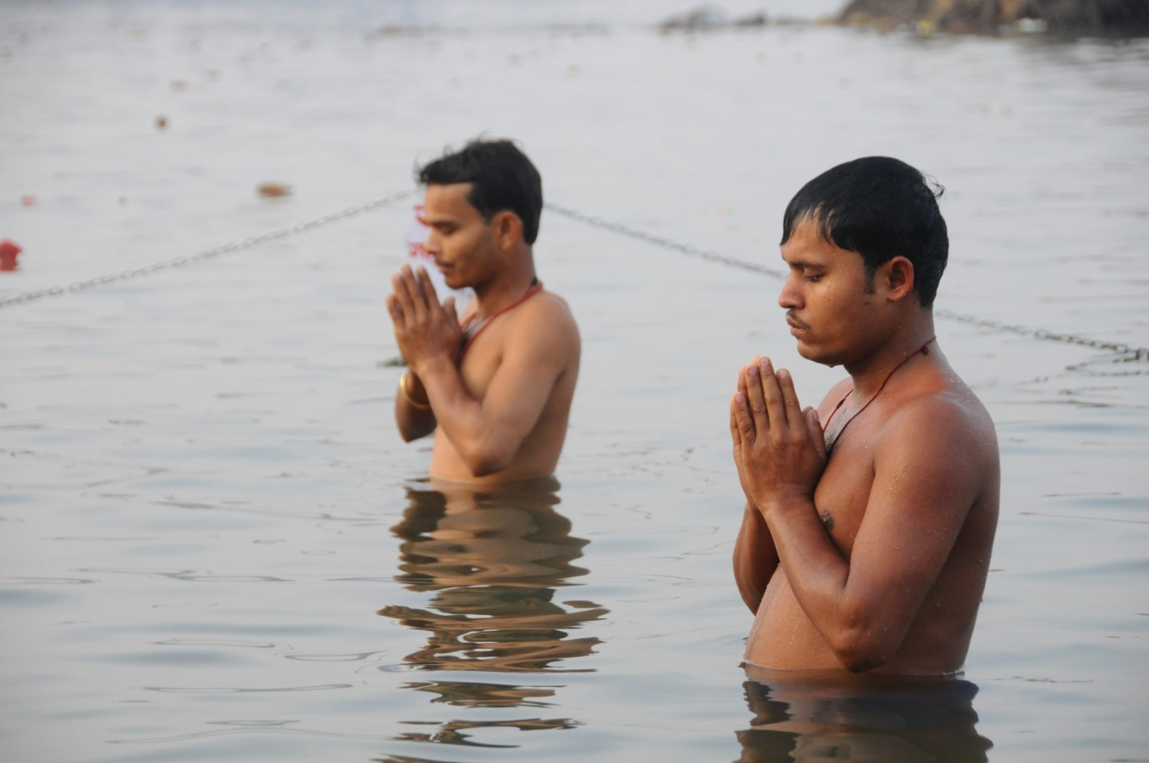
Guide to Mass Gathering Consultation
1. The travel health consultation needs to reflect care and compassion for the greater world
2. The travel medicine consultation should guide the traveller to instinctive personal safety and security means, as well as to understand current health recommendations
3. The Traveller is best advised to gain shared experiences of travel from the Travel Health Professional and from others. The collective knowledge makes for a better understanding

Slide 57

Guide to Mass Gathering Consultation
4. Travel Heath Providers thus need to guide travellers by their knowledge. They need to be prepared to ‘challenge’ the intending traveller, so that a finished journey is a joy to have experienced
5. Travel Health and Medicine is a positive energy and is best given positively
6. Dedicated PERSONAL Travel advisories have assumed great importance, and need to be included in all travel health consultations

Slide 58
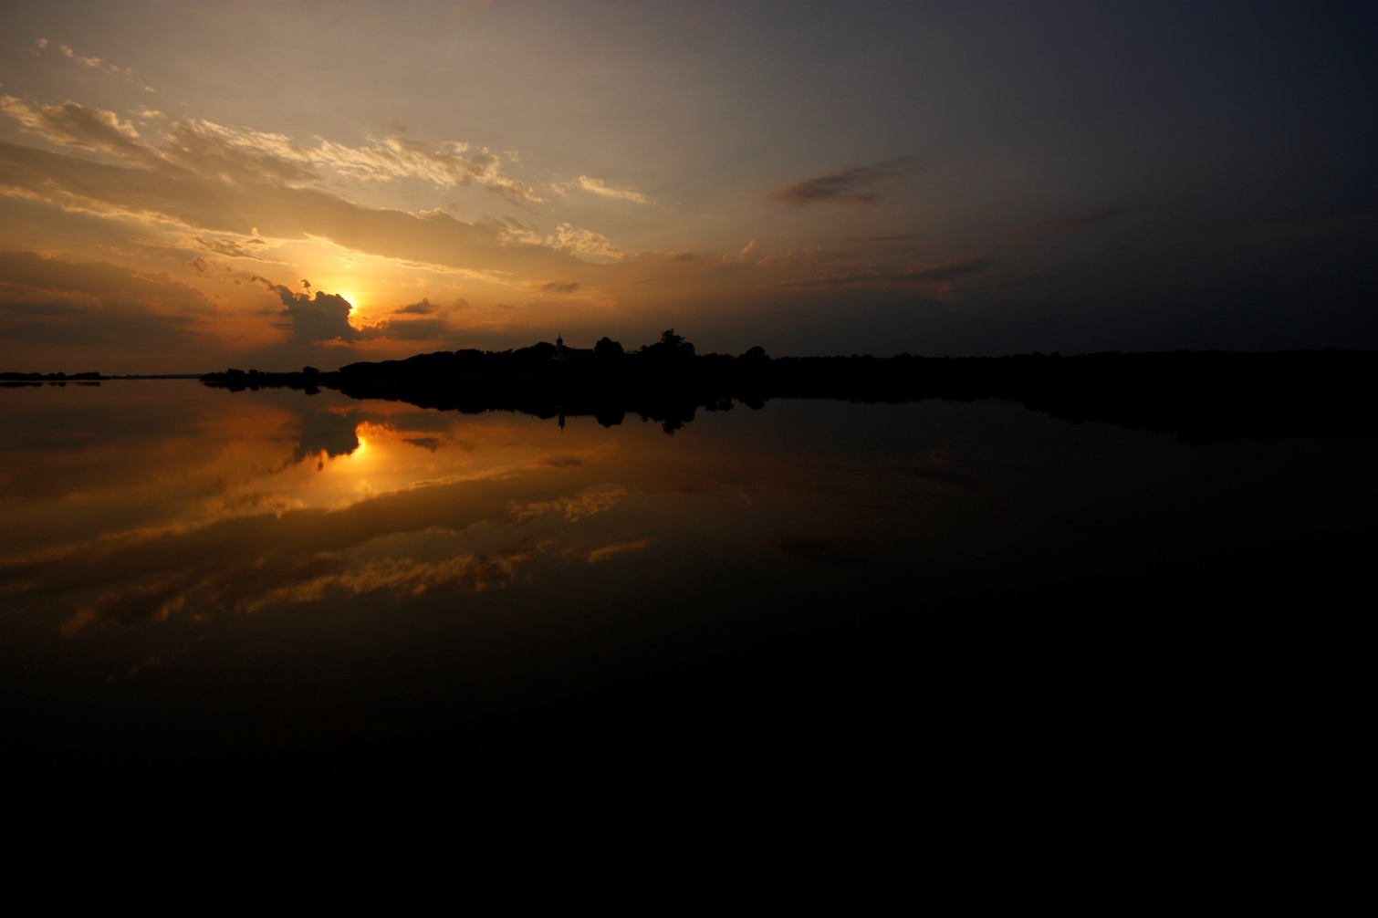
THANK YOU!
Marc Shaw
Worldwise Travellers Health NZ
Travel Health Specialists
Auckland
marc.shaw@worldwise.co.nz
Tel: 09-520-5830

Slide 59
References
Emergency Management Australia. Safe and Healthy Mass Gatherings: a Health, Medical and Safety Planning Manual for Public Events. Commonwealth of Australia; 1999.
Fapore D, Lurie P, Moll M, Weltman A, Rankin J. Public health aspects of the rainbow family of living light annual gathering—Allegheny National Forest, Pennsylvania, 1999. MMWR Morb Mortal Wkly Rep. 2000;49(15):324–6.
Kaiser R, Coulombier D. Epidemic intelligence during mass gatherings. Euro Surveill. 2006;11(12):E061221.3.
Lombardo JS, Sniegoski CA, Loschen WA, Westercamp M, Wade M, Dearth S, et al. Public health surveillance for mass gatherings. Johns Hopkins APL Technical Digest. 2008;27(4):1–9.
Milsten AM, Maguire BJ, Bissell RA, Seaman KG. Mass-gathering medical care: a review of the literature. Prehosp Disaster Med. 2002 Jul–Sep;17(3):151–62.
World Health Organization. Communicable disease alert and response for mass gatherings: key considerations. Geneva: World Health Organization; 2008. Available from: http://www.who.int/csr/Mass_gatherings2.pdf .
Wilder-Smith A, Foo W, Earnest A, Paton NI. High risk of Mycobacterium tuberculosis infection during the Hajj pilgrimage. Trop Med Int Health. 2005 Apr;10(4):336-9.
Non-communicable Health Risks during Mass Gatherings R. Steffen, niversity of Zurich, Travel Health Centre / Epidemiology and Prevention of Communicable Diseases, Zurich, Switzerland
Memish ZA, Ahmed QA. Mecca bound: the challenges ahead. J Travel Med. 2002 Jul-Aug;9(4):202-10.
Gatrad AR, Sheikh A. Hajj: journey of a lifetime. BMJ. 2005 Jan 15;330(7483):133-7.
Balkhy HH, Memish ZA, Bafaqeer S, Almuneef MA. Influenza a common viral infection among Hajj pilgrims: time for routine surveillance and vaccination. J Travel Med. 2004 Mar-Apr;11(2):82-6.
Ahmed QA, Arabi YM, Memish ZA. Health risks at the Hajj. Lancet. 2006 Mar 25;367(9515):1008-15.
Health conditions for travellers to Saudi Arabia for the pilgrimage to Mecca (Hajj). Wkly Epidemiol Rec. 2007 Nov 2;82(44):384-8.
Hajj 2007: vaccination requirements and travel advice issued. Euro Surveill. 2006;11(11):E061130 1.
PHOTOGRAPHS
www.bestokednow.com/2011/02/uttarakhand.html
www.wallpaperswala.com/kumbh-mela/
www.dailymail.co.uk/sport/euro2012/article-2163555/Euro-2012-Russia-hit-28-000-UEFA-fine-fans-display-illicit-banners-lob-fireworks-Greece-loss.html
www.Prague.tv

