Slide 1
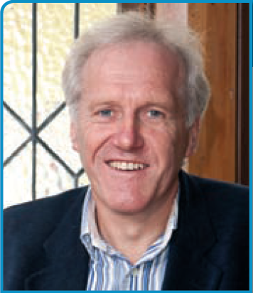
A/Prof Brian Cox
Cancer Epidemiologist
Dunedin

Slide 2

Has PSA testing reduced prostate cancer mortality in New Zealand?
Research Associate Professor Brian Cox
Hugh Adam Cancer Epidemiology Unit
Department of Preventive and Social Medicine
Dunedin School of Medicine
University of Otago

Slide 3
Ethics of screening
We believe there is an ethical difference between everyday clinical practice and screening. If a patient asks a medical practitioner for help, the doctor does the best possible. The doctor is not responsible for defects in medical knowledge. If, however, the practitioner initiates screening procedures the doctor is in a very different situation. The doctor should, in our view, have conclusive evidence that screening can alter the natural history of disease in a significant proportion of those screened.
(From: Cochrane & Holland, 1971)

Slide 4
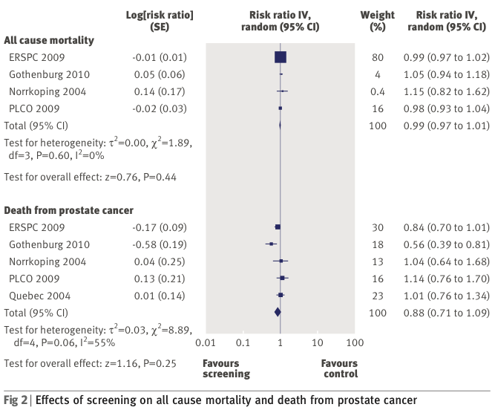
Meta-analysis of RCTs of prostate screening (Djulbegovic et al BMJ 2010)

Slide 6
Estimated cost of PSA diagnoses
From 1990 to 2012 there have been about 19,390 diagnoses of prostate cancer in New Zealand from PSA testing of asymptomatic men that would not have otherwise occurred.
At 2008/2009 prices for treatment*, this was $340m over 23 years and ~$15m in 2012.
About 850 men a year are diagnosed with prostate cancer by PSA testing who would not otherwise have that diagnosis in their lifetime.

Slide 8
Age-period-cohort representation of trends in prostate cancer in New Zealand

Slide 9
Is there an overall benefit of PSA tests in asymptomatic men?
Boniol et al (2012) BJU International — from the International Prevention Research Institute and the Urology Service of the Lyon-Sud hospital, Lyon.
They have estimated that:
Using the results of the ERSPC randomised trial and the Swedish arm, PSA testing produced a loss of years of life.
This was primarily due to prostate biopsy rates of 27% and 40% for the ERSPC and Swedish arm, respectively, and they used an estimate of 1 in 500 for the risk of death from complications of biopsy.
Treatment mortality of 1 in 200 patients treated for prostate cancer (Walz et al, BJU International 2008)

Slide 10
Estimate of iatrogenic illness and death from PSA testing in New Zealand to 2012
 | Proportion | DXT | Surgery
 | treated 50% | 70% | 30%
Number overdiagnosed 19390 | 9695 | 6787 | 2909
Estimated number of biopsies
193900
 | proportion affected | number afflicted | number afflicted
DXT
Faecal incontinence | 3% | 204
Urinary incontinence | 5% | 339
Impotence | 15% | 1018
Total DXT |  | 1561
Surgery
Faecal incontinence | 0% |  | 0
Urinary incontinence | 10% |  | 291
Impotence | 20% |  | 582
Total surgery |  |  | 873
Overall iatrogenic illness |  | 2433
Mortality from treatment | 1 per 400 | 24
Mortality from biopsy | 1 per 2,000 | 97
Total iatrogenic mortality |  | 121

Slide 11
Key information for patients, their spouses and their families
Despite PSA testing of asymptomatic men (PSA screening) since 1993 in New Zealand, there is little evidence that prostate cancer mortality has declined as a result.
It is estimated that since PSA testing began in New Zealand, about 19,000 men have had a diagnosis of prostate cancer that would not have developed symptoms or threatened their life.
Of the 19,000 men, it is estimated that about 2,400 have had chronic impotence, chronic urinary incontinence, or chronic faecal incontinence as the result of their treatment.

Slide 12
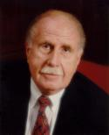
Screening men for prostate-specific antigen (PSA), the most commonly used tool for detecting prostate cancer, has become a "hugely expensive public health disaster," says the researcher who discovered PSA in 1970.
(March 11, 2010)
Richard Ablin, PhD, DSc (Hon.) research professor of immunobiology and pathology at the University of Arizona College of Medicine in Tucson.

Slide 13
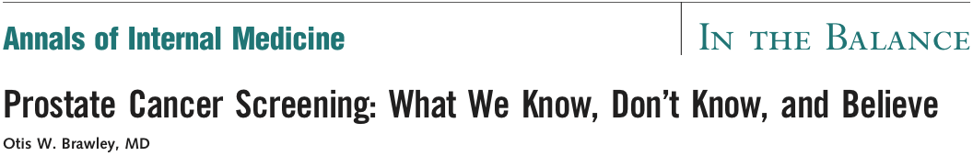
U.S. Preventive Services Task Force (USPSTF) gave PSA screening a grade of “D”.
This is a recommendation against PSA-based screening for men of any age.
The Task Force makes D recommendations when there is at least moderate certainty that the harms of an intervention equal or outweigh the benefits.
Mass screening is also a lucrative business.
“It is difficult to get a man to understand something, when his salary depends on his not understanding it”.
Although the Task Force statement is more pointed than those of other expert organizations, it is not incongruent with those recommendations. Yet, many advocates for prostate cancer screening have ignored the messages of caution of other organizations and continue to encourage screening without caveats.

Slide 14

http://www.auanet.org/education/guidelines/prostate-cancer-detection.cfm
Guideline Statement 1: The Panel recommends against PSA screening in men under age 40 years. (Recommendation; Evidence Strength Grade C)
Guideline Statement 2: The Panel does not recommend routine screening in men between ages 40 to 54 years at average risk. (Recommendation; Evidence Strength Grade C)
Guideline Statement 3: The Panel strongly recommends shared decision-making for men age 55 to 69. (Standard; Evidence Strength Grade B)
Guideline Statement 4: To reduce the harms of screening, a routine screening interval of two years or more may be preferred over annual screening in those men who have participated in shared decision-making and decided on screening. (Option; Evidence Strength Grade C)
Guideline Statement 5: The Panel does not recommend routine PSA screening in men age 70+ years or any man with less than a 10 to 15 year life expectancy. (Recommendation; Evidence Strength Grade C)

