Slide 1
Dr Edward Coughlan
Clinical Director
Christchurch Sexual Health

Slide 2
Christchurch Sexual Health
33 St Asaph Street
Dr Edward Coughlan
Clinical Director
Notes:
1

Slide 3
M genitalium- ? the New Black
History and Biology
NZ studies
Other Studies of Prevalence and Associations
Studies Concerning treatment
Suggested Management Plan

Slide 4
History and Biology
Initial isolation from 2 of 13 men with urethritis in 1980
  Tully,Talyor-Robinson- Lancet 1981;1:1288-91
Class of Mollicutes
Very small
No cell wall
Very small genome – 582,970 base pairs in a circular chromosome,coding for 521 genes

Slide 5
Lacks all the genes for amino acid synthesis
Found preferentially in the genital tract
Morphology – flask shaped with a specialised tip structure
Good at adhering

Slide 6
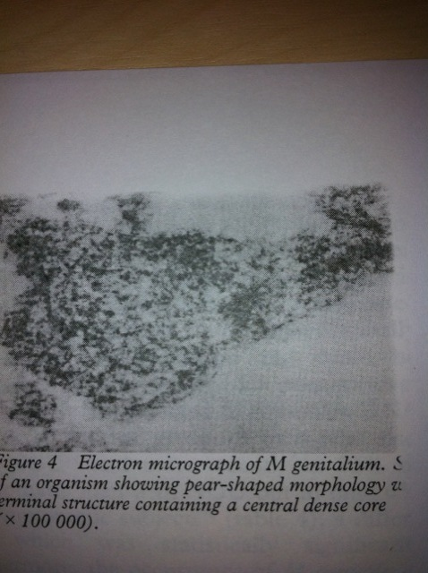

Slide 7

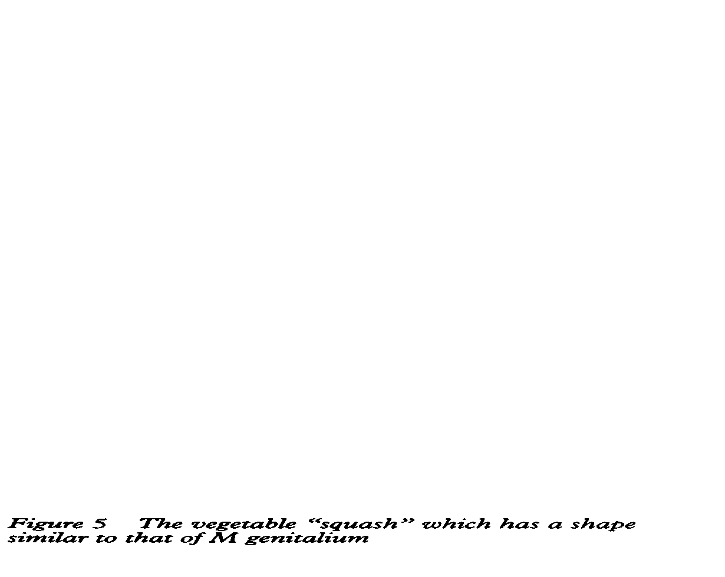

Slide 8
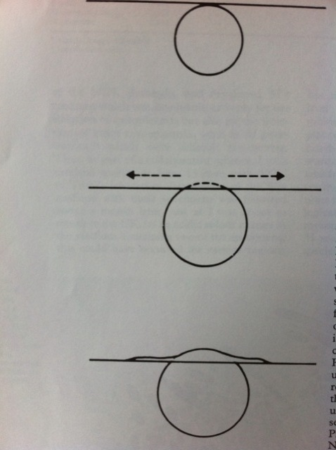

Slide 9
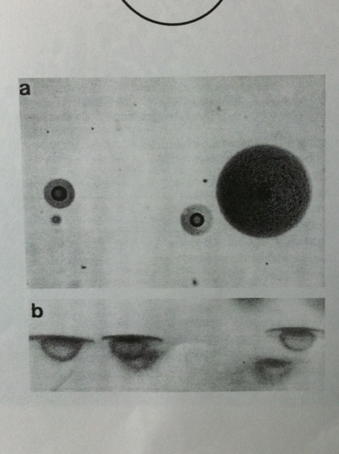

Slide 10
Christchurch Pilot
46 men with diagnosed Urethritis
5 of these positive for M genitalium ( 10.8%)
1 of these had rectal chlamydia at the time of diagnosis,others negative for Gonorrhoea or Chlamydia
All had a past history of chlamydia
2 had recurrent or persistent NGU

Slide 12
In Non Gonococcal Urethritis
Chlamydia trachomatis -33.5%
M genitalium 10%

Slide 13
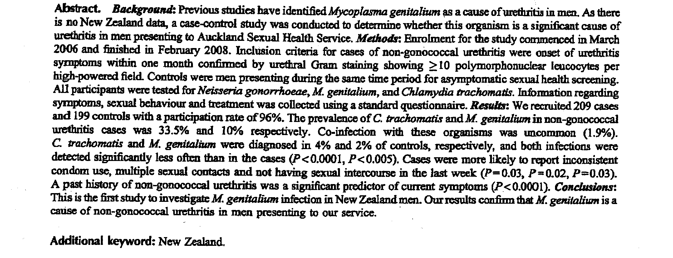

Slide 14
High Prevalence of M genitalium in women presenting for termination of pregnancy
Beverley Lawton,Sally Rose,Collette Bromhead,Louise Gaitanos,Jane McDonald,Kim Lund
  Contraception 77 (2008) 294-298.
300 under 25 year old women presenting for TOP

Slide 15
M genitalium detected in 26 (8.7%)
Infection not significantly associated with BV or chlamydia

Slide 16
Auckland Sexual Health
In women who were being screened for an STI
  Chlamydia trachomatis 10.7%
  M genitalium 8.4%
  N gonorrhoea 1.9%
  -Trichomoniasis 3.5%
          Oliphant ,Azariah 2013

Slide 17
Estimated prevalences in 40 independent studies (27 000) women
7.3% MG in high risk,2.0% low risk
CT ( 4.2% ) ,NG (0.4%) USA

Slide 18
Urethritis
Inoculation of male chimpanzees resulting in urethritis
    Brit J of Exp Path 1985,66:95-100
M genitalium prevalence in urethritis patients varies from 8% ( urology) to 29% among STD patients
M genitalium prevalence in asymptomatic patients varies from 0% ( urology) to 9% among STD patients
      Uuskula Int J of STD and AIDS 2002;13:79-85

Slide 19
Urethritis
Persistent urethral inflammation seen in a substantial number of men despite M genitalium eradication
    Bjornelius STI 2008 ;84:72-76
Relapsing /recurrent urethritis
  M genitalium +ve, respond initially to doxycycline clinically but still can isolate M gentilium then relapse
      Mena CID 2009 ;48 1649-54

Slide 20
Urethritis
Wikstrom and Jenson found 40% of those patients with patients with NCNGU treated with doxycycline who failed treatment were M genitalium positive
    Wikstom Jensen STI 2006 ;82:276-279
Also men with M genitalium more often have urethritis with >10 PMNs/hpf than those with NMGNCNGU. Ie men with urethritis but none of these pathogens

Slide 21
Endometritis
In this study-detected M genitalium in the cervix ,endometrium or both in 9(16% ) of 58 women with histologically confirmed endometritis and in 1 ( 2%) of 57 without endometitritis
    Cohen Lancet Mar 2,2002,359,pg 765

Slide 22
Manhart et al showed women with M genitalium had 3.3 fold greater risk of Mucopurulent cervicitis
  Manhart JID 2003:187 ,650-657

Slide 23
M genitalium in major STI syndromes ( J Jensen)
Male NGU ++++
  Numerous studies shows this association
  Around 15% of NGU and 20% of NCNGU
  Treatment failure leads to persistent symptoms
Proctitis +
  Found in 2 -5% of MSM
  No obvious correlations

Slide 24
Epididymitis +
  Few trials
Female NGU +++
  Only in Scandinavia
Cervicitis +++
  Most studies show an association
PID ++
  Increasing evidence but ??
  Proportion of PID caused by M genitalium less than chlamydia

Slide 25
BV +
Adverse Pregnancy Outcomes +
  Prevalence is low in pregnant women
Male infertility ??
Female Infertility +
  Serological studies
Ectopic Prregnancy ?
Chronic Abdominal Pain ?

Slide 26
Treatments
Initially observational studies
In 2009 – a randomised treatment trial – Mena
Sweden uses Doxycycline for treatment of NGU ,many other countries use azithromycin

Slide 27
Melbourne Experience
1538 males and 313 females tested who had urethritis or cervicitis or PID or a contact
11% of males and 10 % of females infected
Eradication in 84% of those treated with azithromycin 1.0 gram.
All those with persistent infection had M genitalium eradicated with Moxifloxacin 400mg for 10 days
    Bradshaw PloS ONE .Nov 2008 3 Issue 11 e3618

Slide 28
Olafiakilinikken ,Norway
Out of 10,109 patients who had symptoms or contacts , 452 positive for M genitalium
1.0 gram stat of azithromycin had an eradication rate of 79% .This was as effective as a 5 day course of azithromycin.
Moxifloxacin 400mg daily for 7 days - 100% eradication
    Jenburg J of STD and AIDS 2008;19-676- 679

Slide 29
Olafiakilinikken ,Norway
How ever !!
Of those who had failed initial treatment with azithromycin who then received azithromcin as an extended course cure rate was only 34%
    Jenburg J of STD and AIDS 2008;19-676- 679

Slide 30
Randomised Trial -USA-Mena
Comparing Doxycycline and Azithromycin
In New Orleans,patients with NGU
Randomised to either one. All returned to an early followup visit(10 to 17 days) and M genitalium positive returned for second visit.
At early followup visit 87% eradication for azithromycin and 45% for doxycycline

Slide 31
Mena
Of 15 persistently infected men but clinically cured at the first visit, 7(47%) experienced clinical relapse at the second visit
    Mena CID 2009:48,1649

Slide 32
Persistent/Recurrent Urethritis –
Sweden
78 male patients who had persistent or recurrent NCNGU who had been treated with doxycline initially.
32 (41%) M genitalium positive .
Of these 22 treated azithromycin,19 extended and 3 1.0 gram stat =>all 20 who returned were cured
  This included those who failed doxycline and erythromycin
8 doxycycline – 1 cured
2 Roxithromycin – 1 cured ,1 lost
15 erythromycin – 2 cured , 2 lost , rest treated with azithromcyin
  Wikstrom STI 2006 82 ;276

Slide 33
Norway & Sweden
152 men and 60 women positive for M genitalium
Received either doxycline for 9 days or 1 gram stat of azithromycin.
If failed doxycline => extended course of azithromycin
If failed azithromcyin =>Doxycycline for 15

Slide 34
Norway & Sweden
Eradication for 1.0 gram azithromycin was 85% in men and 88% for women
Eradication for Doxycycline was 17% in men and 37% for women
Extended azithromycin treatment eradicated M genitalium in 96% of men and all 6 women ie those who had failed doxycline
Only 6 failed initial azithromcin , 3 lost, 2 failed treatment with extended doxycline
      Bjornelius STI 2008, 84,72-76

Slide 35
Treatments
Clinical trails suggest treatment failure in 70% of doxycline treated infection
  Even when low MIC in vitro
Efficacy of azithromycin 1 gram dose appeared to be lower than extended azithromycin ( 500mg day 1 and 250 mg day 2 to 5)
  85% vs 95% in Scandinavia
  No randomised trials

Slide 36
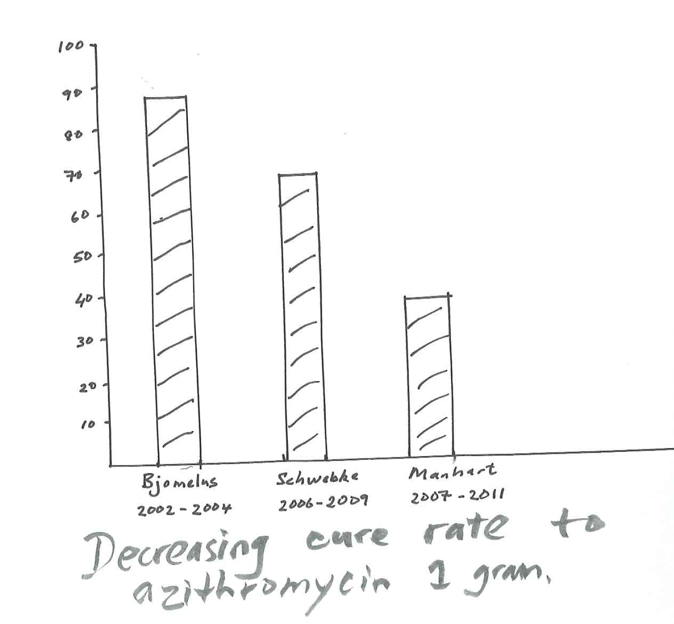

Slide 37
Resistance
Azithromycin binds to the 50S subunit of the ribosome ( includes 23S and 5S)
  =>inhibits translation of mRNA
  => inhibits protein synthesis
Resistance can occur with mutations in the 23S rRNA gene => inhibit azithromycin binding

Slide 38
Resistance
In vitro resistance mediated by mutations in the 23 S rRNA gene
Thought to occur as a result of single dose treatment of 1.0 gram azithromycin
        Jensen CID 2008 :47,1546
Level of azithromycin resistance is very important and is influenced by “treatment tradition”

Slide 39
Melbourne :
Looked at individuals with treatment failure using pre and post treatment samples and looked for mutations in 23sRNA gene.
All cases (20) of treatment failure had resistant mutations
  9 (45%) had this pre and post treatment
  11 (55%) had this post only ie induced
        Plos Twin et al 2012

Slide 40
Moxofloxacin
Treatment with Moxifloxacin 400mg daily for 7 -10 days
  Almost 100% cure rate
  Some failures reported
  Changing field
  -if occurs need to report it
  Has had black box warnings for liver toxicity and rashes
  In NZ just changed from exceptional circumstances to Special Authority

Slide 41
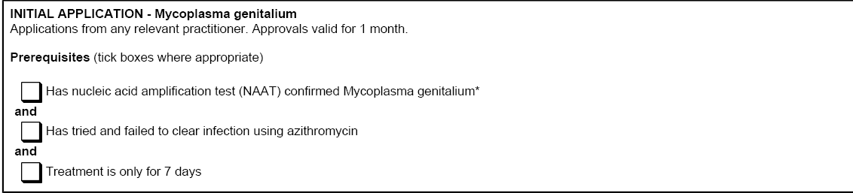

Slide 42
Summary
Definitely a Good idea.
-When working up persistent/recurrent NGU test for M genitalium
Possibly a Good Idea
If treating PID add in azithromycin 1.0 gram stat to any regimen.( it might be Moxifloxacin initially at some time in the future)

Slide 43
Summary
  1) If positive for M genitalium then
  Azithromycin 500mg stat then 250 mg for 4 days
  Test after 5 weeks ( 1 month form completion of treatment )
  For test of cure => if still present
  For Moxifloxacin 400mg for 7 days ( needs Special Authority )
  For test of cure after that – if failures that please tell me.

Slide 44
Acknowledgements
Canterbury Health Laboratories- Julie Creighton, Trevor Anderson.
Colleagues around NZ
Melbourne (Marcus Chen) and Sydney Sexual Health Services ( Chris Bourne)
Jorgen Jenson

