Slide 1

Dr Buzz Boothman-Burrell
Senior Lecturer
University of Otago

Slide 2
General Practice - A Dumping Ground For A Failing Health System

Slide 3
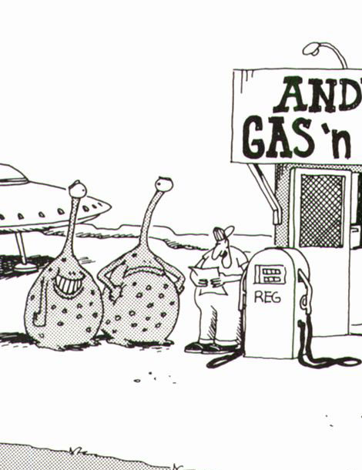

Slide 4

Is the health system failing?

Slide 5
The diabetes rate is slowly increasing over time
5% of adults (almost 200,000 adults) have been diagnosed with diabetes.
The diabetes rate has slowly increased over the past 15 years.
Mental health disorders are common
16% of adults have been diagnosed with depression,
anxiety disorder and/or bipolar disordered.
This rate has increased since 2006/07.

Slide 6


Slide 7
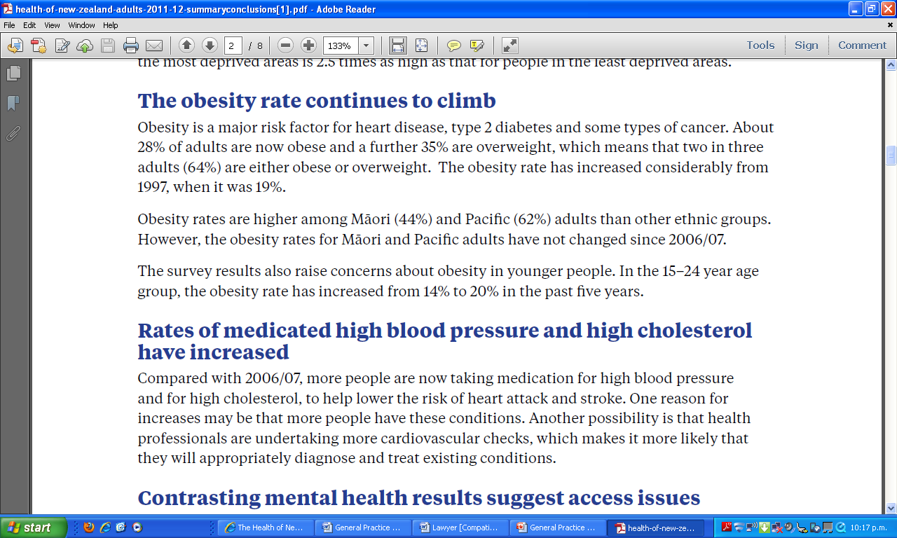

Slide 8
.....and finally ...
A camel is a horse invented by a committee of bureaucrats
The pride of health administrative streamlining
cost-effectiveness and efficiency .....

Slide 9
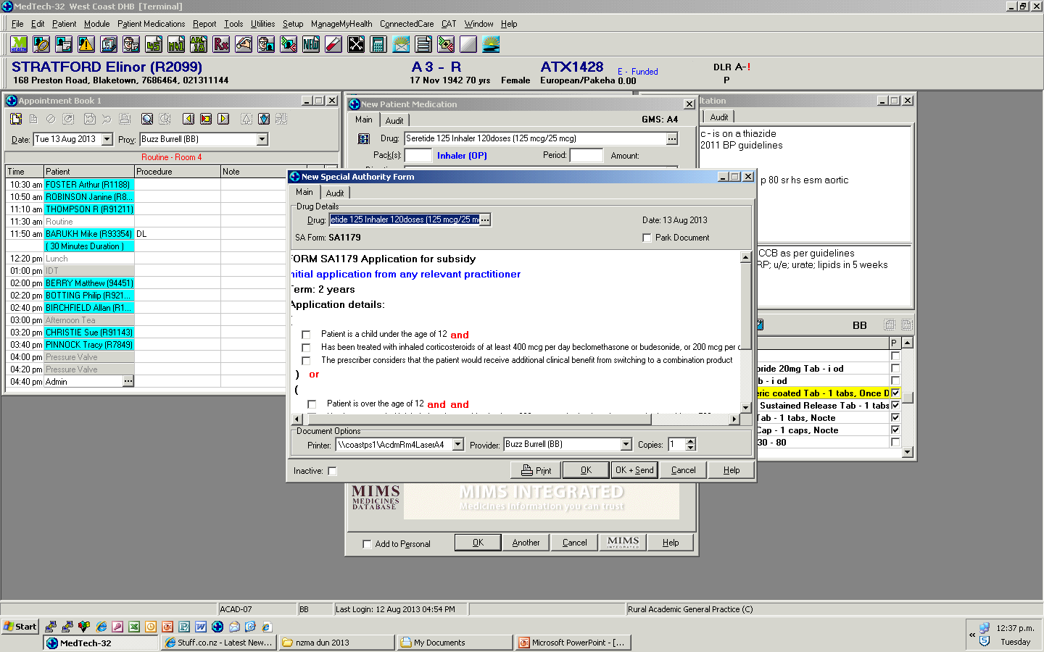
Really?
The prescriber is simply giving their patient this product to piss them off

Slide 10


Slide 11
Dumping ground?

Slide 12
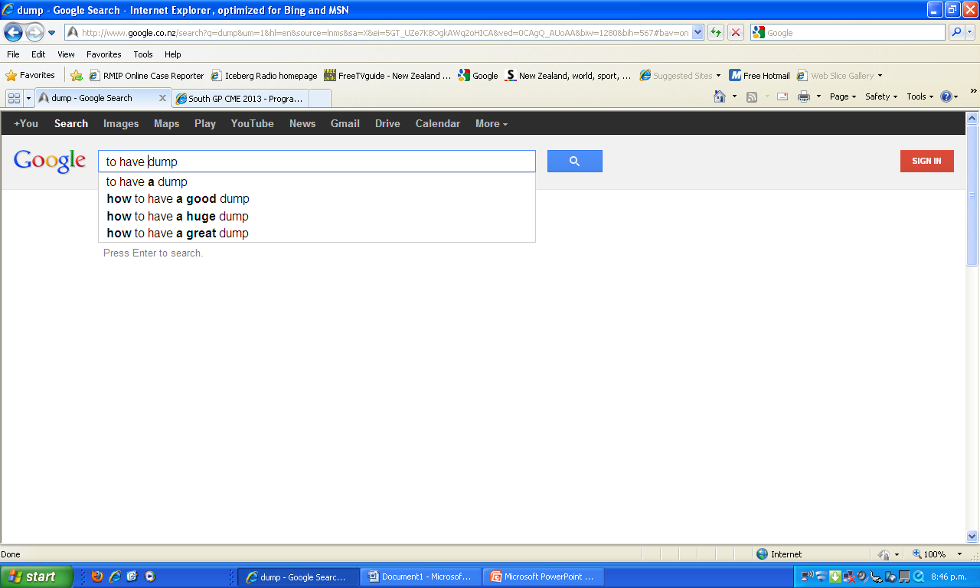

Slide 13


Slide 14

What goes in must come out

Slide 15

Where’s it coming from?

Slide 16
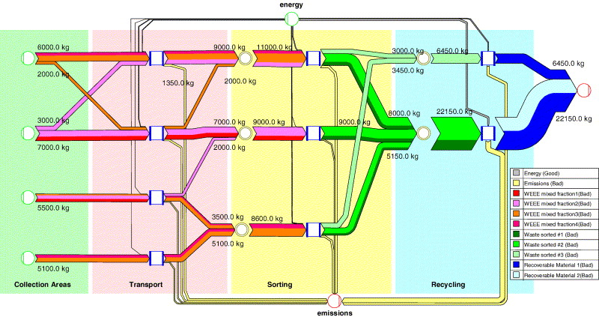
Basics of waste production ….
D
U
M
P
I
N
G
G
R
O
U
N
D
Primary care
ED
Ambulance
spontaneous

Slide 17
Impressive statistics

Slide 18
Hospital beds & discharges
(1988 – 2001)
9,000
700,000
8,000
600,000
7,000
Day stay
Day-stay
500,000
6,000
5,000
400,000
Number of beds utilised
Inpatient
Number of discharges
4,000
Inpatient
300,000
3,000
200,000
2,000
1,000
100,000
0
0
1988
1989
1990
1991
1992
1993
1994
1995
1996
1997
1998
1999
2000
2001
AHB
CHE
HHS
DHB
Reform phase and year
Number of discharges
Number of inpatient discharges
Number of beds utilised
NZ Public Hospital Performance
18
Davis,P. (2010) Quality or Quantity? Markets or Management? University of Auckland

Slide 19
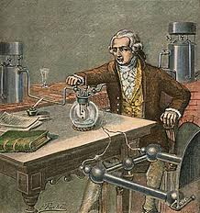
If they’re not staying in hospital for days and nights,
and only staying as day cases ....
“The only way to have a decent
Cappuccino is to make it yourself”
'Matter is neither created
nor destroyed,'

Slide 20
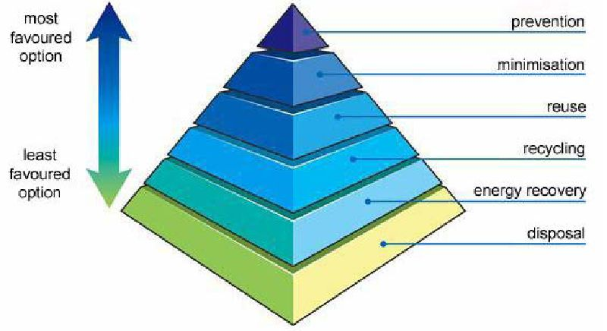
Recycling ….

Slide 21
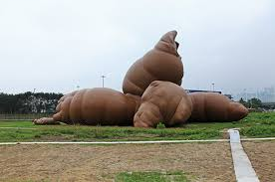
Where’s the dumping ground?

Slide 22

Things sometimes are the wrong way round

Slide 24
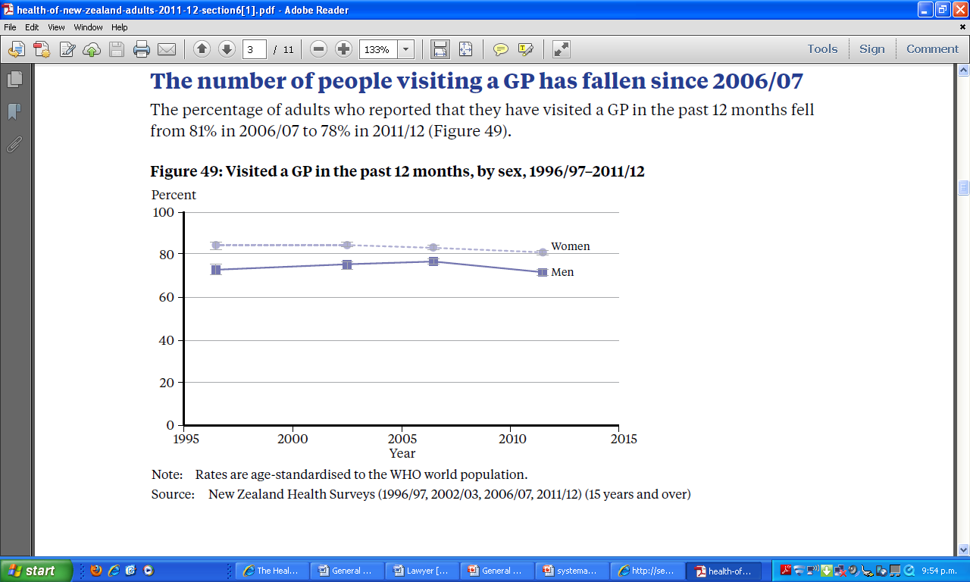
Relative Expenditure on Health – US$ Purchasing Power Parities
0
Canada 3165
OECD 2550
New Zealand 2083

Slide 25


Slide 26
Acute demand – what does it look like?
ED
Some increase: but national ED data prior to 2009/10 not robust
Acute inpatient (excludes short stay admissions <24 hours, electives, and mental health admissions)
2000 - 2009: increase from 323,000 to 371,000 pa - 2/3 in Auckland.
A 15% increase, but only 2.4% greater than the increase in population.
Notes:
Definition - it includes
All age groups
It excludes
Short stay admissions of 3 – 24 hours
Elective admissions
Mental health admissions – (consider including these – work in progress)
??arranged admissions – (yet to be confirmed whether its possible to include these)
.

Slide 27
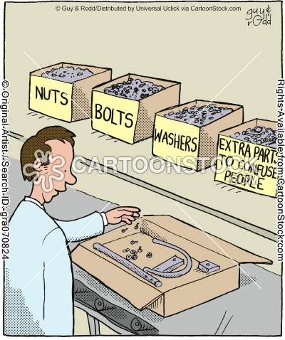
Satistics, Bureaucrats and fragmentation …

Slide 28
Bureaucrat
GP
ED consultant
Hospital
specialist

