Slide 1
Prof Ron Paterson
Parliamentary Ombudsman
Auckland

Slide 2


Indentured labourers?
Doctors under siege
GPCME Conference
Dunedin, 16 August 2013
Ron Paterson
Ombudsman

Slide 3
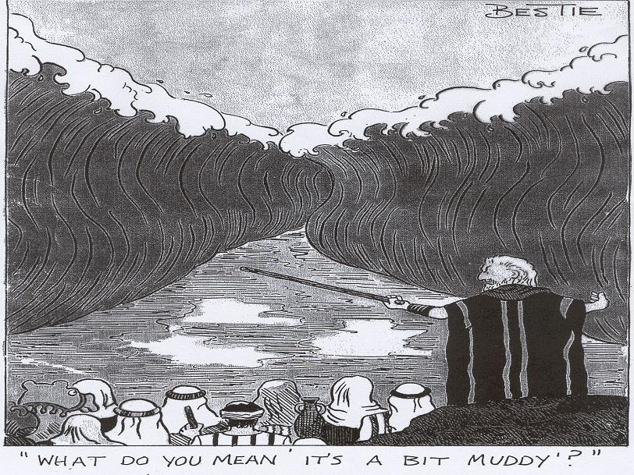

Slide 4
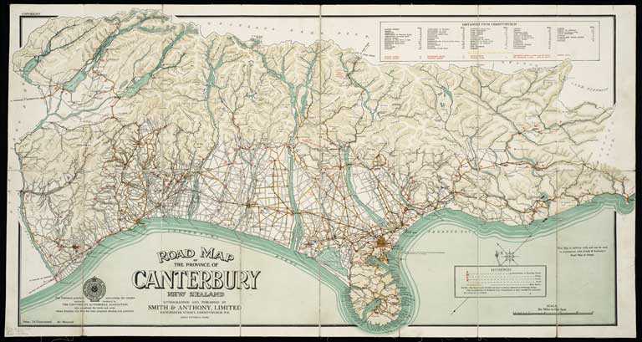
A roadmap
^{Overburdened doctors}
^{Trusting patients}
^{Challenges on the horizon}
Notes:
Road map of the province of Canterbury, New Zealand, 1910.

Slide 5
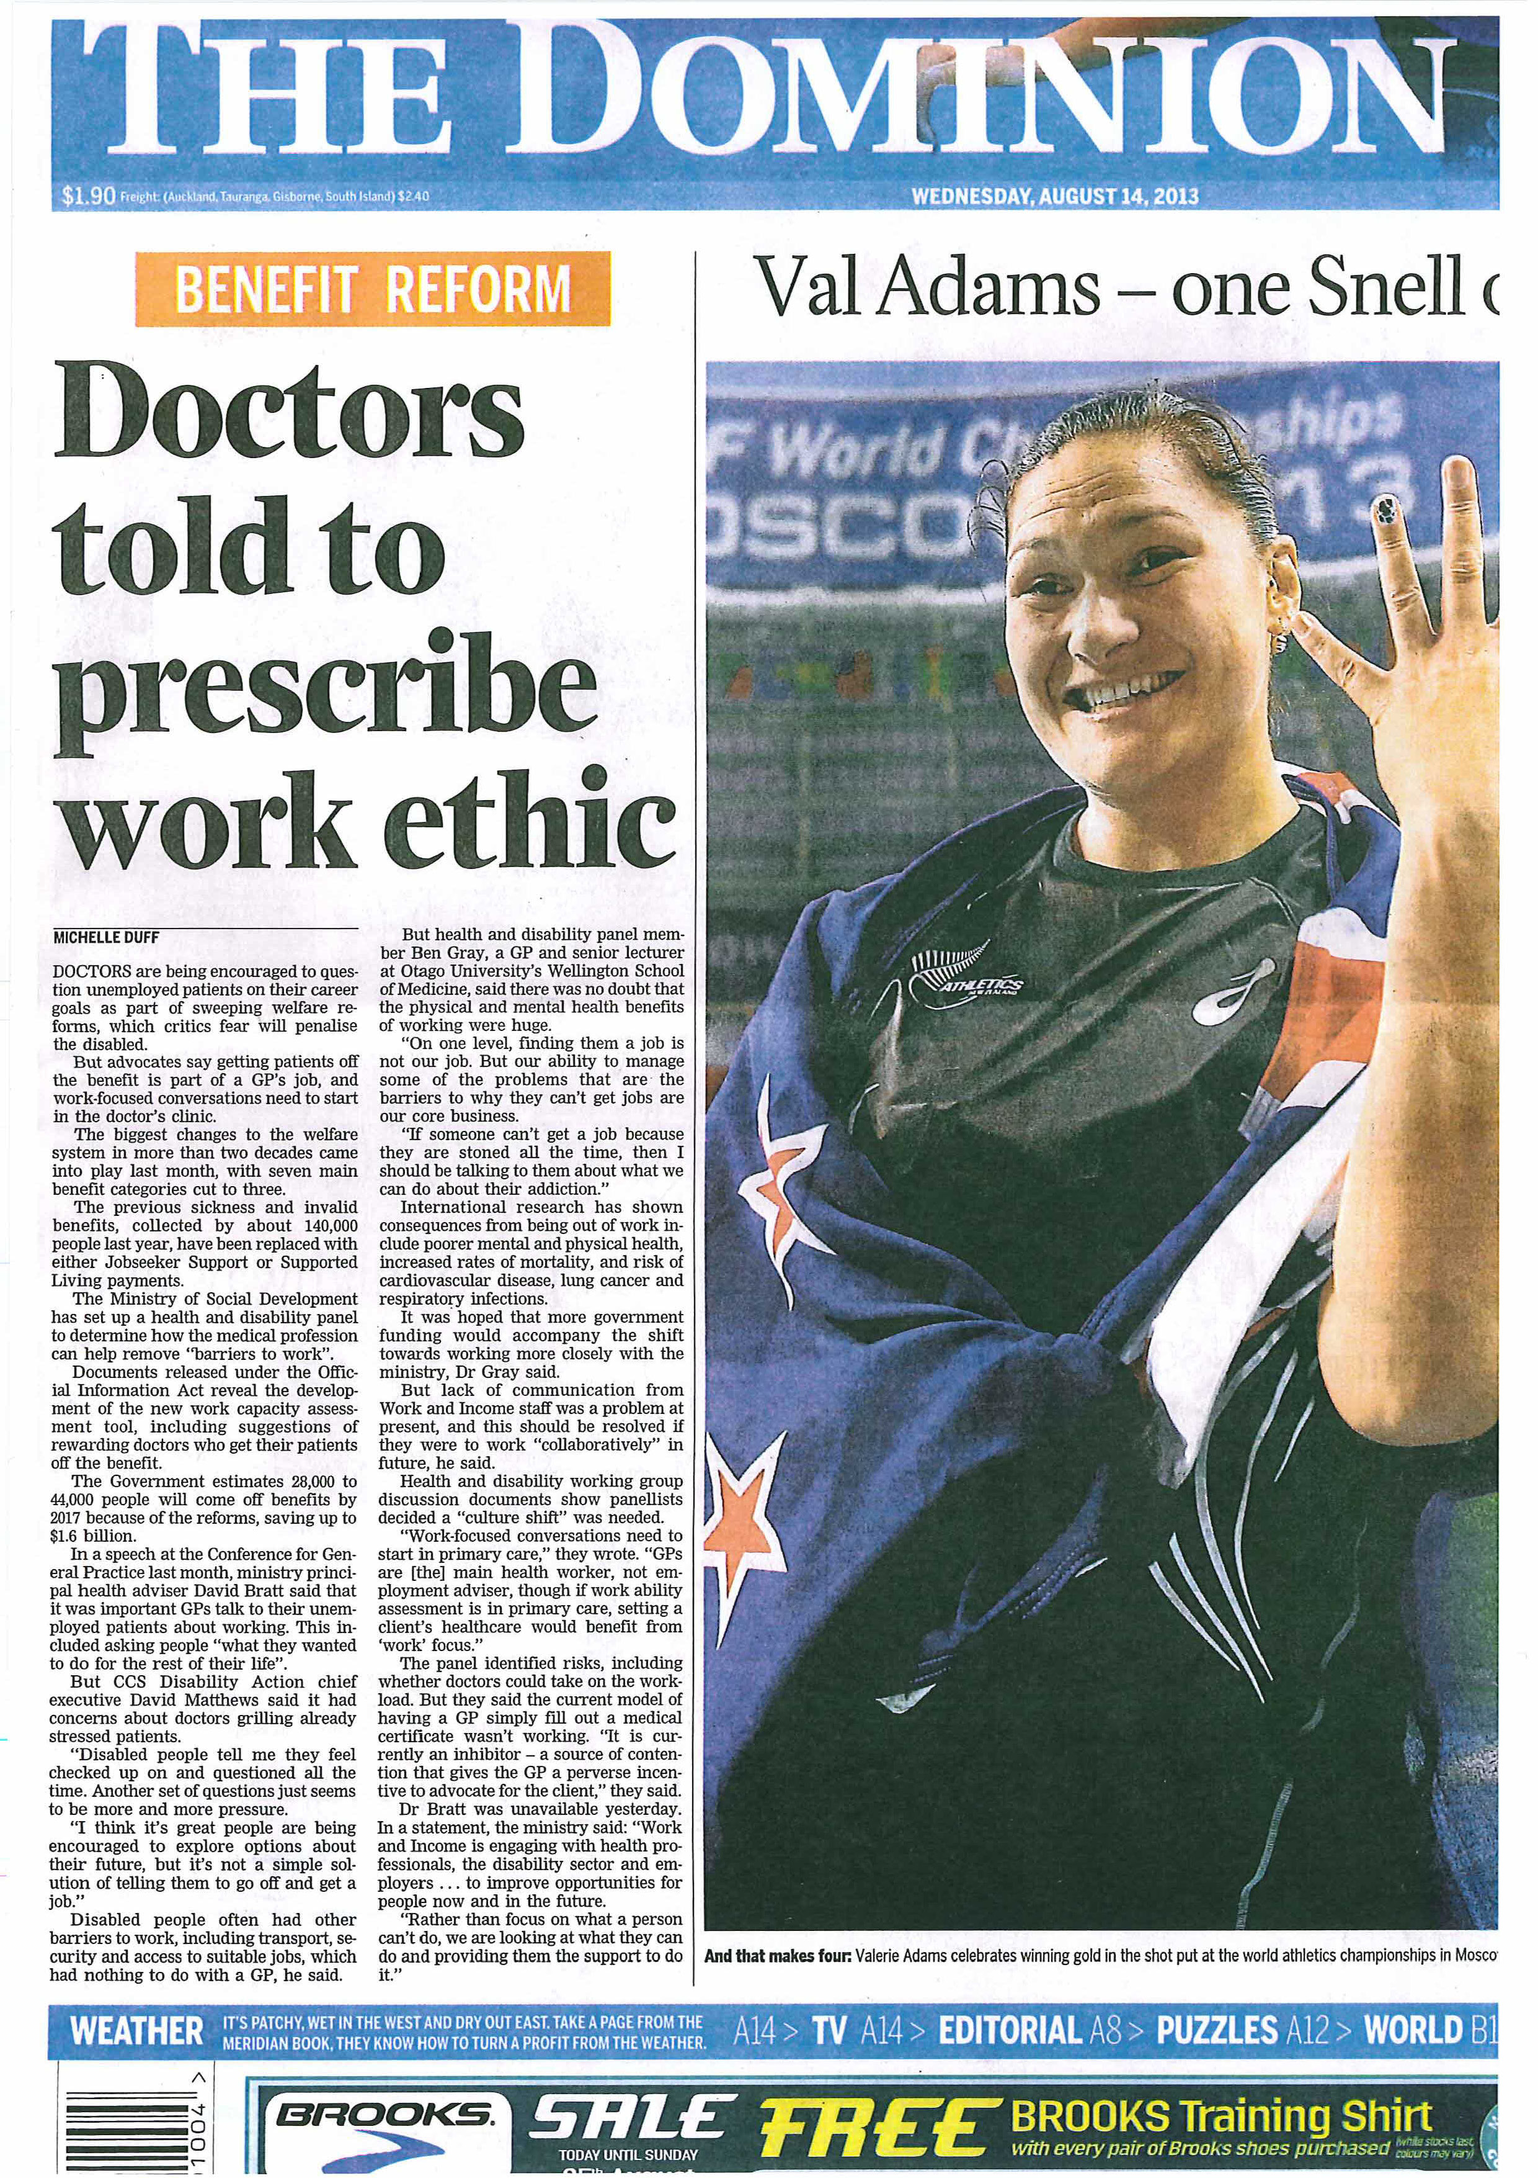

Slide 6
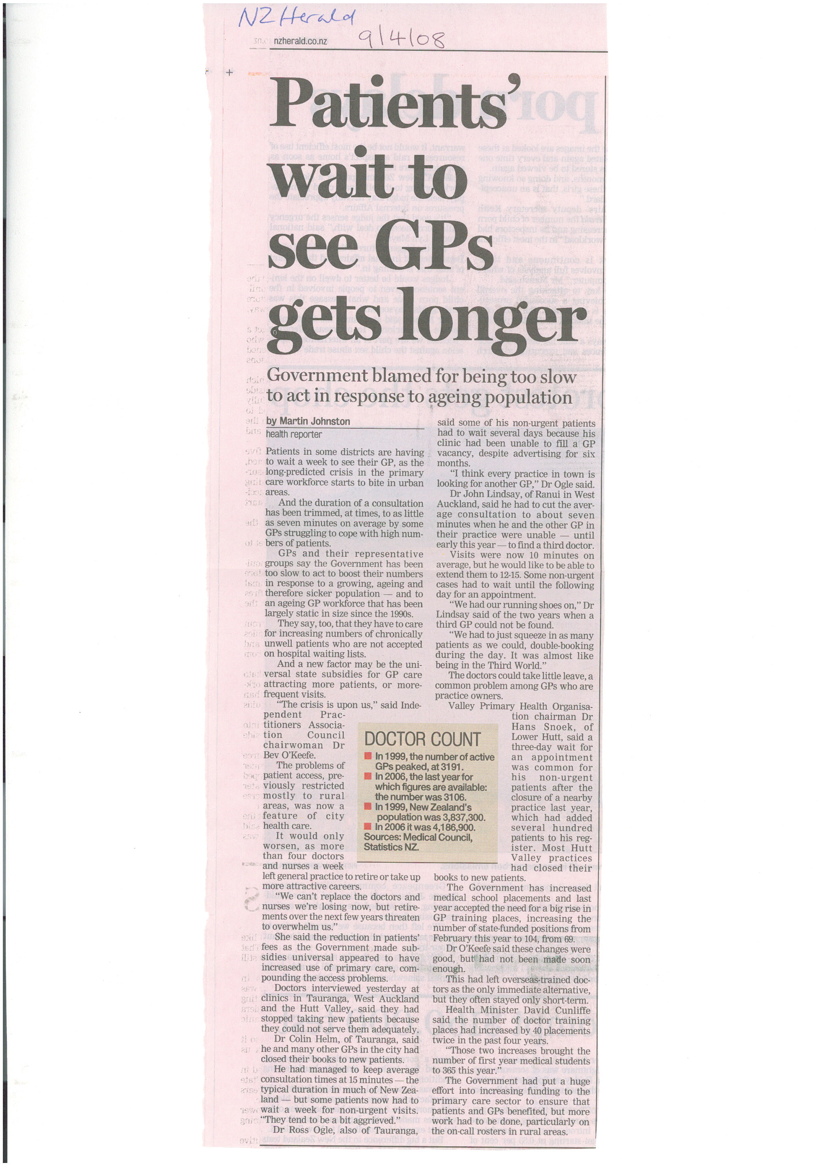
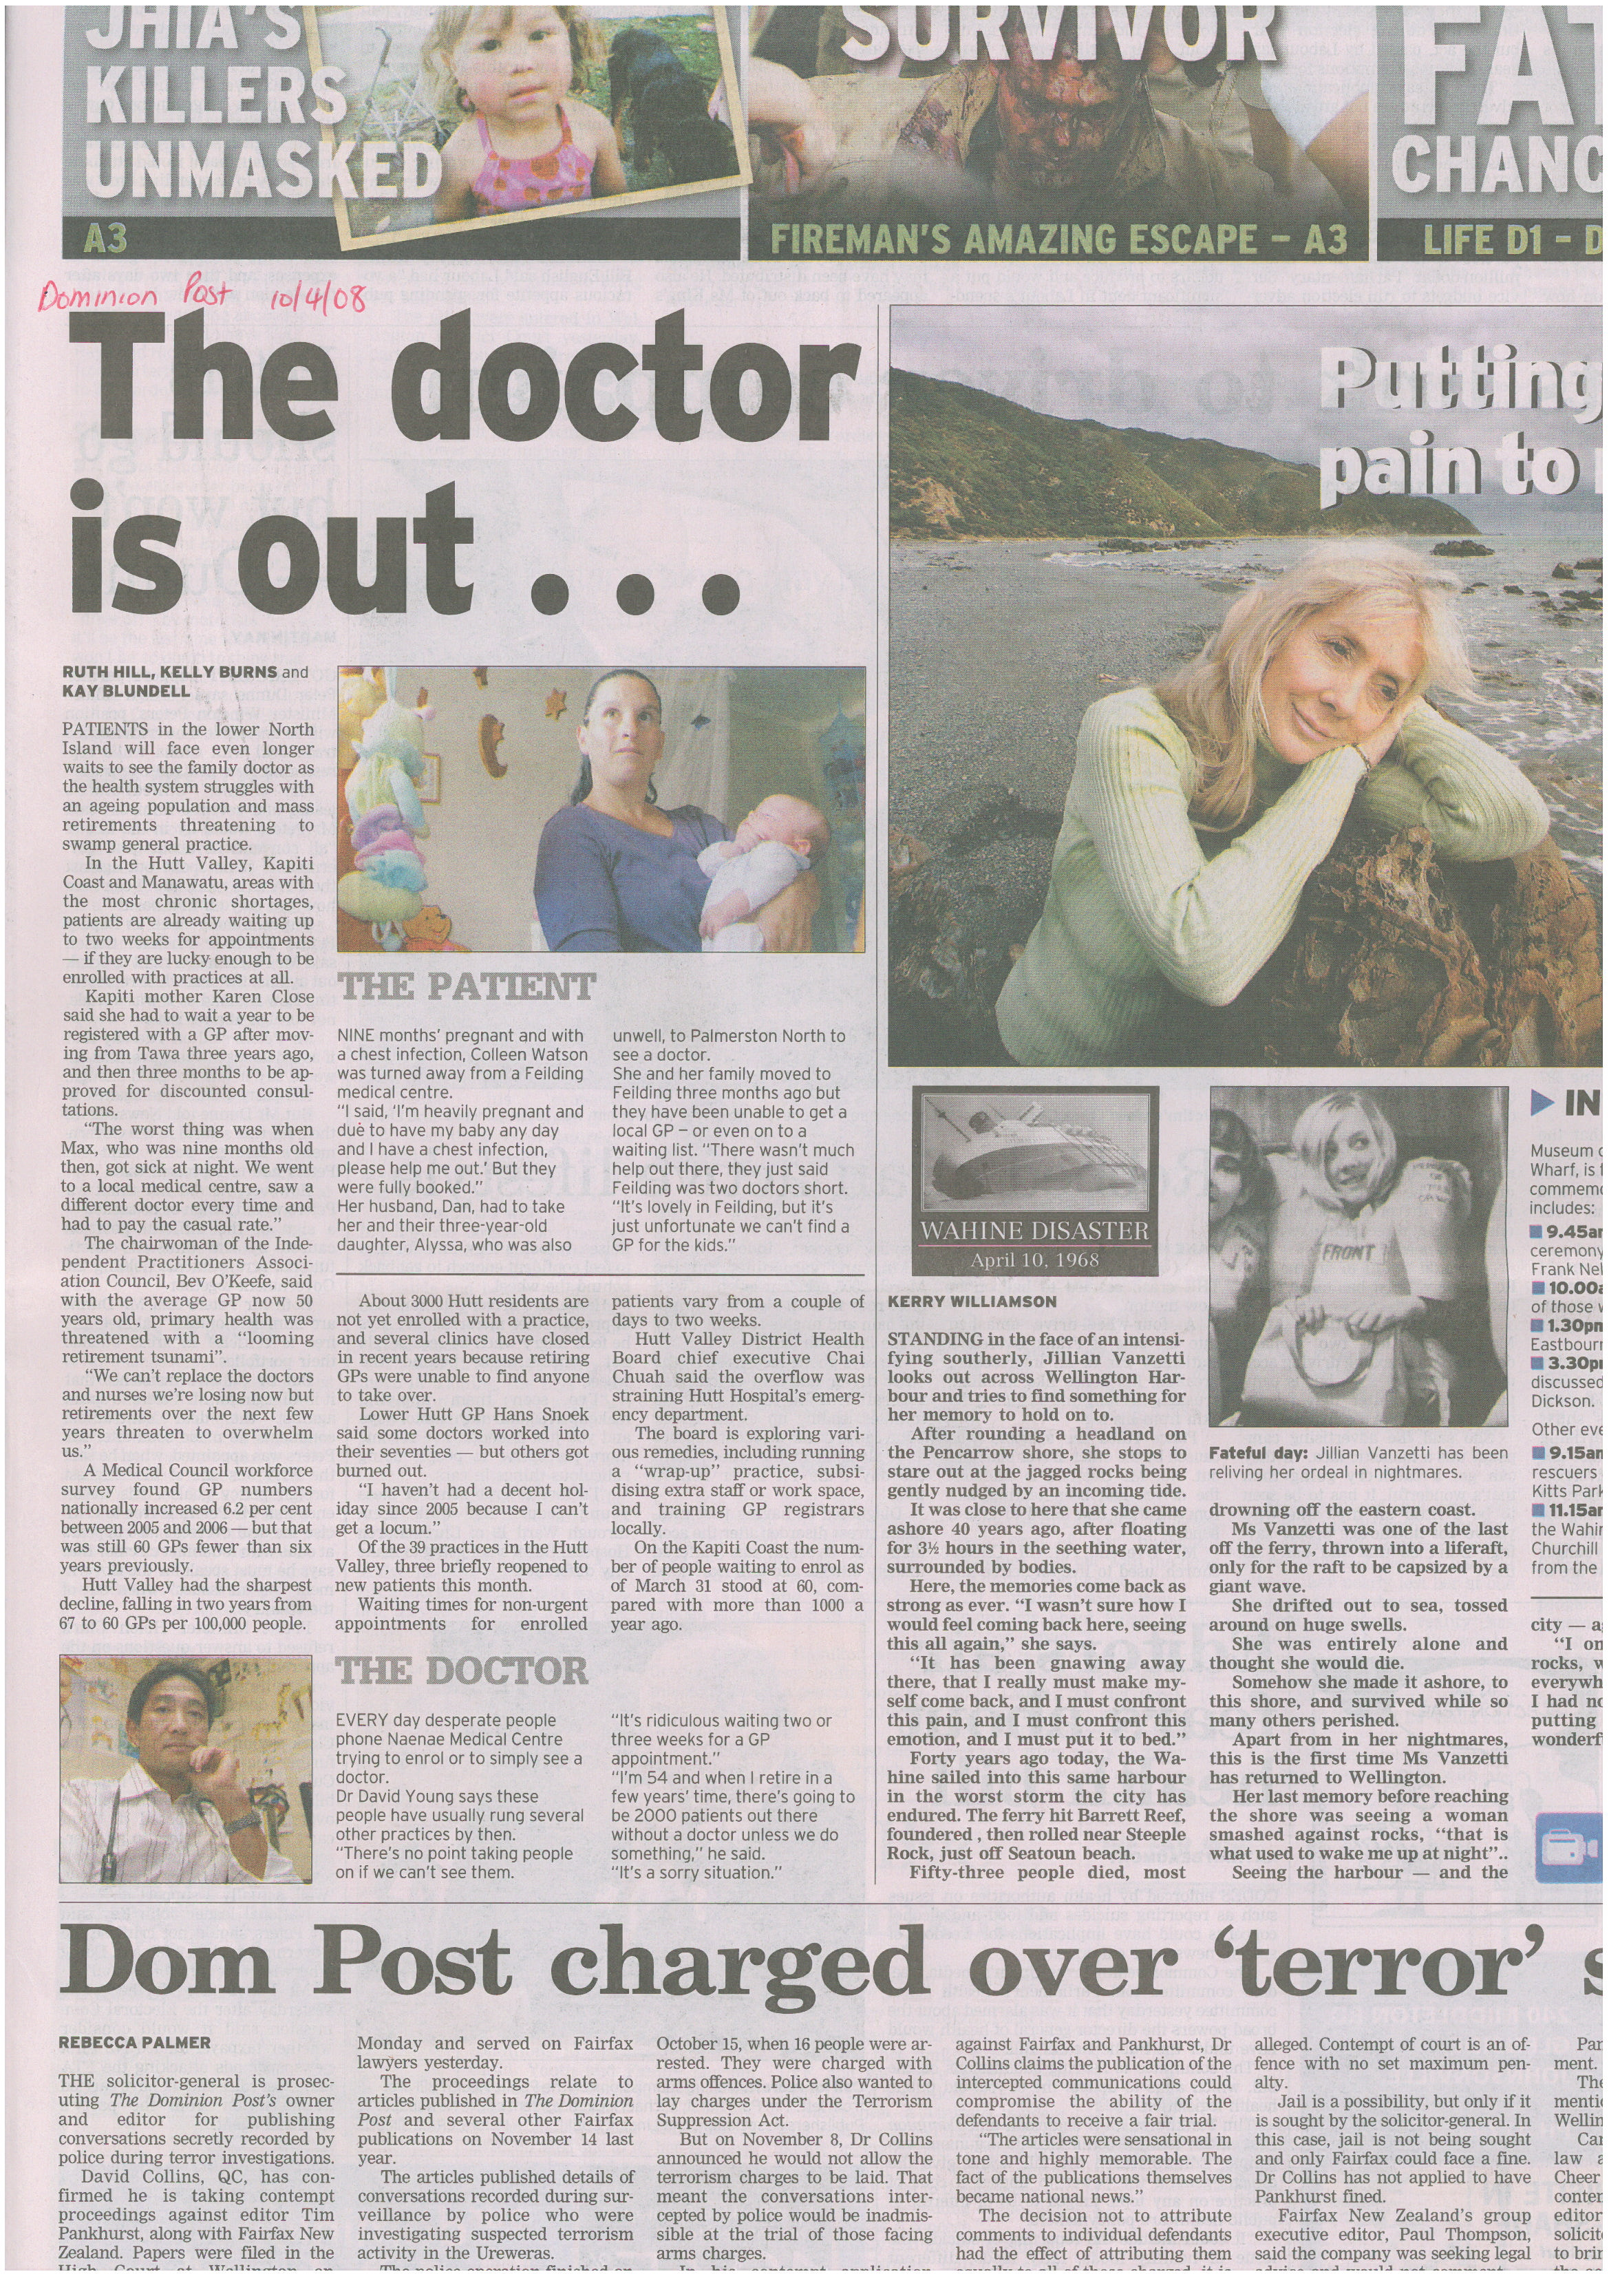

Slide 7
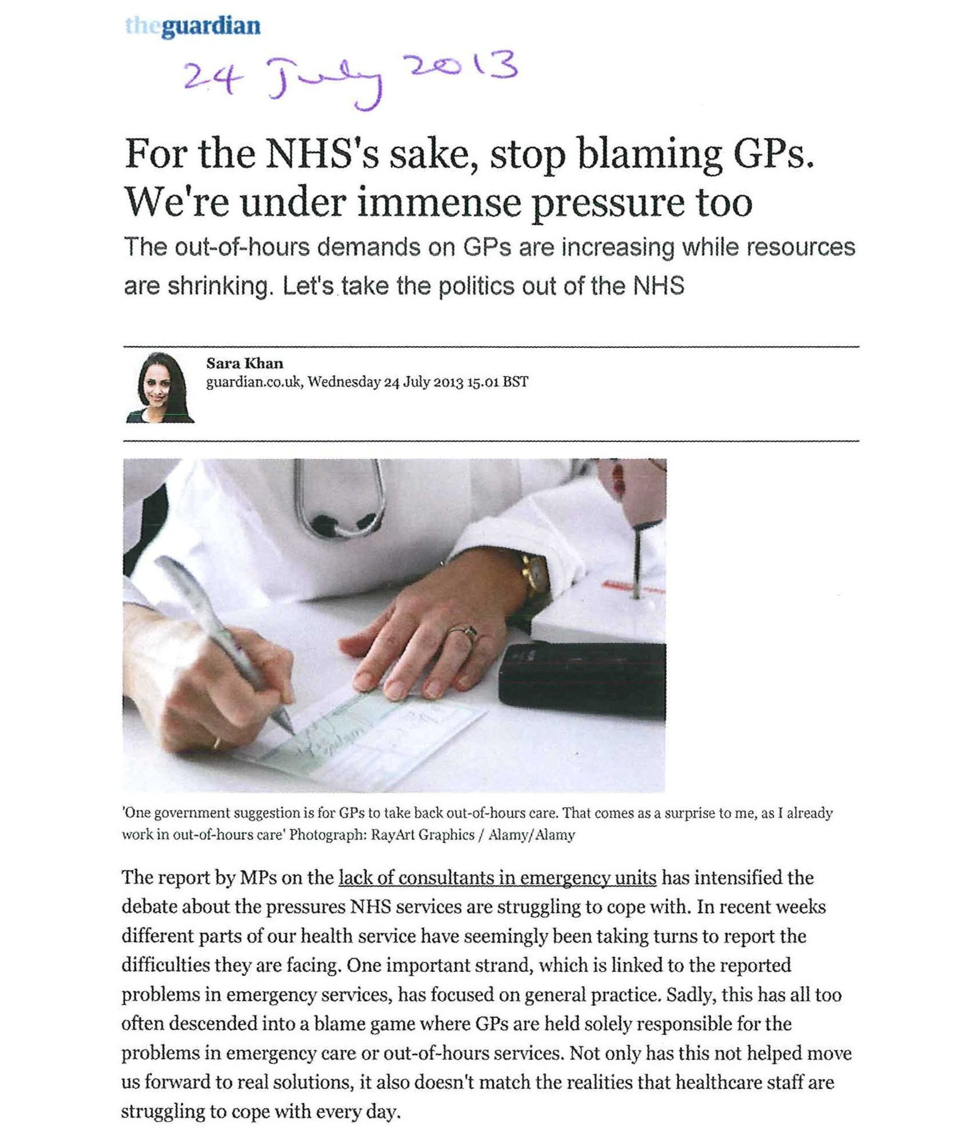

Slide 8
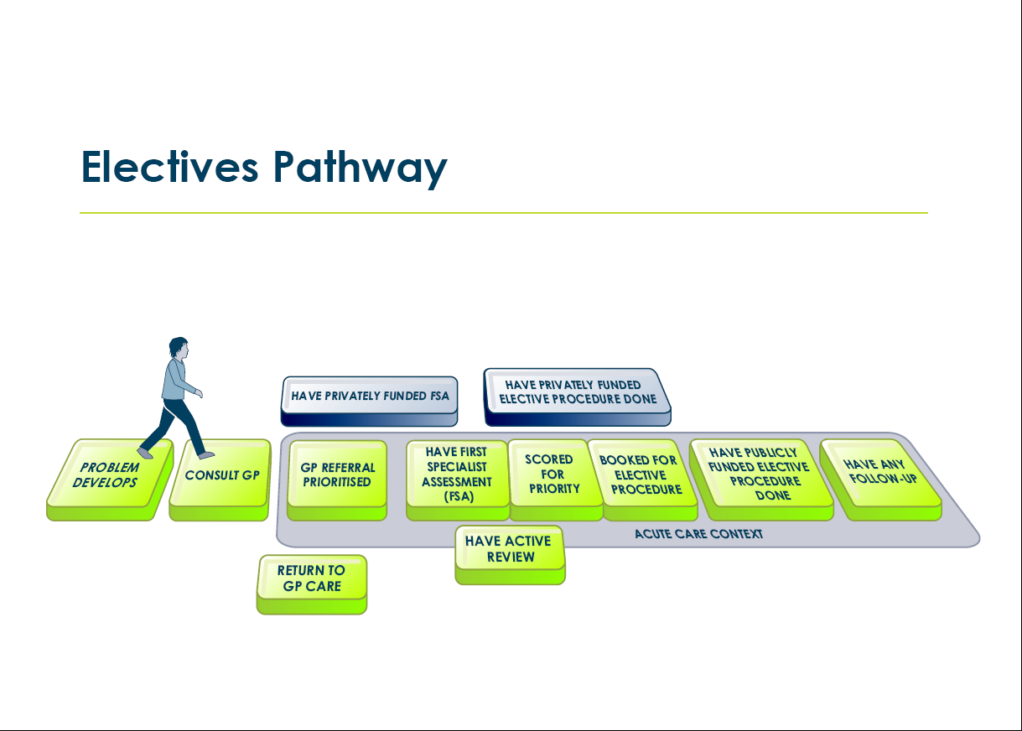
Patient pathway: electives

Slide 9
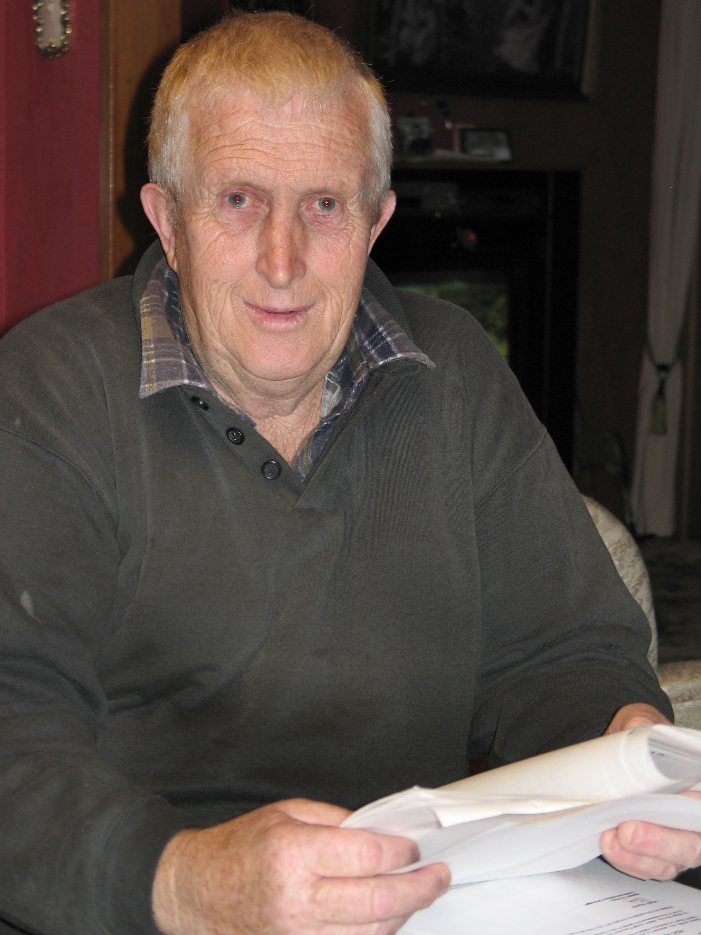
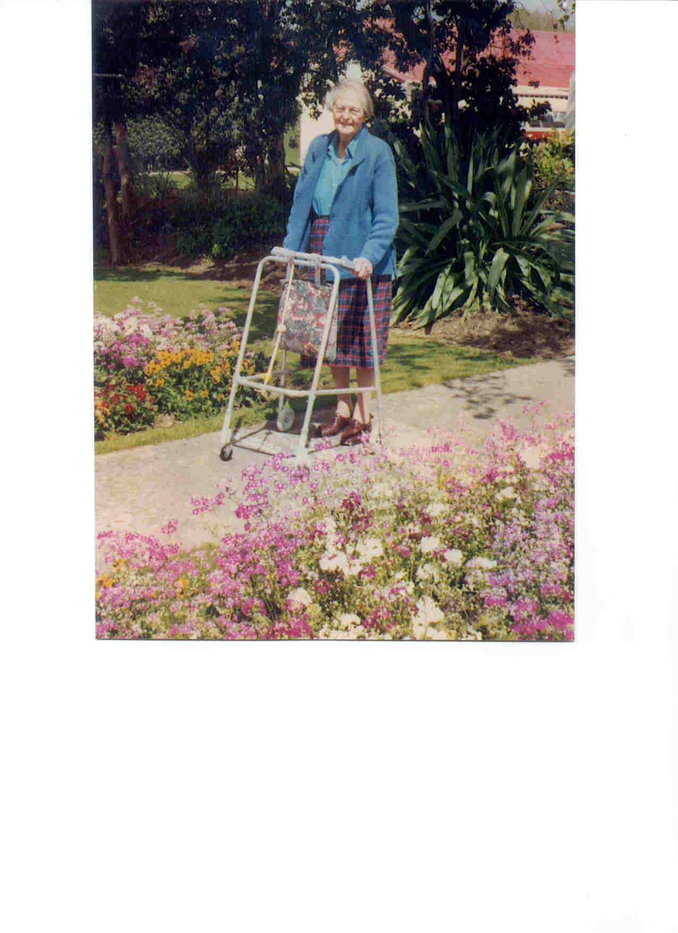
Cull or care?

Slide 10
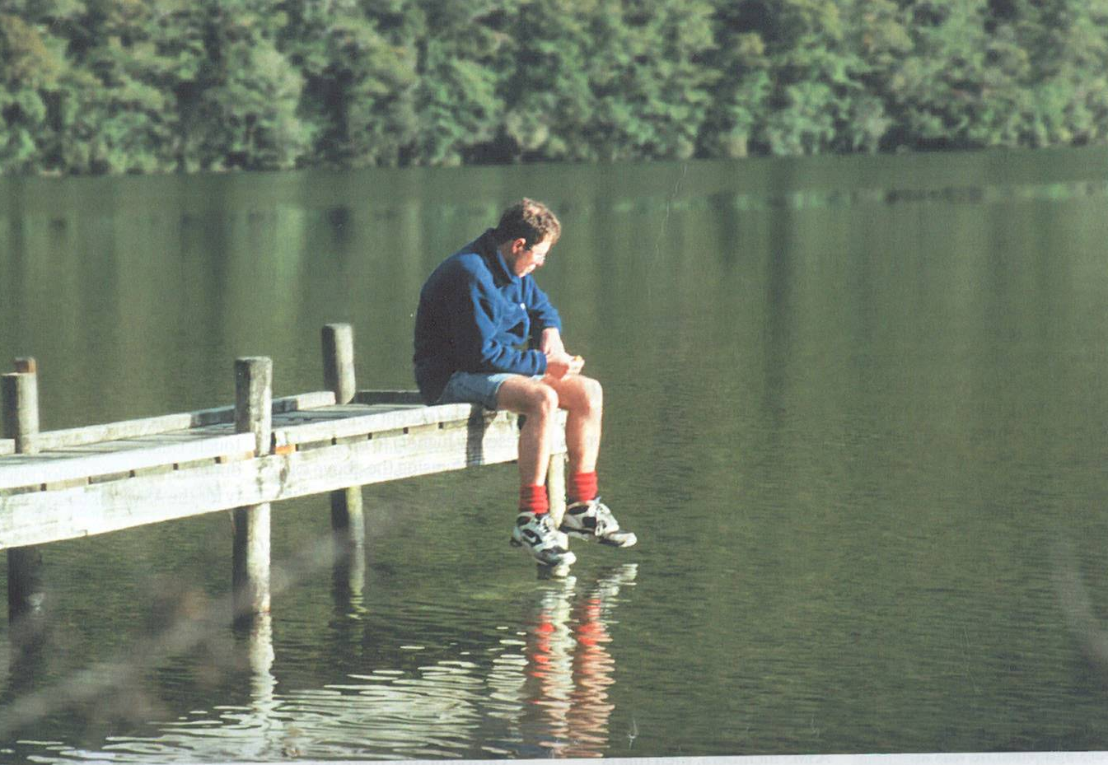
The lingering impact of a patient’s death
“I felt pretty awful about it, and I was made to feel awful.”
01HDC06949, 25 February 2003
Notes:
The current complaints process is slow, results in too many investigations, and is stressful on all participants. The Commissioner must investigate every complaint alleging substandard health care or disability services provided after 1 July 1996. However, pending legislation will give a discretion to determine whether an independent investigation is necessary or appropriate, and will ensure better information sharing between key agencies involved in complaints processes.
The New Zealand regulatory environment is intended to be rehabilitative rather than punitive, and the ‘no-fault’ compensation scheme for medical injuries is consistent with a systems approach to reducing errors and improving patient safety. An effective complaints system is an important complement to the bar on negligence claims. The New Zealand experience suggests that a patient complaints system within a ‘no fault’, universal coverage health system needs to be carefully balanced, if it is to achieve effective complaints resolution and lead to improvement in the quality of health care.

Slide 11
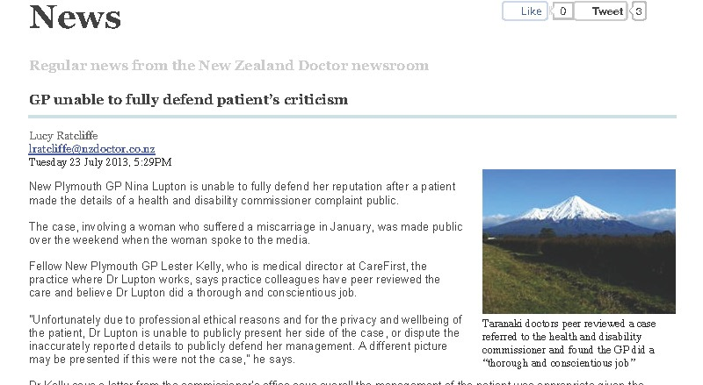

Slide 12
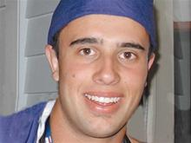
The paradox – naming
‘the innocent’
“[T]he affected health profs ... can take solace from the fact that … there is no finding by the Coroner that would remotely warrant negative publicity about them … ‘it is the system not the individuals that require attention’.”
Whaata J in Gravatt v Coroner’s Court, High Court, 4 March 2013

Slide 13
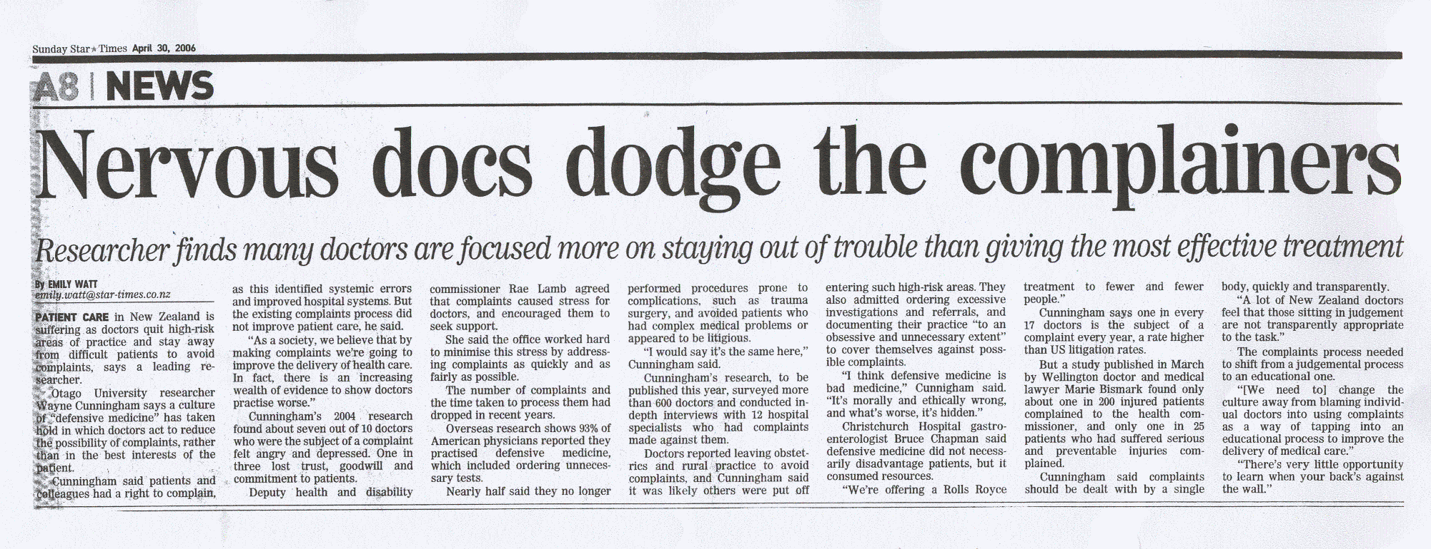
Notes:
₁
Claims that complaints fuel defensive medicine – Wayne Cunningham, 2006

Slide 14
A roadmap
^{Overburdened doctors}
^{Trusting patients}
^{Challenges on the horizon}
Notes:
Road map of the province of Canterbury, New Zealand, 1910.

Slide 15
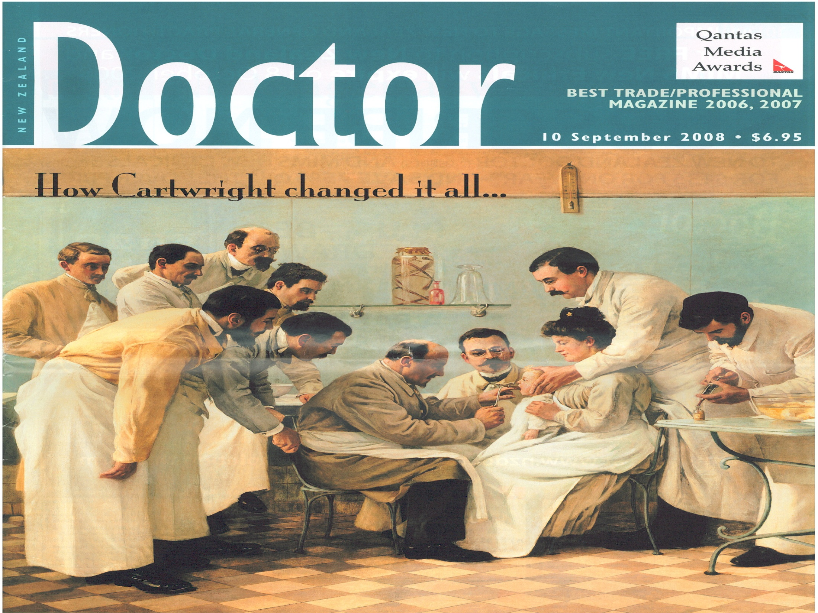
A roadmap
Competence
Professionalism
Problem doctors
Prescription for change

Slide 16
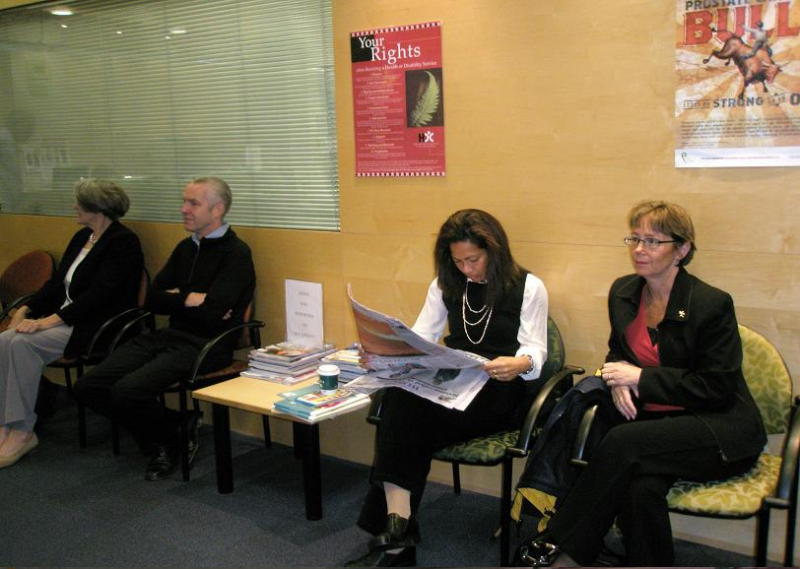
Notes:
Background to NZ Code. Right 5, the right to effective communication:
1) Every consumer has the right to effective communication in a form, language, and manner that enables the consumer to understand the information provided. Where necessary and reasonably practicable, this includes the right to a competent interpreter.
2) Every consumer has the right to an environment that enables both consumer and provider to communicate openly, honestly, and effectively.
Right 4(5) – cooperation between providers:
Every consumer has the right to co-operation among providers to ensure quality and continuity of services.

Slide 17
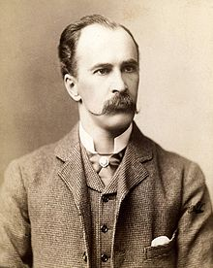

Slide 18
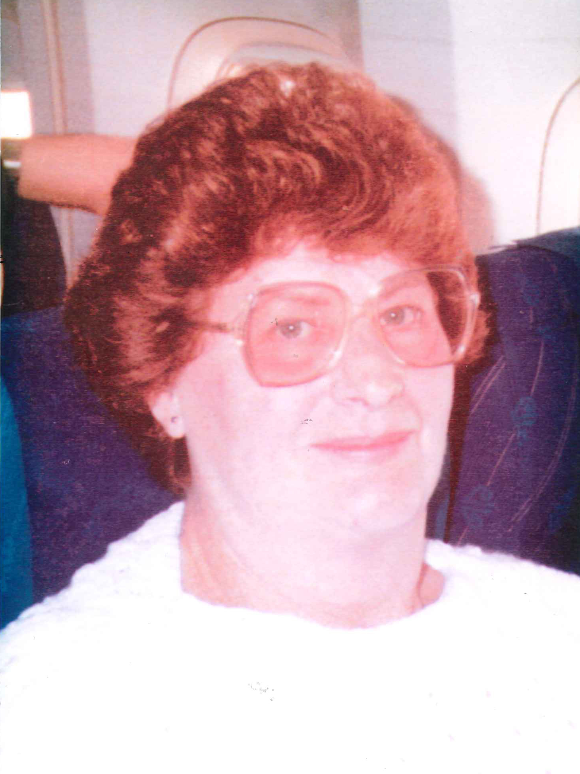

Slide 19
A roadmap
^{Overburdened doctors}
^{Trusting patients}
^{Challenges on the horizon}
Notes:
Road map of the province of Canterbury, New Zealand, 1910.

Slide 20
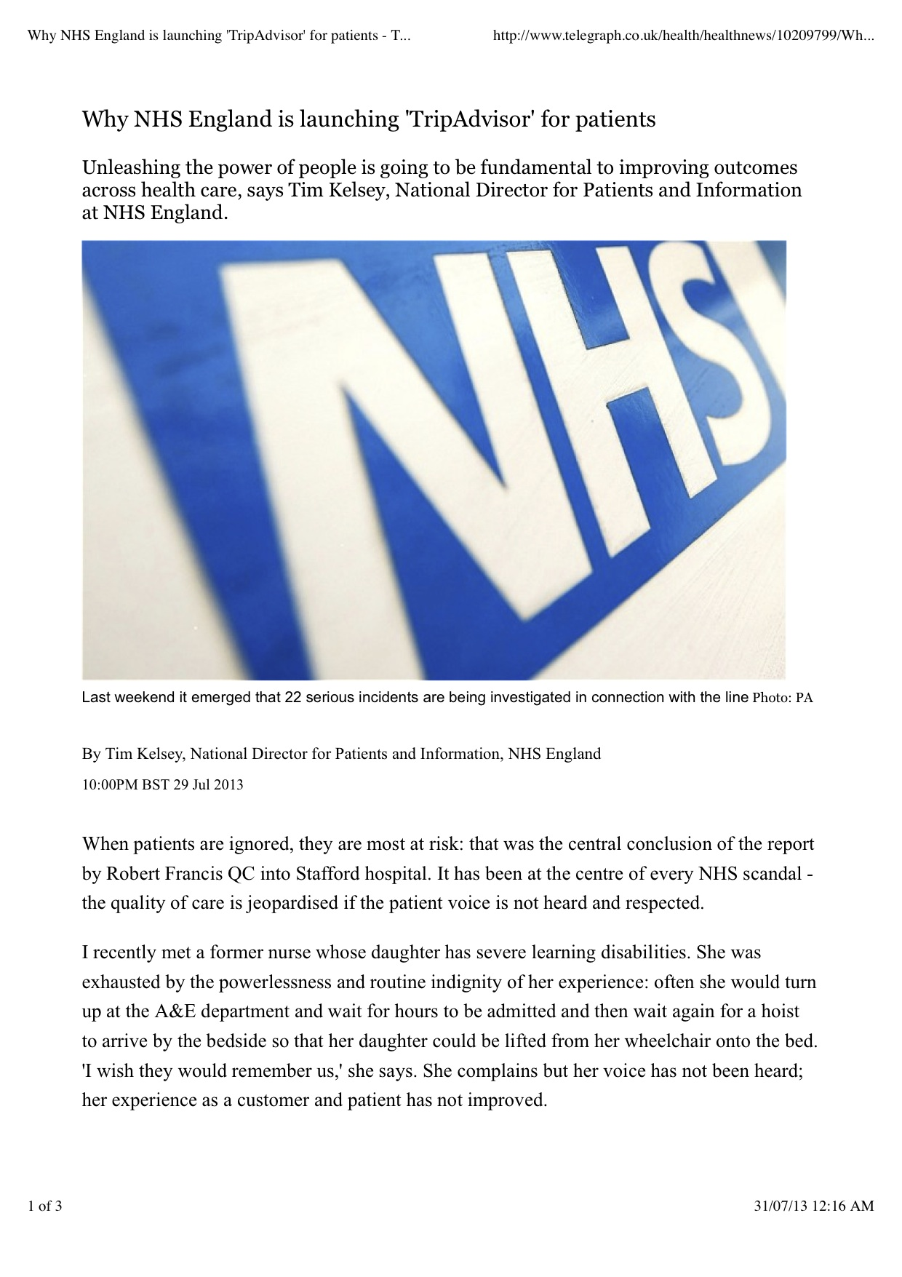

Slide 21
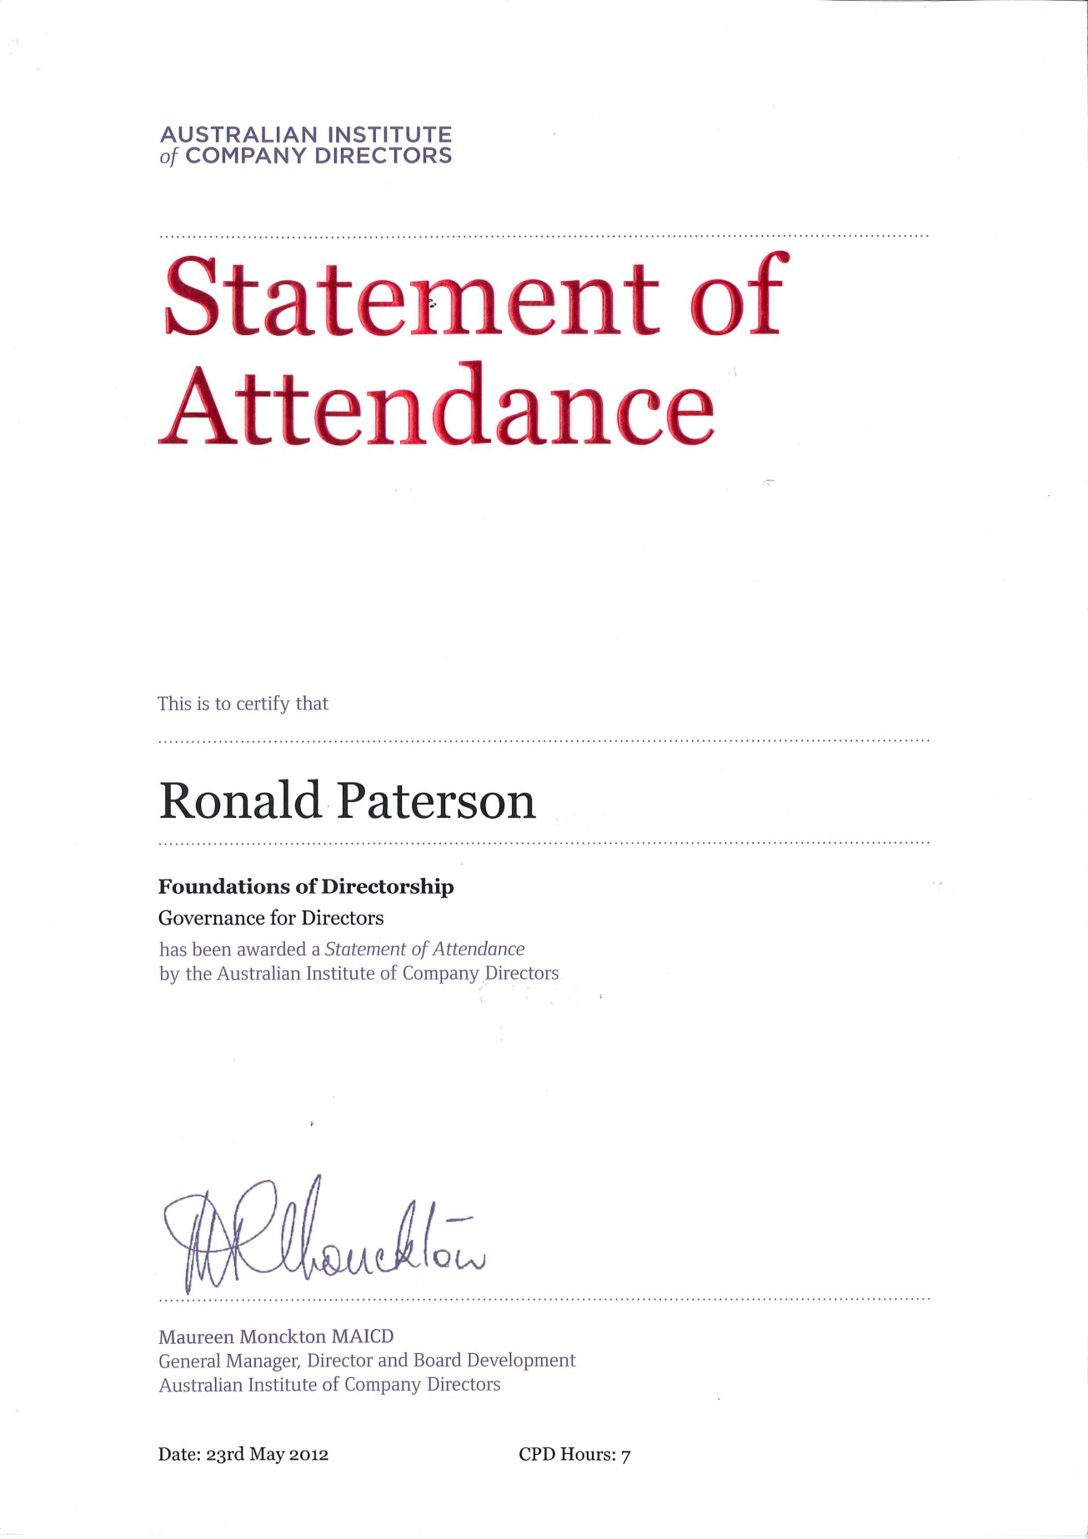


Slide 22
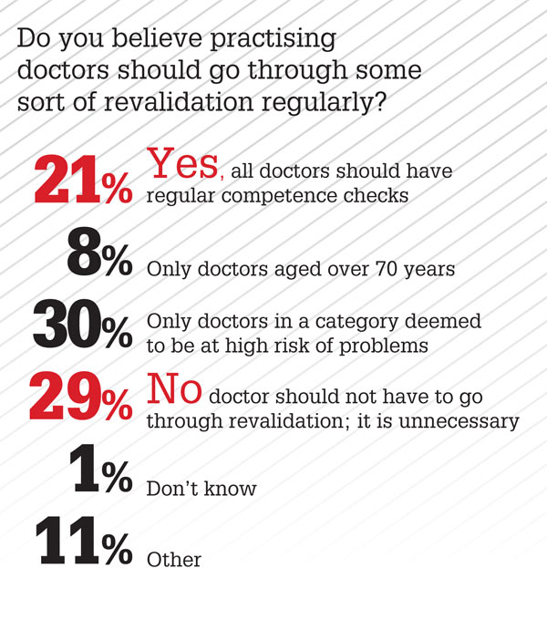

Slide 23
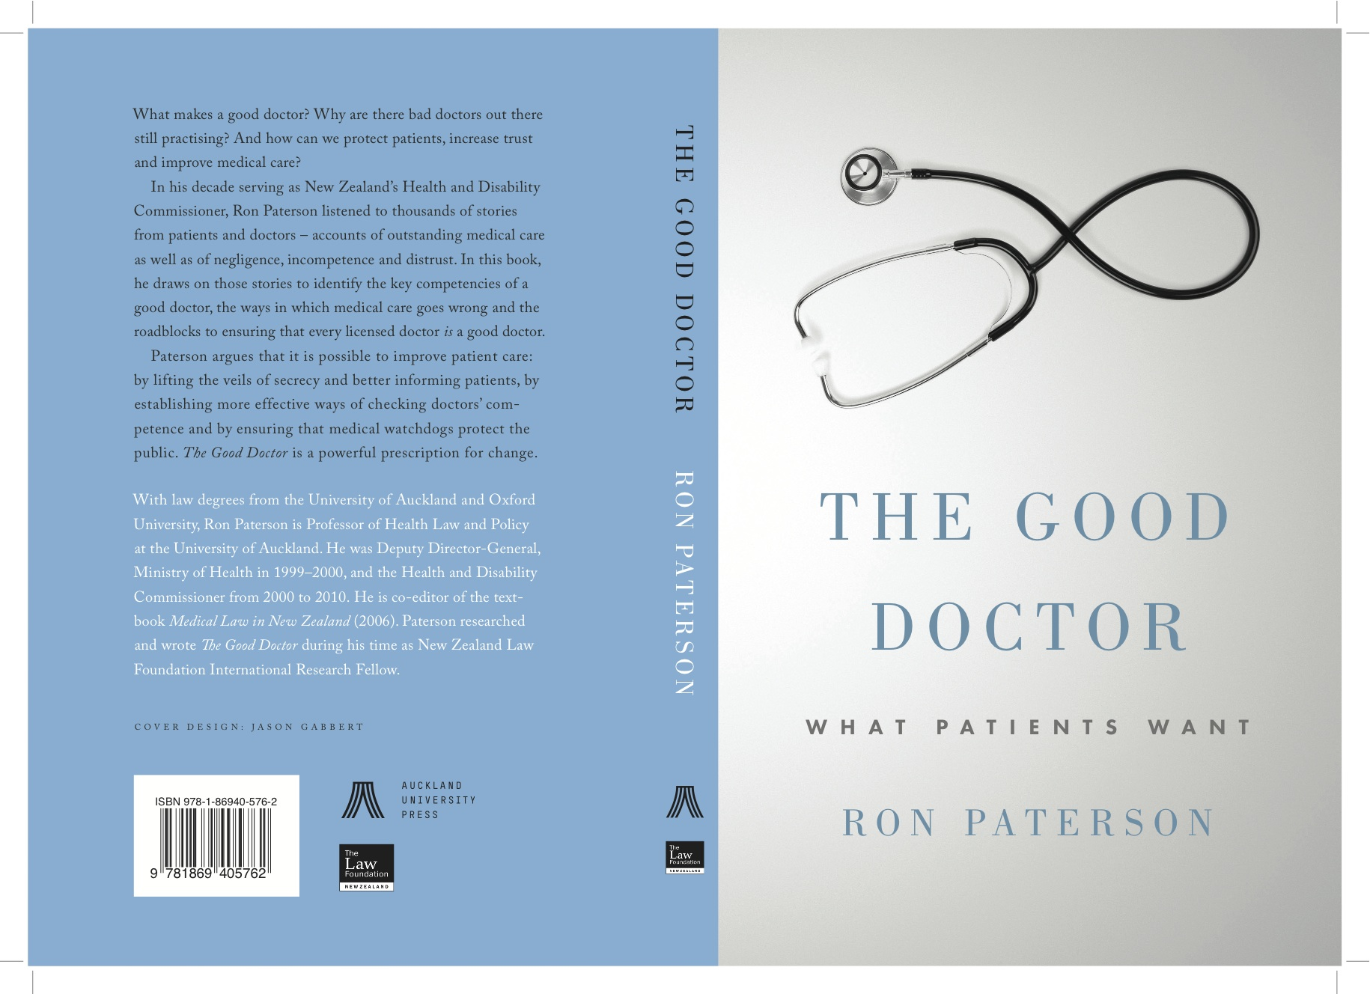
Good Doctors: Competence and Professionalism
Inaugural lecture
Ron Paterson
University of Auckland

