Slide 1

Prof Des Gorman
Professor of Medicine & Associate Dean
University of Auckland’s Faculty of Medical & Health Sciences

Slide 2
Meeting the healthcare workforce challenge in 2013/2014
Professor Des Gorman MD PhD

Slide 3
The HWNZ Mission
To ensure a healthcare workforce in New Zealand that is both sustainable and fit-for-purpose. Every element of the HWNZ work plan is expected to conform to the overall objectives of the National Health Board and consequently to result in:
  An improvement in individuals’ experience of their healthcare and better individual health outcomes; and
  An improvement in the health and wellbeing of New Zealand’s communities; and
  A reduction in the per-capita costs of healthcare.

Slide 4
Core HWNZ Strategies 2013/2014
The primary strategy for 2013/14 is to shift the onus for workforce planning to the health system providers and employers.

Slide 5
Core HWNZ Strategies 2013/2014
There are a number of secondary strategies. The first is to affirm the role of nursing across the continuum and to have systems in place to ensure a sustainable and fit-for-purpose nursing workforce over the next decade.

Slide 7
Core HWNZ Strategies 2013/2014
The second is to address the two major barriers to implementing workforce reform - the overall low standard of clinician leadership and the inadequate state of much of the necessary health system intelligence.

Slide 8
Core HWNZ Strategies 2013/2014
The third is to focus the HWNZ innovation program and where the targets in 2013/14 will be; (a) to reinforce the necessity for regional service and workforce plans; and, (b) to address the workforce shortfalls and other limitations to elective service throughputs and a national roll-out of bowel cancer screening.

Slide 9
Core HWNZ Strategies 2013/2014
Finally, some deliverables are direct and essential responses to the extraordinary change in medical workforce dynamics that have occurred over the last three years – and one is the necessary ongoing work to ensure that the general practice medical workforce will enable a substantial shift of the point of care delivery from hospitals into the community, and, in turn, into the home.

Slide 10
Themes and principles underlying the 2013/2014 HWNZ work plan
Implementing and improving on an accountable, transparent and (as much as is possible) contestable purchasing process.
Creating and maintaining an environment in which (disruptive) innovations are business as usual.
Improving the standard of clinician leadership and health system intelligence.

Slide 11
Themes and principles underlying the 2013/2014 HWNZ work plan
Ensuring that the “systems” for health workforce training are fit for purpose and sustainable.
Preferential investment in the healthcare workforce necessary to underpin national health targets and priorities.

Slide 12
Themes and principles underlying the 2013/2014 HWNZ work plan
Preferential investment in practitioners with a general scope of practice and a shift in investment to community-based healthcare workforces.

Slide 13
The Healthcare Triple Aim
Don Berwick and the IHI.
Increased employment of optometrists in glaucoma and macular degeneration healthcare as an exemplar of the Healthcare Triple Aim in practice.

Slide 14
The purchasing process
HWNZ has:
HWNZ does not have:
an oversight responsibility for “cradle to grave” planning of the entire healthcare and disability workforce; and
funding to purchase postgraduate healthcare workforce education.
funding to purchase undergraduate healthcare workforce education; or
an employment or healthcare provision role.

Slide 15
The purchasing process
Up until 2009: “bulk funding” of DHBs by the CTA.
2009-2012: transition to a new funding model.
2012 onward: an accountable, transparent and contestable purchasing process.

Slide 16
The purchasing process
2012 onward: an accountable, transparent and contestable purchasing process.
  70% upfront on agreement of trainee numbers, appropriate service and workforce plans, and necessary support resources.
  20% six months later based on performance (recruitment of agreed trainee numbers, trainee and professional body satisfaction).
  10% contestable for critical and vulnerable workforce investment.

Slide 17
The origins of the second and third themes
NZIER (2013) conservatively predicts 8% per annum growth in the costs of healthcare in New Zealand over the next decade.
  The two major drivers are the ageing of the community and the cost of recruiting and retaining an also ageing healthcare and disability workforce to meet that demand.
The status quo of healthcare models and service configurations is not a tenable response to this challenge.

Slide 18
NZIER (2005)
NZ Population Projections by Age Cohort
(Assuming medium population growth)
400,000
2001
2011
2021
350,000
300,000
250,000
200,000
150,000
100,000
50,000
0
0-4
5-9
10-14
15-19
20-24
25-29
30-34
35-39
40-44
45-49
50-54
55-59
60-64
65-69
70-74
75-79
80-84
85-89
90+

Slide 19
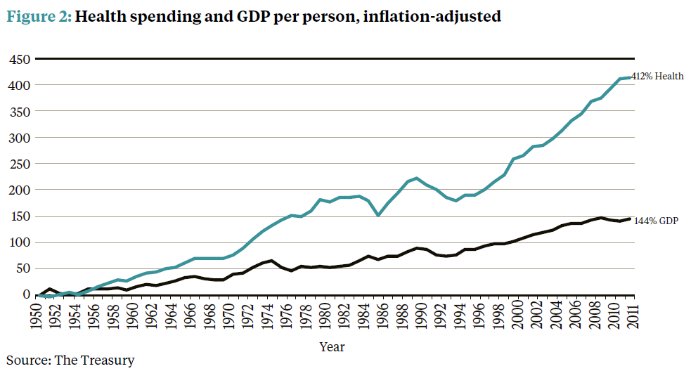

Slide 20
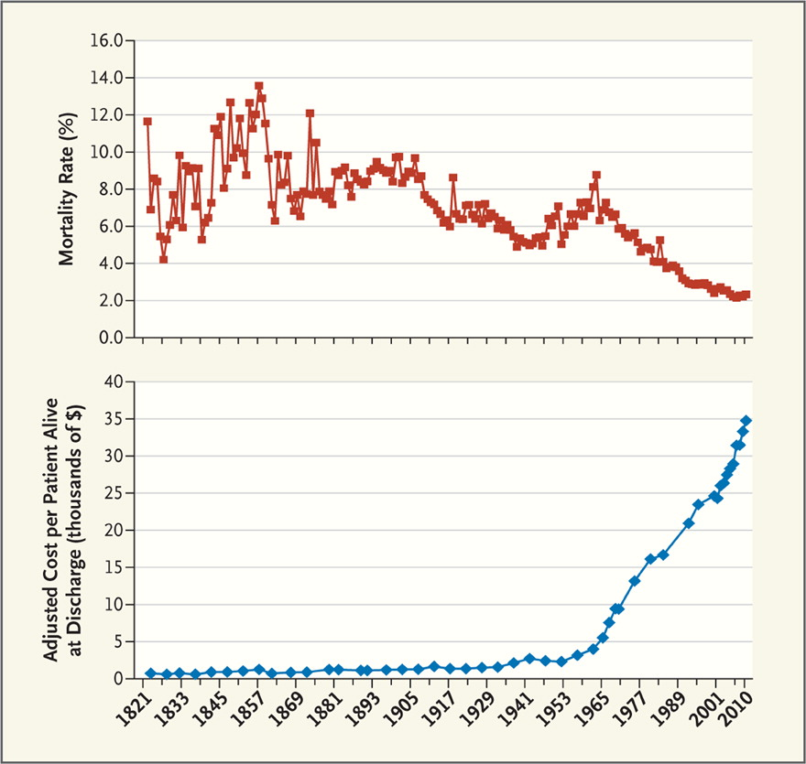

Slide 21
Disruptive innovations as business as usual
Early phase of HWNZ investment in disruptive innovation demonstrations is now complete.
Ongoing and future HWNZ investment in disruptive innovation demonstrations is and will be largely linked to DHB and regional service plans.

Slide 22
Investment in clinician leadership and healthcare intelligence
Two major barriers to health system reform identified as a shortfall in clinician leadership and poor health care intelligence (as compared to data).
First clinician leadership initiative arose from public forum.
Underpinning policy work underway to underpin HWNZ investment.

Slide 23
Investment in clinician leadership and healthcare intelligence
‘Reform’ of RA’s designed to (1) improve the consistency and quality of workforce regulation, (2) to make the data collected useful, and (3) to achieve economies.
Successful development and now widespread use of the service forecast approach to workforce planning (as compared to craft group specific planning that is based on some pre-determined future health system milieu).

Slide 24
Investment in clinician leadership and healthcare intelligence
International collaborations.
  Leadership role in IHWC.
  Close relationship with HWA.
    Ongoing joint-venture to determine the New Zealand response to the ‘over-supply’ of medical graduates in Australia.
    Ongoing joint-venture to determine an Australasian response to the predicted significant shortfall of nurses over the next decade or so.

Slide 25
Development and facilitation of regional training hubs
The Medical Training Board’s and the RMO Commission’s recommendations.
Standards expected of the regional training hubs as a prerequisite for HWNZ funding.
A focus on appropriate apprenticeships (internships) for doctors, nurses, midwives, psychologists, and so on.

Slide 26
National health targets and priorities
Preferential investment in the healthcare workforce necessary to underpin national health targets and priorities.

Slide 27
Investment in generalism and community-based workforces
A doctor-led, sub- specialised and hospital-based system was an appropriate response to an acute disease burden, which was often communicable. The current and future healthcare burden is predominantly chronic and non-communicable.
An affordable health care system will depend upon slowing down the rate at which new hospitals are built.

Slide 28
Increased cost and reduced independence
What is necessary to shift care in this direction?
Hospital based care
Care in community based residential facilities
Care at home with and without special assistance

Slide 29
Investment in generalism and community-based workforces
A shared care record to underpin integrated care.
A new way of funding services and of rewarding providers and consumers.
A diversified and fit for purpose community based health workforce that works as much as is possible at the “top end of their licence.”
Genuine patient-directed and centred care.

Slide 30
Themes and principles underlying the 2013/2014 HWNZ work plan
Details of HWNZ work plans are available at: www.healthworkforce.govt.nz

