Slide 1
Dr Stephen Child
GP / Director of Clinical Training
Auckland District Health Board

Slide 2
Will the Doctor Please Stand Up?
-Dunedin, August 2013-
0
Dr Stephen Child
MD, FRACP, FRCPC
General Physician/Respiratory Interest
Deputy Chair, NZMA
Director of Clinical Training
Auckland District Health Board

Slide 3
Outline
0
13 min
We have a problem?
Leadership is key?
How to lead?
Professionalism

Slide 4
The Problem
0
$
“Healthy” population
- Quality of life
- Productivity

Slide 5
Big Picture
+$1.1 b – ACC
=83% Public $
$2987/person
10.1% of GDP
Social Security
(33%)
Education
(17%)
20%
($14.1 b)
17% “Private”
insurance
pocket
non-profit org
Defence
Government Services
Law & Order
Transport
Economic Services
$ 70.5 billion

Slide 6
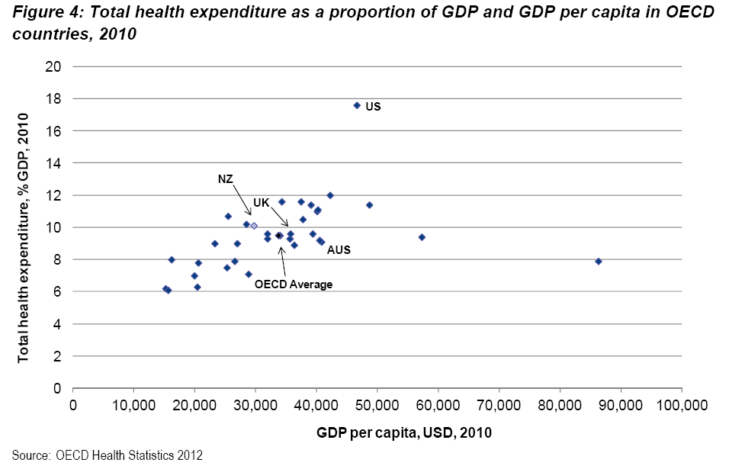

Slide 7
How measure?
Life Expectancy
Other
Amenable Mortality
Performance
Productivity
In-hospital care
Access
Ambulatory – Sensitive Hospitilisations
inter
…. and how “benchmark”
intra

Slide 8
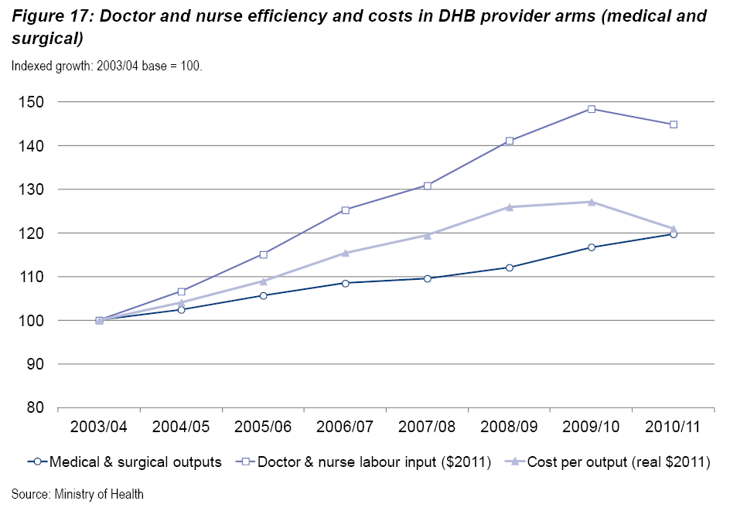

Slide 10
Examples
Pharmacy
Warfarin prescribing
immunisation
“designated” prescriber legislation
Nursing Council
3 level nurse prescribing
Physician Assistants Demonstration Projects
Clinical Assistants Trial
Theatre Assist Projects
etc

Slide 11
Minute Clinic
QuickMedx – 2000 St.Paul,Mn
2005 = 19 clinics ……2009 = > 600 clinics
JCAHO accredited
> 12 million/year

Slide 12
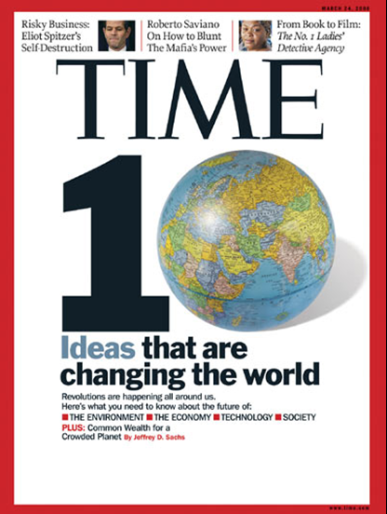

Slide 13
Internet
Mexico (2010) | = 10% via mobile phone
US( 2011 ) | = 68% happy with e-consult
 | = Google diagnosis = 15/26

Slide 14
Internet
NZ | = 60% used internet for Dx (2007)

Slide 15
What does this mean for us ?

Slide 16
Role of Doctor
“Doctors regularly take ultimate responsibility for medical decisions and diagnoses …”
Role of Doctor consensus statement, NZMA, 2011

Slide 17
Role of Doctor - Leadership
“Doctors have a key role in providing higher level sector leadership …. (and) … have a responsibility for ensuring patient safety and monitoring both individual and service level outcomes”
Role of Doctor consensus statement, NZMA, 2011

Slide 18
Leadership
MOH | = 111 hits
Business Unit | = “Clinical Leadership Protection and Regulation (CLPR)

Slide 19
“Good Leadership begins with solid values”
Transformational Leadership
Jeffrey Gandz

Slide 20
American Charter of Professionalism
Professional competence
Honesty with patients
Patient confidentiality
Maintaining proper relationships with patients
Improving quality of care
Professional responsibilities
Just distribution of finite resources
Scientific knowledge
Maintaining trust by managing conflict of interest
Improving access to care

Slide 21
Professionalism – Patients Perspective
N = 953 55 items 1 – 5 score
1) | Respecting confidentiality | 4.60
2) | Respecting patient autonomy | 4.47
3) | Treating fairly and without prejudice | 4.47
4) | Behaving honestly and with integrity | 4.45
RCP, Clin Med 2010, Vol 10(4):364-9

Slide 22
Honesty and Integrity?

Slide 23
Professional?
Cancel public list for “private” benefit
Commercial benefit via devices
Unnecessary treatment eg. skin cancer removal
Creating demand
“Unreasonable” profit ($5000⁺/hour)
etc

Slide 24
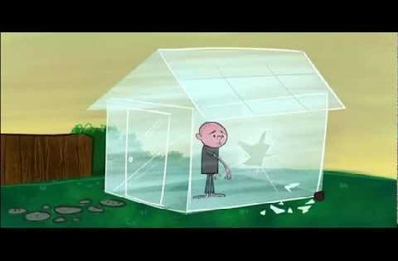

Slide 25
What to do
Do I work in a professional manner?
Is my altruism vs “self interest” appropriate?
Do I “speak out” for professionalism?
Do I “speak out” for patients?

Slide 26
Summary
Change is coming
We need to lead
Leadership comes with values (professionalism)

Slide 27
Do I make a difference?
….. more than just the patient in front of me?
NZMA

Slide 29
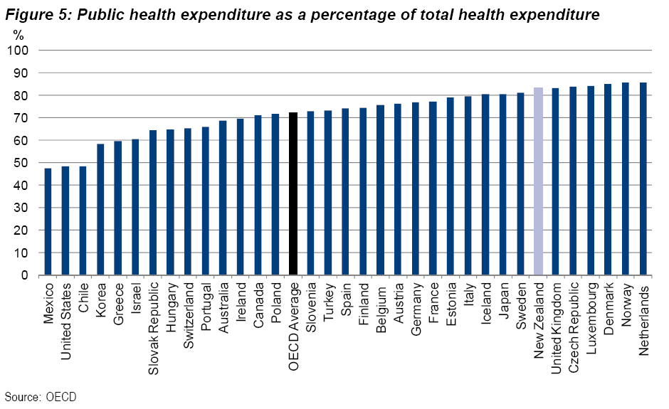

Slide 30
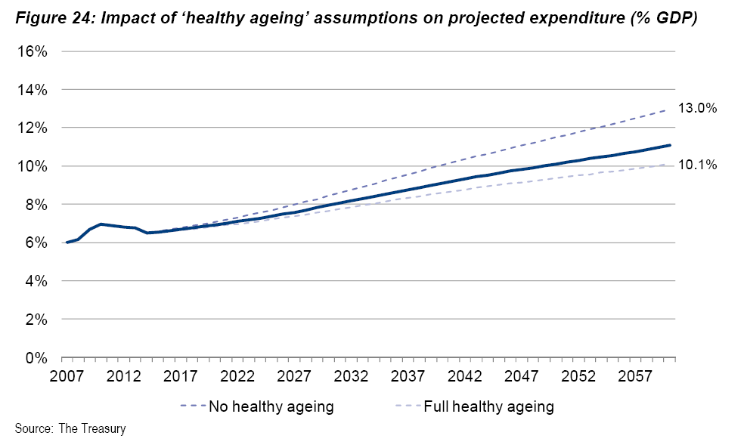

Slide 31
0
Adjust skill mix (Productivity)
Non-doctors performing tasks

Slide 32
Definition of Professionalism:
1912 : Judge Louis Brandeis
A profession is an occupation for which the necessary preliminary training is intellectual in character, involving knowledge and to some extent learning as distinguished from mere skill.
It is an occupation which is pursued largely for others and not merely for one’s self.
It is an occupation in which the amount of financial return is not the accepted measure of success.

