Slide 1
Dr Russell Wills
Commissioner for Children
Hastings

Slide 2
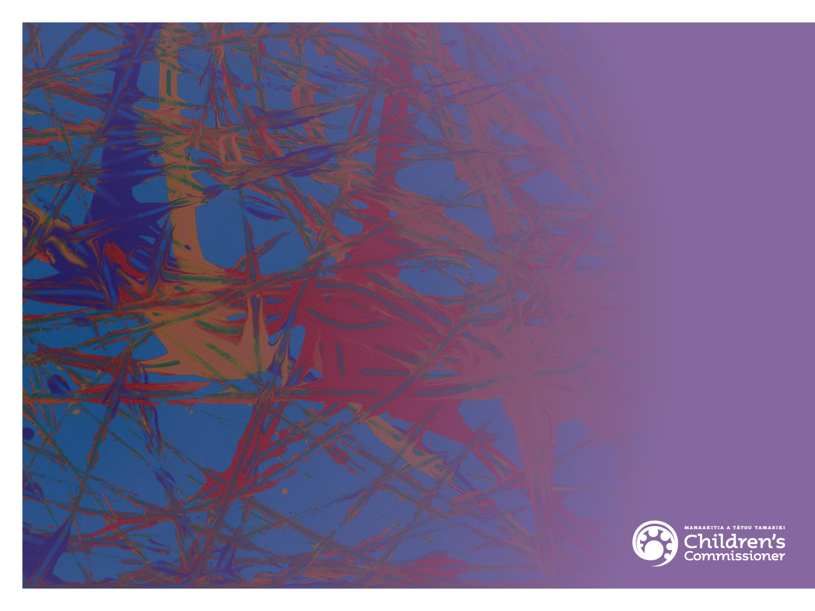
Child Protection update
Dr Russell Wills FRACP, MPH
Children’s Commissioner
GPCME
Dunedin
16th August 2013

Slide 3
This talk
25 min
Brief epidemiology of child abuse and neglect in NZ
Key aspects of the White Paper on Vulnerable Children
Implications for general practice
Opportunities and risks
What will make the implementation of the WP succeed or fail
20 min discussion
This afternoon at 2 and 3pm workshop
Child Abuse for the GP
Notes:
Thanks to Nicola Atwool and Liz Craig for slides and thinking.
3

Slide 4
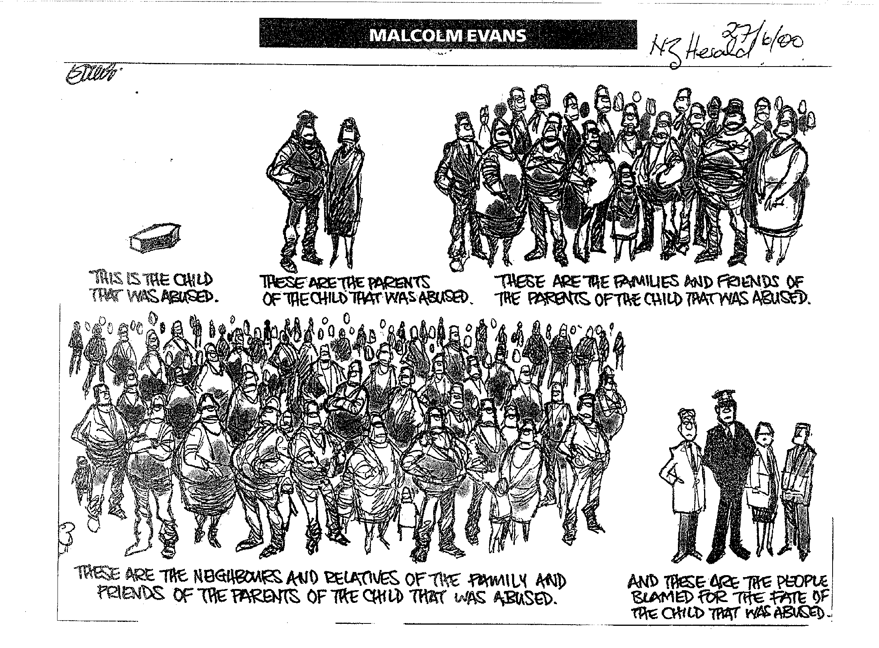
Notes:
4
Evans’ cartoon makes the important point that it’s societal change that will ultimately lead to reduced violence in families.
We all have a role in eliminating and addressing Family Violence
We know from drink-drive and speeding campaigns that societal attitudes can change with sustained attention over time. The repeal of S59 of the Crimes Act and social marketing campaigns like the “It’s Not OK” campaign appear to be helping, as rates of severe domestic violence and substantiated child abuse seem to have begun to fall. But what’s our role in reducing family violence?

Slide 5
Hospital Admissions (2006–2010) and Deaths (2004–2008) due to Injuries Arising from the Assault, Neglect or Maltreatment of New Zealand Children by Age and Gender
Source: Numerator Admissions: National Minimum Dataset, Numerator Mortality: National Mortality Collection; Denominator: Statistics NZ Estimated Resident Population
Notes:
When we look at the age of children who are hospitalised, it is our youngest children most at risk from injuries arising from assault, neglect or maltreatment.

Slide 6
Hospital Admissions for Injuries Arising from the Assault, Neglect or Maltreatment of Children 0–14 Years by NZ Deprivation Index Decile, New Zealand 2006–2010
Source: Numerator: National Minimum Dataset; Denominator: Statistics NZ Estimated Resident Population
Notes:
Children living in households in the poorest areas, are also most at risk. DEP 10 in health as the most deprived.
Children growing up in low-income household face multiple risks. These children are at a 1.4 times higher risk of dying during childhood than children in higher income households (Shaw, et. al., 2005).

Slide 7
Hospital Admissions for Injuries Arising from the Assault, Neglect or Maltreatment of Children 0–14 Years by Ethnicity, New Zealand 2000–2010
Source: Numerator: National Minimum Dataset; Denominator: Statistics NZ Estimated Resident Population.
Note: Ethnicity is Level 1 Prioritised.
Notes:
Maori and Pacifica children are more likely to be hospitalised for injuries arising from the assault, neglect or maltreatment than other ethnicities
Blue dot is Maori - Green square is Pacific
Lets not talk about child abuse and neglect as an abstract issue. Lets looks at what it really means.
If we look at what sort of injuries our youngest children are experiencing
Most common trauma to the head – shaken babies – head injuries.
Injuries to the spine, stomach and pelvis.
Then to the upper limbs and legs.
These are our youngest and most vulnerable children. At the time when we know from neuroscience that they are most susceptible to damage - 80% of a child’s brain function develops in the first three years of life and positive and adverse events will impact on how children’s brains are ‘wired’ for life

Slide 8
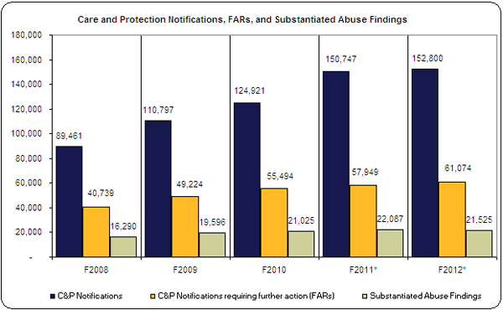
Notifications, further action req’d and substantiations
Insert table here
Notes:
Increase in overall notifications since 2008 and increased numbers of these requiring further action. While there has been an increase in substantiated findings between 2008 and 2012 these are still a smaller proportion of the overall notifications received.

Slide 9
Notifications to CYF 2008-2012
 | 2008 | 2009 | 2010 | 2011 | 2012
Care & Protection Notifications | 89,461 | 110,797 | 124,921 | 93,594 | 90,122
Police Family Violence Notifications |  |  |  | 57,153 | 62,678
Sub Total | 89,461 | 110,797 | 124,921 | 150,747 | 152,800
Distinct clients | 61,403 | 74,340 | 80,218 | 94,478 | 95,532
Notes:
Notifications have almost doubled over the period with 30k more clients over those in 2008.
From July 2010 the family violence referrals requiring no CYF action have been recorded separately.
Some clients may have two or more notifications in the same period.

Slide 10
Notes:
This is what confirmed cases of child abuse look like in New Zealand
Emotional abuse is increasing (child witnesses to DV)
Physical and sexual abuse and relationship and behaviour difficulties (usually young people in relationships) stable.

Slide 11
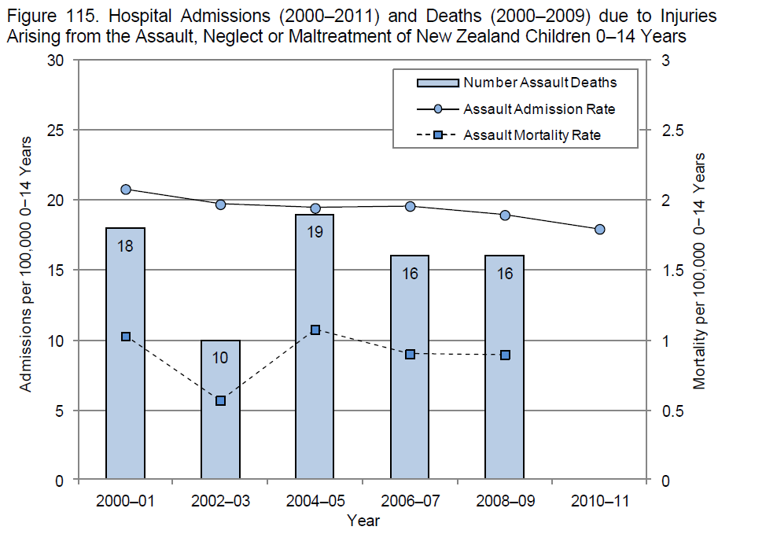
Notes:
Assault admission rate is falling across NZ, consistent with clinicians’ belief that increased reporting has led to earlier intervention and reduced risk overall. Further falls will require change in community attitudes (particularly men’s violence towards women and children) and reduced drivers including poverty, alcohol and drug use, etc)

Slide 12
Serious behaviour difficulties
Population surveys (psychiatry) Boys 6-16%, Girls 2-9%
NZ “serious behaviour difficulties” (%) Church (1996), Bretherton (1997, 2000)
Canterbury survey 1996 N=173 schools
  Decile 1 10.8% SBP -> Decile 10 1.3%
Year | Canterbury 1996 | Otago 1997 | Otago 1999
1 | 2.8 | 4.5 | 2.7
4 | 4.4 | 7.5 | 6.0
7 | 4.5 | 4.5 | 5.7
N | 37,745 | 16,741 | 16,925
Notes:
Increases with age. 5-7% in most studies. Note prevalence 10x in decile 1 than in decile 10

Slide 13
Chch Multidisciplinary Child Development Study: Outcomes at age 18 - Education
Notes:
Conduct problems (5-11y) in early primary were highly predictive of poor educational outcomes by school leaving

Slide 14
Christchurch study – outcomes at age 25
Education & employment
Notes:
These poor educational outcomes persisted into early adulthood.

Slide 15
Christchurch study: crime at 25
Notes:
And violent crime…

Slide 16
Christchurch study: mental health at 25
Notes:
And poor mental health… Recent study at 32 years showed these mental health symptoms persisted. In fact, about 70% of adults in the study with significant mental health problems had conduct problems in early childhood. If these could have been identified and addressed, the impact on adult mental health would have been great.

Slide 17
Christchurch study: sexual and partner relationships at 25
Notes:
And poor sexual and partner outcomes…

Slide 18
Summary: abuse & severe behaviour
Common and overlap
Sharp SE gradient but not unique to low SE
Devastating long-term consequences for health, relationships, education, productivity, criminality, welfare dependence
Current systems have strengths, e.g., improved identification of children at risk
Weaknesses
  Variability across regions
  Not joined up -> multiple cars in the driveway
  Information sharing difficult
  Lack of data on outcomes
  Skills gaps
  Too hard to access support
  Very poor outcomes for children in care
  Resource not directed to most vulnerable
  Fragmented systems, providers & purchasing
  Unclear responsibilities – no-ones job.

Slide 19
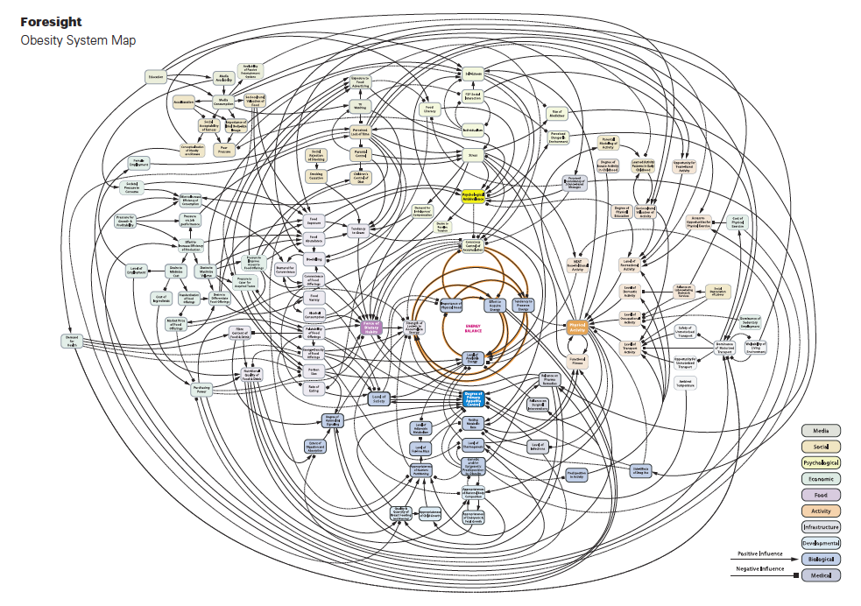
Wicked Problems
Multiple causes
Multiple players
High stakes
Constant change
Uncertain funding
Evidence unclear or conflicting
Values-laden
Competing interests
Notes:
19
19
Most of the problems left in child health are “wicked” problems. There are the features of wicked problems.

Slide 20
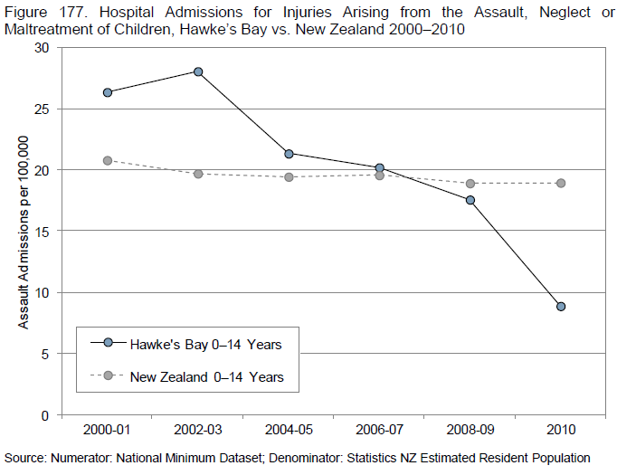
Wicked Problems Have Solutions
Notes:
20
Craig, 2011
Following the introduction of the Family Violence Intervention Programme in HBDHB in 2000 there has been a fall of 2/3 in the admission rate for NAI, while the rest of NZ’s rate was static. Whether this fall in NAI admissions for children in HB was due to the family violence intervention programme or external factors is hard to know, but there was an increase in Police DV attendances and substantiated child abuse over the years to 2008, so external factors seem unlikely.

Slide 21
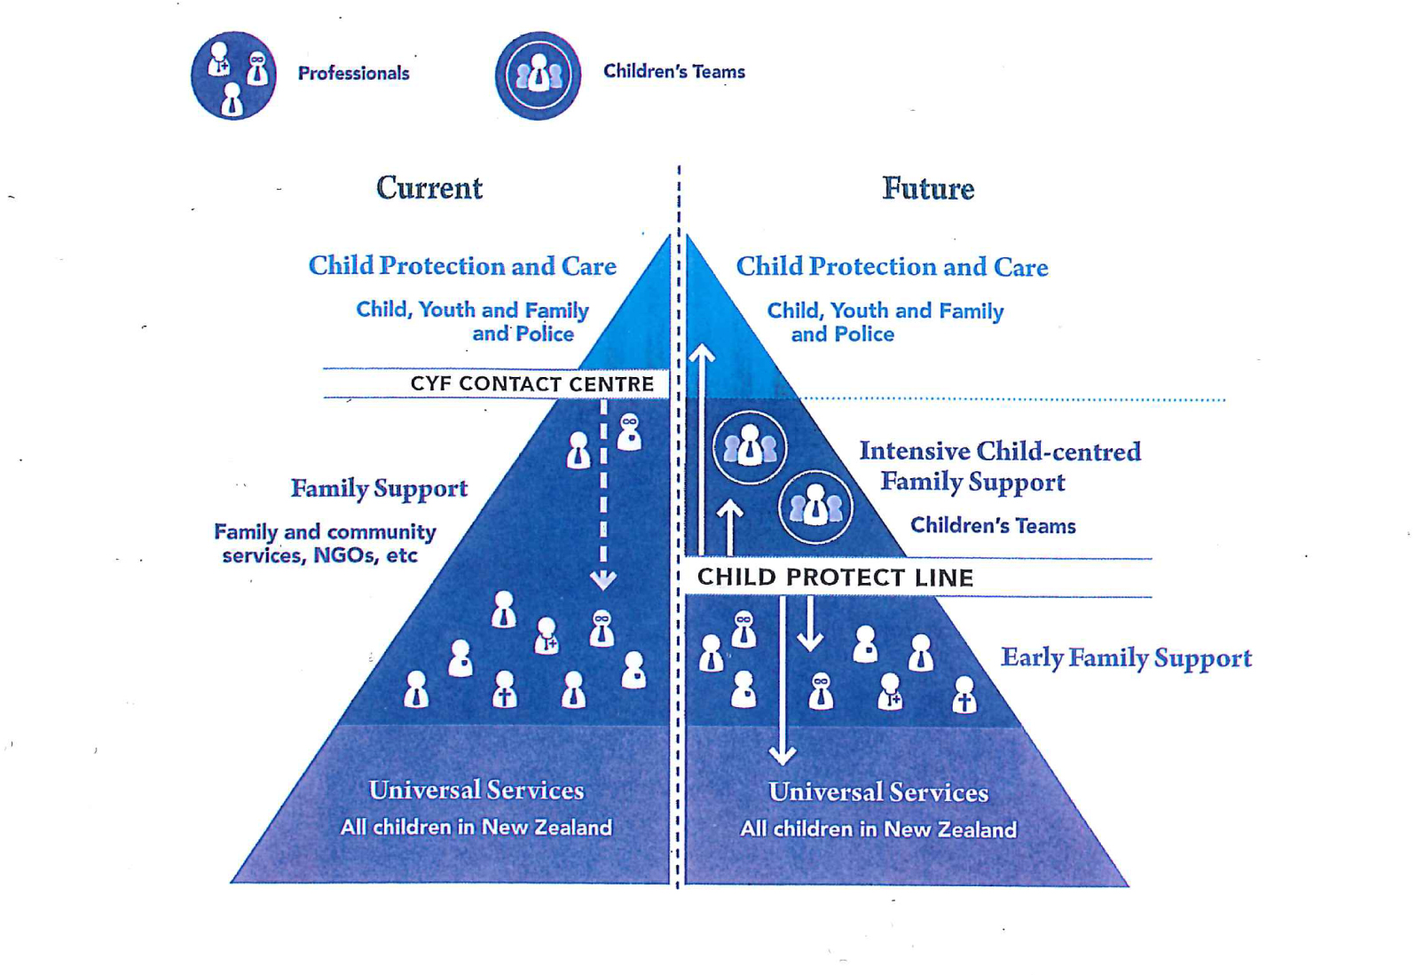
Children’s Action Plan
Notes:
White Paper developed in response to the Green Paper and CYF’s role remains the same – sharp end of child protection only, no increase in role.
Contact Centre currently within CYF, most work redirected down to NGOs. This will continue.
Initial idea a single intake line at lower level, able to direct reports of concern up to Children’s Team or to CYF, or down to partnered response as currently. Currently more likely to be joining up existing lines, e.g., inter-operable IT systems.
21

Slide 22
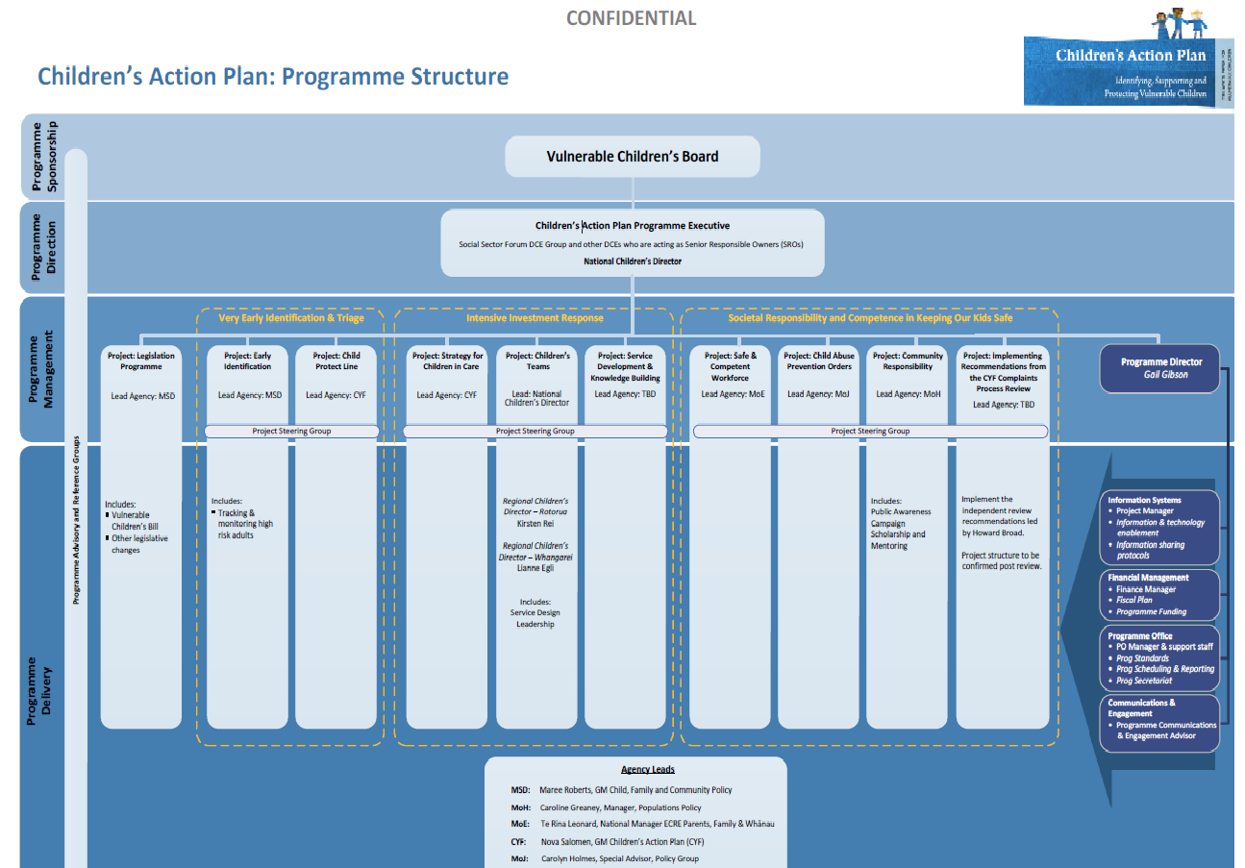
Notes:
Ten work streams, small army of public servants working on improving the system. Takes time, needs to be done well.

Slide 23
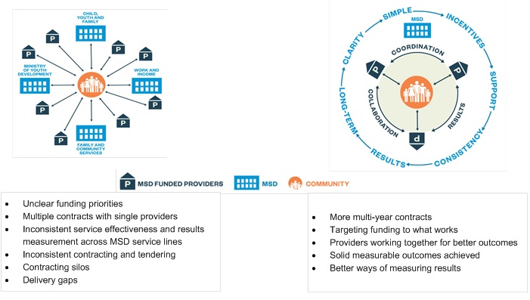
New Funding Model
Notes:
Changes in funding model are key. Notice in particular the words around the circles – emphasis on coordination, collaboration, measurable outcomes, single purchaser, simplicity and quality.
23

Slide 24
What does this mean for GPs?
Training in CAN, DV… (FV is our job)
Services to refer to for children and our adult patients who are parents
    Children’s Teams
    Child Protect Line
    Parenting programmes, support for caregivers
    Children in care (Gateway) and leaving care
Easier information sharing
    By phone, face to face
    IT connectivity
Regional Children’s Director – local purchasing of health, education and social services

Slide 25
What does this mean for GPs?
In Whangarei & Rotorua (& next demonstration sites)
  Will be consulted & included
    in planning for Children’s Teams
    in planning for Regional Children’s Directors’ work
Everywhere - Vulnerable Children’s Bill
    Mandatory policies & training
    Vetting & screening – identity, referee & police checks
    Collaboration
    Focus on the
      most vulnerable
      outcomes (vs inputs/ outputs)

Slide 26
Opportunities and Risks
Opportunities
Risks
Improved outcomes for children at risk
Easier information sharing & identification of children at risk
  Face to face
  Electronically
Standards for C&P training and policies
  Up to each discipline
Expectation of local collaboration
Local leadership including purchasing of MSD-funded services for children
Improves services for children in care and leaving care
Increase in registered SW
First and last chance in a generation
9/11 – VKIS overwhelm with data?
Privacy
C&P seen as specialist/non-core
Overwhelm local services
Overwhelm local leaders
Local variation in collaboration & leadership capacity -> inevitable national variation
Performance funding -> services avoid complex families
Some SW will struggle to achieve registration standard

Slide 27
What’s needed next?
The White Paper will achieve the intended goals where there is
The White Paper will not achieve the intended goals where there is
Existing local collaboration with clear communication, trust and mutual respect
Vision maintained of helping complex families
Power sharing
Local leadership that recognises and values these things
Active participation of practitioners in WF dvpt
Clarity – what is determined centrally vs local flexibility
Patience, figure out together
A change in community attitudes “communitarian” (Judge Mick Brown)
  Violence to women & children
  Don’t get involved in private matters
Poor local collaboration, weak communication, limited trust
Jealous guarding of power
Competition/ conflict for $
Service avoidance of complex families
Poor or limited local leadership
No change in community attitudes

Slide 28
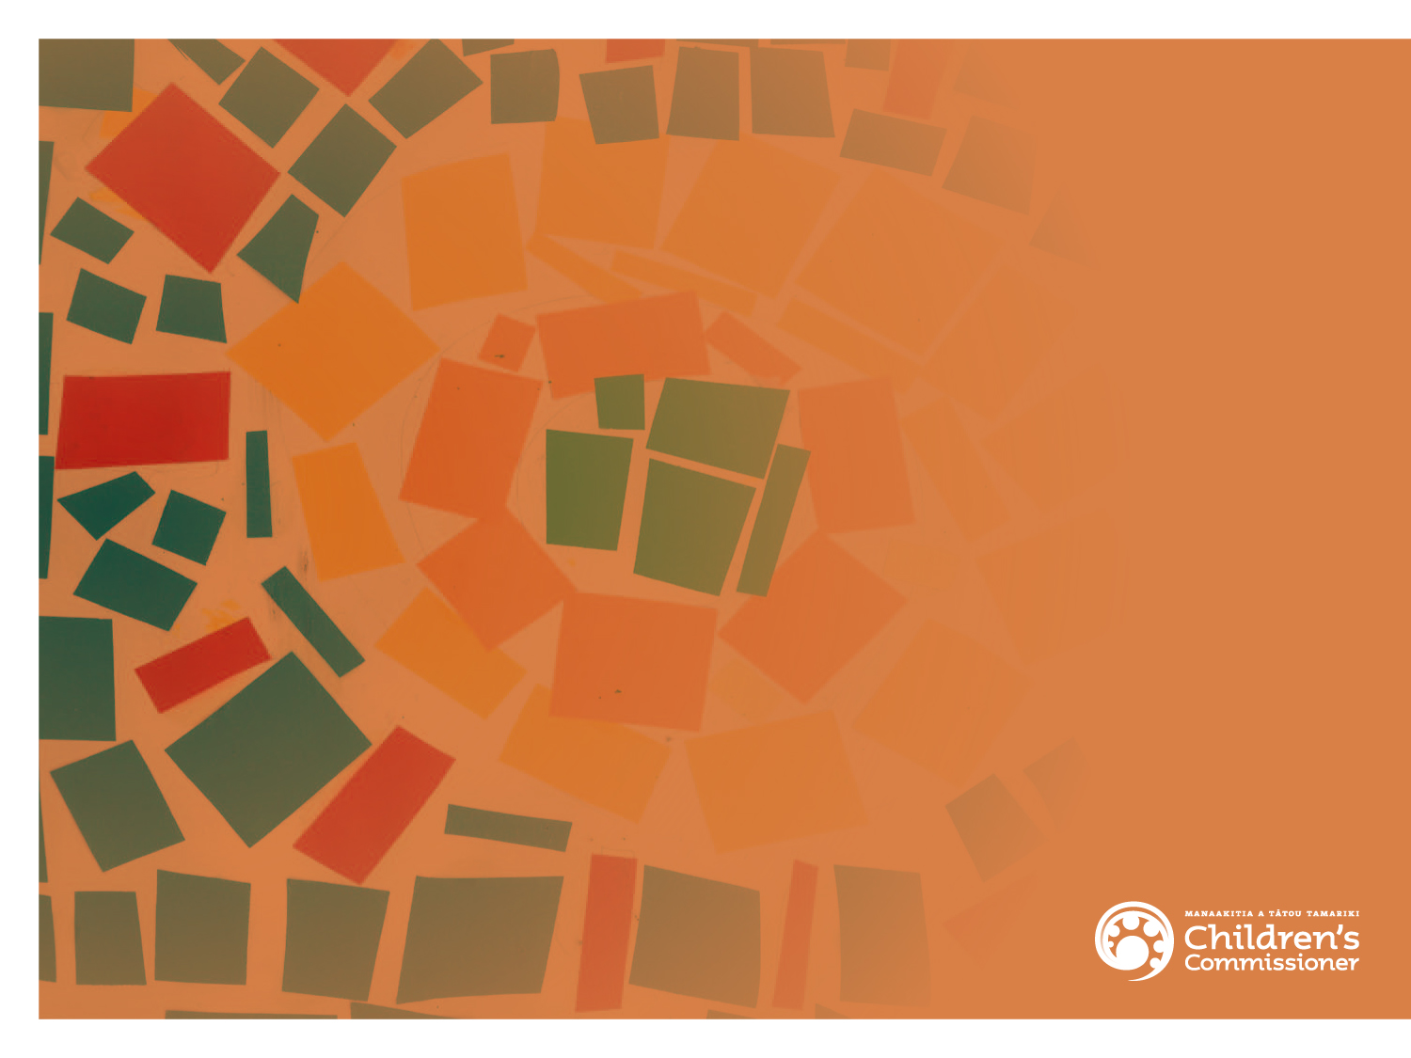
Discussion

