Slide 1
A/Prof Frank Lin
Otolaryngology
Johns Hopkins University

Slide 2

Epidemiology & Clinical Management of Hearing Loss in Older Adults
Frank R. Lin, M.D. Ph.D.
Assistant Professor of Otolaryngology, Geriatric Medicine,
Mental Health, and Epidemiology
Johns Hopkins University
Baltimore, Maryland
Notes:
505

Slide 3
Disclosures
Consultant for Cochlear Limited
Scientific Advisory Board for Pfizer and Autifony Therapeutics
Speaker honoraria from Amplifon & Med El

Slide 4
Hearing Loss in Older Adults
Overview
Myth: Hearing loss is an inconsequential part of getting older
Case presentation
Steps to take from the GP perspective

Slide 5
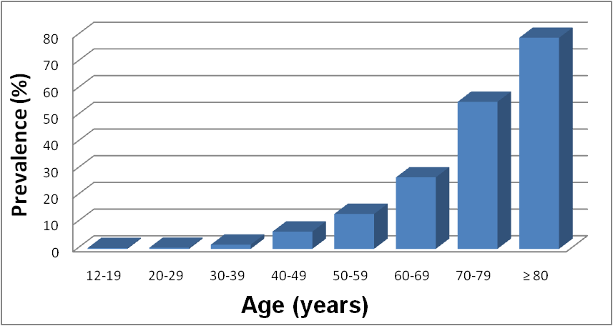
Prevalence of Hearing Loss in the
United States, 2001-2008
Hearing loss defined as a better-ear PTA of 0.5-4kHz tones > 25 dB
Lin et al., Arch Int Med. 2011

Slide 6
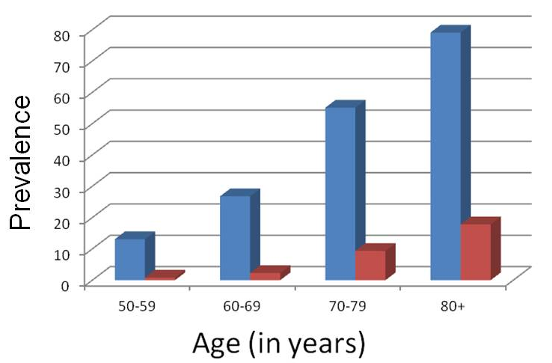
Hearing Loss & Hearing Aid Use Prevalence in the U.S. , 1999-2006
Chien & Lin, Arch Int Med, 2012

Slide 7
Prevalence of Hearing Aid Use
United States (Chien & Lin, Arch Int Med, 2012)
  26.7M adults ≥ 50 years with hearing loss
  3.8M use hearing aids
  Overall rate of HA use: 14.2%
England and Wales (Taylor & Paisley, NICE Report, 2000)
  8.1M with hearing loss
  1.4M use hearing aids
  Overall rate of HA use: 17.3%

Slide 8

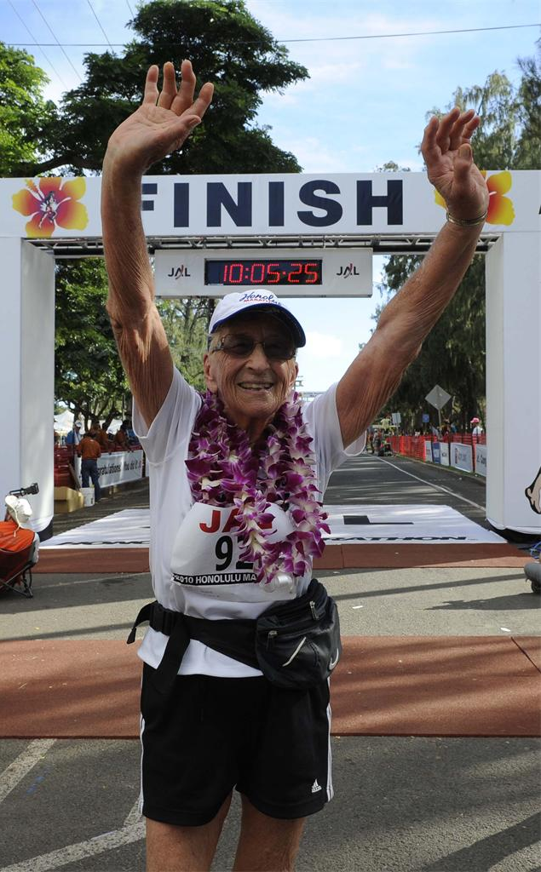
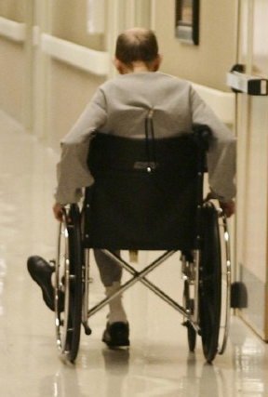
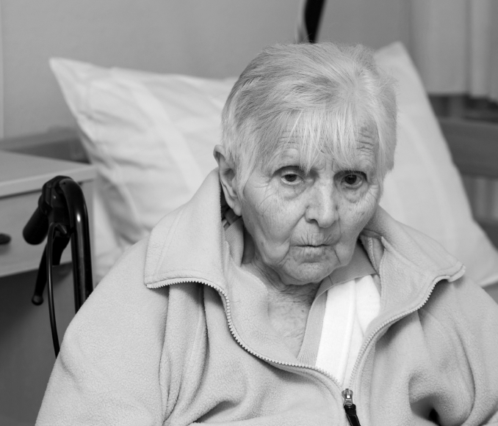
Healthy Aging

Slide 9
Avoiding Injury
Cognitive Vitality
& Avoiding Dementia
Maintaining Physical
Mobility & Activity
Healthy Aging
Keeping Socially
Engaged & Active
Health Economic
Outcomes/Mortality
Hearing Loss

Slide 10
Hearing Loss & Healthy Aging
Common Cause or Modifiable Risk Factor
?
Cognitive & Physical Functioning
Hearing Loss
Common pathological process

Slide 11
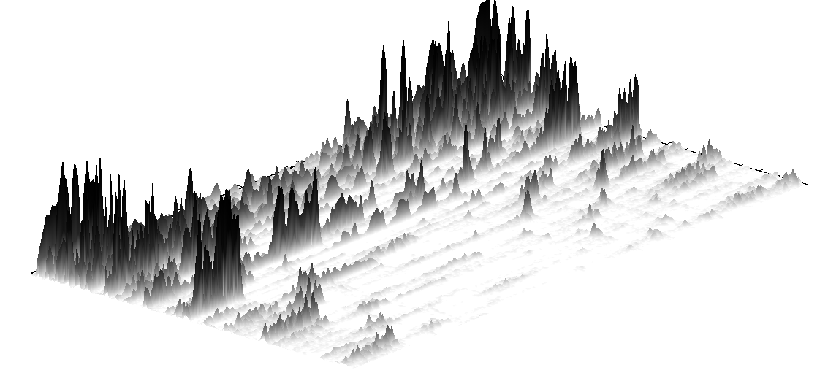
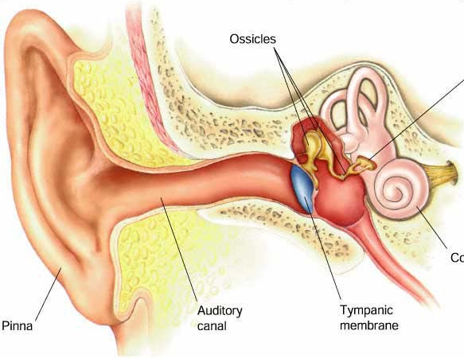
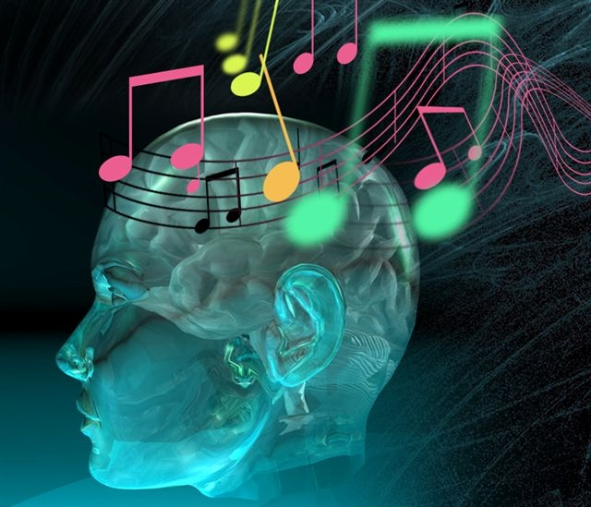
“Effortful listening”
Hearing loss & Cochlear impairment
Intensity →
Frequency
Time →
Increased hearing thresholds & poor frequency resolution
“Sunday”

Slide 12
Hearing Loss & Healthy Aging
Common Cause or Modifiable Risk Factor
Cognitive Load
Cognitive & Physical Functioning
Hearing Loss
Brain structure/function
Social Isolation
Common pathological process
Notes:
Add in brain aging, kahneman, and voxel based image
Then overview with epi results
Then box with RCT
Myth 2 HL can be succesfully treated by any audiologist??
Then slide
Then case presentation

Slide 13
Recent Epidemiologic Studies
Avoiding Injury
Avoiding Injury
Cognitive Vitality
& Avoiding Dementia
Maintaining Physical
Mobility & Activity
Cognitive Vitality
& Avoiding Dementia
Healthy Aging
Keeping Socially
Engaged & Active
Health Economic
Outcomes/Mortality
Cognition & Dementia
  30-40% accelerated rate of cognitive decline (Lin et al. JAMA Int Med 2013)
  Mild, moderate, and severe HL associated with 2x, 3x, and 5x increased risk of dementia (Lin et al, Arch Neuro 2011, Gallacher et al. Neurology, 2012)
Avoiding injury
  Increased falls (Viljanen et al , JGMS 2009; Lin et al. Arch Int Med 2012)

Slide 14
Recent Epidemiologic Studies
Avoiding Injury
Avoiding Injury
Cognitive Vitality
& Avoiding Dementia
Maintaining Physical
Mobility & Activity
Cognitive Vitality
& Avoiding Dementia
Maintaining Physical
Mobility & Activity
Healthy Aging
Health Economic
Outcomes/Mortality
Keeping Socially
Engaged & Active
Health Economic
Outcomes/Mortality
Physical mobility
  Reduced walking speed (Viljanen et al. JAGS 2009; Li et al., Gait & Posture 2012)
  Accelerated decline in physical functioning (Wallhagen JAGS 2001; Chen et. al. Under review)
  Driving ability (Hickson et al. JAGS 2009)
Health economic outcomes/mortality
  Increased odds of hospitalization (Genther et al, JAMA, 2013)
  Increased mortality (Karpa et al Ann Epi 2010; Genther et al, Under review)

Slide 15
Hearing Loss & Healthy Aging
Common Cause or Modifiable Risk Factor
Cognitive Load
Cognitive & Physical Functioning
Hearing Loss
Brain structure/function
Social Isolation
Common pathological process
Notes:
Add in brain aging, kahneman, and voxel based image
Then overview with epi results
Then box with RCT
Myth 2 HL can be succesfully treated by any audiologist??
Then slide
Then case presentation

Slide 16
The question of whether treating hearing loss could delay cognitive/physical decline or dementia remains unknown
There has never been a randomized clinical trial of treating hearing loss to explore effects on reducing the risk of cognitive decline/dementia

Slide 17
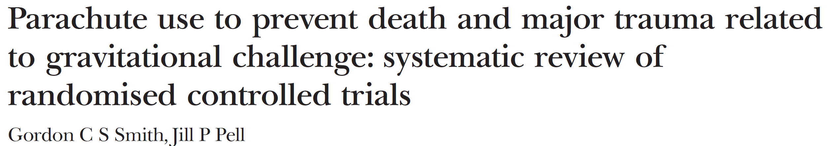
We don’t need to wait for results from an RCT.
Spoof article published in the British Medical Journal on need for evidence-based medicine in 2003:
…We think that everyone might benefit if the most
radical protagonists of evidence based medicine
organised and participated in a double blind,
randomised, placebo controlled, crossover trial of the
parachute.

Slide 18
Case Presentation
67 y.o. man complains that his wife always bugs him to have his hearing checked.
“I can hear fine. People just need to stop mumbling”
“I hear what I want to hear”
Notes:
For politzer—use slide in back

Slide 19
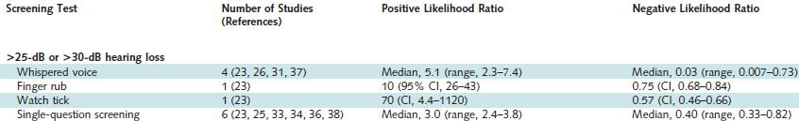
Primary Care Screening for Hearing Loss
Single question: Do you often have trouble understanding people in a busy restaurant or does it sound like people are mumbling in these situations?
Notes:
For politzer—use slide in back

Slide 20
Regardless of screening results, the likelihood of having hearing loss is strongly dependent on pre-test probability
79.1%
55.1%
26.8%
13.1%
Hearing loss defined as a better-ear PTA of 0.5-4kHz tones > 25 dB
Lin et al., Arch Int Med. 2011

Slide 21
Counseling in 3 minutes by the GP
“Hearing loss doesn’t necessarily mean you can’t hear. Instead, you’ll notice that people often sound like they’re mumbling”
“Your HL has likely come on over the last 10-20 years so you’ve gotten used to it”
“Hearing loss has been associated with very real detrimental outcomes (cognitive decline, dementia)”
  Analogy of hypertension
“We don’t know yet if treating HL could help delay cognitive decline/dementia, but it certainly won’t do any harm and could only help”
“Hearing loss treatment is complex and takes 3-6 months of concerted effort”
  Analogy of a prosthetic leg
Notes:
For politzer—use slide in back

Slide 22
Referral
Otolaryngologist or Audiologist
In general, audiologist as the initial referral for dx evaluation & tx unless there are medical concerns
Medical Indications for Otolaryngologist referral:
  Sudden Sensorineural Hearing Loss
    Acute loss of hearing in 1 ear with sudden onset
    Warrants immediate (within the week) evaluation by ENT
  Drainage from ear or ear pain
  Hx of vertigo/dizziness
  Assymmetric/fluctuating hearing loss
  Abnormal ear exam
Notes:
For politzer—use slide in back

Slide 23
Additional Reading Including Patient Handouts
www.linresearch.org
flin1@jhmi.edu
Notes:
For politzer—use slide in back

