Slide 1
Prof Norman Sharpe
Medical Director
New Zealand Heart Foundation
Primary Care, the keystone for heart health improvement – Main Session

Slide 2

Primary Care the Keystone to Heart Health Improvement
Norman Sharpe
The heart health continuum and the keystone position
The culprit disease – atherosclerosis
The past
The present
Future prospects
A new national health target – a step change, an opportunity and a challenge

Slide 3

The Heart Health Continuum also The Lifecourse Journey
District Health Boards
Public Health Providers - - - - - Primary Health Organisations - - - Hospital Services
POPULATION FOCUS INDIVIDUAL FOCUS
Public policy Individual healthcare
Primary Health Organisations
LIFECOURSE
CV risk management in primary care
Communities and schools, “workplace”
Health promotion
Clinical care for heart disease
Quality and equity standards
Access to care
Self management
Environmental change
Smokefree NZ 2025
Food environment
Built environment
MISSION
Stop New Zealanders dying prematurely from heart disease
Secondary prevention
Post discharge care
Cardiac rehabilitation
NS 2007

Slide 4
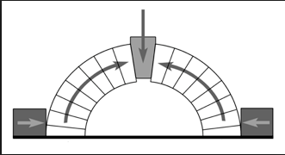
The Heart Health Continuum also The Lifecourse Journey
District Health Boards
Public Health Providers - - - - - Primary Health Organisations - - - Hospital Services
POPULATION FOCUS INDIVIDUAL FOCUS
Public policy Individual healthcare
Primary Health Organisations
LIFECOURSE
CV risk management in primary care
Communities and schools, “workplace”
Health promotion
Clinical care for heart disease
Quality and equity standards
Access to care
Self management
Environmental change
Smokefree NZ 2025
Food environment
Built environment
MISSION
Stop New Zealanders dying prematurely from heart disease
Secondary prevention
Post discharge care
Cardiac rehabilitation
NS 2007

Slide 5
Atherosclerotic plaque progression
ACS
Plaque
rupture/
fissure &
thrombosis
Athero-
sclerotic
plaque
Unstable
Angina
NSTEMI
Normal
Fatty
streak
Fibrous
plaque
STEMI
Clinically silent
Stable angina
Cardiovascular
death
Increasing age
Notes:
How risk factors impact on process

Slide 6
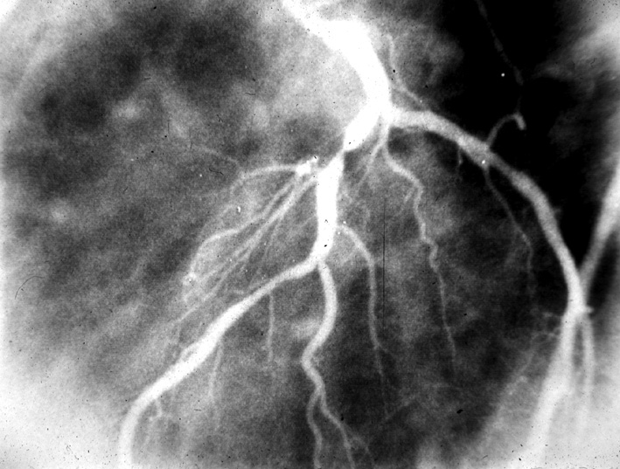
Severe coronary artery narrowing

Slide 7
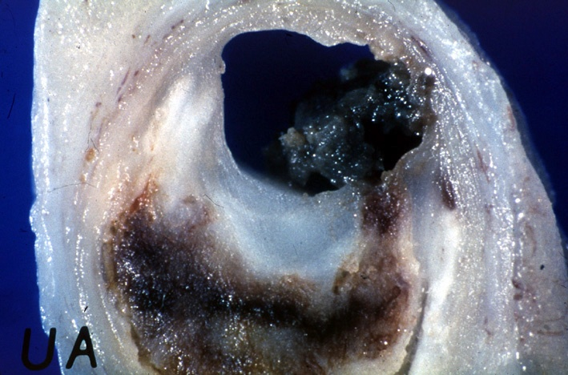
Magnified cross section of
blocked coronary artery

Slide 8

The Past

Slide 9
Source: Blakely T, Tobias M, Robson B, Ajwani S, Bonne M, Woodward A. Widening ethnic mortality disparities in New Zealand 1981-99. Soc Sci Med 2005;61(10):2233-2251.
Updated in: Blakely T. "Social injustice is killing people on a grand scale". N Z Med J 2008;121(1281):7-11.

Slide 10
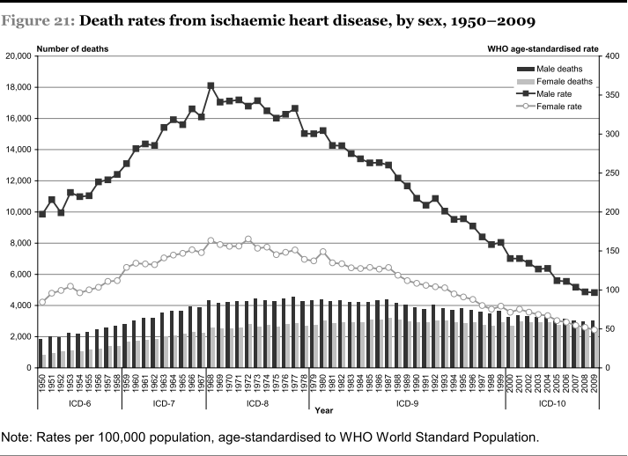

Slide 11
Explaining the fall in coronary heart disease deaths in England & Wales 1981-2000
Risk Factors worse +13%
  Obesity (increase) +3.5%
  Diabetes (increase) +4.8%
  Physical activity (less) +4.4%
Risk Factors better -71%
  Smoking -41%
  Cholesterol -9%
  Population BP fall -9%
  Deprivation -3%
  Other factors -8%
Treatments -42%
  AMI treatments -8%
  Secondary prevention -11%
  Heart failure -12%
  Angina:CABG & PTCA -4%
  Angina: Aspirin etc -5%
  Hypertension therapies -3%
IMPACT-CHD MODEL
1981
2000
Unal, Critchley & Capewell Circulation 2004 109(9) 1101

Slide 12
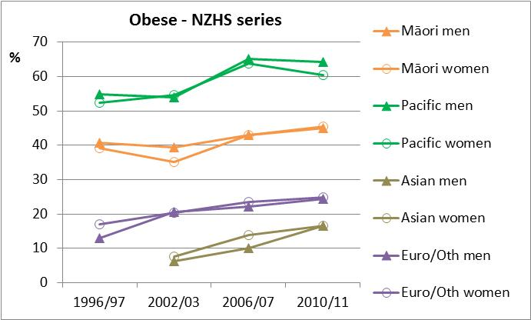
Trends in adult obesity prevalence
NZ Health Survey series, Ministry of Health

Slide 13
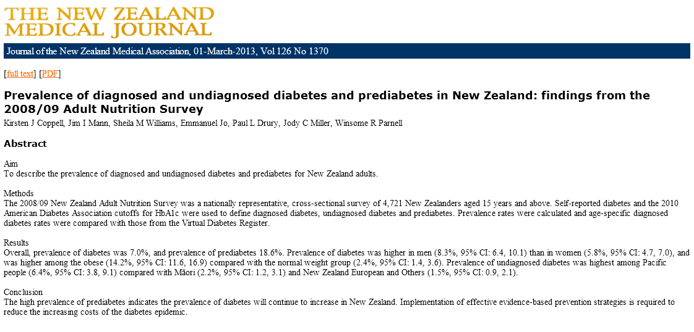
Diabetes & prediabetes increasing in NZ

Slide 14

The Present

Slide 15
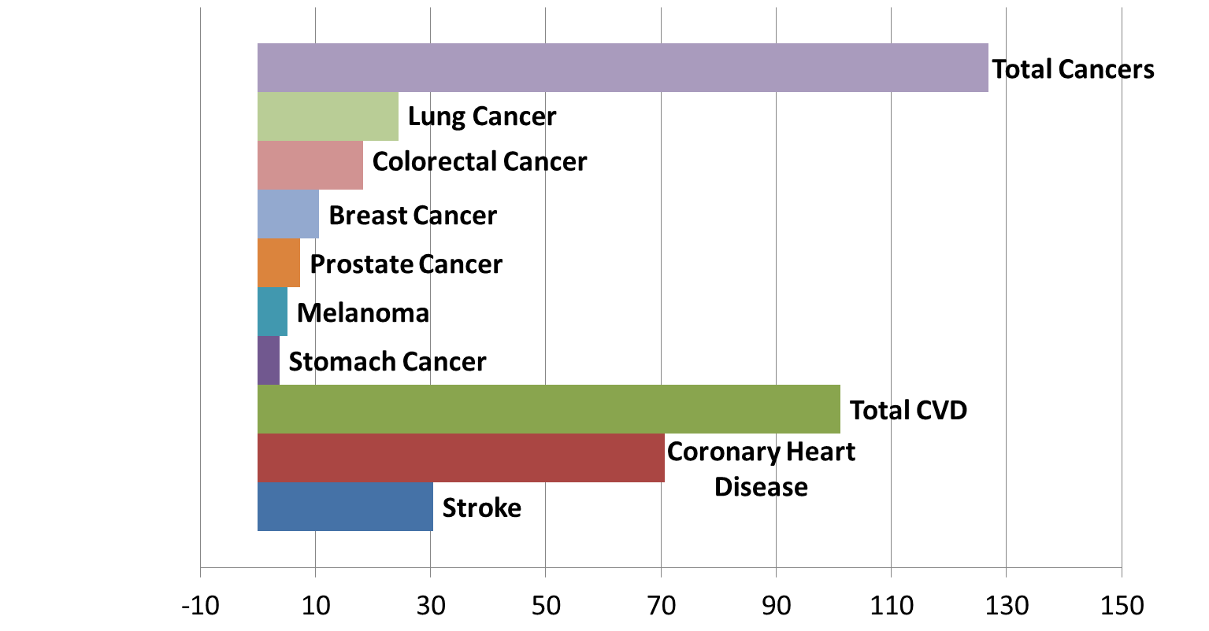
Rates for Selected Causes 2009
Age standardised death rates per 100,000
Notes:
Ref: Mortality and Demographic Data. Ministry of Health 2009
Ages standardised death rates per 100,000 (Total Population)
Total Cancers 126.8 deaths per 100,000
Lung Cancer 24.4
Colorectal/colon Cancer 18.3
Breast Cancer 10.6
Prostate Cancer 7.4
Melanoma of the skin 5.1
Stomach Cancer 3.8
Total CVD 101.1 deaths per 100,000
Coronary Heart Disease 70.7
Stroke 30.4

Slide 16
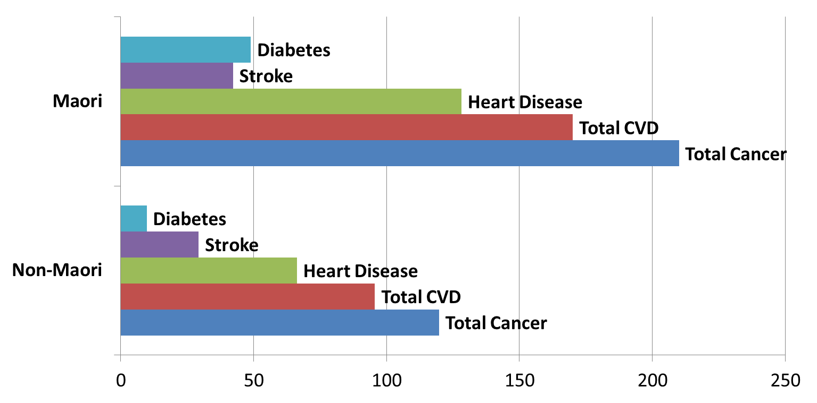
Death Rates by Ethnicity
Age Standardised Death Rates per 100,000 for Selected Causes
Notes:
Ref: Ministry of Health Mortality and Demographic Data 2009
ASR Deaths per 100,000
Maori
Diabetes 49.0
Cerebrovascular Disease 42.2
Coronary heart Disease 128.2
Total CVD 170
Total Cancer 210
Non Maori
Diabetes 9.8
Stroke 29.3
Coronary Heart Disease 66.3
Total CVD 95.6
Total Cancer 119.8

Slide 17
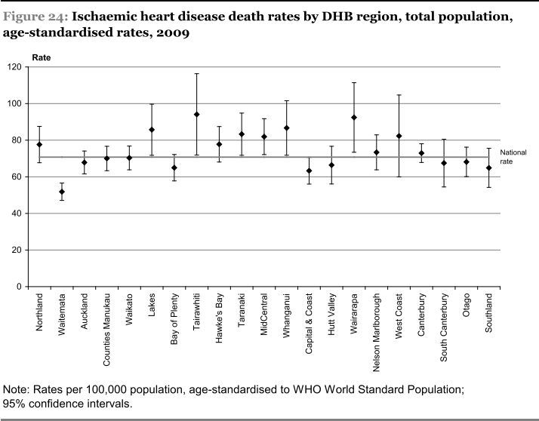

Slide 18

The Future

Slide 19
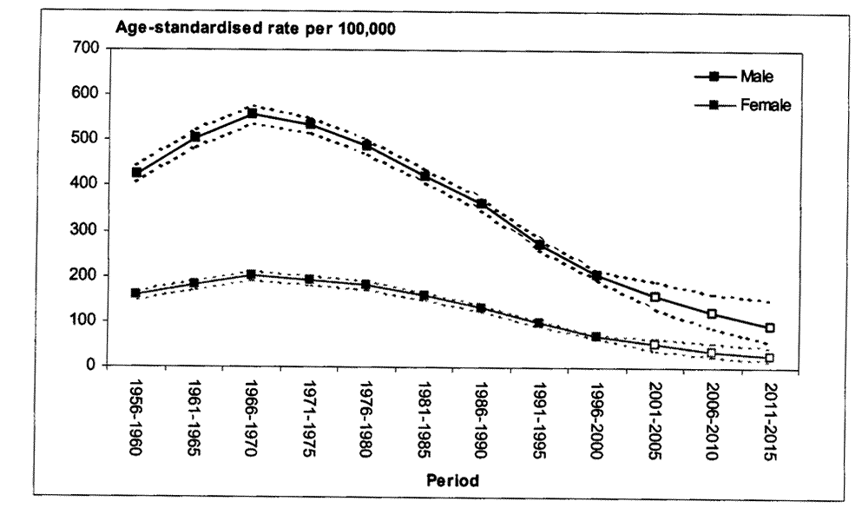
IHD Mortality in NZ Trends and Projections
Tobias et al NZMedJ April 2006
Total population age-standardised IHD mortality projections
ages 35-74 yrs, 5 year periods 1956-2015

Slide 20
?
Source: Blakely T, Tobias M, Robson B, Ajwani S, Bonne M, Woodward A. Widening ethnic mortality disparities in New Zealand 1981-99. Soc Sci Med 2005;61(10):2233-2251.
Updated in: Blakely T. "Social injustice is killing people on a grand scale". N Z Med J 2008;121(1281):7-11.

Slide 21
Mortality:
  Increasing obesity rates will slow life expectancy gains
  But life expectancy will still increase despite obesity.
Morbidity:
  Increasing obesity will increase the amount of life lived in less than perfect health (i.e. expansion of morbidity)
Sources: van Baal et al (2006; 2008); Stewart et al (2009); Preston et al (2012)
Source: Blakely T, Tobias M, Robson B, Ajwani S, Bonne M, Woodward A. Widening ethnic mortality disparities in New Zealand 1981-99. Soc Sci Med 2005;61(10):2233-2251.
Updated in: Blakely T. "Social injustice is killing people on a grand scale". N Z Med J 2008;121(1281):7-11.

Slide 22
An increasing burden for Māori
Annualised CHD mortality count for Māori men and women, 35 – 74 years, 1981 – 2015
For Māori, an actual increase in the absolute number of deaths is projected for males and a relatively stable number for females
Notes:
Rotation changed to match previous graph

Slide 23
The Heart Health Continuum also The Lifecourse Journey
District Health Boards
Public Health Providers - - - - - Primary Health Organisations - - - Hospital Services
POPULATION FOCUS INDIVIDUAL FOCUS
Public policy Individual healthcare
Primary Health Organisations
LIFECOURSE
CV risk management in primary care
Communities and schools, “workplace”
Health promotion
Clinical care for heart disease
Quality and equity standards
Access to care
Self management
Environmental change
Smokefree NZ 2025
Food environment
Built environment
MISSION
Stop New Zealanders dying prematurely from heart disease
Secondary prevention
Post discharge care
Cardiac rehabilitation
NS 2007

Slide 24
Why bother about CVD in primary care?
In a population of 10,000 primary care patients, every year there are about:
10 coronary & stroke deaths
1 diabetic death
1 breast cancer death
1 prostate cancer death
1 suicide every year
1 road traffic death
(1 cervical cancer death every 5 years)
NZHIS annual mortality statistics
Notes:
Some evidence

Slide 25
Assessment of absolute CV risk
What to measure and record
Age and sex
Ethnicity
Smoking history
Family history
Lipid profile and HbA1c
Average of two sitting BPs
BMI and waist circumference
Assessment of absolute risk is
the starting point for discussion
Notes:
No surprises here, in general.
A key question is why fasting glucose and fasting lipids
The next few slides explain the rationale behind this.
Currently approx 75% of lipid testing in community labs is done fasting

Slide 26
What does a Risk Assessment Involve?
Weight
Blood Pressure
Smoking
Diabetes
Gender
Age
Cholesterol Levels
Family History
Ethnicity
Notes:
Key messages slide 7
Overview of what a risk assessment involves
Notes
So what should John expect at his doctor’s appointment? What does a risk assessment involve?
At a risk assessment your Doctor or Practice Nurse will ask you about your age, gender, ethnicity, family history and smoking history.
Your height and weight will be measured to calculate your body mass index (BMI). BMI is your weight in kilograms divided by your height in metres squared. Or, you can do it the easy way and use a chart to find out your BMI. Your waist circumference will also be measured because it is not only the amount of fat you carry that is the problem but where you carry this fat. Abdominal fat (fat around the tummy) is associated with increased cardiovascular disease risk. (slide 8 – further optional information)
Your blood pressure will be checked. Don’t be alarmed if your doctor checks your blood pressure more than once. To get an accurate reading the average of two sitting blood pressure readings should be taken. Blood pressure shows how hard your heart has to work to pump blood around the body. It is represented by two numbers, for example 130/80. The first number (130) represents the systolic blood pressure – the pressure in your blood vessels when your heart beats. The second number (80) is the diastolic blood pressure – the pressure in your blood vessels when the heart rests between beats. Both numbers are important. There is no one ‘normal’ BP reading, the best level for you will depend on your risk level – basically the lower , the better.
A simple fasting blood test will provide your doctor with your cholesterol levels. Cholesterol is a fatty material carried in the blood. Our bodies need a certain level of cholesterol to stay healthy, however, if our cholesterol is too high, it can build up in our artery walls causing our arteries to become narrower and increasing our risk of having a heart attack or stroke.
Your doctor will also ask about your diabetic history and take a simple blood test to show if your blood sugar is elevated. Diabetes is when the level of glucose (sugar) in your blood is higher than normal. If this is the case your doctor will organise further testing to determine an accurate diabetic status.If you have diabetes you will also have other factors taken into account as part of your risk assessment.
In the past, your doctor or practice nurse would have looked at these factors individually and would have treated them separately. However, now these are considered all together as a whole. So, just like a jigsaw puzzle – rather than looking at all the individual pieces, your doctor will put the pieces together and create a whole picture!
May wish to distribute A5 handout on cholesterol and blood pressures if available

Slide 28
APCSC: blood pressure, cholesterol and body mass index
and the risk of coronary heart disease
Blood pressure
Cholesterol
Body mass index
Risk of CHD
Hyper-tension
Hyperchol-esterolaemia
Obesity
Systolic blood pressure (mmHg)
Total cholesterol (mmol/l)
Body mass index (kg/m²)

Slide 29
APCSC: glucose and the risks of stroke, CHD, CV death
238,257 participants and 1.2M person years of follow up
1mmol/l reduction in UFG relates to 23% reduced risk IHD
Diabetes Care
27: 2836, 2004

Slide 30
0
5
10
15
20
25
30
Clinically High Risk
Adjusted CVD Risk
Clinical CVD or High risk diabetes
Some genetic lipid disorders
Consider specialist referral
Treatment Intensity
Urgent + intense multifactor treatment
Drug
interventions
Drug intervention directed at all risk factors
Lifestyle change
Healthy eating & physical activity
General advice
Specific advice
Intensive individual advice
CVD Risk goal
Reduce risk
Reduce 5-year CVD risk to < 15%
Notes:
Targets and Goals of treatment
All decisions to treat should be based on the individual’s level of absolute cardiovascular risk.
Interventions to lower risk should include lifestyle advice (nutrition, physical activity and smoking cessation) and the use of medication when indicated.
A stepwise approach to management based on cardiovascular risk ensures modifiable risk factors are managed more aggressively in people at higher absolute risk of a cardiovascular event.
The priority remains adequately treating those who are easily identifiable as at high risk with multiple risk factors

Slide 31
Intervention for high absolute risk
Vigorous lifestyle measures and ---
Simultaneous drug treatment of all modifiable risk factors
Aspirin (low dose)
BP lowering (combinations of thiazide, ACE inhibitor, beta-blocker )
Lipid modification (statin usually)
Glycaemic control if diabetic

Slide 32
Combined effect of 3 drugs (or 2 drugs & smoking cessation) that each lower CVD by approximately 25%
Three successive 25% RR reductions
Number of interventions

Slide 33
CV Risk Guideline Update August 2013
Risk is a continuum; all people are at risk
Risk estimation (“absolute risk”) is an approximation
Low-medium-high risk bands (<10, 10-20, >20% risk)
Informed patient preference (benefits and harms) and clinical judgement to moderate intervention
CV risk assessment in absentia ---
New risk equations based on NZ data to be introduced
QI/education to be based on monitoring of practice variation

Slide 34
A New National Health Target
In 2012, heart health and diabetes checks became a new national health target mandated in primary care
Linkage of population and individual health care – a keystone initiative and step change
Discuss screening vs risk assessment
An entry point for effective life-long management
Focus on the disadvantaged – an immediate opportunity to reduce inequalities

Slide 35
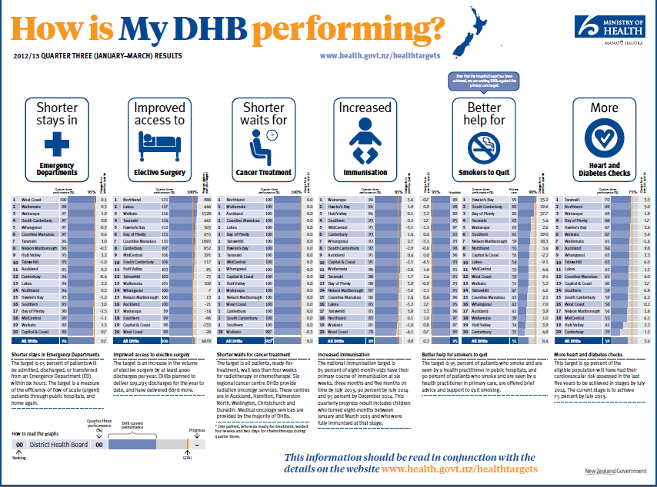
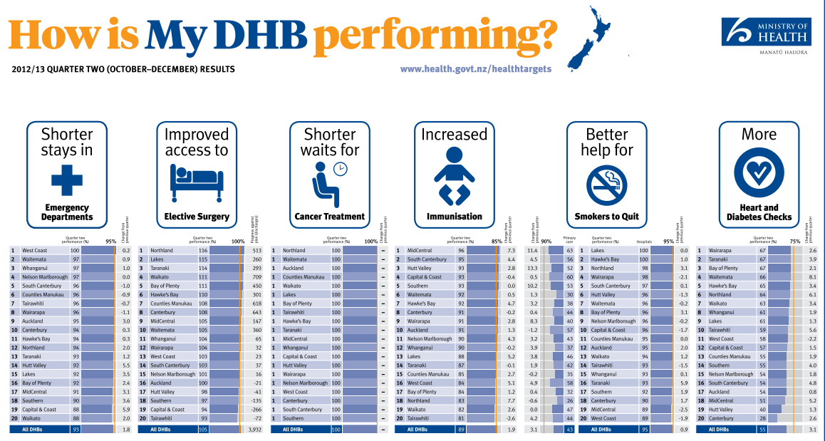
Health Target Performance Q3 2012-13

Slide 36
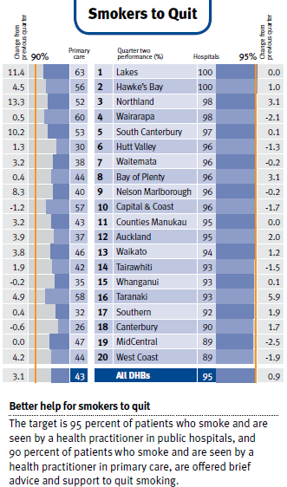
Notes:
Just out of interest, check out how your DHB is doing with the Smoking target – big gap between primary and secondary care.
What is working well for you?
What are the barriers/challenges in achieving this target in primary care?
How could the HF support you?

Slide 37
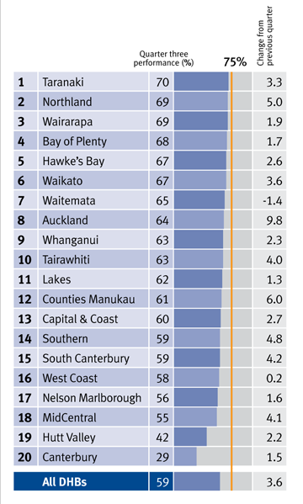
National Health Target:
More heart and diabetes
checks
Q3 Jan-Mar 2013
Q4 April-June 2013
All DHBs 67%
An 8% increase

Slide 38
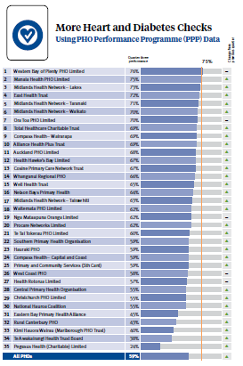
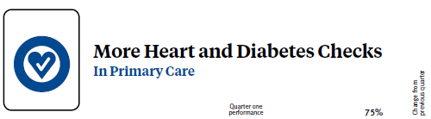
PHO results
Quarter three
Jan-Mar 2013

Slide 39
Leaders in Cardiovascular Risk Assessment
Factors Determining Success
High Assessment Rates
Leadership/ Workforce
Access
Quality Improvement

Slide 40
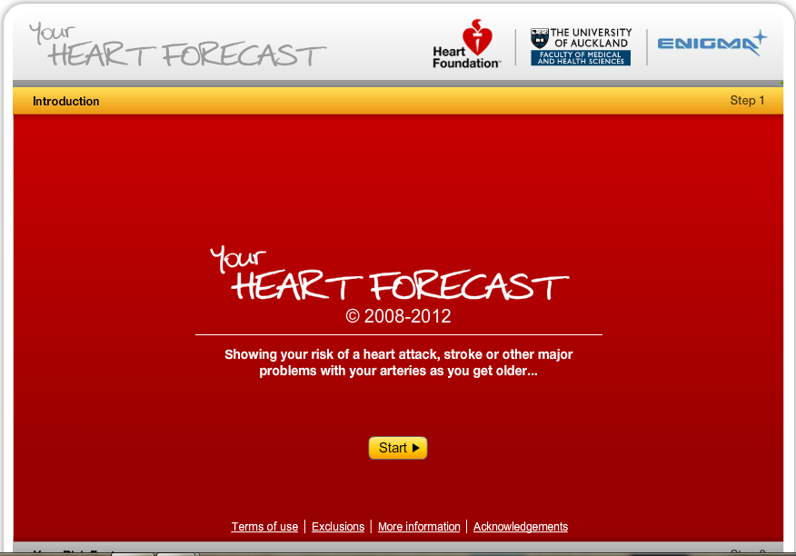

Slide 41


Slide 42


Slide 43


