Slide 1


Dr Gerard Walker
Clinical Director
Accident Compensation Corporation
Making Dependable Decisions – ACC Breakfast Session

Slide 2
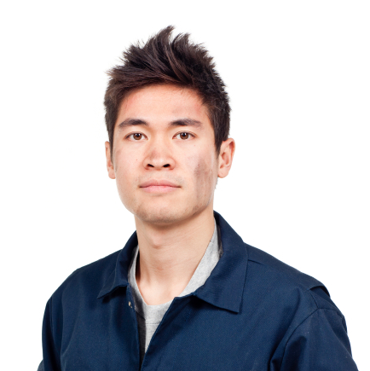




Making Dependable Decisions
South GP CME 2013
Dr Gerard Walker
This version: 06.08.2013

Slide 3
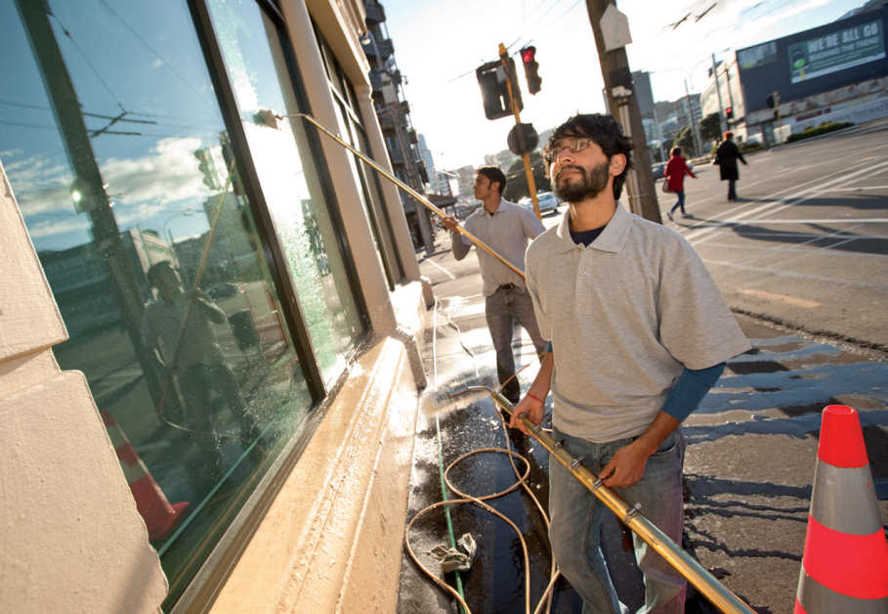
This morning
ACC – overview
Gradual process claims
Certification to support employment & rehabilitation

Slide 4
ACC Scheme
ACC is a 24 hour ‘no fault scheme’ and, in turn, those with accepted claims give up the right to sue
All NZ citizens and residents are eligible for cover if ordinarily resident in NZ at the time of accident
Visitors to NZ are eligible for cover if the injury occurred in NZ

Slide 5

ACC – what is covered
Personal injuries caused by accident
Work-related gradual process injuries, diseases & infections
Sensitive (sexual abuse claims)
Injuries that occur as a result of medical treatment

Slide 6
Work Related Gradual Process Claims (WRGPDI)
Schedule 2
  Onus is on ACC to disprove work causation
and...
The three-part test (s.30)
  Onus is on claimant to
  prove work causation

Slide 7
WRGPDI: The 3-part test (Section 30)
Person has been exposed to something at work believed to be causative (or partly causative); and..
If the causative factor also occurs in the person’s non-work environment then it is a requirement that the non-work exposure was not independently capable of causing the condition …
The work task or work environment must also place the client at significantly greater risk of developing that injury
NB – pre-existing atopy does not exclude cover

Slide 8
WRGPDI: The 3-part test (Section 30) – some exclusions
Conditions caused “wholly or substantially” by the aging process
Causative exposures outside NZ (except if person “ordinarily resident”, i.e. working for NZ company operating overseas and earnings declared in NZ or away from NZ when exposed but only intended to be absent from New Zealand for no longer than 6 months)
Conditions caused by exposures before 1 April 1974 (unless the deemed date of injury was after that date & earlier legislation also satisfied; generally meaning that the causative employment needed to have continued past 1 April 1974)

Slide 9
What would make you think that your patient has an occupational disease or gradually acquired work injury?

Slide 10
WRGPDI: What is an occupational disease?
In order to make a diagnosis of an occupational disease all of the following points need to be satisfied:
Their disease should plausibly have an occupational cause
Occupational exposure must be sufficient to cause disease
Time of exposure must be appropriate relative to timing and nature of the onset, development, and any resolution of disease in question
Other diseases need to be reasonably excluded
Reference:
Hunter’s Diseases of Occupations, 9th Edition, Baxter et al (Ed), Arnold, 2000

Slide 11
What are commonly arising occupational disease/gradual onset injuries & in what settings do they arise?

Slide 12
WRGPDI: conditions often claimed
CTS: repeated forceful gripping or wrist movements or sustained wrist postures
Tenosynovitis: must have the condition
Tennis elbow: repeated forceful arm movements
Rotator cuff conditions: work with arms elevated (flexion/abduction shoulders beyond 60 degrees)
Cubital tunnel syndrome: highly repetitive elbow flexion/extension, seldom caused by work
Osteoarthritis: little evidence re causative role for work
WRGPDI:

Slide 13
WRGPDI: conditions not claimed enough?
Dermatitis - wet work
Bladder cancer – various chemicals
Lung cancer and asbestos exposure
Sinonasal & nasophayrnx – wood dust, chromium
Leukemia - benzene
COPD – organic dust
Adult onset asthma -– organic dust, various chemicals
WRGPDI:

Slide 14

What is an occupational disease? – issues for GPs 1
What is the diagnosis?
Does the client have an Injury?
Is there a recognisable causal agent in the workplace?
Has the work caused (or contributed to the cause) of the condition?
Cause versus aggravation
Harm of false attribution

Slide 15
Certifying Fitness for Work
Certification – an opportunity and a challenge
We have been over-sold benefits of time off work
Now a growing appreciation of the positive effects of work on health and the harm associated with worklessness
We need a culture change, from prescribing time off work to prescribing time at work
Certification provides an opportunity and a challenge
The clinical role is to assess fitness for work and prescribe a safe level of activity
Notes:
Key points
We are increasingly aware from various strands of research that participation in work is a healthy social activity.
We now know that being out of work is independently associated with poorer health – in other words, is harmful.
Medical practitioners are looked to, to provide guidance on how much time OFF work a patient needs to recover.
YET, evidence suggests clinicians’ low interest in certifying can contribute to patients staying away from work longer than necessary and risk losing their links to employment.

Slide 16

Certifying Fitness for Work
Work and health: the evidence
Work is generally good for health and well-being ¹
Unemployment: strongly association with poor health ²
Work and re-employment: the positive effects of return to work have been seen in various populations and settings ^{2, 3}
Families without a working member are more likely to suffer persistent low income, poverty and tangible health effects ⁴
1. Marmot M. Status Syndrome, Bloomsbury, London: 2004
2. Waddell G, Burton K. Is work good for your health and well-being?
TSO, London: 2006
3. Rueda S et al. Am J Pub Health Vol 102, No. 3, 2012
4. Burgess, S., Propper, C. and Rigg, J. (2004 )
Households Below Average Income (HBAI) A9 /95-200/06
Notes:
Key points
Today, our New Zealand approach to fitness for work is influenced by a wealth of epidemiological work which has been done in the UK, North America and Scandinavia.
In 2008, Dame Carol Black oversaw the publication of an important UK review of the health of the working population. The document “Working for a Healthier Tomorrow” was the culmination of three years work involving extensive epidemiological research and community engagement.
Gordon Waddell and Kim Burton reviewed the literature on the association of work and health, summarising the evidence:
A strong positive association between unemployment and increased mortality and morbidity from a range of causes.
Strong evidence that unemployment has a causal or contributory effect on these outcomes.
Strong evidence of unemployment having a detrimental effect on mental health.
These effects may be mitigated by secure social and personal supports. The more vulnerable a community, the more severe the effects of unemployment – a phenomena also noted by Sir Michael Marmot in several pieces of work noting stark differences in morbidity and mortality across socio-economic groups.
It is not just the individual affected by long-term worklessness - There is strong evidence of transgenerational effect on health and wellbeing.
References
Waddell G, Burton K. Is work good for your health and well-being? TSO, London: 2006.
Burgess, S., Propper, C. and Rigg, J. (2004 )
Households Below Average Income (HBAI) A9 /95-200/06

Slide 17
Why does work improve health?

Slide 18

Certifying Fitness for Work
Why does work generally improve health?
Work provides people with a number of benefits:
provides useful physical activity
adds meaning to life
gives a sense of community
provides social supports
provides structure to days, weeks, holiday breaks
economic hardship is avoided
minimises risky behaviours (like alcohol and drugs)
1. White P. Ed. Oxford University Press 2005.
2. Waddell G, Burton K. TSO, London: 2006.
Notes:
Key points
The link between work and health is mediated through the positive effects of participation, links to the community, and the ability to be autonomous and make economic decisions.
The psychological construct of self-worth is reinforced through these rewards and provides a protective effect through enhanced self-care and social resilience.
Conversely, extended periods “outside” employment promote a sense of isolation, poor self-worth, restricted choices, decreased self-care and a raised likelihood of individuals experiencing stress and mental health problems.
References
Biopsychosocial Medicine an integrated approach to understanding illness. White P. Ed. Oxford Uni Press 2005.

Slide 19

Certifying Fitness for Work
What may delay a patient getting back to full participation in work ?
Notes:
Key points
Workplace factors are sometimes called “blue flags” and include things about the work, work interpersonal factors and the employment context. Theses impact on the person’s experience of being off work with their injury or illness. These are known to be very potent influencers of health outcome and job retention.
For example:
Unsupportive supervisor.
Employer has no processes for managing return to work.
Worker’s sense of low autonomy in work.
These flags alert us to the need for clear communication from the GP about safe level and type of activity during recovery and very active links with the workplace during recovery and return to work – usually an OT or Occ physio alongside the patient and liaison with you and the employer.

Slide 20
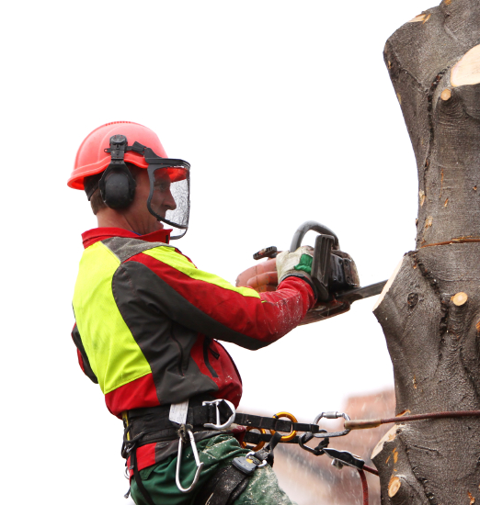
Certifying Fitness for Work
Delays in return to work affect us all
Employees are disadvantaged
Employers’ perspectives
Economic loss
YET high % of NZ doctors routinely certify
fully unfit. For example, in 2011:
  >20,000 certs/year fully unfit for 30 days
  >10,000 exceeded+ expect. recovery times
Notes:
Key points
Employees are your patients. Delays in rehabilitation affect long-term rehab outcomes. Prolonged absence from work can lead to deconditioning, run risks of unemployment and there can be complications from additional psychosocial factors.
Employer perspective – The case for the economic cost of loss of an employee has not until recently had much research attention. As part of Dame Carol Black’s review, a further raft of study has been commissioned to numerate the actual cost of disengaging an employee, recruiting and training a new employee with loss of production, legal costs, etc. Early literature review confirms the hypothesis that even for the employer delays in rehab have an immediate tangible economic cost.
NZ economy – Dame Carol’s review also identified enormous economic loss associated with delayed rehab and disability. The review identified that 7% of the working population as workless and the health costs and loss to productivity is estimated as £130 billion per year.
References
Durand M-J, Loisel P. Therapeutic return to work: Rehabilitation in the workplace. Work: Journal of Prevention, Assessment & Rehabilitation. Vol 17(1) 2001, 57-64. 2001
Cheadle et al A JPH 1994, anxiety
Padgett M et al Work 1993fear of re-injury
Waddell G et al, Pain 1993
and problems with self esteem ( Barab-Ettipio BJ & Centono EJ Work 3 1985)
Christine Roberts-Yates Employers' perceptions of claims/injury management and rehabilitation in South Australia Asia Pacific Journal of Human Resources 44

Slide 21
Certifying Fitness for Work
Facing the challenge
TRADITIONAL PARADIGM
Work is risky when you have an injury
– so stay away
BETTER PARADIGM
Work is generally good for health SO stay at work with safe accommodation
Notes:
Key points
In summary, faced with a patient in front of us, we are still stuck on the old paradigm.
We default to a non-clinical approach to the certificate and the option that doesn’t require clinical judgement yet if medical practitioners do not take up this challenge, who will?
It’s just too costly to continue with this paradigm.

Slide 22
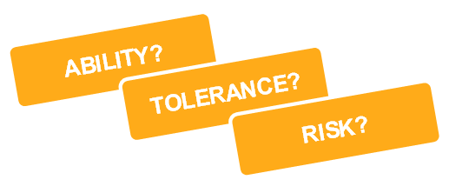
Certifying Fitness for Work
A framework to guide effective conversations
Clinical assessment - wholistic
Work – travel, tasks, environment
Notes:
Key points
Some practitioners find a framework allows them to think about fitness for work.
Firstly ABILITY: the activities the patient can do at the present time. This simply means what actions/activities are safe? Consider the type of injury and what it means for activity.
The consider TOLERANCE: Just because a patient might have the ability to perform an activity, that does not mean the patient will tolerate the work. In the early stages of injury we are often talking about pain and/or fatigue. However, we need to be careful attributing limitations on duration of activity to low tolerance. Deconditioning and fear avoidance lower the patient’s perception of work tolerance but the medical recommendation would not necessarily be restrictive.
RISK: This component of the assessment is generally straightforward. If a patient’s presence in the workplace will significantly endanger the safety of themselves or others, then the GP must put the work setting and public interest first. Don’t be too risk averse: From Darlow B et al (Univ of Otago, Wgtn). European Journal of Pain, 2012 Jan; 16(1): 3-17, a review of 17 studies from 8 countries “…There is moderate evidence that HCP fear avoidance beliefs are associated with reported sick leave prescription and that a biomedical orientation is not associated with the number of sickness certificates issued for LBP…”.
Patient preferences or motivation are important too, and may signal a barrier to rehabilitation. Remember patients are not always the best judge of safe activity.
An example of this might be the motivated worker who can not persuade their supervisor to overcome a barrier such as the absence of suitable alternative duties. In this case it would be wrong to certify the person unfit for work because doing so might close the door on any return to work efforts that another party (e.g. case manager) might make.

Slide 23
What sort of problems do you encounter when writing medical certificates?

Slide 24

Certifying Fitness for Work
Common certification problems
Doctor – patient relationship
Diagnostic uncertainty
Difficult judgements about fitness for work
Patient advocacy
Insufficient time
Insufficient information about work tasks & work envt
Confidentiality issues – can communicate re work fitness & prognosis with employer, eACC18 form for employer
Notes:
Key points
Patients need to have confidence in their GP in order to confide in him/her. The quality of the relationship is important and is dependent on trust and a shared understanding. Conflict may arise in situations where the GP’s opinion on FFW is at odds with that of the patient’s. In such cases, the GP needs negotiation strategies for presenting such an opinion in such a way that minimises strain on the doctor-patient relationship, and at the same time benefiting the patient's overall health.
It is important for the GP to communicate that they are first of all an advocate for their patient and that an appropriate early return to work will be in the patient’s best interests. A discussion about the objectives of ACC can be helpful (financial comp, treatment and rehab costs, encourages an employer’s interest in prevention, and rehabiilitation). It is important to focus on medical criteria. Non-medical factors may enter discussions but patients should be encouraged to re-direct such concerns as appropriate (e.g. non-cooperation from an employer should be addressed by the employee in the workplace in the first instance vis supervisor or HR).
Diagnostic uncertainty – We need to be transparent about our uncertainties and whether or not it is practical to make a decision on certification with or without further information. Ultimately this is a judgement call and that needs to be communicated to the patient.
Difficult judgements about fitness for work – Sometimes it is not easy to make a judgement about someone's ability to return to work, so do not be afraid to say you are unsure at the present time. Explore with your patients what they see as a reasonable plan for returning to work.
Patient advocacy – GPs, by supporting patient desires and expectations, may believe that they are acting in their patients’ best interests but when long-term unemployment could result then they may not be truly acting in patients best interests. Ref: Swartling M, BMC Fam Pract 2007; 8: 44.
There are clearly risks of paternalism. There are duties to the community (i.e. cost that need to be considered, controversial management may invite unnecessary conflict). Doctors to need to appreciate the risks of uncompromising patient advocacy and develop appropriate communication strategies to deal with looming conflict. Ref: J Med Ethics 2002;28:37–40 The ethical basis of certification differs from the therapeutic doctor-patient relationship. Ethical issues here relate to unclear expectations from the requesting agency, role conflict, and role confusion. There are no easy answers for the GP. Factual information in medical certificates can enhance fairness and help preserve the therapeutic doctor-patient relationship.
Ref: Toon PD. Ethical aspects of medical certification by general practitioners. Br J Gen Pract, Nov 1992.

Slide 25
Certifying Fitness for Work
Other common certification problems
Lack of occupational health expertise
Nonmedical flags as barriers to rehab
Communication with the Case Manager
Too much focus on the injury and biomedical factors
when certifying
Pressure from patients
“There’s no light duties, Doctor”
Notes:
Key points
Lack of occupational health expertise often affects GPs’ confidence in certifying. Remember the key task is safe level of activities. You may find it helpful to understand what your patient does at work, but this is not essential for your role.
Non-medical factors can predominate. Be wary of certifying to protect social/ financial stress.
Communication with the case manager is important.
Pressure from patients – It is important to empathise, but GPs do need do the job they are being asked to do (paid by a 3rd party to do a specific task) and attempt to be a “true advocate” by communicating the risks and benefits of their advice and certification.
“There’s no light duties, Doctor“ – If someone visits a GP and asks for a medical certificate to support their truck license, the GP does not need to know whether that person has access to a truck. In the same way, the presence or absence of suitable work is irrelevant to the certification process. Your main role is to identify safe activities. It is then up to the vocational rehab provider, ACC and employer to put your certificate into action.
Patients do not lose income if you certify according to fitness. If the patient can’t do the job they had before their accident, they may still have other work options, so it’s important to indicate whether they have a capacity for work. Marking that they have some capacity (ie. are fit for selected part-time or alternative work) enables ACC to negotiate with all parties for the patient to return to other available duties (within the medical limitations imposed by the injury). This doesn’t mean a stop to their weekly compensation payments.

Slide 26





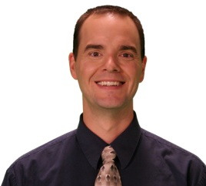
Certifying Fitness for Work
The GP is part of a team
Supervisor
Surgeon
SAW Coordinator
Patient
GP
Case Manager
Physio
Notes:
Key points
The knowledge, attitudes, and behaviour of each player is important. Good return to work outcomes require this team of people to work together, facilitate return to work, and not pose as barriers individually, or collectively.
When working in a team, participants need to respect the skills and contributions of other members. Teams work best when there is good communication and when the patient and team members understand the roles and responsibilities for rehabilitation that each member brings to the process.
Clearly it’s not all about the GP and how you write certificates, but there will be many times when how you certify AND what advice you give, makes a difference.
The GP is not the main player, but is often an important player. Individual patient attitudes and employer attitudes are generally more important than any GP attitude, but it is important that the GP is not a barrier to return to work.

Slide 27
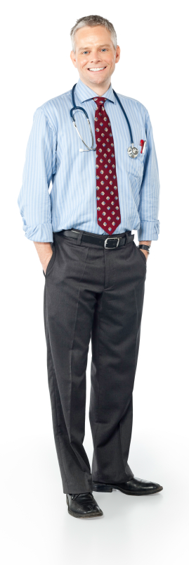
Certifying Fitness for Work
Systems in place to support your work certifying
ACC has developed some new approaches to help you and your patient:
Return to Work (RTW) Assistance – use the tick box on
the eACC18
Stay at Work (SAW) service
Clinical Review of Fitness for Work (CRFW)
Notes:
Key points
When completing the eACC18, you can turn your knowledge of the barriers and flags to rehabilitation into recommendations.
ACC has some new services for you to trigger, which may assist your patients.
Remember the greater the flags and barriers, the more urgent and important is the need for intervention.

Slide 28
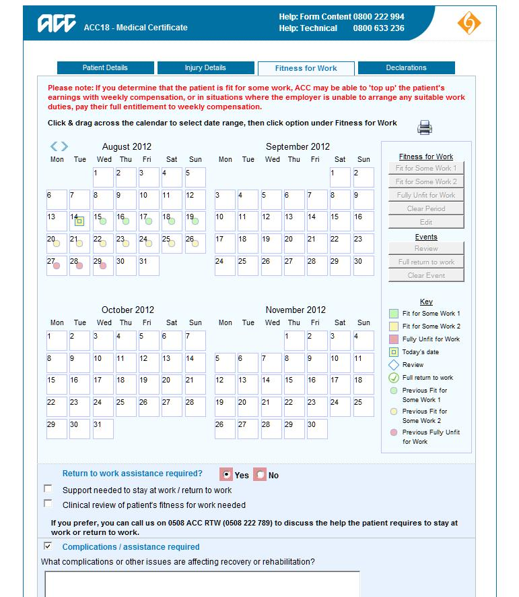
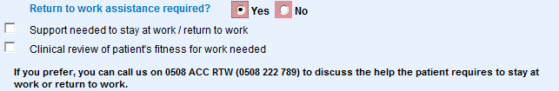
Certifying Fitness for Work
ACC resources and services to support you
The new eACC18 allows emphasis on fitness
New box: “Is return to work assistance required?”
Allows you to request SAW or new clinical review of fitness for work
Notes:
Key points
The new eACC 18 has better functions for guiding fitness for work.
There is a new box where you can tick “Return to work assistance required”.
If you tick “yes”, you can chose between vocational rehabilitation (Stay at Work and Clinical Review of Fitness for Work).
We will now look at these in a bit more detail.

Slide 29

Certifying Fitness for Work
Anna
Sprained her right ankle badly five days ago
X-rayed three days ago – has come back clear
Seen physio
Ankle strapped
Weight-bearing tentatively
Using crutches intermittently
Elevates her ankle when sitting
Taking paracetamol regularly
Notes:
Key points
Remember the framework:
Clinical assessment.
Apply ABILITY/TOLERANCE/RISK considerations.
Form your preliminary certification plan in your own mind.
Inform your patient of your preliminary certification plan.
Evaluate your patient’s response to your preliminary certification plan.
Decision: certification and other management (may involve negotiation).
Assume Clinical Assessment did not uncover any surprises
Ability: It is not clear that Anna has a safe means of travel available to her. Extra supports from her own resources or via ACC may be necessary. There would be no trouble with her ability to do the work.
Tolerance: Pain does not appear to be a significant issue for Anna but may be a problem if elevation at work, as necessary, can not be readily achieved. Tolerance is probably dependent on the workplace +/- ACC supporting appropriate workplace accommodation – some comfortable adaption to allow leg elevation. Even then, it may not prove tolerable, based on patient flexibility and workplace ergonomics.
Risk: There are no obvious risks, unless ability and tolerance issues are not well addressed in the situation where a return to work is undertaken.

Slide 30
Certifying Fitness for Work
Anna (continued)
Examination reveals minimal swelling
Appears comfortable
You prescribe anti-inflammatories
You are having a busy day. As Anna is going out, she says she thinks she should have another week off work and asks whether you would do another medical certificate for her.
How do you respond?
Notes:
Key points
Anna is asking for another certificate in an off hand way : you could just fill it out but let’s consider the clinical need (GP thinks: preliminary certification plan: work capacity potentially full-time, but dependent on transport and workplace accommodations).
Prelim certification plan conversation: (This will be dependent on Anna’s responses to questioning). It should be possible for you to return to work but it’s a matter of you being comfortable there and resting and elevating your leg as you need to when sitting. Is this something you think you could manage and work your normal hours? (A negotiation may then follow re suitable work hours per day).

Slide 31
Certifying Fitness for Work
Anna (continued)
How do you respond?
Provide a certificate for one more week off work
Provide a certificate for two days off work and then review
Provide a certificate for a full clearance for work
Provide a certificate with defined restrictions
and safe activities
Notes:
Key points
How do you respond?
Provide certificate for 1 more week off work.
Provide certificate for 2 days off work and then review.
Provide a certificate for a full clearance for work.
Provide a certificate with provisos.
For Anna, the best option is a certificate with defined restrictions. This allows ACC to use your restrictions to guide the employer. If there are any risks to the safe implementation of these restrictions, ACC can commissions a SAW provider.

Slide 32
Certifying Fitness for Work
Summary
Certification provides both an opportunity and challenge
Work, in general, is good for health
Certified absence can lead to disability and health problems
Conversations with your patients make all the difference
Understand the clinical implications of the “flags”
ACC has resources and services your patient could benefit from as they recover from injury
Take ownership of this shift in your practice
It’s a clinical task – you are the right person to prescribe safe levels of activity
Notes:
Key points
Certification provides both an opportunity and challenge.
Work, in general, is good for health.
Certified absence can lead to disability and health problems.
Conversations with your patients make all the difference.
Understand the clinical implications of the “flags”.
ACC has resources and services your patient could benefit from as they recover from injury.
Take ownership of this shift in your practice.

Slide 33


Thank you

